Slide 1
Securities regulation #5

Slide 2
Your dentist tells you that she just became a “member” of an LLC and shows you an offering brochure. For $10k, you can become a 5% member of Real Estate, LLC, which invests in residential homes for remodel and resale. Which of the following statements is most correct?
LLC member interests are not “securities” because they are not listed in 2(a)(1).
LLC member interests are not “securities” if the LLC is member-managed.
LLC member interests are not “securities” if the LLC is manager-managed, even if the members have significant control over the managers.
LLC member interests may be “securities” if the members are not given management power in the operating agreement or do not have the expertise or ability to use management power.
LLC member interests are “securities” unless they are “investment contracts.”

Slide 3
SEC V. MUTUAL BENEFITS CORP.

Slide 4
Viatical settlement – what is issue?
Person invests money
In a common enterprise
With an expectation of profit
Solely from the efforts of others

Slide 5
Viatical settlement – what is issue?
Person invests money
In a common enterprise
With an expectation of profit
Solely from the efforts of others

Slide 6
REVES V. ERNST & yOUNG

Slide 7
Is it in 2(a)(1)?

Slide 8
What is a security?
Section 2(a)(1) of the Securities Act of 1933:
The term ‘‘security’’ means any note, stock, treasury stock, security future, security-based swap, bond, debenture, evidence of indebtedness, certificate of interest or participation in any profit-sharing agreement, collateral-trust certificate, preorganization certificate or subscription, transferable share, investment contract, voting-trust certificate, certificate of deposit for a security, fractional undivided interest in oil, gas, or other mineral rights, any put, call, straddle, option, or privilege on any security, certificate of deposit, or group or index of securities (including any interest therein or based on the value thereof), or any put, call, straddle, option, or privilege entered into on a national securities exchange relating to foreign currency, or, in general, any interest or instrument commonly known as a ‘‘security’’, or any certificate of interest or participation in, temporary or interim certificate for, receipt for, guarantee of, or warrant or right to subscribe to or purchase, any of the foregoing.

Slide 9
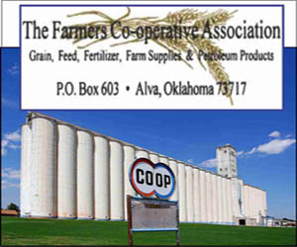
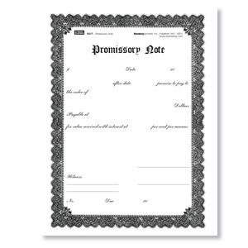
1600 members
$10 million

Slide 10
What about Landreth?
when an instrument is both called “stock” and bears stock’s usual characteristics, “a purchaser justifiably [may] assume that the federal securities laws apply.”

Slide 11
Does it hold for “notes”?
when an instrument is both called “note” and bears a note’s usual characteristics, “a purchaser justifiably [may] assume that the federal securities laws apply.”

Slide 12
NOT (Note) securities
The note delivered in consumer financing
The note secured by a mortgage on a home
The short-term note secured by a lien on a small business or some of its assets
The note evidencing a character loan to a bank customer
Short-term notes secured by an assignment of accounts receivable
A note that simply formalizes an open-account debt incurred in the ordinary course of a business
Notes evidencing loans by commercial banks for current operations.

Slide 13
Reves test or family resemblance test
First, we examine the transaction to assess the motivations that would prompt a reasonable seller and buyer to enter into it. If the seller’s purpose is to raise money for the general use of a business enterprise or to finance substantial investments and the buyer is interested primarily in the profit the note is expected to generate, the instrument is likely to be a “security.” If the note is exchanged to facilitate the purchase and sale of a minor asset or consumer good, to correct for the seller’s cash-flow difficulties, or to advance some other commercial or consumer purpose, on the other hand, the note is less sensibly described as a “security.” .
Second, we examine the “plan of distribution” of the instrument, to determine whether it is an instrument in which there is “common trading for speculation or investment”.
Third, we examine the reasonable expectations of the investing public: The Court will consider instruments to be “securities” on the basis of such public expectations, even where an economic analysis of the circumstances of the particular transaction might suggest that the instruments are not “securities” as used in that transaction. […]
Finally, we examine whether some factor such as the existence of another regulatory scheme significantly reduces the risk of the instrument, thereby rendering application of the Securities Acts unnecessary.

Slide 14
WHAT IS A SECURITY?
Is it listed in 2(a)(1)?
Is it not listed in 2(a)(1)?
Does your “instrument” have the same general characteristics as the stereotypical listed “instrument”?
Is it “stock” or is it “notes”?
Notes – Reves (family resemblance) test
“investment contract”
Howey test
If partnership/LLC interest, use Williamson test for 4th prong of Howey
Watch for alternative regulatory scheme or Section 3(a) exemption.
NO
YES
SECURITY

Slide 15
Is it a security?
Reves Test?
Is it a “Note”?
Yes.
Not a Security
Yes.
No.
No.
Does it have the characteristics of the 2(a)(1) instrument?
Yes.
No.
Is it an “investment contract”?
Yes.
It’s a Security
Is the instrument listed in 2(a)(1)?
Is it an “investment contract”?
Not a Security
No.
No.
No.
Yes.
It’s a Security
Is it a partnership/LLC interest?
Not a Security
Not a Security
First 3 prongs of Howey Test?
No.
Yes.
No.
Williamson Test?
Yes.
Yes.
It’s a Security

Slide 16
SECURITIZATIONS
Making Securities Out of Ordinary Contract Assets
Asset-Backed Securities

Slide 17
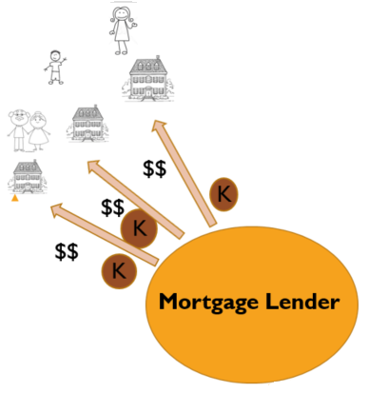
Start with a contract with payment streams for a period of years

Slide 18
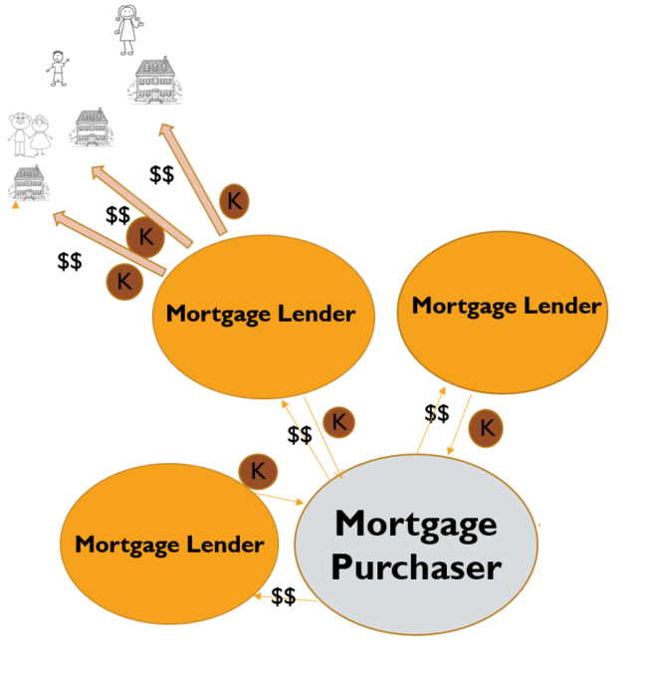
sell those contracts to a mortgage purchaser

Slide 19
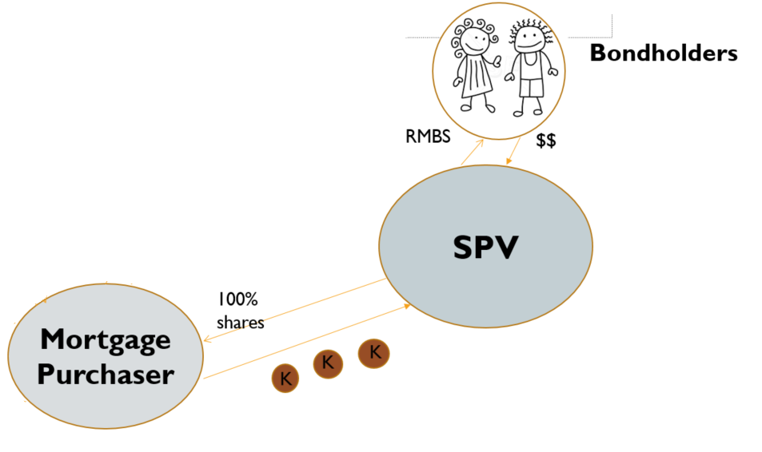
Mortgage purchaser contributes mortgages to special purpose vehicle it owns/controls
SPV issues bonds to Bondholders that pay interest and are secured by mortgages

Slide 20
Residential mortgage-backed security (rmbs)
$$
Bondholders
$$
K
$$
RMBS
$$
Mortgage Lender
Mortgage Lender
SPV
$$
$$
100%
shares
Mortgage Purchaser
Mortgage Lender
$$

Slide 21
Bondholders
$$
RMBS
$$
$$
SPV
100%
shares
Mortgage Purchaser
$$
$$
$$
$$

Slide 22
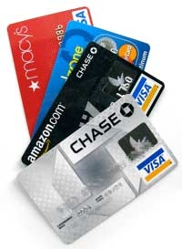
Other asset-backed security (ABS)
$$
Bondholders
$$
K
$$
ABS
$$
Credit Card Lender
Credit Card Lender
SPV
$$
$$
100%
shares
Credit Card Receivables Purchaser
Credit Card Lender
$$

Slide 23
SEC V. MERCHANT CAPITAL, LLC
$$
Bondholders
$$
K
Partners!!!
$$
ABS
$$
Credit Card Lender
Credit Card Lender
SPV, LLP
$$
$$
100%
shares
Credit Card Receivables Purchaser
Credit Card Lender
$$

Slide 24
Celebrity ip bonds
Bondholders
ABS
$$
Creative Work
Creative Work
SPV
$$
$$
$$$
Creative Artist
Creative Work
$$

Slide 25
BOWIE BONDS
Bondholders
ABS
$$
Creative Work
Creative Work
SPV
$$
$$
$$$
Creative Work
$$

Slide 26
Meltdown in rmbs market
Bondholders
$$
RMBS
$$
$$
SPV
100%
shares
Mortgage Purchaser
$$
$$
$$
$$

Slide 27
Collateralized debt obligation: Like an ABS, but secured by different “tranches” of assets in different spv entities
Bondholders
RMBS
“A” Tranche
SPV
“B” Tranche
100%
shares
“C” Tranche
Mortgage Purchaser
$$
$$
CDO
$$
$$

Slide 28
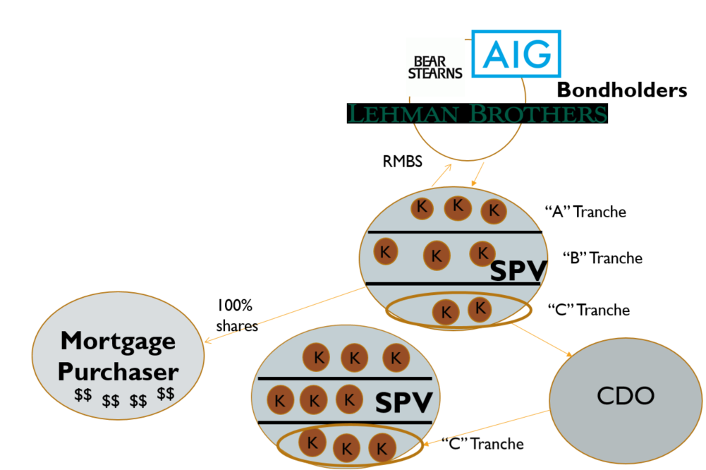
RMBS + CDOs

Slide 29
RMBS/cdo BUYER AND cds SELLER
Credit Default Swap

Slide 30
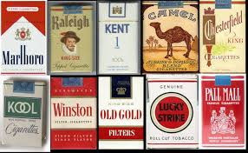
Structured settlement securitization
Tobacco Settlement Bonds
% of sales until 2025

Slide 31
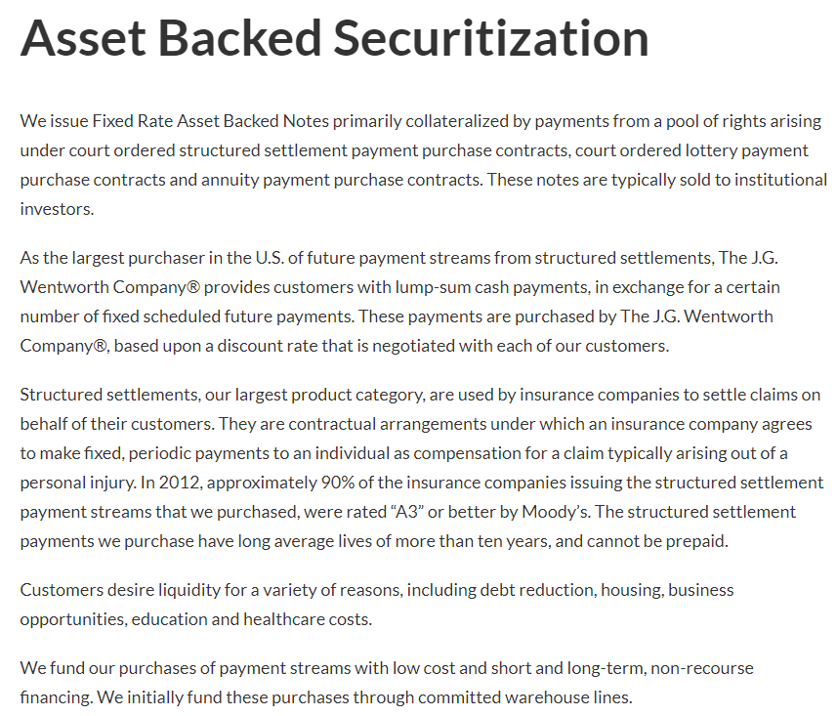
j.g. wentworth

Slide 32
cryptocurrency
1. Distributed Ledger technology (smart contract/blockchain)
2. Cryptocurrency based on Distributed Ledger Technology
3. Bitcoin – SEC said not a security

Slide 33
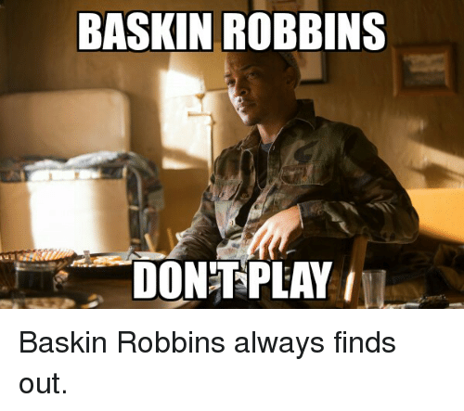
IN THE MATTER OF CLIFFORD HARRIS, JR. (t.i.)

Slide 35
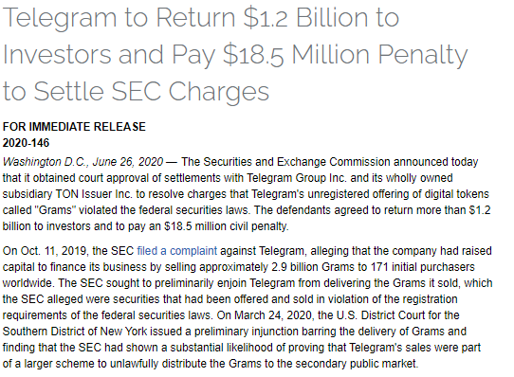

Slide 36
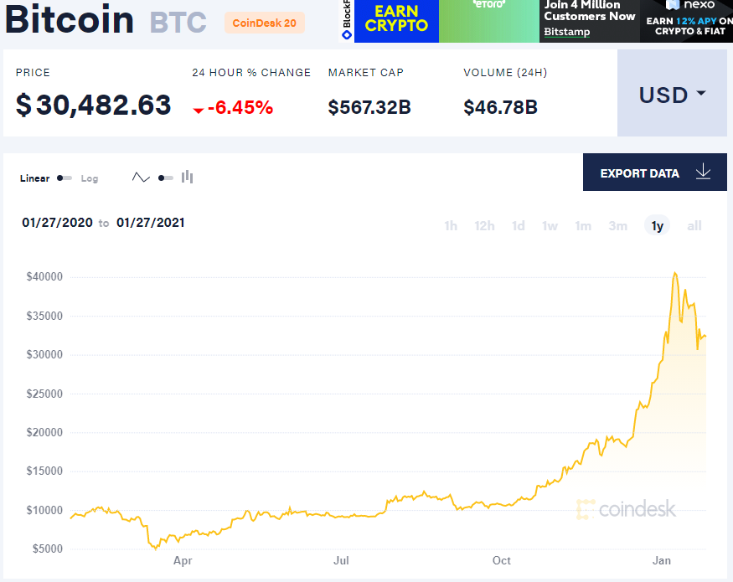

Slide 37
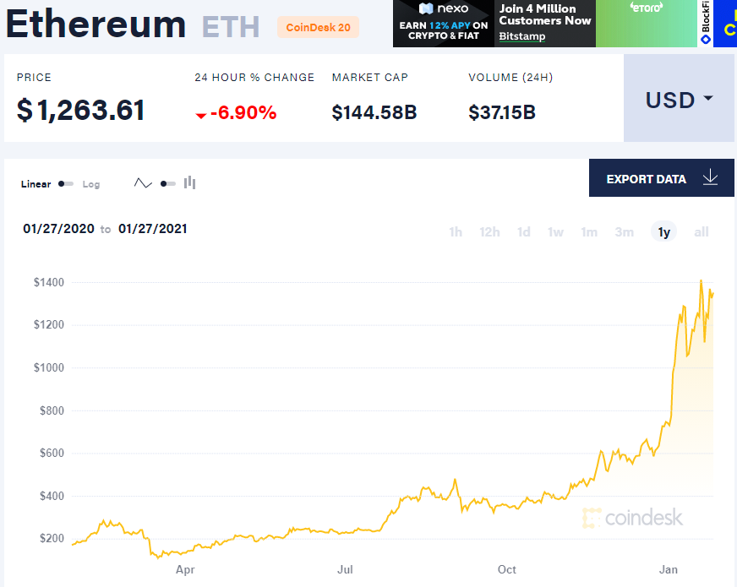

Slide 38
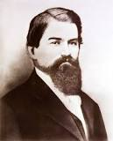
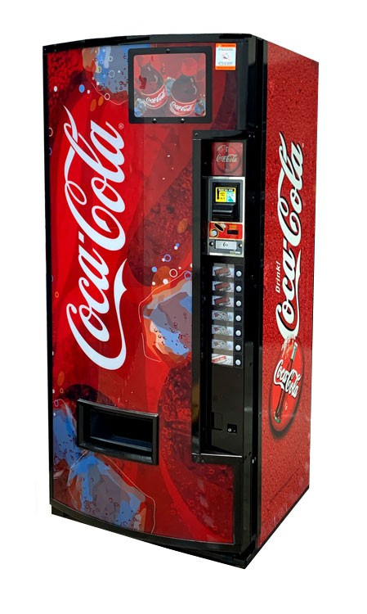
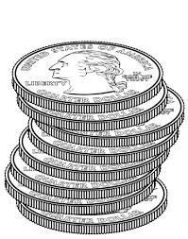
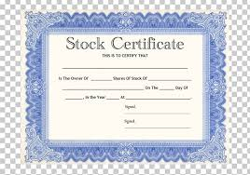
Coin-operated capitalism: raising capital

Slide 39
raising capital by selling shares in an entity

Slide 40
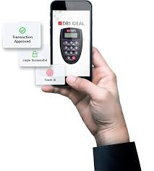
raising capital by selling tokens

Slide 41
Growth = profit

Slide 42
Rights to profits?
Statute – rights for common stock holders
Fiduciary Duties
Articles of Incorporation
Bylaws
Audited Financial Statements
Disclosure Documents
Code in the digital token
Described in the “white paper”

Slide 43
In the matter of the dao
ICO – Initial Coin Offering
Participants in DAO ICO traded Ether (cryptocurrency) for DAO token, which gave them rights in the profits of DAO (decentralized, virtual entity)
DAO was to use Ether to fund “projects” selected by “Curators” and voted on by DAO Token holders
Curators chosen by creators of DAO

Slide 44
raising capital by selling tokens

Slide 45
Are DAO Tokens Securities?
Are “tokens” in 2(a)(1)?
Are “tokens” “investment contracts?”

Slide 46
“investment contract”
A person invests his/her money
In a common enterprise
Is led to expect profits
Solely from the efforts of others

Slide 47
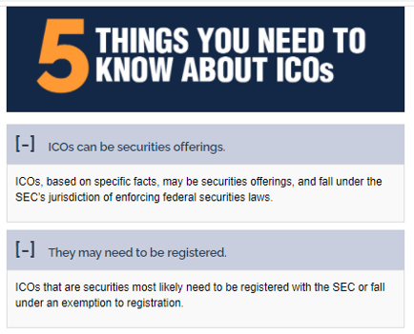
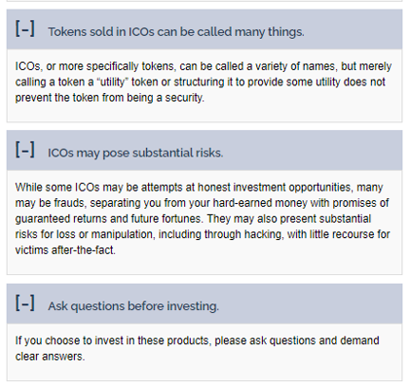

Slide 48
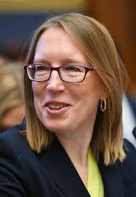
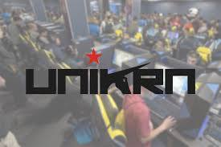
Peirce dissents to enforcement action settlement

