Slide 1
SECURITIES REGULATION #13

Slide 2
Rule 10b-5
It shall be unlawful for any person. . . .
A. To employ any device, scheme, or artifice to defraud
B. To make any untrue statement of a material fact or to omit to state a material fact necessary in order to make the statements made, in the light of the circumstances under which they were made, not misleading, or
C. To engage in any act, practice, or course of business which operates or would operate as a fraud or deceit upon any person,
In connection with the purchase or sale of any security.

Slide 3
ELEMENTS OF 10b-5
Material
Misrepresentation of fact
Scienter (allege facts with particularity. . . )
Reliance (Basic)
Loss Causation (must adequately allege in complaint)

Slide 4
1995: Private securities litigation reform act
Section 21D of the Securities Exchange Act
Lead Plaintiff Rules
Enhanced pleading rules (preempts Section 9(b) FRCP)
Must plead with particularity SCIENTER
Stay on discovery until after MTD
Rule 11 Sanctions for frivolousness
Several liability for outside directors (in proportion to responsibility)

Slide 5
ELEMENTS OF 10b-5
Material
Misrepresentation of fact
Scienter (allege facts with particularity. . . )
Reliance (Basic)
Loss Causation (must adequately allege in complaint)

Slide 6
Litigation timeline
Motion to Certify the Class
Appeal of Class Certification
SETTLEMENT VALUE
Motion for Summary Judgment
Complaint Filed
Motion to Dismiss
Trial
Appeal of MTD

Slide 7
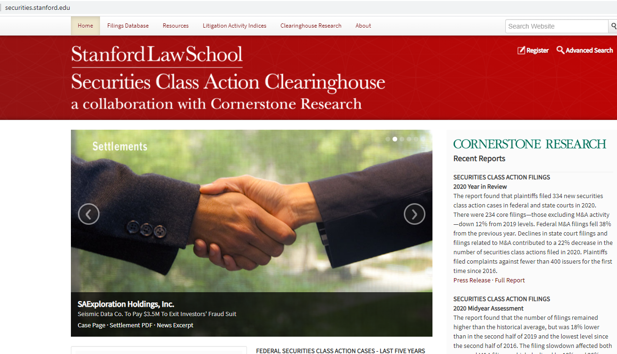

Slide 8
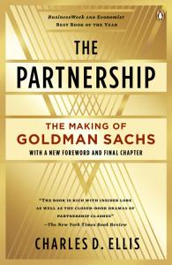
Arkansas Teachers Retirement system v. goldman sachs group

Slide 9
What is Goldman arguing?
1. Inflation Maintenance Theory is stupid
2. Plaintiffs didn’t meet their burden on Inflation Maintenance Theory
3. Goldman rebuts the presumption of Basic reliance

Slide 10
Nuts and bolts
Once the plaintiff makes a “showing” of Basic reliance,
Burden shifts to the defendant to rebut the presumption
Defendant may rebut by showing (by a preponderance of the evidence) that the entire price decline on the relevant dates was due to something else
Plaintiff may also present evidence of price impact to demonstrate the shortcomings of the defendant’s rebuttal evidence, BUT THEY DON’T HAVE TO

Slide 11
Second circuit
We are not blind to the widespread understanding that class certification can pressure defendants into settling large claims, meritorious or not, because of the financial risk of going to trial.

Slide 12
Here’s the deal!
Materiality/Price Impact/Loss Causation all try to get at the same thing:
Did positive statements inflate/maintain inflation of the share price?
  If they didn’t, was it because the statements weren’t material? Because the stock does not trade in an efficient market?
Did disclosures make share price decline?
  If they didn’t, was it because the statements weren’t material? Because the stock does not trade in an efficient market? Because something else caused the loss?

Slide 13
What is Loss Causation?
The false statement/omission
CAUSED
Damages (loss)

Slide 14
Dura Pharms. v. Broudo (U.S. 2005)
What does Plaintiff have to prove?
This case is about (1) pleading particularity and (2) what it means to “cause” a loss

Slide 15
Ninth circuit
“Plaintiffs establish loss causation if they have shown that the price on the date of purchase was inflated because of the misrepresentation.”
“The injury occurs at the time of the transaction”

Slide 16
scotus
At time of purchase at inflated price, no injury
  The shares are worth the inflated price, can be instantly resold
Complaint was adequately allege that the share price fell significantly after the truth became known

Slide 17
Two views
Artificially inflated price due to fraud will invariably decline as the truth is revealed
Truth may be revealed slowly over time, and not all at once
Purchasing at an artificially inflated price due to fraud does not cause the injury
The revelation of the fraud and decline in price causes the injury

Slide 18
Two views
Artificially inflated price due to fraud will invariably decline as the truth is revealed
Truth may be revealed slowly over time, and not all at once
Purchasing at an artificially inflated price due to fraud does not cause the injury
The revelation of the fraud and decline in price causes the injury
losers

Slide 19


When is the injury?
When you purchase at the inflated price?
When you sell at the lower, accurate price?

Slide 20
Mineworkers’ Pension Scheme v. First Solar Inc.
What is the test for causation?
What’s the difference between a link between
the revealed misrepresentation of facts and the loss
And
The revealed fraud and the loss?

Slide 21
Difference?
Defendant lies: our profits are going to be great next year!
Next year: Profits are way down, causing share price decline
Defendant lies: our profits are going to be great next year! (knows that they will have to replace a lot of defective product, reducing profits)
Next year: Manufacturing defect revealed, causing share price decline

Slide 22
Difference?
Defendant lies: our profits are going to be great next year!
Next year: Profits are way down
Defendant lies: our profits are going to be great next year! (knows that they will have to replace a lot of defective product, reducing profits)
Next year: Revealed that defendants knew they had to replace a lot of defective product, reducing profits
sufficient
sufficient

Slide 23
Who are the 10b-5 defendants?

Slide 24
Who Can We Sue?
Central Bank of Denver v. First Interstate Bank of Denver (U.S. 1994)
  Pre-PSLRA, but PSLRA did not reinstate aiding/abetting
  No 10b-5 aiding and abetting liability for private litigation – must be primary actor
  PSLRA specifies that SEC may prosecute aiding and abetting

Slide 25
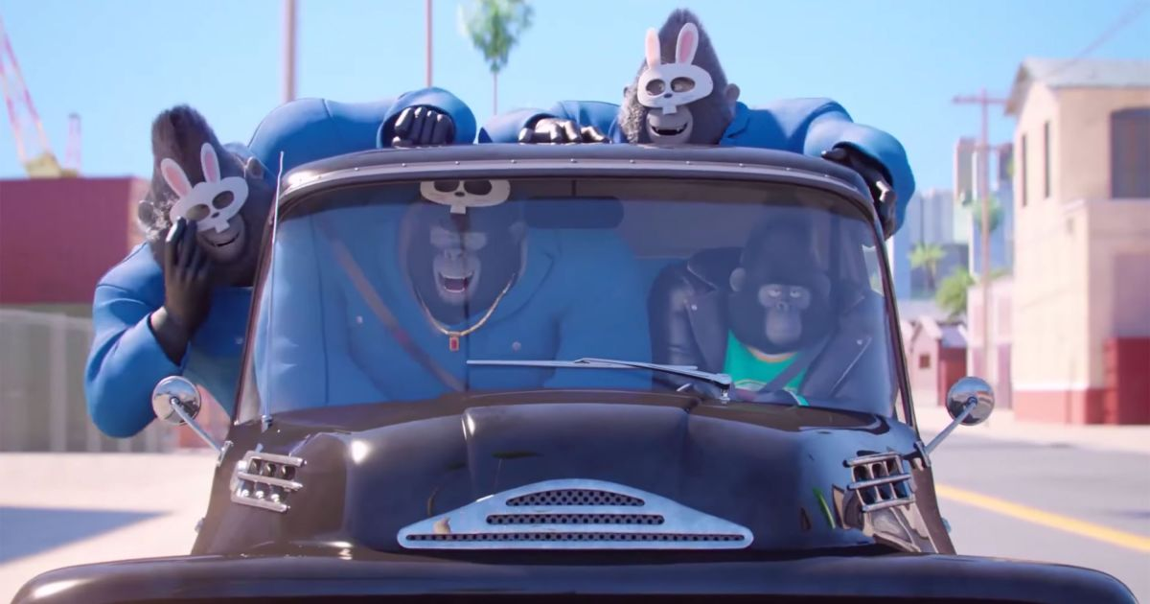

Slide 26


Slide 27
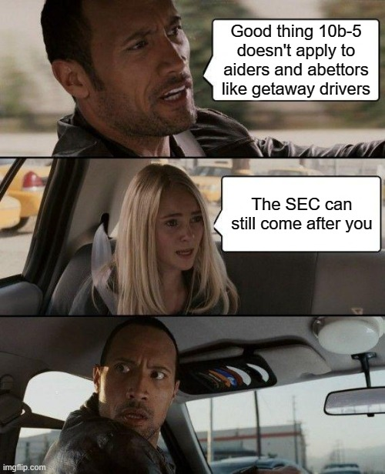

Slide 28
Stoneridge Inv. P’ners, LLC v. Scientific-Atlanta, Inc. (U.S. 2008)
Charter has contracts with
  Motorola
  Scientific-Atlanta
“Wash Sales”

Slide 29
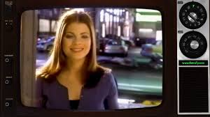
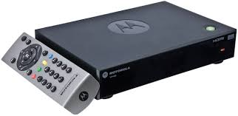

“wash sale”
Price + $20
Advertising + $20
Mot
Charter
S-A
Economic Effect == ZERO

Slide 30
Stoneridge Investment P’ners LLC v. Scientific-Atlanta, Inc.
What is the fraud?

Slide 31
Are Scientific-Atlanta & Motorola “primary actors” or “secondary actors”?
No duty to speak
Do they “speak” to the market?
  Fraudulent letters/documents, but only Arthur Andersen saw them

Slide 32
note
SEC could prosecute Charter and Scientific-Atlanta
Charter and Scientific-Atlanta probably committed common law fraud (scheme liability)
Rule 10b-5 private securities litigation does not incorporate common law fraud

Slide 33
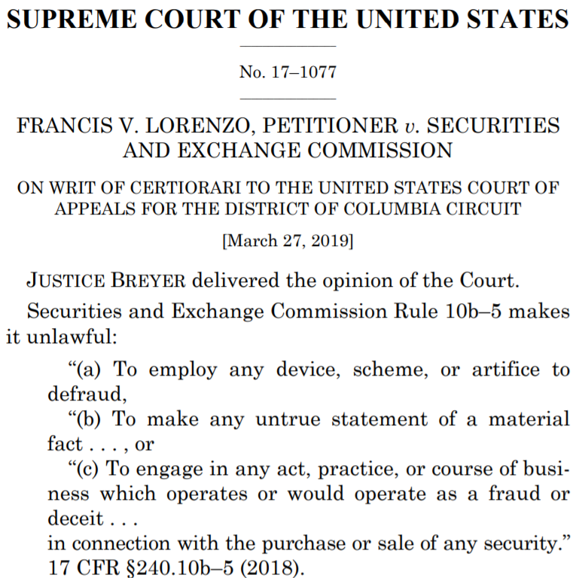
What if you aren’t a maker?
Janus Capital Grp., Inc.
v. First Derivative Traders (2011)

Slide 34
Insider trading

Slide 35


Rule 10b-5 and Classical Theory
Classic “Insider”
Classic “Tippee”
V.P. of BigCo. – knows that next quarter’s earnings will be shockingly good – buys shares
V.P.– gives info to Brother-in-Law – he buys shares
10b-5
violation
10b-5
violation
Notes:
Suppose that Jack subsequently learns that Amtel’s new manufacturing process for computer processors will increased yields by 30%. Before the public announcement of this breakthrough, Jack rushes out and purchases 1 million shares of Amtel. Suppose that Jack puts a copy of the press release announcing the new manufacturing process on top of his car and then forgets about it, driving off. Katharina, an individual unaffiliated with Amtel, sees the press release fly off the car, watches Jack (who she recognizes from CNN/FN broadcasts) drive off, and then grabs the press release. Katharina shortly thereafter purchases 10,000 shares of Amtel. Both make substantial profits once the press release is made public the next day.
1.How would Jack fare under the Texas Gulf Sulphur formulation of liability?
Answer – Jack is clearly trading on inside, corporate information that is highly material. Jack faces a disclose or abstain duty under Rule 10b-5.

Slide 36
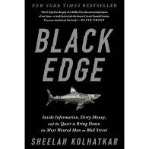
Black Edge/SAC CAPITAL
Classic “Insider”
Classic “Tippee”
“Hedge Fund Club”
Newman
Chiasson
Horvath
V.P. of BigCo. – knows that next quarter’s earnings will be shockingly good – buys shares
V.P.– gives info to Brother-in-Law – he buys shares
B-in-L joins “edge club” and members share “edge”
10b-5
violation
10b-5
violation
???
Notes:
Suppose that Jack subsequently learns that Amtel’s new manufacturing process for computer processors will increased yields by 30%. Before the public announcement of this breakthrough, Jack rushes out and purchases 1 million shares of Amtel. Suppose that Jack puts a copy of the press release announcing the new manufacturing process on top of his car and then forgets about it, driving off. Katharina, an individual unaffiliated with Amtel, sees the press release fly off the car, watches Jack (who she recognizes from CNN/FN broadcasts) drive off, and then grabs the press release. Katharina shortly thereafter purchases 10,000 shares of Amtel. Both make substantial profits once the press release is made public the next day.
1.How would Jack fare under the Texas Gulf Sulphur formulation of liability?
Answer – Jack is clearly trading on inside, corporate information that is highly material. Jack faces a disclose or abstain duty under Rule 10b-5.

Slide 37

Rule 10b-5 and misappropriation Theory
Temporary “Insider”
Classic “Tippee”
Scientist running drug trials – signs Confidentiality Agreement – trades on info
Trader pays scientist for information, trades on it
10b-5
violation
10b-5
violation
Notes:
Suppose that Jack subsequently learns that Amtel’s new manufacturing process for computer processors will increased yields by 30%. Before the public announcement of this breakthrough, Jack rushes out and purchases 1 million shares of Amtel. Suppose that Jack puts a copy of the press release announcing the new manufacturing process on top of his car and then forgets about it, driving off. Katharina, an individual unaffiliated with Amtel, sees the press release fly off the car, watches Jack (who she recognizes from CNN/FN broadcasts) drive off, and then grabs the press release. Katharina shortly thereafter purchases 10,000 shares of Amtel. Both make substantial profits once the press release is made public the next day.
1.How would Jack fare under the Texas Gulf Sulphur formulation of liability?
Answer – Jack is clearly trading on inside, corporate information that is highly material. Jack faces a disclose or abstain duty under Rule 10b-5.

Slide 38
Rule 10b-5
It shall be unlawful for any person. . . .
A. To employ any device, scheme, or artifice to defraud
B. To make any untrue statement of a material fact or to omit to state a material fact necessary in order to make the statements made, in the light of the circumstances under which they were made, not misleading, or
C. To engage in any act, practice, or course of business which operates or would operate as a fraud or deceit upon any person,
In connection with the purchase or sale of any security.

Slide 39
So how does insider trading fit?
Insider
Has material, nonpublic information
Trades on the basis of the information without disclosing the information

Slide 40
So how does insider trading fit?
Insider -- Tipper/Tippee and Classic Insider/ Misappropriating Insider?
Has material, nonpublic information
Trades on the basis of the information without disclosing the information

Slide 41
Who is defrauded?

Slide 42
Rule 10b-5 and Classical Theory
Equal Access Theory
(Unerodable Advantages)
Parity of Information
Property Rights Theory
Fiduciary Duty
Misappropriation Theory?

Slide 43
Congress & Insider Trading
Insider Trading Sanctions Act of 1984
Insider Trading and Securities Fraud Enforcement Act of 1988
Stop Trading on Congressional Knowledge Act of 2012
  Sen. Kelly Loeffler
  Sen. Richard Burr
  Sen. David Perdue
  Sen. Dianne Feinstein
SEC
  14e-3 (1980)
  Rule 10b5-1 and Rule 10b5-2 (2000)

Slide 44
Read closely
Section 10(b) of the Securities Exchange Act of 1934 and the Securities and Exchange Commission’s Rule 10b–5 prohibit undisclosed trading on inside corporate information by individuals who are under a duty of trust and confidence that prohibits them from secretly using such information for their personal advantage.
  Justice Alito, U.S. v. Salman (2017)

Slide 45
Rule 10b-5 and Classical Theory
Classic “Insider”
Classic “Tippee”
V.P. of BigCo. – knows that next quarter’s earnings will be shockingly good – buys shares
V.P.– gives info to Brother-in-Law – he buys shares
10b-5
violation
10b-5
violation
Notes:
Suppose that Jack subsequently learns that Amtel’s new manufacturing process for computer processors will increased yields by 30%. Before the public announcement of this breakthrough, Jack rushes out and purchases 1 million shares of Amtel. Suppose that Jack puts a copy of the press release announcing the new manufacturing process on top of his car and then forgets about it, driving off. Katharina, an individual unaffiliated with Amtel, sees the press release fly off the car, watches Jack (who she recognizes from CNN/FN broadcasts) drive off, and then grabs the press release. Katharina shortly thereafter purchases 10,000 shares of Amtel. Both make substantial profits once the press release is made public the next day.
1.How would Jack fare under the Texas Gulf Sulphur formulation of liability?
Answer – Jack is clearly trading on inside, corporate information that is highly material. Jack faces a disclose or abstain duty under Rule 10b-5.

Slide 46
Chiarella v. united states (1980)
CLASSIC
Pandick
Press
client
planning
take-over bid
Investor
in target
Chiarella
printer
Notes:
Preliminary Questions
1. Who is Chiarella?
Answer – An employee of a printing firm hired to print documents for various tender offers. The target company's identity was concealed in the galleys sent to the printer in order maintain confidentiality. Chiarella, however, managed to identify the target company by reading the other information in the tender offer documents.
2. What does Chiarella do with the information he obtains from the tender offer documents?
Answer – Chiarella purchased the target company's stock and sold his holdings at a profit after the tender offer was publicly announced.
3. Does the Court consider that to be insider trading?
Answer – No. Upholding Chiarella’s conviction here would require imposing a duty of disclosure on anyone who has material non-public information. That duty would be owed to everyone else in the market. The Court rejects such a broad duty saying that “not every instance of financial unfairness constitutes fraudulent activity under § 10(b)”.

Slide 47
p. 339 – “The Commission emphasized [in Cady, Roberts] that the duty arose from (i) the existence of a relationship affording access to inside information intended to be available only for a corporate purpose, and (ii) the unfairness of allowing a corporate insider to take advantage of that information by trading without disclosure.”
p. 339 – “That the relationship between a corporate insider and the stockholders of his corporation gives rise to a disclosure obligation is not a novel twist of the law.”
Notes:
Note shift in Chiarella from SEC’s equal access position (endorsed by Texas Gulf Sulfur) toward fiduciary duty position.

Slide 48
p. 339 – “The Commission emphasized [in Cady, Roberts] that the duty arose from (i) the existence of a relationship affording access to inside information intended to be available only for a corporate purpose, and (ii) the unfairness of allowing a corporate insider to take advantage of that information by trading without disclosure.”
DUTY OF LOYALTY
p. 339 – “That the relationship between a corporate insider and the stockholders of his corporation gives rise to a disclosure obligation is not a novel twist of the law.”
Notes:
Note shift in Chiarella from SEC’s equal access position (endorsed by Texas Gulf Sulfur) toward fiduciary duty position.

Slide 49
CLASSIC
Pandick Press
client
relationship of trust and confidence
no relationship
Investor
in target
Chiarella
printer
Chiarella is not a Classic Insider!
Notes:
5. To whom does Chiarella have a duty of confidentiality?
Answer – His principal, Pandick, and by extension, Pandick’s clients (Chiarella can be considered a sub-agent of the clients). Chiarella has no relationship to his counterparties.

Slide 50
Justice powell & insider trading
Does not accept that all traders have a duty not to trade on material, nonpublic information.
The trader must have a duty to disclose in order to have a duty not to trade.
Only traders with a fiduciary relationship with the corporation in whose shares they trade have a duty to disclose or abstain from trading.

Slide 51
Chiarella v. united states
DUTY OF CONFIDENTIALITY
Agency Restatement § 395
“Unless otherwise agreed, an agent is subject to a duty to the principal not to use ... information confidentially given him by the principal or acquired by him during the course of or on account of his agency or in violation of his duties as agent, in competition with or to the injury of the principal, on his own account or on behalf of another ....”
Notes:
5. To whom does Chiarella have a duty of confidentiality? (answer next slide)
Answer – His principal, Pandick, and by extension, Pandick’s clients (Chiarella can be considered a sub-agent of the clients).

Slide 52
Foreshadowing in chiarella
“The United States offers an alternative theory to support petitioner’s conviction. It argues that petitioner breached a duty to the acquiring corporation when he acted upon information that he obtained by virtue of his position as an employee of a printer employed by the corporation. The breach of this duty is said to support a conviction under § 10(b) for fraud perpetrated upon both the acquiring corporation and the sellers.
We need not decide whether this theory has merit for it was not submitted to the jury.”

Slide 53
Foreshadowing in chiarella
“The United States offers an alternative theory to support petitioner’s conviction. It argues that petitioner breached a duty to the acquiring corporation when he acted upon information that he obtained by virtue of his position as an employee of a printer employed by the corporation. The breach of this duty is said to support a conviction under § 10(b) for fraud perpetrated upon both the acquiring corporation and the sellers.
We need not decide whether this theory has merit for it was not submitted to the jury.”
MISAPPROPRIATION THEORY

Slide 54
Williams Act: Rule 14e-3
Transactions in Securities on the Basis of Material, Nonpublic Information in the Context of Tender Offers
Notes:
Question – What if Chiarella had gone out and purchased “put” options on the acquirer’s stock, betting that the price would fall when the tender offer was announced?
Answer – Section 20(d) brings this within the prohibition of the classical theory, despite lack of a duty to the option holders.

Slide 55
Short-swing profits:
Section 16(b)
For the purpose of preventing the unfair use of information which may have been obtained by such beneficial owner [of more than 10 percent], director, or officer by reason of his relationship to the issuer, any profit realized by him from any purchase and sale, or any sale and purchase, of any equity security of such issuer within any period of less than six months. . .shall inure to and be recoverable by the issuer. . . .

Slide 56
So how do core insiders ever sell?
“on the basis of” the material, nonpublic information

Slide 57
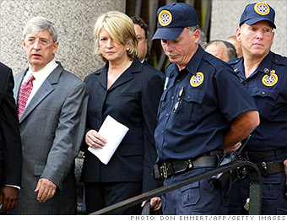

Slide 58


Slide 59
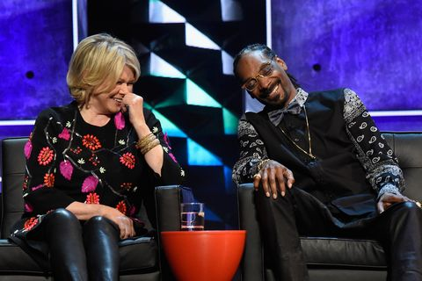
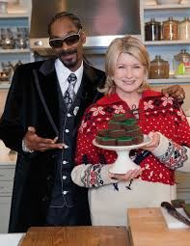

Slide 60
Defense to insider trading
I did not “trade on the basis” of material, nonpublic information that I knew. I traded because of [something else].
The best way to prove: 10b5-1

Slide 61
Rule 10b5-1
(A) Before becoming aware of the information, the person had:
(1) Entered into a binding contract to purchase or sell the security,
(2) Instructed another person to purchase or sell the security for the instructing person's account, or
(3) Adopted a written plan for trading securities;
(B) The contract, instruction, or plan described in paragraph (c)(1)(i)(A) of this Section:
(1) Specified the amount of securities to be purchased or sold and the price at which and the date on which the securities were to be purchased or sold;
(2) Included a written formula or algorithm, or computer program, for determining the amount of securities to be purchased or sold and the price at which and the date on which the securities were to be purchased or sold; or
(3) Did not permit the person to exercise any subsequent influence over how, when, or whether to effect purchases or sales; provided, in addition, that any other person who, pursuant to the contract, instruction, or plan, did exercise such influence must not have been aware of the material nonpublic information when doing so; and
(C) The purchase or sale that occurred was pursuant to the contract, instruction, or plan.

Slide 62
Dirks v. SEC
Equity
Funding
America
Sell Equity Funding
Securities
Secrist &
Other Employees
Dirks
Clients
Notes:
Dirks v. SEC (US 1983) (Powell, J.)
Equity Funding America (EFA) sold life insurance and mutual funds. Secrist, a former officer of EFA, notified Dirks, a broker, of massive fraud at EFA and urged Dirks to investigate. Dirks did investigate and found some employees who corroborated the fraud allegations. Dirks discussed his findings with his clients, several of whom sold their EFA holdings. Dirks urged the Wall Street Journal to run a story but the Journal refused at first. During the 2-week period in which Dirks was investigating and spreading the word about EFA’s fraud, EFA’s stock price plummeted. The NYSE halted trading, the fraud was discovered, and only then did the WSJ run a story and the SEC file a complaint against EFA. The SEC then brought an enforcement action against Dirks for aiding and abetting by repeating the inside information (the allegations of fraud) to his clients in violation of Rule 10b-5. Recognizing his role in uncovering the fraud, the SEC chose only to censure Dirks.
Issue: Did Dirks violate Rule 10b-5 in passing on the inside information of the fraud to his clients?
Held: Dirks owed no fiduciary duty to EFA shareholders.

Slide 63
Equity
Funding
America
Secrist &
Other Employees
Notes:
Preliminary Questions
1. Who is Secrist?
Answer – Secrist is a former officer of an insurance company called Equity Funding of America. Equity Funding was engaging in massive fraud. Secrist tried to disclose the fraud but his story seemed so outrageous – a large, publicly-traded company surely would not commit such an extensive fraud – that no one believed him.
2. What if Secrist had sold shares of Equity Funding based on his knowledge of the fraud?
Answer – Secrist would be liable for insider trading. Even though Secrist is a former officer, his fiduciary duty continues after his employment to cover confidential information learned in the course of his employment. See Restatement (2nd) Agency § 396.

Slide 64
Why isn’t dirks a tippee?
SEC – a tippee inherits the duty of the insider/tipper
Justice Powell – not really

Slide 65
Justice Powell’s Tippee
Classic
Did the tipper breach a duty by giving the tipper the information?
Did the insider receive a monetary or personal benefit for revealing the information?
Was there an expectation by the insiders that the tippee would keep the information in confidence?
Did the tippee misappropriate or illegally obtain the information?
Did the tippee induce insiders to repose trust or confidence in him?
If the insider/tipper did not breach a duty and did not expect the tippee to keep information confidential, then the tippee breaches no duty trading on the information
Misappropriation

