Slide 1
Securities regulation class #1

Slide 2
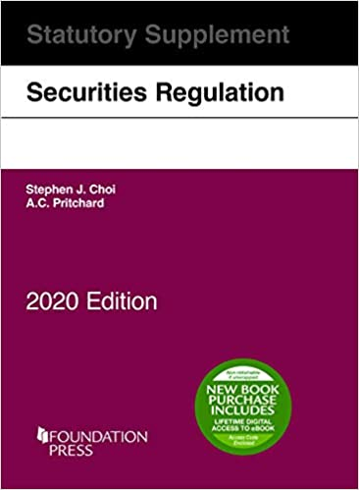
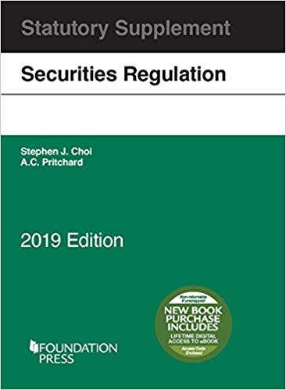
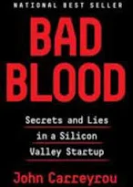
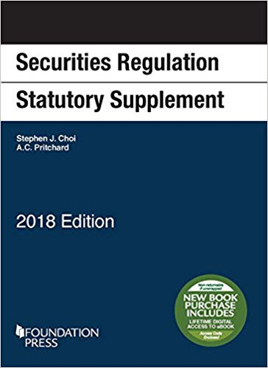
Administrative
Choi & Pritchard,
Securities Regulation Statutory Supplement (2020)
Choi & Pritchard,
Securities Regulation (5th ed.)

Slide 3
What is Securities Regulation?
Securities Act of 1933
Securities Exchange Act of 1934

Slide 4
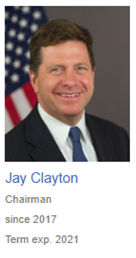
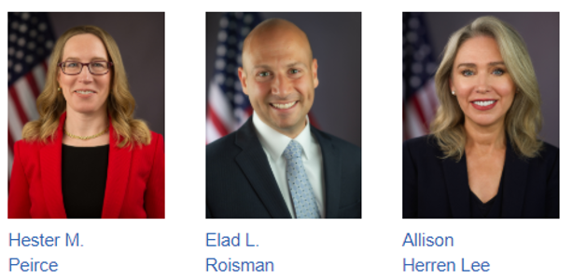
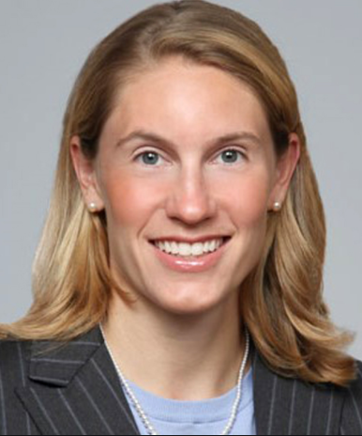
The Securities and Exchange Commission

Slide 5
The Securities and Exchange Commission

Slide 6
SEC Divisions
Corporation Finance
Enforcement
Investment Management
Trading and Markets
Economic and Risk Analysis

Slide 7
Other Agencies
Federal Agencies
CFPB (Consumer Finance Protection Bureau)
SIPC (Securities Investor Protection Corporation)
Self-Regulatory Agencies
FINRA (Financial Industry Regulatory Authority)
PCAOB (Protecting Investors through Audit Oversight)

Slide 8
Other Federal Laws
Investment Company Act of 1940
Investment Advisor Act of 1940
Trust Indenture Act of 1939
Securities Investor Protection Act
Broker-Dealer Regulation (SEC rules; FINRA rules)

Slide 9
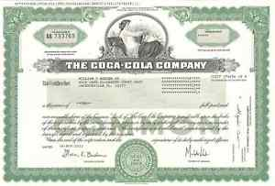
Issuing securities (Primary market)
ABC CORPORATION
Dealers
Underwriters
Investors

Slide 10
Issuing securities (Primary market)
ABC CORPORATION
Dealers
Underwriters
Investors

Slide 11
Securities trading (secondary market)
Investor
Broker
Broker
Investor
I’d like to sell my Coca-Cola stock

Slide 12
Securities trading (secondary market)
Investor
Broker
Broker
Investor
I’d like to sell Coca-Cola stock
I’d like to buy Coca-Cola stock

Slide 13
Securities trading (secondary market)
Investor
Broker
Broker
Investor
I’d like to sell Coca-Cola stock
I’d like to buy Coca-Cola stock

Slide 14
Securities trading
Investor
Broker
Broker
Investor

Slide 15
History of Federal Securities Regulation
Stock Market Crash (1929) & Great Depression (1930s)
Securities Act of 1933
Securities Exchange Act of 1934
Goals:
Investor Protection
Market Integrity

Slide 16
Pre-1933
State Blue Sky Laws

Slide 17
Big Question: How to Regulate?

Slide 18
Big Question: How to Regulate?
Disclosure-Based Approval?
Merit-Based Approval?

Slide 19
How much would you pay for this box?

Slide 20
Valuable?

Slide 21
This box contains something very valuable!
This box contains something very valuable!

Slide 22
Information Asymmetry

Slide 23
Information Asymmetry

Slide 24
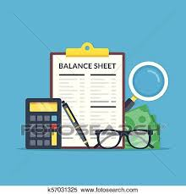
Merit-Based Solution

Slide 25
Disclosure-Based Solution

Slide 26
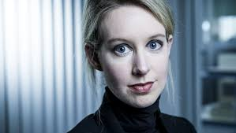
Unregulated Market?

Slide 27
Solution: mandatory disclosure + anti-fraud enforcement for public offerings
Mandatory Information Disclosure
Registration of securities prior to offering for sale (‘33 Act)
Periodic Disclosure for registered securities (‘34 Act)
Anti-Fraud Enforcement (civil and criminal; government and private)
Section 11, 12, 17 (‘33 Act)
Rule 10b-5 (‘34 Act)
Securities Fraud (Duty, Breach, Reliance, Causation, Damages)

Slide 28
Cyclical regulatory reforms
1929 Great Depression
2001 Accounting Scandals
2008 Financial Crisis
Securities Act of 1933
Securities Act of 1934
Sarbanes-Oxley Act of 2002
Dodd-Frank Act of 2010
JOBS Act of 2012
FAST Act of 2015
1980s Hostile Takeovers/Junk Bonds Williams Act Amendments
Insider Trading Jurisprudence
Early 2000s Recession IPO Reforms (2005)

Slide 29
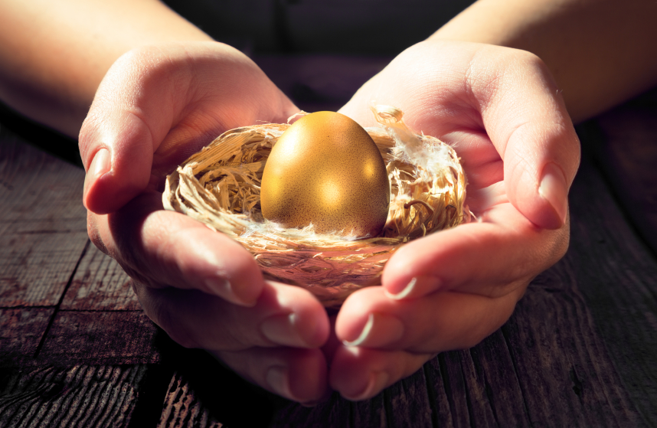
Modern SEC Goals:
Investor Protection
Capital Formation

Slide 30
What is a Capital Market?
A market for firms raising “capital” through the sale of long-term claims on the firm.
Equity Investments
Debt Instruments

Slide 31
What is an equity investment?
ABC CORPORATION
Board of Directors
Officers

Slide 32
Publicly-held corporation
ABC CORPORATION
Board of Directors
Officers

Slide 33
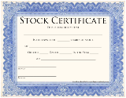
Start-up corporation
Venture L.P.
PREFERRED
ABC CORPORATION
Board of Directors
Officers

Slide 34
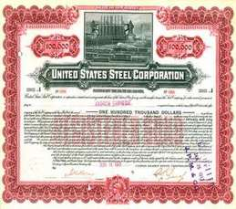
What is a debt instrument?
Venture L.P.
PREFERRED
ABC CORPORATION
Board of Directors
BOND
Officers

Slide 35
Corporate Finance
Common Stock
Preferred Stock
Buyer of stock = Shareholder/Stockholder
Debt Securities (Bonds or Debentures)
Buyer of a bond/debenture/note = Creditor

Slide 36
What is Common Stock?
Right to Vote
Right to Dividends as and when declared
Right to the Residual
No right to redemption
Corporation cannot force shareholders to redeem
Dividends are not deductible to corporation

Slide 37
What is Preferred Stock?
Contractual duties, not fiduciary duties
No default right to vote
Liquidation preference
Dividend preference
Dividends may be cumulative
Can be convertible to common
Generally not publicly-traded
May give corporation right to prepay
Dividends are not deductible

Slide 38
What is a Debt Security?
Contractual obligation – evidence of money loaned from “investor” to corporation (I.O.U.)
Interest paid by issuer (Debtor) has historically been deductible by issuer
Stated rate of return but may be “fixed” or “floating”
Fixed (3.5%) or Floating (Prime + 1%)
Nonpayment = breach of loan agreement/trust indenture
No control rights (voting rights)
No fiduciary duties
Contractual obligations ensure repayment
Financial ratios; pledges not to borrow or grant liens; pledges not to make capital expenditures or dividends; may be secured or unsecured

Slide 39
Comparison
 | Common Stock | Preferred Stock | Debt Security
Fiduciary Duties | Yes | No | No
Right to Repayment | No | maybe | X
Fixed Return | No | Yes, but | Yes
Default Rights | No | maybe | Yes
Unlimited Upside | Yes | No | No
Prepayment Risk | No | Maybe | maybe
Liquidation Preference | No | Maybe | Yes

Slide 40
What are Investment Risks?
Interest Rate Risk
Credit Risk
Prepayment Risk
Business Risk

Slide 41
To understand risk and how to price a capital asset we need to understand
Time Value of Money
Present Value
Difference between Systematic Risks and Unsystematic Risks

Slide 42
SAVINGS
BORROW
$100,000
$100,000
$100,000

Slide 43
SAVINGS
BORROW
$100,000
$100,000
Was earning 4.5%
$100,000
Owe interest of 5.75%

Slide 44
SAVINGS
BORROW
$100,000
$100,000
Was earning 4.5%
$100,000
Owe interest of 5.75%
$374,531.81
AFTER 30 YEARS. . .
$535,070.84
You save $160,539.03 if you use your savings
You lose $160,539.03 if you borrow

Slide 45
SAVINGS
BORROW
$100,000
$100,000
Was earning 15%
$100,000
Owe interest of 5.75%
$6,621,177.20
AFTER 30 YEARS. . .
$535,070.84
You lose $6,086,106.36 if you use your savings
You make $6,086,106.36 if you borrow

Slide 46
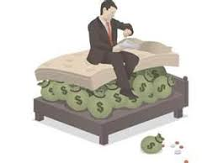
Time value of money
$1,000
Jan. 1, 1980
$1,000
10%
$1,000
Jan. 1, 1990
$2,593.74

Slide 47
Time value of money
$1,000
Jan. 1, 1980
$1,000
$1,000
Jan. 1, 1990
$2,593.74
$630.45
$1,635.20
Average Inflation rate:
4.72%/year

Slide 48
Historic Inflation Rate

Slide 49
Time value of money
$1,000
Jan. 1, 2010
$1,000
4%
$1,000
Jan. 1, 2020
$1,480.24

Slide 50
Time value of money
$1,000
Jan. 1, 2010
$1,000
4%
$1,000
Jan. 1, 2020
$1,480.24
$847.78
$1,186.89
Average
Inflation rate:
2.24%/year

Slide 51
Reverse Time value of money: discount to present value
$1,000
Jan. 1, 2010
$1,186.89
$1,000
$847.78
2.24%
2.24%
4%
$1,000
Jan. 1, 2020
$1,480.24
Discount Rate:
2.24%

Slide 52
Present value
Opposite of compound interest
The present value of $1000 in three years
Catch: You have to know what the inflation rate is for next 3 years
And: You have to know the risk you won’t get $1000 in three years.
Risk-free Rate of Return?

Slide 54
annuity
Cost of Annuity = Net Present Value of each payment, totaled.
Catch – have to know the rate; have to know how many payments will be made
Credit Risk of the Annuity Provider
Texas Tomorrow Fund (1996-2003)
$10,500 for 4-year tuition & fees in 18 years
Assumptions: interest rates and tuition rates

Slide 55
ASSUMPTIONS?
SELF-FUNDED
TEXAS TOMORROW FUND
$10,000
Available Funds for 2016-20 Tuition & Fees
$10,000
2016-20 Tuition & Fees
Investment Rate
Inflation Rate/
Tuition Increase Rate

Slide 56
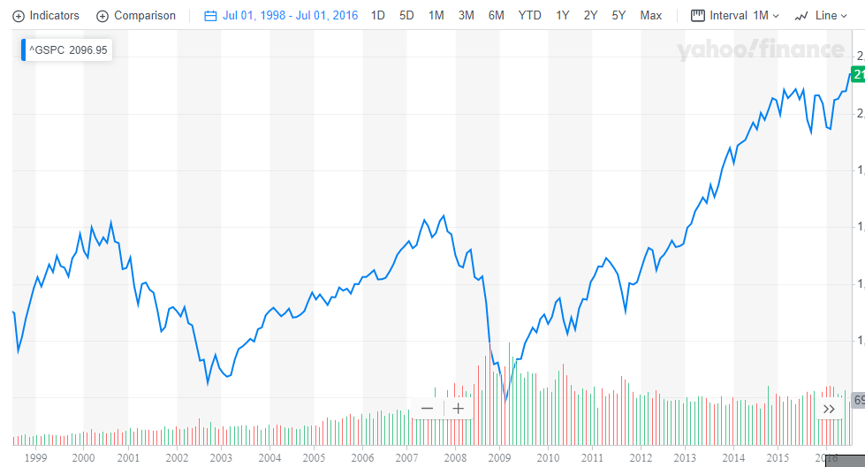

Slide 57
Interest Rate/Prepayment Risk: Time Value of Money
If you buy a bond that pays 5% a year/10 years
Is this a good investment?
Depends on the prevailing market rate of interest for a similarly risky investment
If interest rates go up, may be a bad investment
If interest rates go down, may be a good investment (but corporation may prepay/refinance)

Slide 58
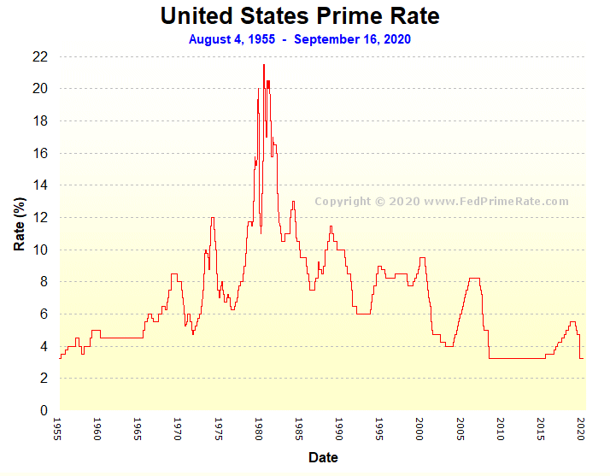
Prime Rate

Slide 59
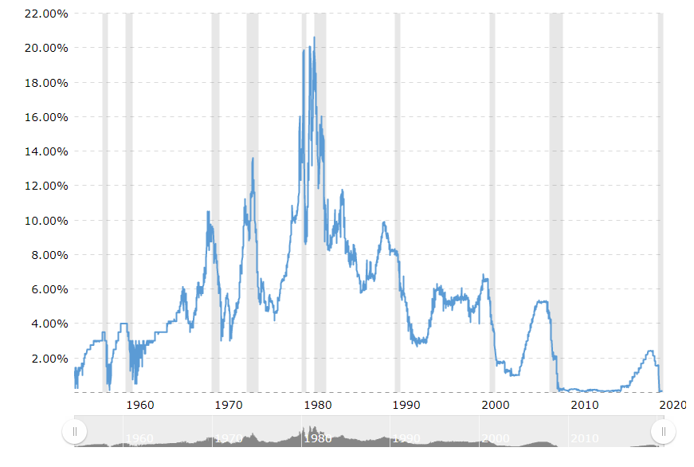
Federal Funds Rate

Slide 60
Prime Rate
Winter: (4.75%) (Federal Funds Rate + 3)
Fall: (3.25%)
Federal Funds Rate
Winter: (1.75%) (risk-free rate)
Fall: (.25%)
LIBOR
Winter: (2.0%)
Fall: (.45%)

Slide 61
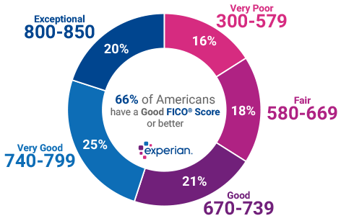
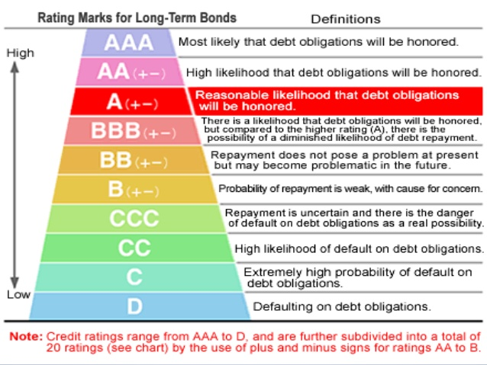
Credit risk/financial risk
Every borrower, individual or firm, has a different credit risk

Slide 62
Credit risk/financial risk v. cost of borrowing
Every borrower, individual or firm, has a different cost of borrowing
PRIME + .5%
PRIME + 7.5%

Slide 63
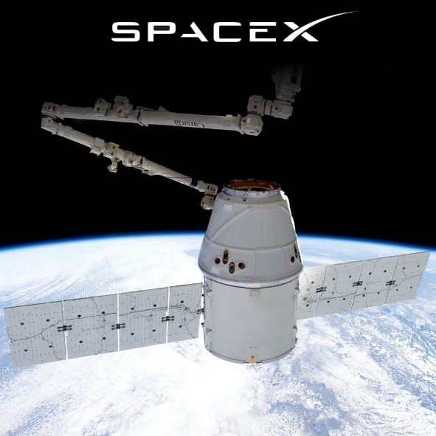
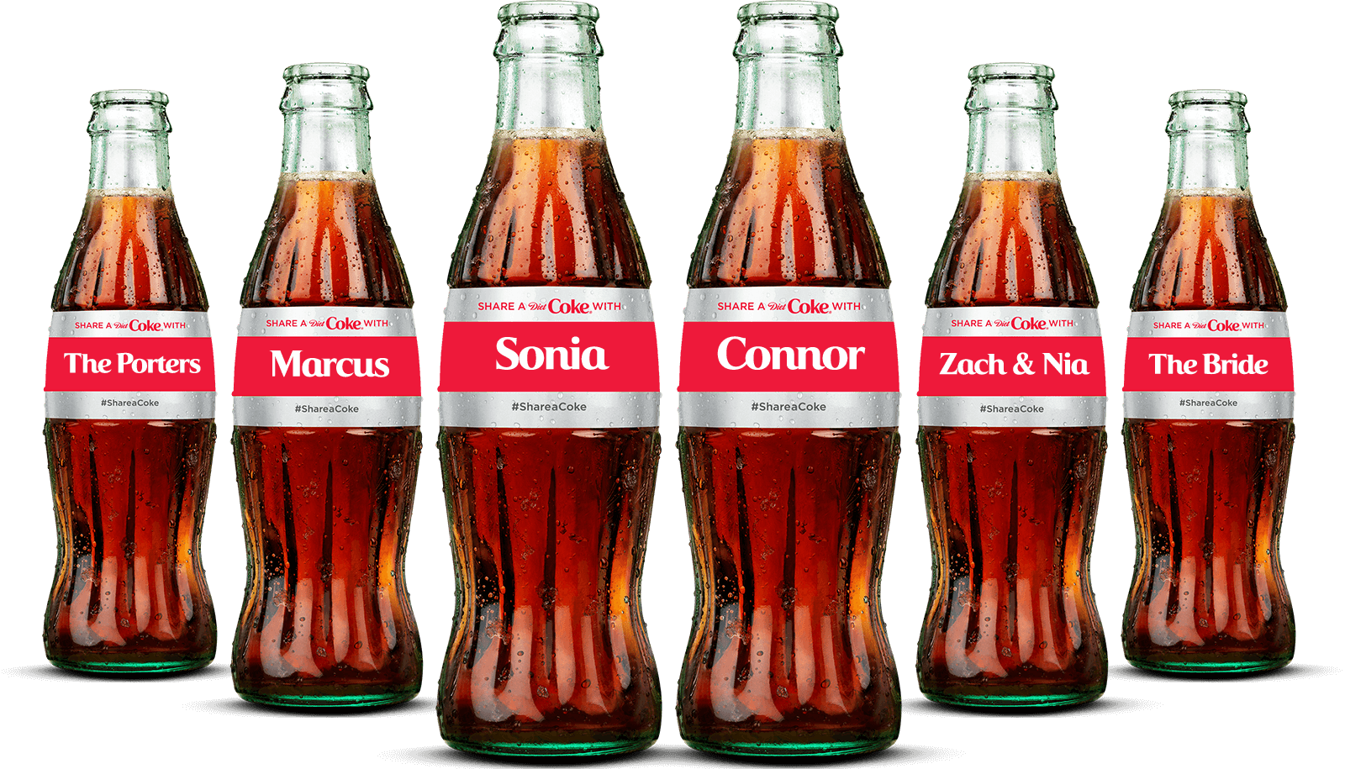
Business risk
The risk inherent in the company’s operations

Slide 64
To sum up:
If you invest with my company, your money will grow at 5% a year for the next 10 years!
I need to consider:
Instrument Risk
Business Risk
Credit Risk
Inflation Risk

Slide 65
Equity Investment in a going concern?
I can offer you 5% of this company for $100,000 today!
I need to consider:
Instrument Risk
Business Risk
Credit Risk
Inflation Risk
In a nutshell:
How much is 5% of the company worth?
How do I value a going concern?

Slide 66
So, what does this have to do with securities regulation?
What information is material to Price Discovery?
Need to understand how securities are priced
If. . .
Stable Market for Securities
So Securities Regulation Supports Price Discovery and not Price Distortion
How can regulation overcome information asymmetry?
What circumstances increase information asymmetry?

Slide 67
How do you price an equity interest in a going concern?

Slide 68
The Old Man and the Tree
For Sale:
Apple tree: Yields $100 apples a year. Ten years old.
Bought tree for $30 over 10 years ago
Lumber is worth $50
Make me an offer!

Slide 69
Lumberjack
$50 – the price that the chopped wood would fetch on the open market
Liquidation Value – usually lower than the value as a “going concern”

Slide 70
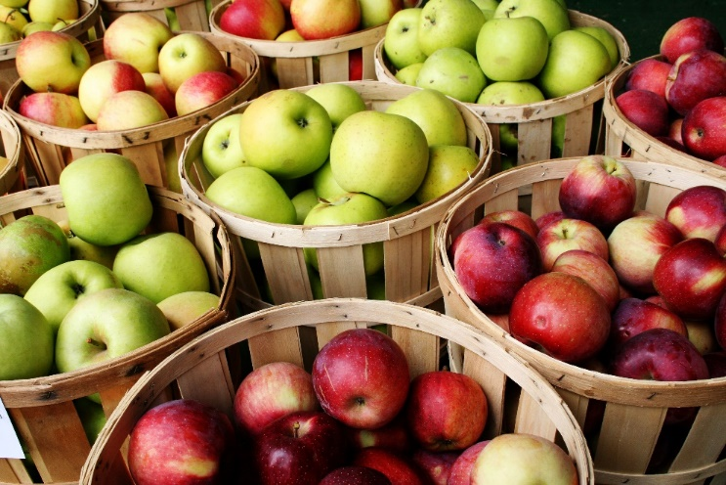
Apple Producer #1
$100 – I will make $100 next year from selling apples
$100 – I will make $100 next year off the crop of fruit

Slide 71
Apple Producer #1
$100 – I will make $100 next year off the crop of fruit
Only assumes that tree will produce one year
Also confuses revenue with profit
$100 – I will make $100 next year off the crop of fruit

Slide 72
Marketing Major
$1,500 – tree will produce for 15 more years
May confuse revenue with profit;
$1500 in 2032 is much less than $1500 in 2018
Will the tree last 15 years at the same level of production?

Slide 73
Accounting Student
$30 – what the man paid for the tree 30 years ago.

Slide 74
Accounting Student
$30 – what the man paid for the tree 30 years ago.
Book value is usually much lower than “going concern”

Slide 75
Old Man’s Rebuttal
Discounted Cash Flow
What is the present value of the income from this asset over its useful life?
Expected cash flows in the future
Discounted by the “discount rate”
Every project has a different discount rate and expected life
$270

Slide 76
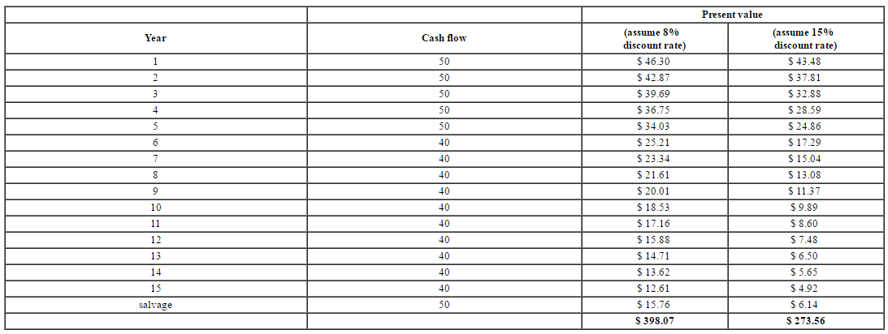

Slide 78
Why isn’t the valuation just profits x 15 years?
Time Value of Money
Must Know the Discount Rate

Slide 79
Why isn’t the valuation just profits x 15 years?
Time Value of Money
Must Know the Discount Rate
How Risky? What Kind of Risky?

