Slide 1
Securities Regulation Day #3

Slide 2
Under the Semi-strong view of the efficient capital markets. . .
A. All information concerning historical prices is fully reflected in the current price.
B. Current stock prices reflect all private and publicly-available information.
C. Current stock prices reflect all publicly-available information.
D. Markets are more efficient when there are fewer buyers in the marketplace.
E. Markets are more efficient when there are fewer sellers in the marketplace.

Slide 3
Investment Decisions
Summary
Investors must be compensated for the time value of money and for bearing risk
Discount rate reflects the level of risk from an investment
Diversification can eliminate firm-specific risks, but not market-wide risks
4. Disclosure helps investors in:
Making an estimate of future cash flows
Assessing the risk of the firm relative to the market as a whole (beta)

Slide 4
Information is key to investment decisions

Slide 5
Daily lingo: Start-up, ipo, small-cap, mid-cap, etc.

Slide 6
Initial public offering market

Slide 7
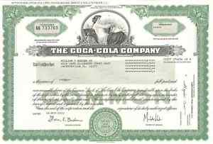
Start-up corporation
Venture L.P.
PREFERRED
ABC CORPORATION
Board of Directors
Valuation
Officers

Slide 8
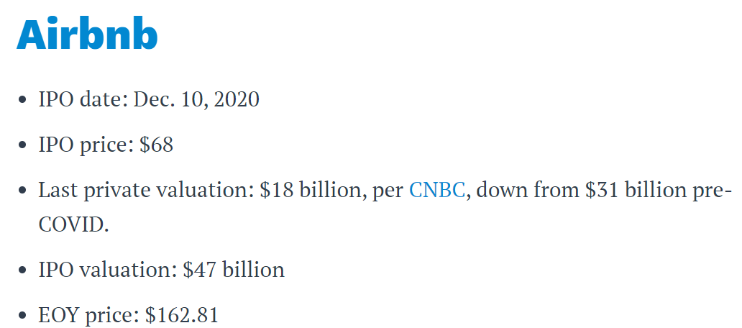

Slide 9
Publicly-held corporation
ABC CORPORATION
Board of Directors
Officers

Slide 10
Publicly-held corporation
ABC CORPORATION
Board of Directors
Market Capitalization
“Public Float”
Officers

Slide 11
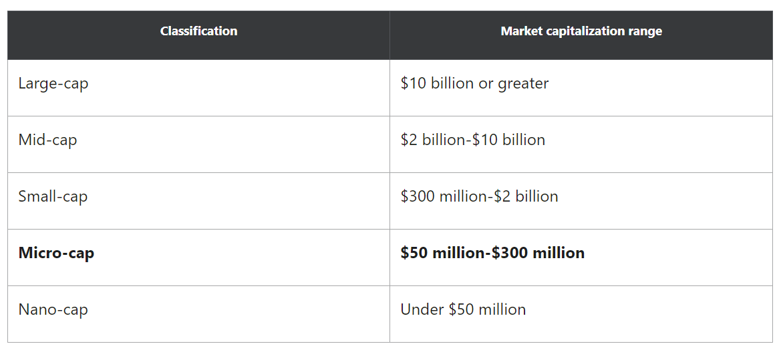
Market cap

Slide 12
What is a security?

Slide 13
What is a security?
Section 2(a)(1) of the Securities Act of 1933:
The term ‘‘security’’ means any note, stock, treasury stock, security future, security-based swap, bond, debenture, evidence of indebtedness, certificate of interest or participation in any profit-sharing agreement, collateral-trust certificate, preorganization certificate or subscription, transferable share, investment contract, voting-trust certificate, certificate of deposit for a security, fractional undivided interest in oil, gas, or other mineral rights, any put, call, straddle, option, or privilege on any security, certificate of deposit, or group or index of securities (including any interest therein or based on the value thereof), or any put, call, straddle, option, or privilege entered into on a national securities exchange relating to foreign currency, or, in general, any interest or instrument commonly known as a ‘‘security’’, or any certificate of interest or participation in, temporary or interim certificate for, receipt for, guarantee of, or warrant or right to subscribe to or purchase, any of the foregoing.

Slide 14
What is a security?
Section 2(a)(1) of the Securities Act of 1933:
The term ‘‘security’’ means any note, stock, treasury stock, security future, security-based swap, bond, debenture, evidence of indebtedness, certificate of interest or participation in any profit-sharing agreement, collateral-trust certificate, preorganization certificate or subscription, transferable share, investment contract, voting-trust certificate, certificate of deposit for a security, fractional undivided interest in oil, gas, or other mineral rights, any put, call, straddle, option, or privilege on any security, certificate of deposit, or group or index of securities (including any interest therein or based on the value thereof), or any put, call, straddle, option, or privilege entered into on a national securities exchange relating to foreign currency, or, in general, any interest or instrument commonly known as a ‘‘security’’, or any certificate of interest or participation in, temporary or interim certificate for, receipt for, guarantee of, or warrant or right to subscribe to or purchase, any of the foregoing.

Slide 15
What is a security?
Section 2(a)(1) of the Securities Act of 1933:
The term ‘‘security’’ means any note, stock, treasury stock, security future, security-based swap, bond, debenture, evidence of indebtedness, certificate of interest or participation in any profit-sharing agreement, collateral-trust certificate, preorganization certificate or subscription, transferable share, investment contract, voting-trust certificate, certificate of deposit for a security, fractional undivided interest in oil, gas, or other mineral rights, any put, call, straddle, option, or privilege on any security, certificate of deposit, or group or index of securities (including any interest therein or based on the value thereof), or any put, call, straddle, option, or privilege entered into on a national securities exchange relating to foreign currency, or, in general, any interest or instrument commonly known as a ‘‘security’’, or any certificate of interest or participation in, temporary or interim certificate for, receipt for, guarantee of, or warrant or right to subscribe to or purchase, any of the foregoing.

Slide 16
What is a security?
Section 2(a)(1) of the Securities Act of 1933:
The term ‘‘security’’ means any note, stock, treasury stock, security future, security-based swap, bond, debenture, evidence of indebtedness, certificate of interest or participation in any profit-sharing agreement, collateral-trust certificate, preorganization certificate or subscription, transferable share, investment contract, voting-trust certificate, certificate of deposit for a security, fractional undivided interest in oil, gas, or other mineral rights, any put, call, straddle, option, or privilege on any security, certificate of deposit, or group or index of securities (including any interest therein or based on the value thereof), or any put, call, straddle, option, or privilege entered into on a national securities exchange relating to foreign currency, or, in general, any interest or instrument commonly known as a ‘‘security’’, or any certificate of interest or participation in, temporary or interim certificate for, receipt for, guarantee of, or warrant or right to subscribe to or purchase, any of the foregoing.

Slide 17
What is a security?
Section 2(a)(1) of the Securities Act of 1933:
The term ‘‘security’’ means any note, stock, treasury stock, security future, security-based swap, bond, debenture, evidence of indebtedness, certificate of interest or participation in any profit-sharing agreement, collateral-trust certificate, preorganization certificate or subscription, transferable share, investment contract, voting-trust certificate, certificate of deposit for a security, fractional undivided interest in oil, gas, or other mineral rights, any put, call, straddle, option, or privilege on any security, certificate of deposit, or group or index of securities (including any interest therein or based on the value thereof), or any put, call, straddle, option, or privilege entered into on a national securities exchange relating to foreign currency, or, in general, any interest or instrument commonly known as a ‘‘security’’, or any certificate of interest or participation in, temporary or interim certificate for, receipt for, guarantee of, or warrant or right to subscribe to or purchase, any of the foregoing.

Slide 18
What is a security?
Section 2(a)(1) of the Securities Act of 1933:
The term ‘‘security’’ means any note, stock, treasury stock, security future, security-based swap, bond, debenture, evidence of indebtedness, certificate of interest or participation in any profit-sharing agreement, collateral-trust certificate, preorganization certificate or subscription, transferable share, investment contract, voting-trust certificate, certificate of deposit for a security, fractional undivided interest in oil, gas, or other mineral rights, any put, call, straddle, option, or privilege on any security, certificate of deposit, or group or index of securities (including any interest therein or based on the value thereof), or any put, call, straddle, option, or privilege entered into on a national securities exchange relating to foreign currency, or, in general, any interest or instrument commonly known as a ‘‘security’’, or any certificate of interest or participation in, temporary or interim certificate for, receipt for, guarantee of, or warrant or right to subscribe to or purchase, any of the foregoing.

Slide 19
What is a security?
Section 2(a)(1) of the Securities Act of 1933:
The term ‘‘security’’ means any note, stock, treasury stock, security future, security-based swap, bond, debenture, evidence of indebtedness, certificate of interest or participation in any profit-sharing agreement, collateral-trust certificate, preorganization certificate or subscription, transferable share, investment contract, voting-trust certificate, certificate of deposit for a security, fractional undivided interest in oil, gas, or other mineral rights, any put, call, straddle, option, or privilege on any security, certificate of deposit, or group or index of securities (including any interest therein or based on the value thereof), or any put, call, straddle, option, or privilege entered into on a national securities exchange relating to foreign currency, or, in general, any interest or instrument commonly known as a ‘‘security’’, or any certificate of interest or participation in, temporary or interim certificate for, receipt for, guarantee of, or warrant or right to subscribe to or purchase, any of the foregoing.

Slide 20
What is a security?
Section 2(a)(1) of the Securities Act of 1933:
The term ‘‘security’’ means any note, stock, treasury stock, security future, security-based swap, bond, debenture, evidence of indebtedness, certificate of interest or participation in any profit-sharing agreement, collateral-trust certificate, preorganization certificate or subscription, transferable share, investment contract, voting-trust certificate, certificate of deposit for a security, fractional undivided interest in oil, gas, or other mineral rights, any put, call, straddle, option, or privilege on any security, certificate of deposit, or group or index of securities (including any interest therein or based on the value thereof), or any put, call, straddle, option, or privilege entered into on a national securities exchange relating to foreign currency, or, in general, any interest or instrument commonly known as a ‘‘security’’, or any certificate of interest or participation in, temporary or interim certificate for, receipt for, guarantee of, or warrant or right to subscribe to or purchase, any of the foregoing.

Slide 21
What is a security?
Section 2(a)(1) of the Securities Act of 1933:
The term ‘‘security’’ means any note, stock, treasury stock, security future, security-based swap, bond, debenture, evidence of indebtedness, certificate of interest or participation in any profit-sharing agreement, collateral-trust certificate, preorganization certificate or subscription, transferable share, investment contract, voting-trust certificate, certificate of deposit for a security, fractional undivided interest in oil, gas, or other mineral rights, any put, call, straddle, option, or privilege on any security, certificate of deposit, or group or index of securities (including any interest therein or based on the value thereof), or any put, call, straddle, option, or privilege entered into on a national securities exchange relating to foreign currency, or, in general, any interest or instrument commonly known as a ‘‘security’’, or any certificate of interest or participation in, temporary or interim certificate for, receipt for, guarantee of, or warrant or right to subscribe to or purchase, any of the foregoing.

Slide 22
What is a security?
Section 2(a)(1) of the Securities Act of 1933:
The term ‘‘security’’ means any note, stock, treasury stock, security future, security-based swap, bond, debenture, evidence of indebtedness, certificate of interest or participation in any profit-sharing agreement, collateral-trust certificate, preorganization certificate or subscription, transferable share,
investment contract,
voting-trust certificate, certificate of deposit for a security, fractional undivided interest in oil, gas, or other mineral rights, any put, call, straddle, option, or privilege on any security, certificate of deposit, or group or index of securities (including any interest therein or based on the value thereof), or any put, call, straddle, option, or privilege entered into on a national securities exchange relating to foreign currency, or, in general, any interest or instrument commonly known as a ‘‘security’’, or any certificate of interest or participation in, temporary or interim certificate for, receipt for, guarantee of, or warrant or right to subscribe to or purchase, any of the foregoing.

Slide 23
A Few issues
Is everything listed in 2(a)(1) ALWAYS a security?
What if it’s not listed in 2(a)(1)?

Slide 24
Exempted securities
Section 3 of the Securities Act of 1933
Section 4 of the Securities Act of 1933
Exempted transactions

Slide 25
Consequences of being a security

Slide 26
Consequences of being a security
ALL Securities must be registered at the federal level or qualify for an exemption
Selling unregistered (nonexempt) securities is a violation of Section 5 of the Securities Act
Fraudulent statements in connection with the purchase or sale of a security violate Rule 10b-5 of the Exchange Act
Only registered broker-dealers may sell securities

Slide 27
Who is complaining?
SEC
Purchaser

Slide 28
SEC v. W.J. HOWEY CO.

Slide 32
INVESTMENT V. CONSUMPTION

Slide 33
Investment appreciation “solely by the efforts of others”?

Slide 35
h
HOUSE, CO.
NOT A SECURITY
SECURITY

Slide 36
Q: If I call this interest something new (not stock, not LLC interest), is it still a security?
h
HOUSE, CO.
NOT A SECURITY
SECURITY

Slide 37
What is a security?
Section 2(a)(1) of the Securities Act of 1933:
The term ‘‘security’’ means any note, stock, treasury stock, security future, security-based swap, bond, debenture, evidence of indebtedness, certificate of interest or participation in any profit-sharing agreement, collateral-trust certificate, preorganization certificate or subscription, transferable share,
investment contract,
voting-trust certificate, certificate of deposit for a security, fractional undivided interest in oil, gas, or other mineral rights, any put, call, straddle, option, or privilege on any security, certificate of deposit, or group or index of securities (including any interest therein or based on the value thereof), or any put, call, straddle, option, or privilege entered into on a national securities exchange relating to foreign currency, or, in general, any interest or instrument commonly known as a ‘‘security’’, or any certificate of interest or participation in, temporary or interim certificate for, receipt for, guarantee of, or warrant or right to subscribe to or purchase, any of the foregoing.

Slide 38
“investment contract”
A person invests his/her money
In a common enterprise
Is led to expect profits
Solely from the efforts of others

Slide 39
Howey-in-the-Hills
W.J. Howey Co.

Slide 40
Howey-in-the-Hills
W.J. Howey Co.

Slide 41
Howey-in-the-Hills
W.J. Howey Co.

Slide 42
“investment contract”
A person invests his/her money
In a common enterprise
Is led to expect profits
Solely from the efforts of others

Slide 43
International brotherhood of teamsters v. Daniel
What part of the Howey test is at issue in the Daniel case?
A. A person invests his/her money
B. In a common enterprise
C. Is led to expect profits
D. Solely through the efforts of others

Slide 44
International brotherhood of teamsters v. Daniel
What part of the Howey test is at issue in the Daniel case?
A. A person invests his/her money
B. In a common enterprise
C. Is led to expect profits
D. Solely through the efforts of others

Slide 45
Why is this a securities case?

Slide 46
Why is this a securities case?
If the pension interest is an “investment contract” (“security”), then anti-fraud liability applies if fraudulent misstatements

Slide 47
Noncontributory, compulsory pension plans
Not a security

Slide 48
Voluntary, contributory
Are securities
But, Section 3(a)(2) – most pension plans are exempt

Slide 49
Alternative regulatory schemes
ERISA, e.g.

Slide 50
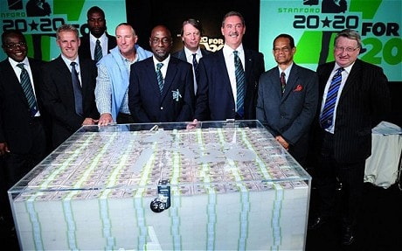

Slide 51
SEC v. sg ltd.

Slide 52
“investment contract”
A person invests his/her money
In a common enterprise
Is led to expect profits
Solely from the efforts of others

Slide 53
What is a Ponzi scheme?

Slide 54
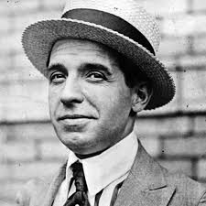
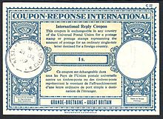
Carlo Ponzi

Slide 55
