Slide 1
Securities regulation #12

Slide 2
From materiality to liability for false statements of material facts!

Slide 3
Section 11 & 12

Slide 4
Section 11 & 12 liability
After the IPO. . . .
After a new class of “purchasers” is created

Slide 5
Section 11
Civil Liabilities on Account of False Registration Statement

Slide 6
Section 11 liability
(a) Persons possessing cause of action; persons liable
In case any part of the registration statement, when such part became effective, contained an untrue statement of a material fact or omitted to state a material fact required to be stated therein or necessary to make the statements therein not misleading, any person acquiring such security (unless it is proved that at the time of such acquisition he knew of such untruth or omission) may, either at law or in equity, in any court of competent jurisdiction, sue—
(1) every person who signed the registration statement;
(2) every person who was a director of (or person performing similar functions) or partner in the issuer at the time of the filing of the part of the registration statement with respect to which his liability is asserted;
(3) every person who, with his consent, is named in the registration statement as being or about to become a director, person performing similar functions, or partner;
(4) every accountant, engineer, or appraiser, or any person whose profession gives authority to a statement made by him, who has with his consent been named as having prepared or certified any part of the registration statement, or as having prepared or certified any report or valuation which is used in connection with the registration statement, with respect to the statement in such registration statement, report, or valuation, which purports to have been prepared or certified by him;
(5) every underwriter with respect to such security.

Slide 7
Section 12 liability
Sells unregistered securities
Fraud in prospectus/oral communications
(a) In general
Any person who—
(1) offers or sells a security in violation of section 5, or
(2) offers or sells a security (whether or not exempted by the provisions of section 3 of this title, other than paragraphs (2) and (14) of subsection (a) of said section), by the use of any means or instruments of transportation or communication in interstate commerce or of the mails, by means of a prospectus or oral communication, which includes an untrue statement of a material fact or omits to state a material fact necessary in order to make the statements, in the light of the circumstances under which they were made, not misleading (the purchaser not knowing of such untruth or omission), and who shall not sustain the burden of proof that he did not know, and in the exercise of reasonable care could not have known, of such untruth or omission,
shall be liable, subject to subsection (b), to the person purchasing such security from him, who may sue either at law or in equity in any court of competent jurisdiction, to recover the consideration paid for such security with interest thereon, less the amount of any income received thereon, upon the tender of such security, or for damages if he no longer owns the security.

Slide 8
Statute of LImitations
Section 13: No action shall be maintained to enforce any liability created under Section 11 or Section 12(a)(2) unless brought within one year after the discovery of the untrue statement or the omission, or after such discovery should have been made by the exercise of reasonable diligence. . .
Section 12(a)(1) (failure to register) liability – must be brought within one year after the violation upon which it is based.
Statute of repose: three years from the time the security was offered to the public (12(a)(1) and 11) or more than three years after the sale (12(a)(2)).

Slide 9
Securities Fraud! Rule 10b-5
False statement
Speaker must know it is false
Material fact
Induces plaintiff to change position
Reliance
Causation
Causes Damages
Loss Causation
Damages
PSLRA

Slide 10
Section 11 liability
(a) Persons possessing cause of action; persons liable
In case any part of the registration statement, when such part became effective, contained an untrue statement of a material fact or omitted to state a material fact required to be stated therein or necessary to make the statements therein not misleading, any person acquiring such security (unless it is proved that at the time of such acquisition he knew of such untruth or omission) may, either at law or in equity, in any court of competent jurisdiction, sue—
(1) every person who signed the registration statement;
(2) every person who was a director of (or person performing similar functions) or partner in the issuer at the time of the filing of the part of the registration statement with respect to which his liability is asserted;
(3) every person who, with his consent, is named in the registration statement as being or about to become a director, person performing similar functions, or partner;
(4) every accountant, engineer, or appraiser, or any person whose profession gives authority to a statement made by him, who has with his consent been named as having prepared or certified any part of the registration statement, or as having prepared or certified any report or valuation which is used in connection with the registration statement, with respect to the statement in such registration statement, report, or valuation, which purports to have been prepared or certified by him;
(5) every underwriter with respect to such security.

Slide 11
Who signs?
The registration statement shall be signed by the registrant, its principal executive officer or officers, its principal financial officer, its controller or principal accounting officer and by at least a majority of the board of directors or persons performing similar functions.

Slide 12
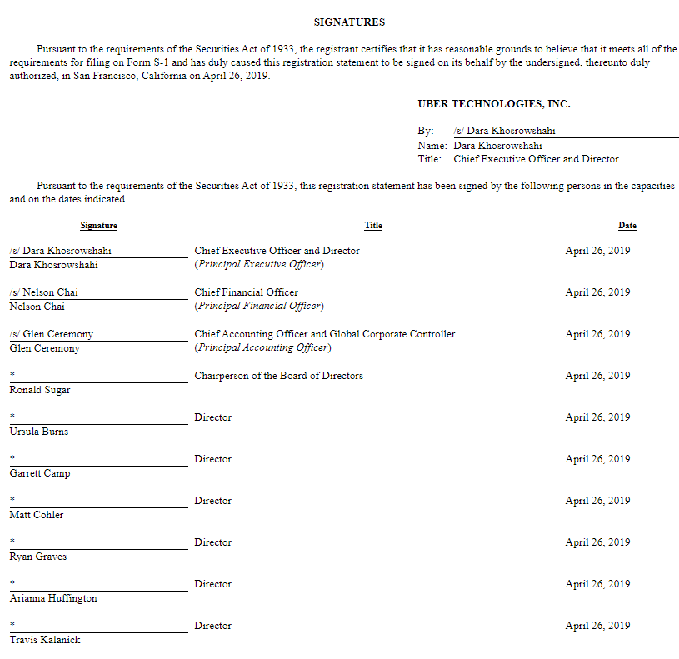

Slide 13
Section 11 elements
Section 11 elements
Misstatement/Omission
Materiality
NOT:
Scienter
Reliance
Loss Causation

Slide 14
Section 11 defenses (NONISSUER)
Due Diligence
Experts liable for “expertised portion” ONLY; defense if had, after reasonable investigation, reasonable ground to believe and did believe that the statements therein were true at the time
Nonexperts not liable for “expertised portion” if had no reasonable ground to believe and did not believe, that the statements therein were untrue at the time
Nonexperts not liable for “nonexpertised portion” if had, after reasonable investigation, reasonable ground to believe and did believe, that the statements therein were true at the time.

Slide 15
Who is an expert?

Slide 16
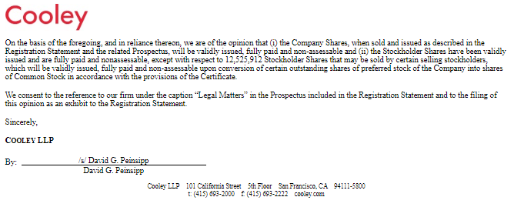
Uber experts

Slide 17
Other defenses/limitations
Purchaser knew of untruth/omission
Outside Directors are jointly and severally liable for “proportionate share”
Offering price is maximum amount recoverable

Slide 18
(e)Measure of damages; undertaking for payment of costs
The suit authorized under subsection (a) may be to recover such damages as shall represent the difference between the amount paid for the security (not exceeding the price at which the security was offered to the public) and (1) the value thereof as of the time such suit was brought, or (2) the price at which such security shall have been disposed of in the market before suit, or (3) the price at which such security shall have been disposed of after suit but before judgment if such damages shall be less than the damages representing the difference between the amount paid for the security (not exceeding the price at which the security was offered to the public) and the value thereof as of the time such suit was brought:
(g)Offering price to public as maximum amount recoverable
In no case shall the amount recoverable under this section exceed the price at which the security was offered to the public.

Slide 19
Compare to 10b-5
Plaintiff does not have to prove a causal link between misrepresentation and price drop

Slide 20
Other Section 11 issues
MONSTER
Standing –”tracing requirement” – must show that your specific shares were sold as part of the public offering under the defective registration statement

Slide 21
Tracing monster?

Slide 22
This monster?

Slide 23
This guy

Slide 24
3rd Purchaser
2nd Purchaser
3rd Purchaser
VC
IPO Purchaser
2nd Purchaser
ISSUER
IPO Purchaser
2nd Purchaser
VC
3rd Purchaser
IPO Purchaser

Slide 25
3rd Purchaser
2nd Purchaser
3rd Purchaser
2nd Purchaser
3rd Purchaser
VC
IPO Purchaser
2nd Purchaser
ISSUER
IPO Purchaser
2nd Purchaser
VC
3rd Purchaser
IPO Purchaser

Slide 26
3rd Purchaser
standing
2nd Purchaser
no standing
3rd Purchaser
2nd Purchaser
3rd Purchaser
VC
IPO Purchaser
2nd Purchaser
ISSUER
IPO Purchaser
2nd Purchaser
VC
3rd Purchaser
IPO Purchaser

Slide 27
Krim v. pcOrder, Inc.
IPO – February 26, 1999
Secondary Offering – December 7, 1999

Slide 28
3rd Purchaser
3rd Purchaser
2nd Purchaser
2nd Purchaser
3rd Purchaser
1st Purchaser
VC
IPO Purchaser
2nd Purchaser
ISSUER
IPO Purchaser
2nd Purchaser
VC
3rd Purchaser
IPO Purchaser

Slide 29
standing
3rd Purchaser
3rd Purchaser
2nd Purchaser
no standing
2nd Purchaser
3rd Purchaser
1st Purchaser
VC
IPO Purchaser
2nd Purchaser
ISSUER
IPO Purchaser
2nd Purchaser
VC
3rd Purchaser
IPO Purchaser

Slide 30
Dr. Burke?
Street Name Certificate
0.15%
99.85%
Non-public offering shares
IPO shares

Slide 31
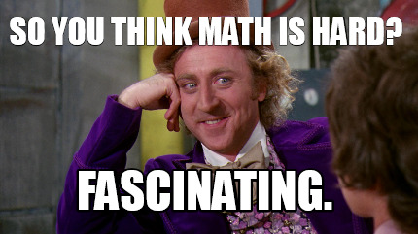

Slide 32
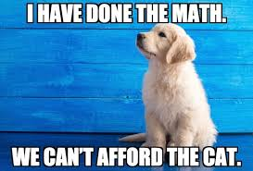

Slide 33
Dr. Burke?
Street Name Certificate
49.15%
50.85%
IPO shares
Non-public offering shares

Slide 34
Private securities litigation Rule 10b-5

Slide 35
Section 10(b) of the Securities Exchange Act
It shall be unlawful for any person, directly or indirectly, by the use of any means or instrumentality of interstate commerce . . .to use or employ, in connection with the purchase or sale of any security registered on a national securities exchange or any security not so registered, or any securities-based swap agreement, any manipulative or deceptive device or contrivance in contravention of such rules and regulations as the Commission may prescribe. . .

Slide 36
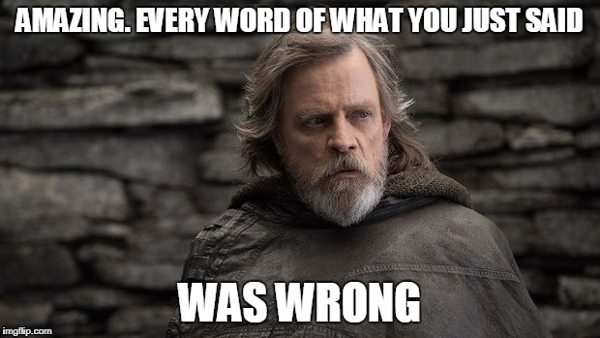
SEC: Manipulative, deceptive, device?

Slide 37
Rule 10b-5
It shall be unlawful for any person. . . .
A. To employ any device, scheme, or artifice to defraud
B. To make any untrue statement of a material fact or to omit to state a material fact necessary in order to make the statements made, in the light of the circumstances under which they were made, not misleading, or
C. To engage in any act, practice, or course of business which operates or would operate as a fraud or deceit upon any person,
In connection with the purchase or sale of any security.

Slide 38
ELEMENTS OF 10b-5
Material
Misrepresentation of fact
Scienter (allege facts with particularity. . . )
Reliance (Basic)
Loss Causation (must adequately allege in complaint)

Slide 39
1995: Private securities litigation reform act
Section 21D of the Securities Exchange Act
Lead Plaintiff Rules
Enhanced pleading rules (preempts Section 9(b) FRCP)
Must plead with particularity SCIENTER
Stay on discovery until after MTD
Rule 11 Sanctions for frivolousness
Several liability for outside directors (in proportion to responsibility)

Slide 40
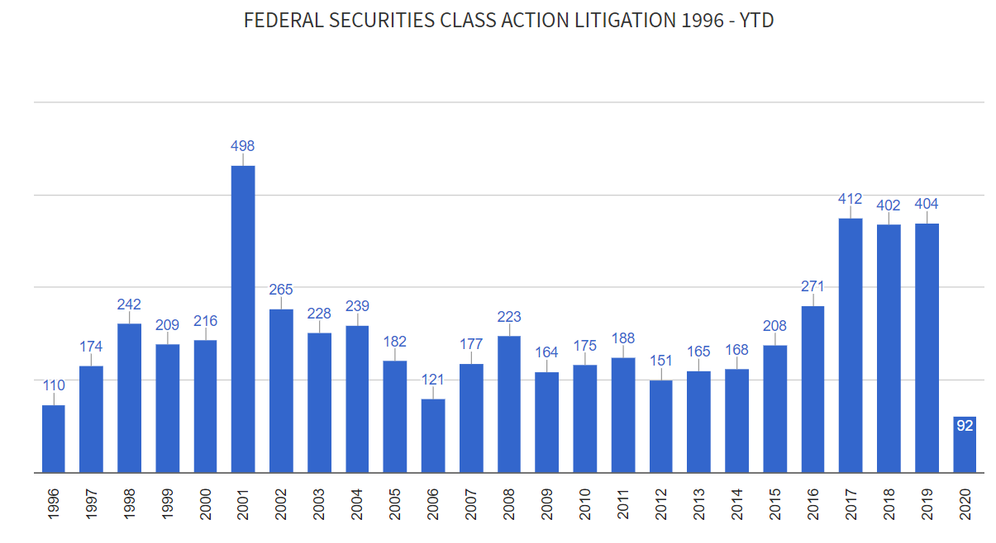
334

Slide 41
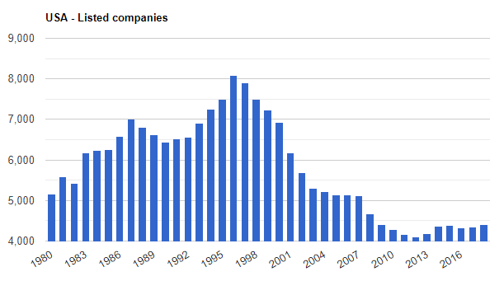

Slide 42
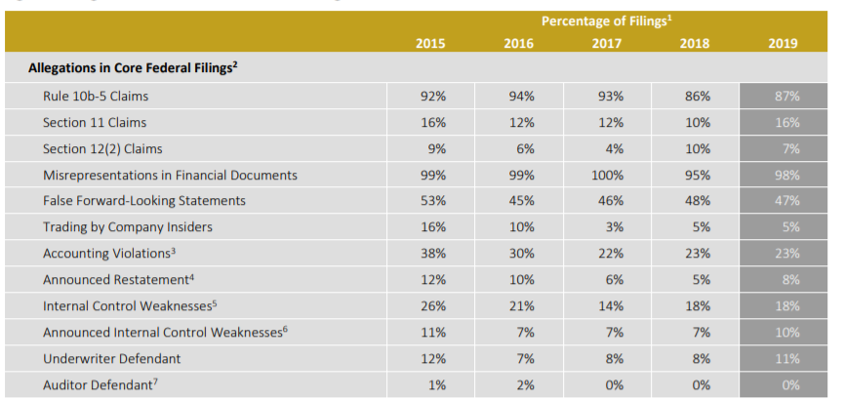

Slide 43
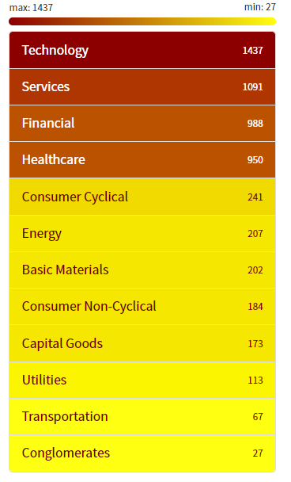
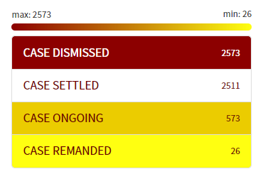
Securities fraud stats

Slide 44
What about trials?

Slide 45
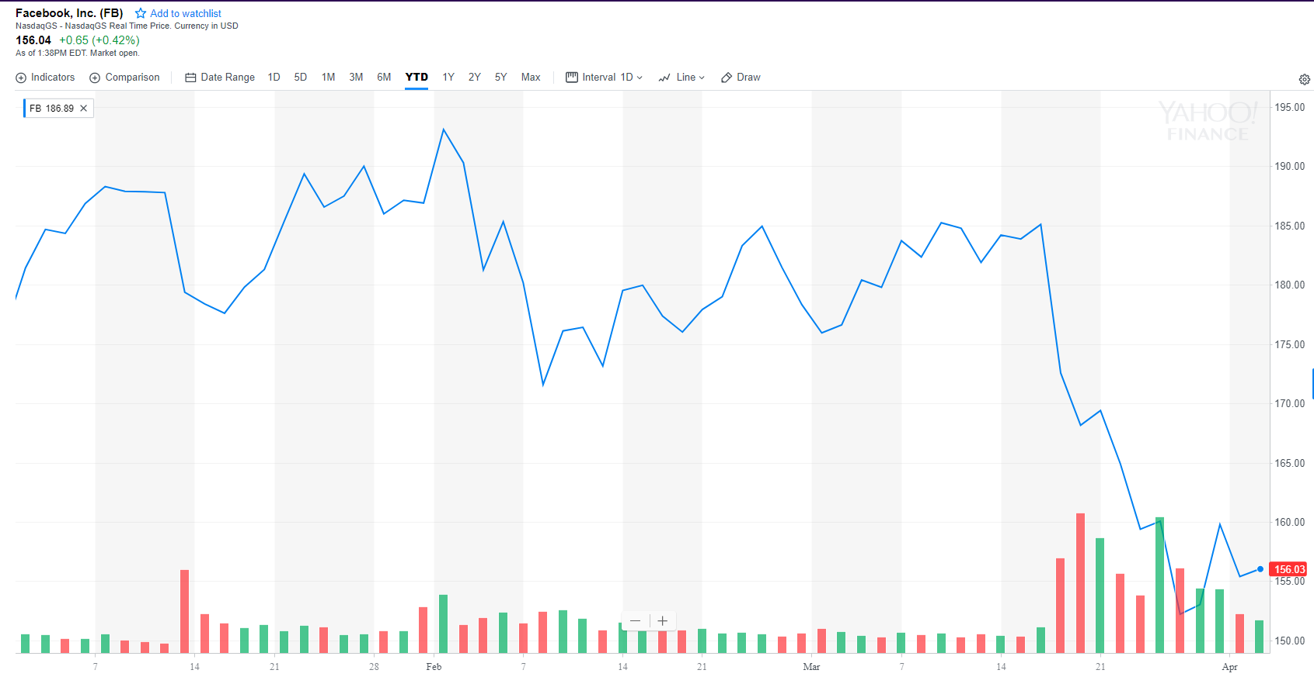
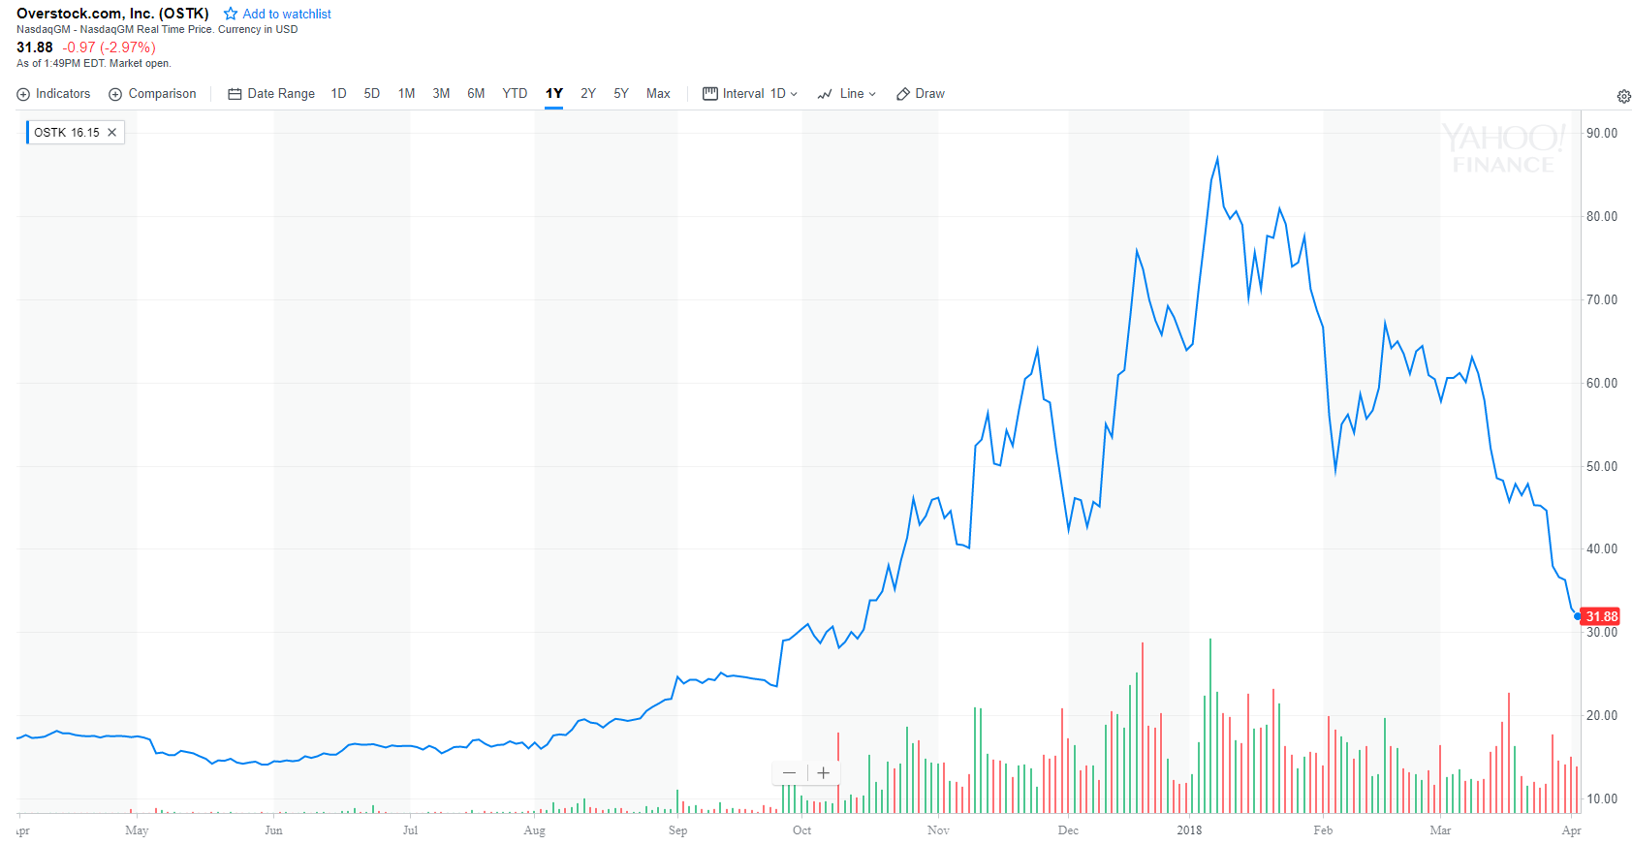
A few scenarios
Issuer
Issuer
Business
Changes
Issuer
Restates Financials
Litigation
Risk

Slide 46
Litigation timeline
Motion to Certify the Class
Appeal of Class Certification
Motion for Summary Judgment
Complaint Filed
Motion to Dismiss
Trial
Appeal of MTD

Slide 47
Litigation timeline
Motion to Certify the Class
Appeal of Class Certification
SETTLEMENT VALUE
Motion for Summary Judgment
Complaint Filed
Motion to Dismiss
Trial
Appeal of MTD

Slide 48
ELEMENTS OF 10b-5
Material
Misrepresentation of fact
Scienter (allege facts with particularity. . . )
Reliance (Basic)
Loss Causation (must adequately allege in complaint)

Slide 49
Materiality v. loss causation
Can use “market test”
Whether a reasonable investor would consider the misstatement important
Must use “market test”
Whether a misstatement actually resulted in a loss

Slide 50
What is the required state of mind? scienter
Ernst & Ernst v. Hochfelder (U.S. 1976)
Rule 10b-5 requires “intent”

Slide 51
SCIENTER
To survive a motion to dismiss, must state with particularity facts giving rise to a strong inference that the defendant acted with the required state of mind.

Slide 52
Halliburton Co. v. Erica P. John Fund, Inc. (“Halliburton i”)
Halliburton Co. v. Erica P. John Fund, Inc. (“Halliburton Ii”)
Loss causation
RELIANCE

Slide 53
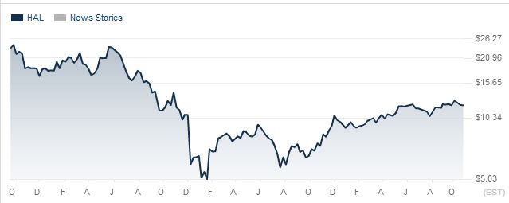
Halliburton Stock Price

Slide 54
Basic v. levinson presumption of reliance
If the stock trades in an efficient market,
Then the court presumes that the members of the class relied on the integrity of the market price, which incorporates all material, publicly available information
Do not have to prove each member of the class had “eyeball reliance”

Slide 55
Basic reliance:
“In Basic, Inc. v. Levinson, we held that investors could satisfy this reliance requirement by invoking a presumption that the price of stock traded in an efficient market reflects all public material information – including material misstatements. In such a case, we concluded, anyone who buys or sells the stock at the market price may be considered to have relied on those misstatements.”

Slide 56
Halliburton I
Motion to Certify the Class
Motion for Summary Judgment
Complaint Filed in Halliburton
Motion to Dismiss
Trial

Slide 57
(a) Prerequisites. One or more members of a class may sue or be sued as representative parties on behalf of all members only if:
(1) the class is so numerous that joinder of all members is impracticable;
(2) there are questions of law or fact common to the class;
(3) the claims or defenses of the representative parties are typical of the claims or defenses of the class; and
(4) the representative parties will fairly and adequately protect the interests of the class.
(b) Types of Class Actions. A class action may be maintained if Rule 23(a) is satisfied and if:
(3) the court finds that the questions of law or fact common to class members predominate over any questions affecting only individual members, and that a class action is superior to other available methods for fairly and efficiently adjudicating the controversy.
If no Basic presumption of reliance,
Then every member of the class will have different
“eyeball reliance” facts

Slide 58
Class certification
N.D. Tex. – must prove loss causation at the class certification state in order to get Basic presumption
Plaintiffs had not established a connection between losses and misstatements (they have the burden)

Slide 59
Halliburton i
Appeal of Class Certification
Denial
DENIED
Motion to Certify the Class
Motion for Summary Judgment
Complaint Filed in Halliburton
Motion to Dismiss
Trial

Slide 60
Halliburton i
Appeal of Class Certification
Denial
5th Circuit
Upholds Denial of Class Certification
DENIED
Motion to Certify the Class
Motion for Summary Judgment
Complaint Filed in Halliburton
Motion to Dismiss
Trial

Slide 61
Halliburton i
Appeal of Class Certification
Denial
5th Circuit
Upholds Denial of Class Certification
SCOTUS REVERSES & REMANDS
DENIED
Motion to Certify the Class
Motion for Summary Judgment
Complaint Filed in Halliburton
Motion to Dismiss
Trial

Slide 62
Why would defendants want plaintiffs to have to prove loss causation at class certification?

Slide 63
Event Study?
Motion to Certify the Class
Appeal of Class Certification
SETTLEMENT VALUE
Motion for Summary Judgment
Complaint Filed
Motion to Dismiss
Trial
Appeal of MTD

Slide 64
Halliburton ii
Appeal of Class Certification
Denial
5th Circuit
Upholds Denial of Class Certification
SCOTUS REVERSES & REMANDS
DENIED
Motion to Certify the Class
Motion for Summary Judgment
Complaint Filed in Halliburton
Motion to Dismiss
Trial
Motion to Certify the Class

Slide 65
Halliburton ii
Appeal of Class Certification
Denial
5th Circuit
Upholds Denial of Class Certification
SCOTUS REVERSES & REMANDS
DENIED
Motion to Certify the Class
Motion for Summary Judgment
Complaint Filed in Halliburton
Motion to Dismiss
Trial
Motion to Certify the Class
reliance

Slide 66
Class certification
Halliburton Defendants argue – Without Basic presumption, common issues of law and fact do not predominate surrounding RELIANCE
So, Defendants should be able to rebut the presumption of reliance at CLASS CERTIFICATION

Slide 67
reliance
Basic v. Levinson – no need for “eyeball” reliance if shares of the issuer are traded in an “efficient market”
The alleged misrepresentations were publicly known
They were material
The stock traded in an efficient market
The plaintiffs traded the stock between the misrepresentation and the reveal
Cammer factors –
Trading volume
Market cap
Analyst coverage
Multiple market makers
“cause and effect relationship between unexpected corporate events or financial releases and an immediate response in the stock price.”
Is there an efficient market for this stock?

Slide 68
What about section 11 IPO claims?

Slide 69
Halliburton Ii (2014): can defendants rebut the Basic Presumption at the class certification stage?
Basic presumption: Presumption of reliance based on the efficient capital market hypothesis (ECMH) – the price of stock traded in an efficient market reflects all public, material information – including material misstatements
Basic also holds: a defendant can rebut the presumption, including that the misrepresentation did not affect the stock’s price (no “price impact”)
Defendants argue that they should be able to rebut this presumption at class certification
Defendants want to show no price impact – False Statements were not Incorporated into Stock Price!

Slide 70
So. . . .
Can’t force plaintiffs to prove materiality at class certification (with event study)
Can’t force plaintiffs to prove loss causation at class certification (with event study)
Can you force plaintiffs to prove “price impact” to get the Basic presumption at class certification? (with event study)

Slide 71
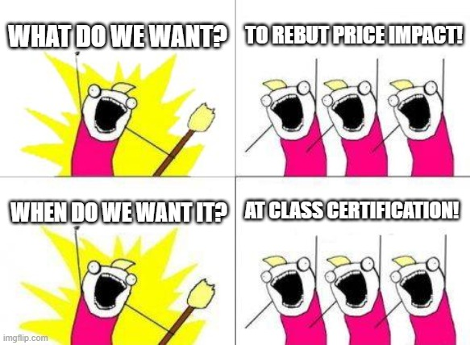
Halliburton ii – new argument against class certification
If no Basic presumption, then the class cannot be certified because individual facts (eyeball reliance) will predominate

Slide 72
Halliburton ii
Appeal of Class Certification
Denial
5th Circuit
Upholds Denial of Class Certification
SCOTUS REVERSES & REMANDS
DENIED
Motion to Certify the Class
Motion for Summary Judgment
Complaint Filed in Halliburton
Motion to Dismiss
Trial
granted
Motion to Certify the Class

Slide 73
Halliburton ii
Appeal of Class Certification
Denial
5th Circuit
Upholds Denial of Class Certification
SCOTUS REVERSES & REMANDS
DENIED
Motion to Certify the Class
Motion for Summary Judgment
Complaint Filed in Halliburton
Motion to Dismiss
Trial
granted
Motion to Certify the Class
5th Circuit
Upholds Class Certification
Appeal of Class Certification
Denial
SCOTUS

Slide 74
If so, then plaintiffs would always have to prove direct reliance (no more class actions)
Did not see this coming --

Slide 75
If so, then plaintiffs would always have to prove direct reliance (no more class actions)
Did not see this coming --
Because the market for publicly-held stocks is not efficient.

Slide 76
If so, then plaintiffs would always have to prove direct reliance (no more class actions)
Did not see this coming --
WHAT?
Because the market for publicly-held stocks is not efficient.

Slide 77
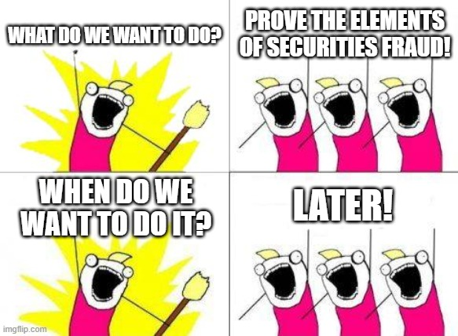
Note:
Halliburton is not about what plaintiffs eventually have to prove
Halliburton is about when the plaintiffs have to prove it

Slide 78
Motion to Certify the Class
Appeal of Class Certification
SETTLEMENT VALUE
Motion for Summary Judgment
Complaint Filed
Motion to Dismiss
Trial
Appeal of MTD

Slide 79
How could the court overrule Basic?
Defendants would have to prove that U.S. capital markets are not efficient or that investors do not rely on the efficiency of the market when investing
i.e., investors purchase at price X, not because they think the “market value” is X, but because they think that the market is inefficient and the value is X+Y (or X-Y).

Slide 80
Is the capital market efficient?
Halliburton
SCOTUS
Efficiency is not a toggle – efficiency is a spectrum
“overwhelming empirical evidence now suggests that capital markets are not fundamentally efficient”
Many investors do not invest in reliance on “price integrity” – try to get undervalued stocks, etc., computer algorithms, program trades
Basic does not rest on a binary view of efficiency
Basic merely posits that capital markets are generally efficient and that most investors rely on price integrity

Slide 81
Second question presented
Reliance/ Fraud on the Market:
The alleged misrepresentations were publicly known
They were material
The stock traded in an efficient market (price impact)
The plaintiffs traded the stock between the misrepresentation and the reveal
Plaintiffs have the burden of proving this at the “merits stage”
Defendants may rebut this at “merits stage”
Petitioners: Plaintiffs should have to prove not market efficiency, but price impact at class certification
In the alternative, Defendants should be able to rebut the presumption at class certification with evidence of no market impact

Slide 82
Halliburton ii compromises
Fraud on the Market:
The alleged misrepresentations were publicly known
They were material
The stock traded in an efficient market
The plaintiffs traded the stock between the misrepresentation and the reveal
Defendant can rebut at class certification
Defendant cannot rebut
at class certification
Defendant can rebut at class certification
BUT, Plaintiff does not have the burden to prove price impact (FOTM) at the Class Certification stage.

Slide 83
How does that work?
Trading volume, market cap, analyst coverage, multiple market makers, and “cause and effect relationship between unexpected corporate events or financial releases and an immediate response in the stock price.”
The stock traded in an efficient market
Plaintiff must establish with “Cammer” factors
Defendant can rebut at class certification
With evidence of “no price impact”

Slide 84
Does this all sound familiar?
Form S-1
WSJ

Slide 85
Market test: price impact(Basic presumption) materiality loss causation
Price impact
Loss causation & Materiality

Slide 86
10b-5 Plaintiffs Must Prove & when & how
Material Misrepresentation (MTD)
Scienter (MTD)
Reliance -- Do not need to prove “eyeball reliance”
Can invoke Fraud-on-the-market theory
Trade timing (plaintiff shows at class cert)
Market efficiency (defendant can rebut at class cert)
Publicity (defendant can rebut at class cert)
Materiality (plaintiff has burden at MTD)

Slide 87
10b-5 Plaintiffs Must Prove & When & HOW
Material Misrepresentation (MTD)
Scienter (MTD)
Reliance (mixed, merits & class cert.)
Loss Causation (MTD)
Event study
Halliburton I: Plaintiffs do not need to establish loss causation to receive the Basic presumption at class certification
Plaintiffs have burden at MTD

Slide 88
10b-5 Plaintiffs Must Prove & When & HOW
Material Misrepresentation (MTD)
Scienter (MTD)
Reliance (mixed, merits & class cert.)
Loss Causation (MTD)

Slide 89
The rest of the story
$100M settlement (before summary judgment determination)
$33M attorney’s fees
$100,000 Lead Plaintiff award

Slide 90
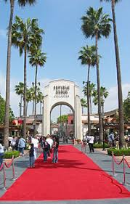
In re Vivendi Universal, S.A. Securities Regulation

Slide 91
Restructuring!

Slide 92
currently!

Slide 93
In re Vivendi Universal, S.A. Securities Regulation

Slide 94
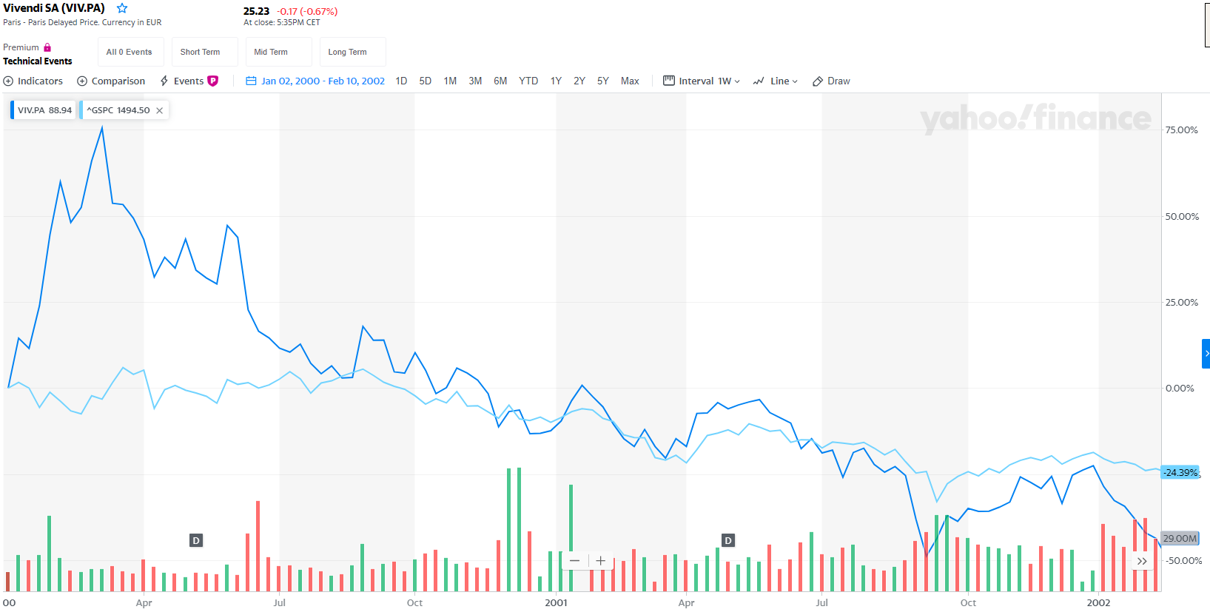
In re Vivendi, S.A. Securities Regulation

Slide 95
Price impact
Can Defendants rebut “price impact” by showing that the stock price did not go up when the false positive statements were made?

Slide 96
In re Vivendi, S.A. Securities Regulation

Slide 97
False statements may just maintain an artificially high price

