Slide 1
Last Day!!

Slide 2
After newman
A. The corporate insider was entrusted with a fiduciary duty
B. The corporate insider breached his fiduciary duty by (a) disclosing confidential information to a tippee (b) in exchange for a personal benefit
C. The tippee knew of the tipper’s breach: he knew the information was confidential and knew about the personal benefit
D. The tippee still used that information to trade in a security or tip another individual for personal benefit.

Slide 3
Salman v. united states (U.S. 2016)
Healthcare
Investment
Information
Maher
Kara
Michael
Kara
Salman
Notes:
5. According to the Salman court, did the government need to establish that Maher Kara had the potential to gain from his disclosure?
Answer – No. According to the Supreme Court, a gift of information to a relative or friend to enable them to trade is sufficient to show a personal benefit under Dirks. The Court rejects the government’s proposed standard that any disclosure of confidential information lacking a corporate purpose should be presumed to be a gift under Dirks, but the relationship between Maher and Michael Kara easily fell with the standards set forth in Dirks.

Slide 4
Salman v. U.S. (2016)
Justice Alito’s insider trading
1. “A Tippee acquires the Tipper’s duty to disclose or abstain from trading if the tippee knows the information was disclosed in breach of the tipper’s duty.”
2. “A tipper breaches such a fiduciary duty when the tipper discloses the inside information for a personal benefit.”
3. “A jury can infer a personal benefit – and thus a breach of the tipper’s duty – where the tipper receives something of value in exchange for the tip or makes a gift of confidential information to a trading relative or friend.”

Slide 5
Salmon v. U.S. (2016)
Justice Alito’s insider trading
1. “A Tippee acquires the Tipper’s duty to disclose or abstain from trading if the tippee knows the information was disclosed in breach of the tipper’s duty.”
2. “A tipper breaches such a fiduciary duty when the tipper discloses the inside information for a personal benefit.”
3. “A jury can infer a personal benefit – and thus a breach of the tipper’s duty – where the tipper receives something of value in exchange for the tip or makes a gift of confidential information to a trading relative or friend.”

Slide 6
What is a personal benefit?
Does a tipper have to expect something of tangible value in return?
Even if the tip is to a family member or friend?
Who is a “friend”?
Notes:
1. What counts as a personal benefit after Salman? What is excluded?
Answer – Salman leaves undisturbed the portion of the personal benefit test that includes a quid pro quo arrangement. It clarifies that a gift to a family member or friend also counts as a personal benefit, without any additional requirement that the tipper expect to receive a pecuniary or other valuable benefit from the relationship. The rationale of the Court relied on the analogy of the insider engaging in insider trading and then making a gift of the cash proceeds to a relative or friend. This rationale does not apply to non-relatives and non-friends. Although the government argued that a gift of information to anyone—regardless of the relationship—for noncorporate purposes should count as a personal benefit to the tipper, the Court did not accept this view of gifts in Salman.
Left unresolved by Salman is how close the family relationship or friendship needs to be. Does your second cousin count? A co-worker or other acquaintance? These are the issues raised by Newman which the Court did not have occasion to address in Salman because of the close relationship between Maher Kara and his brother Michael.

Slide 7
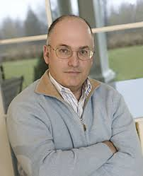


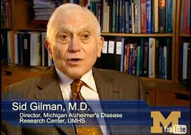
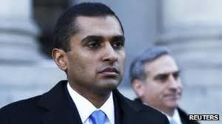
U.S. v. Martoma
Bapineuzumab

Slide 8
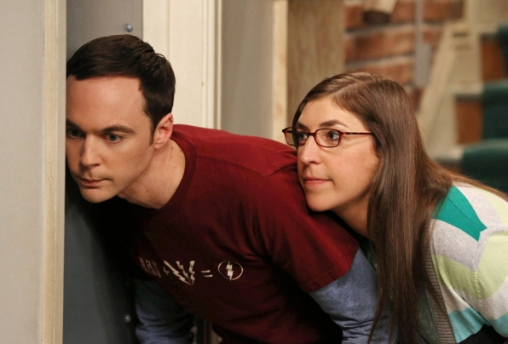
What about eavesdroppers?

Slide 9


Slide 10
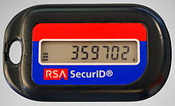

Slide 11
Misappropriation Theory
Notes:
“Misappropriation” theory applies when information that is subject to a fiduciary duty of confidentiality is used for trading in securities without disclosing to the source of the information that the information is being used for trading. Classical insider trading theory focuses on trades by an insider of a company in that company’s shares, misappropriation deals with outsider trading. As such, the misappropriation theory has the potential to reach a much wider variety of trades and traders.
Not all informational advantages may be worthwhile. The benefit from allowing informational advantages in the market is that it gives people an incentive to produce information and incorporate into stock market price. The cost is that informational advantages will scare away uninformed investors – particularly if they cannot reproduce benefit with own effort (or through a mutual fund) – or at least cause them to discount securities.
What does the law say about misappropriation – how does the Court shoehorn it into Rule 10b-5 doctrine? To understand this we need to remember that a Rule 10b-5 violation requires, among other things, (1) a deceptive practice (2) in connection with the purchase or sale of securities.
3. How does the doctrine square with justifiable versus non-justifiable information advantages in the market. Because after all, what most care about is the health of the capital market and its investors – not necessarily the source of the information. Some puzzles in the doctrine will then appear (e.g., (a) what if source gives the trader the OK to make trades?; (b) what if outright theft from the source – but no fiduciary duty violation; (c) what if fiduciary duty violation – but open and vocal about this violation to the source – the brazen misappropriator.

Slide 12
Misappropriation Theory
$4.3m
Dorsey &
Whitney LLP
Grand
Met
tender offer
confidential
deception
tender offer
public
call options
stocks
O’Hagan
Pillsbury
Notes:
United States v. O’Hagan, (US 1997) (Ginsburg, J.)
O’Hagan was a litigation partner at the Dorsey & Whitney law firm. Grand Met had retained Dorsey & Whitney as counsel for a takeover attempt of the Pillsbury Company. O’Hagan (who was not working directly on the deal) learned about the takeover attempt and purchased both Pillsbury call options (more than any other investor) and Pillsbury stock. Jury convicted O’Hagan for insider trading under Rule 10b-5 (as well as for violation of Rule 14e-3). The Eighth Circuit reversed.

Slide 13
Is O’Hagan an insider?
Is o’hagan a tippee?

Slide 15
Misappropriation Theory
Why did the government choose not to pursue O’Hagan under the classical theory of insider trading set forth in Chiarella and Dirks?
Notes:
Questions
1. Why did the Justice Department choose not to pursue O’Hagan under the classical theory of insider trading set forth in Chiarella and Dirks?
Answer – O’Hagan does not owe a fiduciary duty to the shareholders of Pillsbury (the target company). Therefore, the SEC in O’Hagan needed to find another, unrelated fiduciary duty (owed to O’Hagan’s law firm and its clients) pursuant to the misappropriation theory. Instructors may wish to point out the large expansion of the scope of Rule 10b-5 insider trading prohibition posed under the misappropriation theory. Seemingly any fiduciary duty – even if unconnected with the securities markets or trading in the markets – may qualify under the misappropriation theory.

Slide 16
Misappropriation Theory
What if O’Hagan had told Grand Met and his law firm before the acquisition was announced that that he planned to buy Pillsbury options?
Notes:
2. What if O’Hagan had told Grand Met and his law firm before the acquisition was announced that he planned to buy Pillsbury options?
Answer – This is the case of the brazen misappropriator. Rule 10b-5 requires deception. So the brazen misappropriator is free and clear of Rule 10b-5 liability. (Although Rule 14e-3 still applies). Because the misappropriation theory keys on deception in the breach of a duty to disclose to the source of the information the information available to shareholders is irrelevant. Does this make sense? Instructors may also wish to ask what result if Grand Met authorizes O’Hagan to get as “much as he can” from trades in Pillsbury stock prior to the acquisition (at least under Rule 10b-5). Same result; no Rule 10b-5 liability.
Question – If O’Hagan had disclosed would Grand Met have been likely to give its consent?
Answer – No. Grand Met would have faced a much higher price for its tender offer if it had authorized trading by its lawyers in advance. The market price would rise in the face of heavy buying volume.

Slide 17
Misappropriation Theory
What if O’Hagan had told Grand Met and his law firm before the acquisition was announced that that he planned to buy Pillsbury options?
Brazen Tippee
Notes:
2. What if O’Hagan had told Grand Met and his law firm before the acquisition was announced that he planned to buy Pillsbury options?
Answer – This is the case of the brazen misappropriator. Rule 10b-5 requires deception. So the brazen misappropriator is free and clear of Rule 10b-5 liability. (Although Rule 14e-3 still applies). Because the misappropriation theory keys on deception in the breach of a duty to disclose to the source of the information the information available to shareholders is irrelevant. Does this make sense? Instructors may also wish to ask what result if Grand Met authorizes O’Hagan to get as “much as he can” from trades in Pillsbury stock prior to the acquisition (at least under Rule 10b-5). Same result; no Rule 10b-5 liability.
Question – If O’Hagan had disclosed would Grand Met have been likely to give its consent?
Answer – No. Grand Met would have faced a much higher price for its tender offer if it had authorized trading by its lawyers in advance. The market price would rise in the face of heavy buying volume.

Slide 18
SEC v. rocklage
CUBIST
PHARMACEUTICALS
Mrs.
Rocklage
Rocklage
CEO
Sold
Cubist
Shares
$$$
Brother
Failed Clinical Trial
Notes:
Mr. Rocklage was the Chairman and CEO of Cubist Pharmaceuticals. His wife was not an employee of the company. Mr. Rocklage learned that one of the company’s drugs had failed its clinical trial and told his wife about the failure while making clear that the information was to be kept confidential. (Mr. Rocklage had routinely shared non-public material information with his wife with the shared expectation and understanding that the information would be kept confidential). Mrs. Rocklage passed along the information to her brother who traded on the information (and Mrs. Rocklage knew or had reason to know about the trades). Mrs. Rocklage’s deception allowed her to receive the non-public, material information from Mr. Rocklage. Before passing the information along to her brother, Mrs. Rocklage informed her husband that she was going to tip her brother; her brother then sold his shares in Cubist before any public announcement of the drug trial failure.

Slide 19
Rule 10b5-2
A duty of trust or confidence arises, in addition to other circumstances, whenever:
  a person agrees to maintain information in confidence;
  persons sharing confidence have a history, pattern, or practice of sharing confidences such that the recipient of material non-public information knows or reasonably should know that the person communicating the information expects that the recipient will maintain its confidentiality; or
  a person receives or obtains material non-public information from a spouse, parent, child, or sibling, unless the recipient can demonstrate that, under the facts and circumstances of that family relationship, no duty of trust or confidence existed.
Notes:
4. How does Rule 10b5-2(b)(3) apply here?
Answer – It essentially creates a fiduciary relationship among family members. Moreover, in this case Mrs. Rocklage has agreed to maintain the information from Mr. Rocklage in confidence.

Slide 20
Misappropriation Theory
Why was Mrs. Rocklage’s disclosure to her husband of her intention to tip her brother relevant to the court’s decision?
Notes:
Questions
1. Why was Mrs. Rocklage’s disclosure to her husband of her intention to tip her brother relevant to the court’s decision?
Answer – According to O’Hagan, disclosure eliminates the possibility of deception. On its face, this seems to have put Mrs. Rocklage in the clear.

Slide 21
Misappropriation Theory
What was the SEC’s theory of deception?
Notes:
2. What was the SEC’s theory of deception?
Answer – The SEC argues that Mrs. Rocklage deceived her husband at the time she obtained the information, and that this deception was not undone by her later disclosure that she was going to tip her brother. The SEC’s position was that disclosure of the breach of duty to the source must occur in a manner that allows the source to take remedial action in preventing the unauthorized use of information. Here the disclosure to Mr. Rocklage occurred right before the New Year’s holiday and the marital relationship made it unlikely that Mr. Rocklage would attempt to stop Mrs. Rocklage from tipping her brother.
The court rejected the SEC’s position on the importance of the remedy. One can wonder whether the lack of a remedy really is important to the deception requirement; the O’Hagan Court seemed to recognize that the post-remedy disclosure might be ineffective. If we look back to Santa Fe, the presence (or lack) of a remedy for minority shareholders for a fiduciary duty breach is not important to the Supreme Court’s ruling. Instead, what is important is the requirement of deception that the Court found in the statutory language of § 10(b). The SEC’s focus on the existence of a remedy therefore does not seem consistent with the Supreme Court’s Santa Fe rationale.

Slide 22
Deception?
DISCLOSURE
Mrs.
Rocklage
Deception?
Rocklage
CEO
Brother
Notes:
Mr. Rocklage was the Chairman and CEO of Cubist Pharmaceuticals. His wife was not an employee of the company. Mr. Rocklage learned that one of the company’s drugs had failed its clinical trial and told his wife about the failure while making clear that the information was to be kept confidential. (Mr. Rocklage had routinely shared non-public material information with his wife with the shared expectation and understanding that the information would be kept confidential). Mrs. Rocklage passed along the information to her brother who traded on the information (and Mrs. Rocklage knew or had reason to know about the trades). Mrs. Rocklage’s deception allowed her to receive the non-public, material information from Mr. Rocklage. Before passing the information along to her brother, Mrs. Rocklage informed her husband that she was going to tip her brother; her brother then sold his shares in Cubist before any public announcement of the drug trial failure.

Slide 23



Sec v. cuban
Sold entire block of Mamma.com shares
1
3
CEO
Cuban
2
4
PIPE announced and
stock drops 8.5%
Notes:
SEC v. CUBAN, 620 F.3d 551 (5th Cir. 2010) Higginbotham, J.
Cuban was a large block shareholder of Mamma.com (with a 6.3% stake in Mamma.com shares). The CEO of Mamma.com told Cuban that he would share confidential information with Cuban if Cuban agreed to keep the information confidential. Cuban agreed and the CEO told Cuban that Mamma.com was planning a private placement of its publicly traded equity (a PIPE transaction) and asked if Cuban would like to invest. Cuban became upset and told the CEO that he was not going to invest and moreover said: "Well, now I'm screwed. I can't sell." Cuban then asked to see the terms and conditions of the private placement and Mamma.com arranged for Cuban to obtain the terms and conditions. Cuban also learned that the PIPE was being sold at a discount to the market price along with other incentives (that would have the effect of diluting Cuban and the existing shareholders). Upon learning this additional confidential information, Cuban immediately ordered his broker to sell his entire stake in Mamma.com. Shortly thereafter, Mamma.com publicly announced its PIPE offering and its stock price fell 8.5% the same day and declined a total of 39% over the next week. By selling pre-public disclosure, Cuban avoided over $750,000 in losses.
The district court dismissed the SEC's complaint because it found that "the complaint asserts no facts that reasonably suggest that the CEO intended to obtain from Cuban an agreement to refrain from trading on the information as opposed to an agreement merely to keep it confidential." Without an agreement to keep the information confidential, Cuban – who owed no fiduciary duty to the CEO or to Mamma.com – would be free to trade on the PIPE offering information.

Slide 24
Is Cuban a core insider?
“large minority stakeholder” – 6.3%

Slide 25
Misappropriation Theory
Why does it matter whether Cuban agreed not to trade based on confidential information? Isn't it enough that Cuban agreed not to tell others of the confidential information he obtained from Mamma.com?
Notes:
Answer – The SEC alleges Rule 10b-5 illegal insider trading under the misappropriation theory. Cuban owes no fiduciary duty to the CEO of Mamma.com or Mamma.com itself. If Cuban had agreed to keep information obtained from the CEO or Mamma.com confidential with respect to the trading of Mamma.com securities, he would have entered into a relationship of trust and confidence with the CEO or Mamma.com. By trading while in the possession of non-public, material information obtained from the CEO or Mamma.com, Cuban would then violate duty and thus be considered deceptive for purposes of Rule 10b-5. Without a relationship of trust and confidence then Rule 10b-5 would not apply to Cuban (justifying a court to grant Cuban's motion to dismiss).
The Cuban case poses the question of what it means to enter into a duty of trust or confidence for purposes of Rule 10b-5. Is merely agreeing not to tell others enough to trigger a corresponding duty not to trade? Or does someone also need to agree expressly not to trade on the confidential information?

Slide 26
Rule 10b5-2(b)(1)
A duty of trust or confidence arises, in addition to other circumstances, whenever:
  a person agrees to maintain information in confidence;
  persons sharing confidence have a history, pattern, or practice of sharing confidences such that the recipient of material non-public information knows or reasonably should know that the person communicating the information expects that the recipient will maintain its confidentiality; or
  a person receives or obtains material non-public information from a spouse, parent, child, or sibling, unless the recipient can demonstrate that, under the facts and circumstances of that family relationship, no duty of trust or confidence existed.
Notes:
SEC argues that agreement to maintain in confidence is sufficient.

Slide 27

What about the brazen thief?
Purchased
$41,670.90 of
IMS put options
SEC v. Dorozhko
IMS Health
Dorozhko
(the “hacker”)
Account opened earlier the same month and never used
Notes:
SEC v. DOROZHKO, 574 F.3d 42 (2d Cir. 2009) Cabranes J.
Early in October 2007, a computer hacker (Dorozhko) opened an online trading account with Interactive Brokers LLC and deposited $42,500 into the account. On October 17, the hacker then hacked into the computers of IMS Health, Inc. and illicitly obtained non-public, material information on IMS's earnings (showing that IMS's earnings were disappointing). The hacker --who previously had not used the online trading account--then proceeded to purchase $41,670.90 worth of IMS "put" options also on October 17. The volume of put options purchases represented 90% of all purchases of put options in IMS stock for the six weeks prior to October 17. The put options, according to the SEC, were "extremely risky" -- representing a bet by the defendant that within the next two-days IMS's stock price would decline by greater than 20%. After the market close on October 17, IMS announced its disappointing earnings that were below expectations on Wall Street. The next trading day, IMS's stock price immediately dropped 28% and the hacker sold all of his options for a net profit of over $286,000.

Slide 28
Sec v. Dorozhko
Dorozhko is not a core insider.
Dorozhko is not a temporary insider.
Dorozhko does not “misappropriate” the information because he does not breach a fiduciary duty.
Dorozhko is not a tippee.
Is Dorozhko “deceptive”?
Notes:
Answer - The court characterizes Dorozhko as possibly involving an affirmative misrepresentation. This allows the court to avoid the problem that non-disclosure requires a breach of a duty to disclosure that is absent in this case (such a duty typically comes from a pre-existing fiduciary duty or other duty of trust or confidence that Dorozhko lacks).

Slide 29
Is there a misrepresentation if Dorozhko merely enters a false account ID and password into IMS's automated computer servers even if no person ever sees the ID or password?
Notes:
Answer – The court states that: "In our view, misrepresenting one's identity in order to gain access to information that is otherwise off limits, and then stealing that information is plainly "deceptive" within the ordinary meaning of the word." If Dorozhko had put on a disguise and conned his way into IMS's corporate offices by representing that he was in fact an SEC official, this misrepresentation would presumably count as an "affirmative misrepresentation" for purposes of Rule 10b-5. What the court is unclear on, however, is whether "exploiting a weakness in an electronic code to gain unauthorized access is 'deceptive,' rather than being mere theft." Can an inanimate object be deceived?

Slide 30
Would Dorozhko have violated Rule 10b-5 if he had simply picked the locks of IMS's corporate headquarters at night and stolen the information?
Notes:
Answer – The court's theory of an affirmative misrepresentation turns on the existence of a misrepresentation to IMS (or more accurately IMS's computer servers). But this rationale does not apply to the burglar who does not try to con his way into the corporate headquarters but instead just breaks in–what the court calls a "mere theft." Likewise, if the computer hacker had physically stolen IMS's hard drives and then cracked their encryption this would also be a "mere theft." Why should this distinction matter? As discussed in the answer to Question 2 above, from a policy perspective, it is unclear why the presence of an affirmative misrepresentation should matter. One response to this policy argument is that the Second Circuit in Dorozhko is mirroring the rationale of O'Hagan in connecting a deception to the source (in this case a misrepresentation) to a securities transaction even though the deception does not directly affect those who trade in the securities markets.

Slide 31
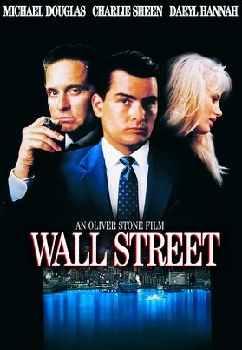

Slide 32
Steve Rogers and Bucky Barnes design a line of jewelry made of a rare metal, vibranium. They purchase vibranium from the King of a small African country for this purpose. The jewelry is very popular on Etsy, creating revenues of over $25 million in 2018. The company, Brooklyn Bling, headquartered in New York, would like to expand into other lines, such as fine watches and tiaras, but that means outside capital. Steve and Bucky come to you to give them legal advice on how to raise additional capital. You find out during discussions that on November 11, 2019, the company sold $7 million of common stock to 26 investors, mostly friends from the army. Steve and Bucky offered the shares on a Facebook page for veterans. Which of the following statements is the most accurate?
The 2019 offering could qualify as an exempt offering under Rule 504 if the conditions of 502 were met.
The 2019 offering could qualify as an exempt offering under Rule 147 as long as all purchasers were from New York.
The 2019 offering could qualify as an exempt offering under Rule 147 as long as all purchasers were from New York and Brooklyn Bling is incorporated in New York.
The 2019 offering could qualify under 144A as long as all purchasers were accredited investors.
None of the above.
A
B
C
D
E

Slide 33
Steve and Bucky want to go ahead and raise $25 million in 2020. They ask you to give them advice on an initial public offering for Brooklyn Bling (“BB”). Which of the following statements is the most accurate?
An IPO may be the most cost-effective way for BB to raise $25 million.
In considering an IPO, BB should know that the legal, accounting, and investment banking fees for a crowdfunding campaign would be the same, and they could raise just as much capital.
In considering an IPO, BB should know that because they are an emerging growth company, some of the accounting and disclosure burdens would be reduced, for up to five years.
An IPO subjects an issuer to liability for false misstatements and omissions in the prospectus under Rule 11.
An IPO is often inevitable if an issuer has more than 500 shareholders and must therefore comply with the disclosure requirements of a public company anyway.
A
B
C
D
E

Slide 34
Citigroup, N.A., an extremely large international bank, purchased $200 million worth of Exxon Corporation bonds in a Rule 144A transaction. Exxon has registered common shares and preferred shares. A few months later, Citigroup begins to rethink its investment following an Exxon pipeline oil spill that drained into a residential neighborhood in Arkansas. Which of the following statements is the most accurate?
Citigroup may resell the bonds at any time because they are unrestricted.
Citigroup may resell the bonds at any time because Citigroup qualifies as a “Qualified Institution Buyer.”
Citigroup may resell the bonds at any time to accredited investors under 4(a)(7).
Citigroup may resell the bonds twelve months after purchasing.
(c) and (d).
A
B
C
D
E

Slide 35
Investors in Sunrun Inc.’s IPO filed a lawsuit alleging misstatements in the “Industry Overview” section of the registration statement regarding the profitability of solar units under state law subsidies that had already been modified by state legislatures at the time of the IPO. Which of the following statements is the most correct regarding this lawsuit?
Investors will need to prove that the statements about the subsidies were incorrect when the registration statement was declared effective.
Investors will need to prove that the statements about the subsidies were incorrect when the registration statement was declared effective and that the defendants knew that the statements were incorrect.
To successfully sue the accounting firm, investors will need to prove that the accountants ignored red flags when reviewing the “Industry Overview” section.
To successfully sue the underwriters, investors will need to prove that the underwriters were “primary actors” in the fraudulent misstatement.
(a) and (d).
A
B
C
D
E

Slide 36
Carol Danvers, a pilot in the Air Force, would like to borrow money from her local bank, Pegasus Bank, to make some renovations on some old planes. She is signing papers to borrow $500,000 for two years when she notices she is asked to sign a “Promissory Note.” Carol remembers from law school that “notes” are listed in Section 2(a)(1) of the Securities Act of 1933. Which of the following statements is most correct?
Carol’s note is not a security under the Reves “family resemblance” test.
Carol’s note is not a security under the Howey test.
Carol’s note is a security, so Pegasus Bank should register the note or find an exemption.
Carol’s note is a security, but it is exempt under Section 3.
None of the above.

Slide 37
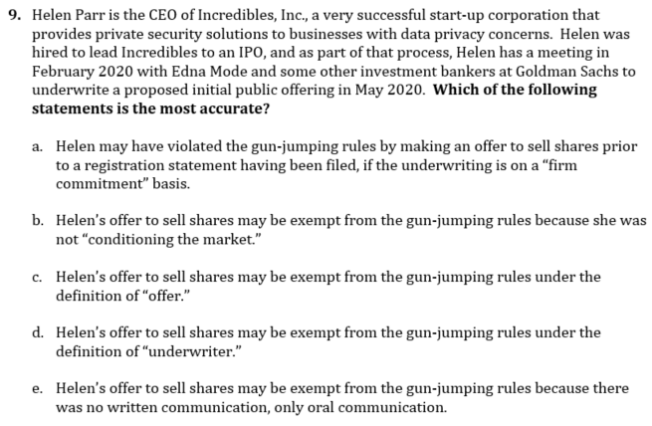

Slide 38
