Slide 1
351 Problems
Problem Set #3

Slide 2
Section 358
SUBSTITUTE BASIS
Gain recognized
boot
Shareholder’s basis
In stock received

Slide 3
wash
Section 358
SUBSTITUTE BASIS
Gain recognized
boot
Shareholder’s basis
In stock received

Slide 4
Section 362
SUBSTITUTE BASIS
Shareholder’s
Gain recognized
Corporation’s basis
In property received

Slide 5
Built-in Losses
Section 362 (e) – if aggregate built-in loss
Section 362(e)(2) – Corporation’s aggregate adjusted bases of the property transferred shall not exceed the FMV of such property
Section 362(e)(2)(c) – election to adjust shareholder’s stock basis instead.

Slide 6
Boot Example
Alex contributes property to CorpM with Basis of 40/FMV of 100. Receives shares worth $90 plus $10 cash.
Built-in Gain? $60 (Realized Gain)
Recognized Gain? $10 (not in excess of BOOT $10)

Slide 7
Boot Example -- Basis
Alex’s basis in the CorpM stock:
Substitute Basis – Boot + Gain Recognized
$40 - $10 + $10 = $40
How does that preserve $50 remaining built-in gain and not double-count $10 recognized gain?

Slide 8
Alex’s CorpM stock is worth $90.
40B/90FMV – built-in gain of $50

Slide 9
CorpM’s Basis?
Substitute Basis + Gain Recognized by Sh’der
$40 + $10 = $50
Property is worth $100, so built-in gain of $50
We preserve the gain
TWICE

Slide 10
Loss Example
Alex’s property has FMV of $100 but Basis of $125. (built-in loss of $25)
Receives $90 worth of stock and $10 cash in 351 contribution.

Slide 11
What do you recognize?
GAIN TO THE EXTENT OF THE BOOT

Slide 12
What do you recognize?
GAIN TO THE EXTENT OF THE BOOT

Slide 13
No Loss Recognized
Alex’s Basis? (358)
Substitute Basis – BOOT + Gain Recognized
$125-10 + 0 = $115
Stock is worth $90 – built-in loss of $25

Slide 14
Do we preserve the loss
OR
ONCE
TWICE

Slide 15
Do we preserve the loss
OR
ONCE
But where?
TWICE

Slide 16
Default Rule:
Preserve the loss in shareholder’s basis in her shares

Slide 17
Normally – Corporation’s Basis in Property Received (362)

Slide 18
If an AGGREGATE BUILT-IN LOSS
Section 362(e)(2) – if the transferee’s aggregate basis in the property transferred by a given transferor in a section 351 transaction exceeds the aggregate fair market value of such property immediately after the transaction, then the transferee’s basis must be reduced by the excess.
CorpM’s Basis = $100 ($125 – 25)
SUBSTITUTE BASIS
Gain recognized
Excess basis

Slide 19
But, wait!
Section 362(e)(2)(c) -- can elect to have transferor’s basis reduced to FMV instead
Shareholder’s Basis in Shares = $100
Corporation’s Basis in Property = $125
ONCE

Slide 20
Other Issues: Multiple Properties
Each property is treated separately for purposes of:
Allocating BOOT
Determining gain (no loss)
Corporation’s basis in each property is calculated separately (Carryover + Gain Recog)

Slide 21
Multiple Properties: Shareholder Basis
Shareholder’s Basis in shares determined on an aggregate, not asset-by-asset basis. All stock has the same basis.
However, each share of stock may have a split holding period
Aggregate carryover basis – BOOT + Gain Recognized

Slide 22
Rev. Rul. 68-55
 | FMV/B | Built-in G/L | % FMV | % BOOT | Gain Recognized
Capital Asset (>6 mo.) | $22FMV/ $40B | ($18) | 20% | $2 | $0
Capital Asset (<6 mo.) | $33FMV/ $20B | $13 | 30% | $3 | $3
1245 Asset (ord. income) | $55FMV 25B | $30 | 50% | $5 | $5
Total Basis | $85 |  |  | Total Gain | $8
Total FMV | $110
X transfers three assets in return for stock worth $100 and $10 cash (BOOT).
X’s basis in Y stock is AGGREGATE BASIS – BOOT + GAIN (85 – 10 + 8 = 83)

Slide 23
Problem Set #3, Question #1
FMV = $1000
Amy
Land $200 cash
Basis = $900 $800 worth stock (100% FMV = $1000 X stock)
FMV = $800
ACR

Slide 24
Problem Set #3, Question #1
Basis= $130
FMV = $100
Amy
Land $200 cash
Basis = $900 $800 worth stock (100% FMV = $1000 X stock)
FMV = $90
ACR

Slide 25
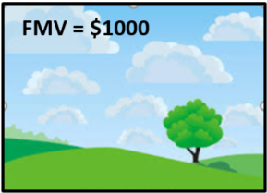
Question #1, Cont’d
Gain or Loss realized by Amy?
Gain or loss realized = amount realized – basis
Amount realized = $200 cash + $800 fmv stock = $1000
Basis in Land = $900
Gain realized = $1000 - $900 = $100
Gain or Loss recognized by Amy?
Lesser of: (i) gain realized or (ii) boot
Lesser of: (i) $100 or (ii) $200 cash
→ $100

Slide 26
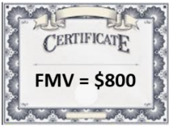
Question 1: Basis?
Amy’s basis in stock?
Basis –BOOT + Gain Recognized
$900 – 200 + 100 = $800
(Stock is worth $800, so no deferred gain – recognized 100% of gain)
Corporation’s Basis in land -- $900 + 100 = $1000

Slide 27
Basis Rules
Section 358 – Shareholder/Transferor
Section 362 – Corporation/Transferee

Slide 28
Question #2
Amy
Land $200 cash
Basis = $700 $800 worth stock (100% FMV = $1000 X stock)
ACR

Slide 29
Question #2, Cont’d
Gain or Loss realized by Amy?
Amount realized = $200 cash + $800 fmv stock = $1000
Basis in Land = $700
Gain realized = $1000 - $700 = $300
Gain or Loss recognized by Amy?
Lesser of: (i) gain realized or (ii) boot
Lesser of: (i) $300 or (ii) $200 cash
→ $200 gain

Slide 30
Question 2: Basis?
Amy’s basis in stock?
Basis –BOOT + Gain Recognized
$700 – 200 + 200 = $700
(Stock is worth $800, so $100 deferred gain )
Corporation’s Basis in land -- $700 + 200 = $900

Slide 31
Question #3
Amy
Land $200 cash
Basis = $1200 $800 worth stock (100% FMV = $1000 X stock)
ACR

Slide 32
Question #3, Cont’d
Gain or Loss realized by Amy? Amount realized = $200 cash + $800 fmv stock = $1000
Basis in Land = $1200
Loss realized = $1000 - $1200 = $200
Gain or Loss recognized by Amy?
None. No loss can be recognized even if there is boot.

Slide 33
Question 2: Basis?
Amy’s basis in stock?
$1200 - $200 = $1000
unless 362(2)(E) election (preserves $200 loss in $800 FMV stock)
Corp’s basis in land – FMV
1200 + 0 - 200

Slide 34
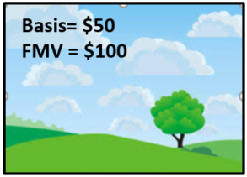
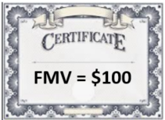
Question #4
Basis = $50
FMV = $100
Max and Evan, two individuals, form ME, Inc. a new entity treated as a corporation for tax purposes.
Max contributes land with a basis of $50 and a fair market value of $100.
Evan contributes equipment with a basis of $50 and a fair market value of $100.
Max receives 50 shares of newly issued voting common stock from ME, Inc. The stock is worth $100.
Evan receives 50 shares of newly issued NQPS from ME, Inc. The stock is worth $100.
NQPS

Slide 35
Question #4
Basis = $15
FMV = $10
Max and Evan, two individuals, form ME, Inc. a new entity treated as a corporation for tax purposes.
Max contributes land with a basis of $50 and a fair market value of $100.
Evan contributes equipment with a basis of $50 and a fair market value of $100.
Max receives 50 shares of newly issued voting common stock from ME, Inc. The stock is worth $100.
Evan receives 50 shares of newly issued NQPS from ME, Inc. The stock is worth $100.
NQPS

Slide 36
Results?
351 N/A to contribution by Evan because B receives solely NQPS. B recognizes $50 gain.
351(a) applies to Max and Max recognizes no gain. Control likely not a problem because Evan contributes qualifying property, so is in the control group, even though he receives disqualifying property for himself.

Slide 37
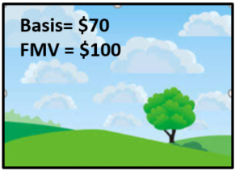
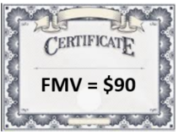
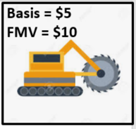
Question #5
Shrek
Land
FMV = $100
Basis = $70
Capital Asset
held 2 yrs
Stock (90% DW Stock)
FMV = $90
Equipment
FMV = $10
Dream’s basis = $5
Dreamworks

Slide 38
Question #5
(a) Gain or Loss Realized by Shrek?
Amount realized = $90 FMV stock + $10 FMV equipment = $100
Basis = $70
Gain realized = $100 - $70 = $30
(b) Gain or Loss Recognized by Shrek?
351(b) applies (property, in exchng for stock, control)
Gain recognized = lesser of $30 (gain realized) or $10 (FMV boot)
$10 gain recognized

Slide 39
Shrek’s Basis
(c) Basis in Dreamworks stock held by Shrek?
Basis in property contributed – cash and fmv other boot + gain recognized
= $70 - $10 + $10 = $70.
(e) Shrek’s basis in equipment?
$10 (FMV) per Section 358(a)(2)
If Shrek sold Dreamworks stock immediately, how much gain would Shrek recognize on sale?
$90 FMV - $70 basis = $20 (same as the amount of realized gain that was not recognized).

Slide 40
Question #5
(d) Shrek’s holding period in X stock?
2 years per 1223(1) because the land contributed was a capital asset
Significance of holding period?
If Shrek sold Dreamworks stock one day after acquiring it, treated like held it for 2 years → LTCG.

Slide 41
Question #5
Shrek
Land
FMV = $100
Basis = $70
Capital Asset
held 2 yrs
Stock (90% DW Stock)
FMV = $90
Equipment
FMV = $10
Dream’s basis = $5
Dreamworks

Slide 42
Question #5
(f) Gain or Loss, if any, recognized by Dreamworks?
None as a result of issuing stock per Section 1032
$5 gain as a result of distributing equipment (appreciated property) per Sections 351(f)/311 ($10k FMV, $5k basis).

Slide 43
Question #5
(a): $30 realized by Shrek
(b): $10 gain recognized by Shrek
(c): Shrek’s basis in stock is $70 (leaving $20 built-in gain in stock)
(e) Shrek’s basis in equipment is $10 (FMV)
(f): Dreamworks recognizes $5 gain with respect to equipment and no gain/loss as a result of issuing stock
(g) Dreamwork’s basis in the land?
$80 = B’s basis ($70) + $10 gain recognized by B.
Note: if land were sold by Dreamworks for $100 (FMV) → $20 gain by Dreamworks (same as Shrek’s realized but unrecognized gain in land).

Slide 44
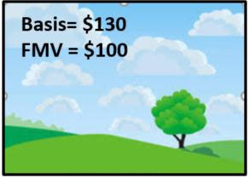
Question #6
Shrek
Land
FMV = $100
Basis = $130
Capital Asset
held 2 yrs
Stock (90% DW Stock)
FMV = $90
Equipment
FMV = $10
Dream’s basis = $5
Dreamworks

Slide 45
Question #6, Cont’d
Gain or loss realized by Shrek?
$30 loss realized by Shrek
Gain or loss recognized by Shrek?
None
Shrek’s basis in stock?
$130 basis in land - $10 boot = $120 (leaving $30 built-in loss in stock)
Shrek’s basis in equipment?
$10 (FMV)
Dreamworks’ gain or loss recognized?
$5 gain with respect to equipment and no gain/loss as a result of issuing stock
Dreamworks’ basis in the land?
Would be $130 without special rule and that would exceed FMV → reduce by the excess basis to FMV ($100).

Slide 46
Question #6, Cont’d
 | Shrek’s Basis in Stock | FMV Stock | Dreamwork’s Basis in Land | FMV Land
If 362(e)(2) were not in the Code at all | $120 | $90 | $130 | $100
Given that 362(e)(2) is in the code | B’s Basis in Stock | FMV Stock | Corporation’s Basis in Land | FMV Land
No Election under 362(e)(2)(C) | $120 | $90 | $100 | $100
Yes Election under 362(e)(2)(C) | $90 | $90 | $130 | $100

Slide 47
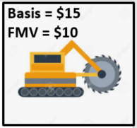
Question #7
Shrek
Land
FMV = $100
Basis = $70
Capital Asset
held 2 yrs
Stock (90% DW Stock)
FMV = $90
Equipment
FMV = $10
Dream’s basis = $15
Dreamworks

Slide 48
Question #7
Gain or Loss, if any, recognized by Dreamworks?
None as a result of issuing stock per Section 1032
None as a result of distributing equipment per Sections 351(f)/311, since no loss is recognized.
Shrek’s basis in equipment?
$10 (FMV) per Section 358(a)(2)
Note: $5 loss is not recognized by Dreamworks and will never be recognized because if Shrek sold for $10 → no loss.

Slide 49
Duplication of Gains
If Shrek sold his/her stock → $20 tax gain (plus earlier $10).
If Shrek sold land → $30 tax gain
→ The $20 realized but unrecognized gain is duplicated.
Is 351 non-recognition of gain a good thing for shareholders?
Deferral as long as corporation holds asset and shareholder holds stock for a while before selling.

Slide 50
Question #8
 |  | Transfers to FC |  | Receives from FC
 |  | Basis | FMV | Shares (# and FMV) | Cash
 | Leia – cash | - | $10 | 10 | 0
 | Luke- land (capital asset) | $50 | $80 | 80 | 0
 | Han – inventory | $1 | $10 | 5 | $5
 | Ben – building (capital asset) | $15 | $10 | 5 | $5
Leia’s gain or loss realized/ gain or loss recognized?
None realized. Cash’s basis is always FMV. None recognized.

Slide 51
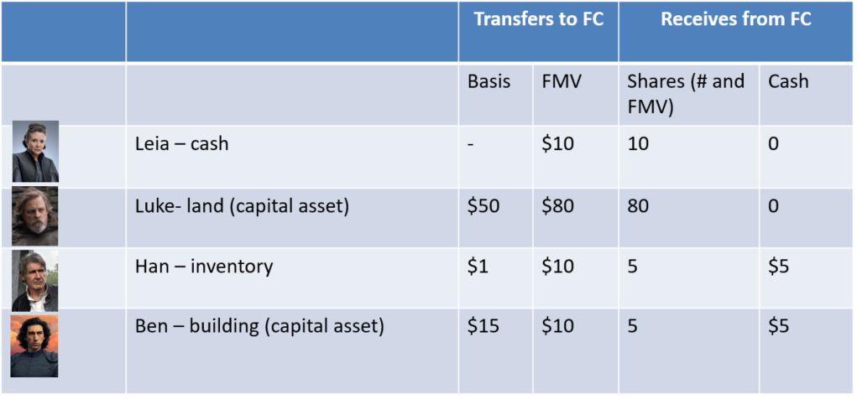
Question #8
Leia’s basis in stock?
$10.

Slide 52
Question #8
Luke’s gain or loss realized?
$30 gain realized = $80 amount realized - $50 basis in land

Slide 53
Question #8
Luke’s gain or loss recognized?
None. 351(a) applies since Luke contributes property, in exchange for stock, and together with other transferors, has control after. And there is no boot received by Luke.

Slide 54
Question #8
Luke’s basis in stock received?
$50. Basis in property contributed ($50) + gain recognized ($0) – money and FMV of other boot received ($0) = $50 per Section 358(a)(1).

Slide 55
Question #8
Han’s gain or loss realized?
$9 gain realized = $10 amount realized - $1 basis in inventory

Slide 56
Question #8
Han’s gain or loss recognized?
$5. 351(b) applies since Han contributes property, in exchange for stock, and together with other transferors, has control after. There is $5 boot received by Han and $9 gain realized → $5 is recognized.

Slide 57
Question #8
Han’s basis in stock received?
$1. Basis in property contributed ($1) + gain recognized ($5) – money and FMV of other boot received ($5) = $1 per Section 358(a)(1) → $4 built-in gain (same as amount realized but not recognized.

Slide 58
Question #8
Ben’s gain or loss realized?
$5 Loss = $10 amount realized - $15 basis in building

Slide 59
Question #8
Ben’s gain or loss recognized?
None. 351(b) applies since Ben contributes property, in exchange for stock, and together with other transferors, has control after. Ben receives boot but no loss is recognized under 351(b).

Slide 60
Question #8
Ben’s basis in stock received?
If there is NOT a 362(e)(2)(C) election: $10 per Section 358(a)(1). Basis in property contributed ($15) + gain recognized ($0) – money and FMV of other boot received ($5) = $10.
If there IS a 362(e)(2)(C) election: $5 (FMV of stock)

Slide 61
Question #8
Force Corp.’s gain or loss recognized?
None. None with respect to stock issued per Section 1032. And no non-cash boot distributed so no gain recognized per Section 311.

Slide 62
Question #8
Force Corp’s basis in land?
$50. Luke’s basis in land ($50) + gain recognized by Luke ($0) = $50 per Section 362(a).

Slide 63
Question #8
Force Corp.’s basis in inventory?
$6. Han’s basis in inventory ($1) + gain recognized by Han ($5) = $6 per Section 362(a).

Slide 64
Question #8
Force Corp.’s basis in building?
If there is NOT a 362(e)(2)(C) election: $10 (FMV) per Section 362(e)(2)(A).
If there IS a 362(e)(2)(C) election: Per Section 362(a): $15 (D’s basis) + $0 gain recognized by D.

Slide 65
Question #8
How do results change if Luke contributes services?
Luke is no longer in transferor group b/c Luke contributes no property. Without Luke, the transferors do not have control.
→ Section 351 does not apply to any of the contributions. Each shareholder recognizes all realized gain or loss. FMV basis in everything. Corporation still recognizes no gain or loss per Section 1032.

Slide 66
Question #8
351(a)/(b) does not apply to Luke’s contribution of services → Luke recognizes $60 compensation income
But 351(a)/(b) apply to contributions by Leia, Han and Ben and Luke’s contribution of building. Luke’s holdings should count since Luke puts in property and not relatively small compared to services

Slide 67
Question #8
Luke’s transfer takes place a year after transfers by A, C, and D.
→ same results as #8(a):
After Leia, Han and Ben contribute, they hold 20/20 shares.
After Luke contributes, Luke holds 80/100
→ All meet control and other requirements

Slide 68
Question #8
Ben’s transfer takes place a year after transfers by the others
→ Leia, Luke and Han’s contributions qualify. But, assuming Ben’s contribution is a separate transaction, does not qualify since Ben will only hold 5/100.

Slide 69
Question #8
Han’s transfer takes place a year after transfers by others. At time of Han’s transfer, Luke purchases 2 shares for $2.
→ Leia’s, Luke’s and Ben’s contributions qualify. But, assuming Han’s contribution is a separate transaction, does not qualify since Han, by himself, will only hold 5/100 and Luke’s contribution of $2 does not allow Luke to be counted because of accommodation transferor rules.

