Slide 1
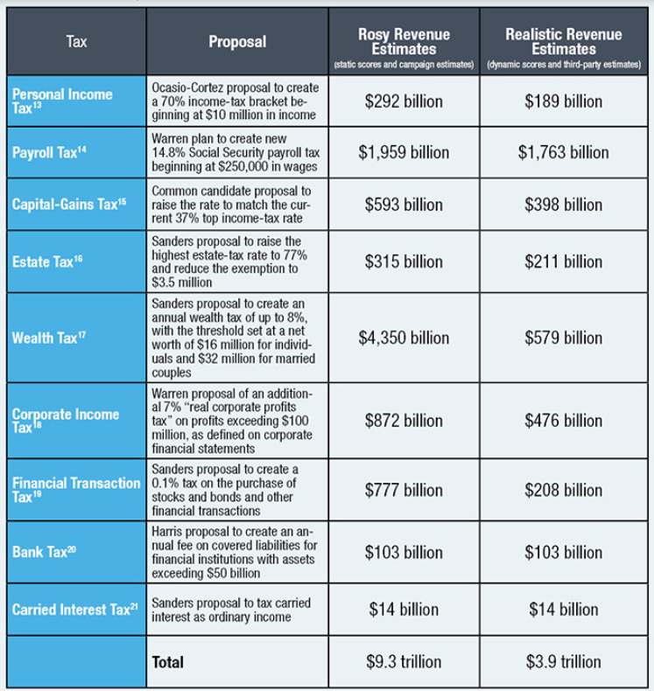

Slide 2
Redemptions
Problem Set #7

Slide 3
Question #2
Facts:
Abby and Ben are unrelated.
Before redemption:
A owns 2,500/5,000 shares of voting common stock
B owns 2,500/5,000 shares of voting common stock
(a) Xtra redeems 501 shares from Abby
(b) Xtra redeems 834 shares from Abby

Slide 4
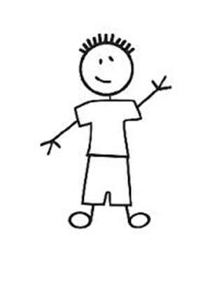
Question #2
A
50% (2500)
50%
(2500)
B
XtraCo
Redeems 501 shares
If X redeems 501 shares held by A will it be substantially disproportionate?
Before, A owned 50% (2500/5000)
Afterwards, A will own 1999/4499 = 44%

Slide 5
Question #2
A
50% (2500)
50%
(2500)
B
XtraCo.
Redeems 501 shares
1. Will Abby hold less than 50% TOTAL VOTING POWER?
2. Will Abby hold less than 80% of Beginning Percentage of Voting Stock?
3. Will Abby hold less than 80% of Beginning Percentage of Common Stock?

Slide 6
Less than 50% TVP?
Will own 1999/4499 (44%)
Less than 80% of Beginning Percentage of Voting Stock?
Will own 44%. Is 44% less than 80% of 50%?
80% of 50% is 40%. 44% is not less than 40%
OR, 44/50 = 88%. 88% is greater than 80%
Less than 80% of Beginning Percentage of Common Stock?
No. Same as Voting Stock.

Slide 7
Question #2(b)
If X redeems 834 shares held by Abby? will it be substantially disproportionate?
Less than 50% TOTAL VOTING POWER?
Will own 166/4166 = 39.99% Yes.
Less than 80% of Beginning Percentage of Voting Stock?
Will own 1666/4166 = 39.99%. Is 39.99% less than 80% of 50%?
80% of 50% is 40%. 39.99% is less than 40%
OR, 39.99/50 = 79.98%. 79.98% is less than 80%
Less than 80% of Beginning Percentage of Common Stock?
Yes. Same.

Slide 8
Question #3
A
5100 Voting Common
4900
Non-Voting Common
B
XtraCo.
Redeems 2000 shares
Less than 50% TOTAL VOTING POWER?
Yes -- ZERO
Less than 80% of Beginning Percentage of Voting Stock?
HMMM. (Zero to Zero)
Less than 80% of Beginning Percentage of Common Stock?
49% (4900/10,000) TO 36.25% (2900/8000)
36.25% is less than 80%(49%) = 39.2%
36.25/49 = 73.98% (less than 80%)

Slide 9
Question #3
A
5100 Voting Common
4900
Non-Voting Common
B
X Corp.
Redeems 2000 shares
Less than 80% of Beginning Percentage of Voting Stock?
HMMM.

Slide 10
What happens if shareholder owns no voting stock before or after and only nonvoting common stock or nonvoting preferred stock is redeemed?
The redemption cannot be substantially disproportionate under the rules
See Treas. Reg. Section 1.302-3(a) (“Section 302(b)(2) only applies to a redemption of voting stock or to a redemption of both voting stock and other stock. Section 302(b)(2) does not apply to the redemption solely of nonvoting stock (common or preferred)”)

Slide 11
Question #4
A
5100 Voting Common
4900
Voting Preferred
B
XtraCo.
Redeems 2000 shares
Less than 50% TOTAL VOTING POWER?
Less than 80% of Beginning Percentage of Voting Stock?
Less than 80% of Beginning Percentage of Common Stock?

Slide 12
Question #4
A
5100 Voting Common
4900
Voting Preferred
B
X Corp.
Redeems 2000 shares
Less than 50% TOTAL VOTING POWER?
Yes -- Started with 49%, now has 36.25%
Less than 80% of Beginning Percentage of Voting Stock?
Yes – Started with 49%, now has 36.25% (73.9%)
Less than 80% of Beginning Percentage of Common Stock?
HMMMM.

Slide 13
What happens if owns no common stock before or after and only voting preferred stock is redeemed?
This can work as long as the 50% and 80% test are met with respect to the voting preferred stock.
See Rev. Rul. 81-41 Example: Before redemption: A owns voting preferred stock that represents 49% of voting stock
After redemption: A owns voting preferred stock that represents 36% of voting stock
36% voting power < 50% → 50% test met
36%/49% = 73%,
which is less than 80% → 80% test met.
→ Is substantially disproportionate

Slide 14
Question #5
30 Shares NV Common
A
4 Shares Voting Common
6 Shares Voting Common
B
X Corp.
Redeems 3 Shares Voting
27 NonVoting
Less than 50% TOTAL VOTING POWER?
3/7 – Yes, (42.85%) less than 50%
Less than 80% of Beginning Percentage of Voting Stock?
Yes -- 6/10 (60%) to 3/7 (42.85%) = 71.42%
or, 80% of 60% is 48%; 42.85% is less than 48%
Less than 80% of Beginning Percentage of Common Stock?
Yes -- 36/40 (90%) to 6/10 (60%) = 66/67% (or, 80% of 90% = 72%)

Slide 15
Note: Multiple Classes of Common Stock
80% test with respect to all common stock?
If applied class by class, A fails because A holds 100% nonvoting common stock before and after.
However, the test is applied on an aggregate basis to all classes of common stock and by reference to fair market value.
% FMV common stock held by A before = 36/40 = 90%
% FMV common stock held by A after = 6/10 = 60%
60%/90% = 67% which is less than 80% (or 80% of 90 = 72%)
Thus 80% test is met.

Slide 16
Section 302(b)(2): Substantially Disproportionate: Cautionary Notes/Clarifications

Slide 17
Question #6
Facts:
XtraCo has outstanding 5000 shares voting common stock
Abby owns 2500 and Ben owns 2500
Xtra redeems 1000 shares from Abby for cash
One month later Xtra redeems 1000 shares from Ben for cash

Slide 18
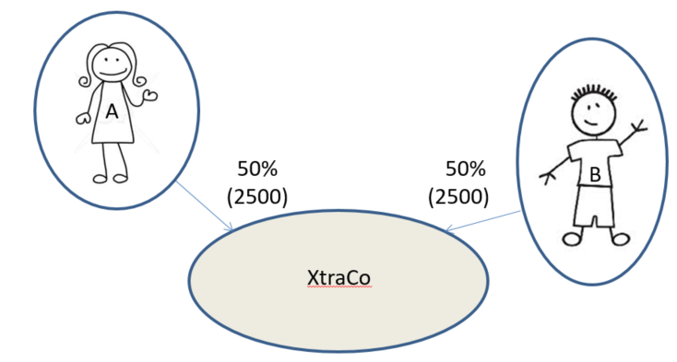
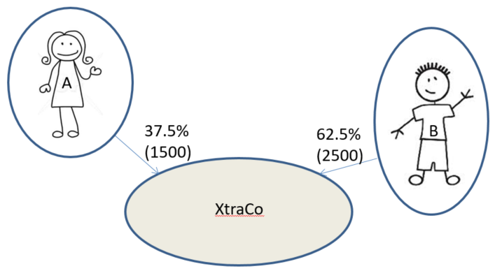
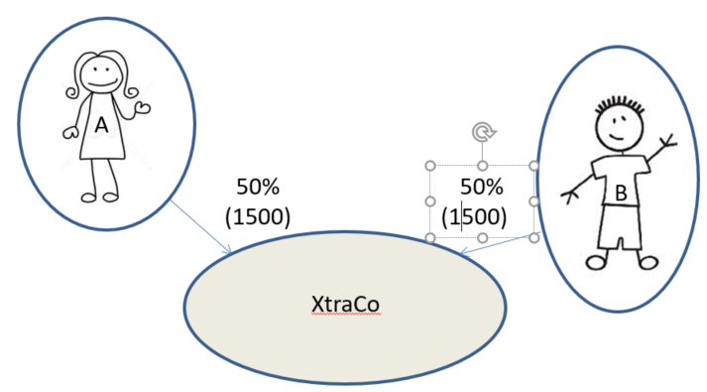

Slide 19
Part of a Plan??
Do the redemptions qualify as substantially disproportionate?
Not if they are part of a plan because then the before and after % for each shareholder is 50% (2500/5000 before vs. 1500/3000 after both redemptions) See 302(b)(2)(D)
If they are not part of a plan:
A’s qualifies (since A owns 1500/4000 = 37.5% immediately after and owned 50% before, so that A meets the 50% and 80% tests)
B’s does not since B owns 50% afterwards and thus does not meet the 50% test.

Slide 20
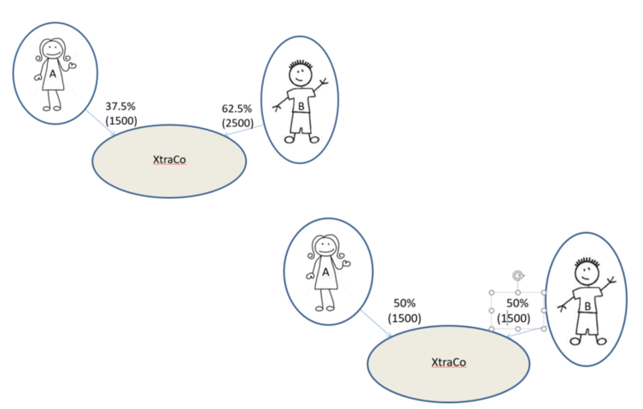
BUT!!!!

Slide 21
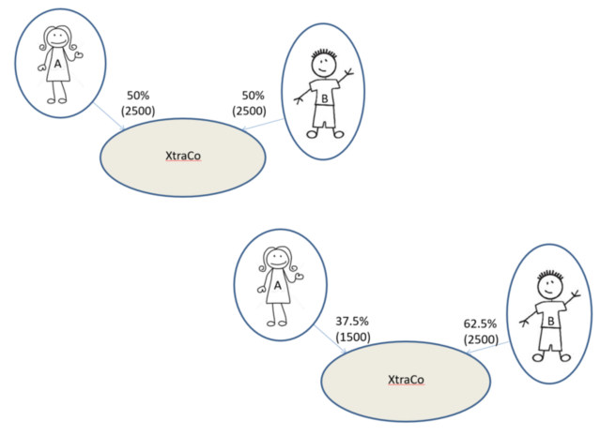
What if Abby and Ben were married?

Slide 22
Section 318 Attribution Rules!!!

Slide 23
318(a)(1)
An individual owns what certain family members own (directly or indirectly)
(a)(1) = FAMILY

Slide 24
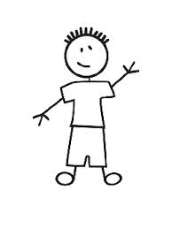
Section 318 (a)(1) Amy owns. . . .
Amy
What her
Spouse
Children
Grandchildren
Parents
Own
Directly or Indirectly
NOT What her
Siblings
Grandparents
Own

Slide 25
318(a)(2)
A taxpayer owns what its entities own (directly or indirectly)
(a)(2) = ENTITIES

Slide 26
Section 318 (a)(2)Amy owns
What her
Partnership
Trust
IN PROPORTION
What her
Corporation Owns
IN PROPORTION
IF Amy owns 50% or more of the Corporation
Owns
In proportion to ownership interest if Amy owns 50% or more of Corporation
In proportion to Amy’s p’ship interest
Partnership
In proportion to Amy’s beneficial interest
Corporation
Trust

Slide 27
Section 318 (a)(2): Amy owns. . .
8% of Z Corp (P’ship)
5% of Z Corp (Trust)
10.2% of Z Corp (Corp.)
40%
51%
Partnership
25%
Corporation
Amy Family Trust
20%
Z Corp
20%
20%
Z Corp
Z Corp

Slide 28
Section 318 (a)(2): Amy owns. . .
8% of Z Corp (P’ship)
5% of Z Corp (Trust)
0% of Z Corp (Corp.)
40%
49%
Partnership
25%
Corporation
Amy Family Trust
20%
Z Corp
20%
20%
Z Corp
Z Corp

Slide 29
318(a)(3)
An entity owns what its investors/beneficiaries own (directly or indirectly)
(a)(3) = INVESTORS and BENEFICIARIES

Slide 30
Section 318(a)(3): ABC P’ship owns stock owned directly or indirectly by a partner
From Amy: 10% XYZ Corp.
From Ben: 20% QRS Corp.
Ben
20%
80%
10%
20%
ABC P’ship
QRS Corp.
XYZ Corp.

Slide 31
Section 318(a)(3): ABC P’ship owns stock owned directly or indirectly by a partner
From Amy: 60% XYZ Corp.
AND 6% ABC Corp.
From Ben: 20% QRS Corp.
Ben
60%
20%
80%
20%
XYZ Corp.
ABC P’ship
10%
QRS Corp.
ABC
Corp.

Slide 32
Section 318(a)(3) Amy Family Trust owns stock owned directly or indirectly by a beneficiary
From Amy: 10% XYZ Corp.
From Ben: 20% QRS Corp.
Ben
80%
10%
20%
20%
Amy Family Trust
XYZ Corp.
QRS Corp.

Slide 33
Section 318(a)(3) Amy Family Trust owns stock owned directly or indirectly by a beneficiary
From Amy: 60% XYZ Corp. AND 6% ABC Corp.
From Ben: 20% QRS Corp.
Ben
60%
80%
20%
20%
XYZ Corp.
Amy Family Trust
10%
QRS Corp.
ABC
Corp.

Slide 34
Section 318(a)(3): AB Corp. owns stock owned directly or indirectly by any person who owns 50% or more
From Amy: 0% XYZ Corp.
From Ben: 20% QRS Corp.
Ben
80%
20%
10%
20%
AB Corp.
QRS Corp.
XYZ Corp.

Slide 35
Section 318(a)(3): AB Corp. owns stock owned directly or indirectly by any person who owns 50% or more
From Amy: 0% XYZ Corp.
From Ben: 80% QRS Corp.
AND 8% ABC Corp.
Ben
80%
80%
20%
QRS Corp.
10%
AB Corp.
10%
XYZ Corp.
ABC
Corp.
10%

Slide 36
Operating Rules: Family Constructive Ownership Rules 318(a)(1) not used again for 381(a)(1)
5%
Amy owns 20% of Z Corp.
Amy constructively owns 20%, plus 15%, plus 10%, plus 5% = 50%
Charles owns 15% of Z Corp.
Charles also constructively owns what Amy owns (20%), but not what Amy constructively owns (50%), and what Emma owns (10%) = 45%., but not what Emma constructively owns (15% + 20%).
Dan constructively owns 15%, plus 20% = 35%
15%
Z Corp
20%
Z Corp.
Amy
Charles
10%
Dan
Emma

Slide 37
Operating Rules: Stock constructively owned by entity by 318(a)(3) not used for 318(a)(2)
Ben
20%
80%
60%
ABC P’ship
XYZ Corp.
70%
60%
ABC constructively owns 60% of XYZ and 36% of DE
Ben owns 80% of what ABC owns, but not 80% of what ABC constructively owns from (a)(3)
Ben owns 56% of QRS; 44.8% of GH
Ben owns ZERO of XYZ and DE
QRS Corp.
DE, Inc.
80%
GH, Inc.

Slide 38
BUT, Stock owned by virtue of 318(a)(1) and (a)(2) is available for (a)(3)
Ben
20%
80%
40%
60%
ABC P’ship
XYZ Corp.
60%
70%
Amy owns 60% of XYZ directly and 40% constructively: 100%
ABC constructively owns 100% of XYZ and 60% of DE
DE, Inc.
QRS Corp.
80%
GH, Inc.

Slide 39
AND, 318(a)(1) can be waived in a 302(b)(3)
50%
50%
Father & Daughter, Inc.

Slide 40
Complete Termination of Interest Waiver -- 302(c)(2)
RETIRE!
50%
50%
Father & Daughter, Inc.

Slide 41
BUT. . . .302(c)(2)(A)
Must have “no interest in the corporation (including an interest as officer, director, or employee), other than an interest as a creditor
Must not “acquire any such interest within 10 years”
Must file an agreement to notify Treasury of (ii)

Slide 42
AND. . . .302(c)(2)(B) Game Over if. . .
Redeemed stock was acquired within 10 years from 318(a)(1) stockholder OR
Remaining 318(a)(1) stockholder holds stock acquired by redeeming taxpayer

Slide 43
Scenario One
I need cash!
I don’t have any cash?
100 shares
Father, Inc.

Slide 44
Scenario One
Here, take 50 shares of stock
50 shares
50 shares
Father, Inc.

Slide 45
Now redeem them in a 302(b)(3), with a family attribution waiver under 302(c)(2)
Wow! Cash!
50 shares
Father, Inc.
50 shares

Slide 46
Scenario One
No Waiver!
Now redeem them in a 302(b)(3), with a family attribution waiver under 302(c)(2)
Wow! Cash!
50 shares
Father, Inc.
50 shares

Slide 47
Scenario Two
I need a job!
I need cash!
100 shares
Father, Inc.

Slide 48
Scenario Two
Here, take 50 shares of stock
50 shares
50 shares
Father, Inc.

Slide 49
Now I’ll redeem my shares in a 302(b)(3), with a family attribution waiver under 302(c)(2)
Wow! I’m the CEO!
50 shares
Father, Inc.
50 shares

Slide 50
UNLESS: 318(c)(2)(B): The preceding sentence shall not apply if the acquisition or disposition by the distribute did not have as one of its principal purposes the avoidance of Federal income tax.
Wait, I’m still really the CEO.
50 shares
Father, Inc.
50 shares

Slide 51
Question #7
20% 80%
50%
A
B
P
What percentage of stock in XtraCo is considered to be owned by Partnership?
50%
X

Slide 52
Question #7
20% 80%
50%
A
B
P
P constructively owns 100% of X (through A)
50%
X

Slide 53
Question #7
20% 80%
50%
A
B
P
What percentage of XtraCo does Abby own?
50%
X

Slide 54
Question #7
A constructively owns 50 + (.20 x 50 = 10) = 60%
20% 80%
50%
A
B
P
50%
X

Slide 55
Question #7
20% 80%
50%
A
B
P
50%
What percentage of XtraCo does Ben own?
X

Slide 56
Question #7
A constructively owns 50 + (.20 x 50 = 10) = 60%
20% 80%
50%
A
B
B constructively owns (.80 x 50) = 40%
P
BUT, B does not constructively own 80% of what P constructively owns by virtue of 318 (a)(3) (100%)
50%
P constructively owns 100% of X (through A)
X

Slide 57
Attribution Rules: Example 2 of Operating Rules
B
P
10%
50%
X
50%
Y

Slide 58
Attribution Rules: Example 2 of Operating Rules
B
Is Y stock that was attributed from X to P attributed again from P to B?
Yes – 10% of it (2.5%)
P
10%
50%
X
25% Y Stock
By attribution from X
50%
Y

Slide 59
Example 3 of Operating Rules
B
30% 10%
50%
50%
Z
P
X
Y

Slide 60
Example 3 of Operating Rules
B
P constructively owns 30% Z stock
X constructively owns 30% Z stock
Y constructively owns 30% Z stock
30%
10%
Z
P
50%
30% Z stock
(attributed from B to P)
X
Is the 30% Z stock re-attributed from P to X?
Yes – and then again from X to Y
50%
Y

Slide 61
Question #8
child child
spouse
25% 25%
25% 25%
A
D
B
C
What percentage of X and Y does Alex own?
X
100%
Y

Slide 62
Question #8
A actually owns 25%
A constructively owns 25% from each child (50%)
The stock from D that is attributed to B is not reattributed to A
Total = 75%
child child
spouse
25% 25%
25% 25%
A
D
B
C
X
100%
Y

Slide 63
Question #8
How much X and Y stock does Casey own?
child child
spouse
25% 25%
25% 25%
A
D
B
C
X
100%
Y

Slide 64
Question #8
child child
spouse
25% 25%
25% 25%
C owns 25% directly and 25% from A (parent)
The stock attributed to A from B is not reattributed to C
Total = 50%
A
D
B
C
X
100%
Y

Slide 65
Question #8
child child
spouse
25% 25%
25% 25%
How much X and Y stock does Bella own?
A
D
B
C
X
100%
Y

Slide 66
Question #8
child child
spouse
25% 25%
25% 25%
B: Actually owns 25%, then 25% from spouse and 25% from parent = 75%
Does not own what A and C constructively own from each other.
A
D
B
C
X
100%
Y

Slide 67
Question #9
30% 50%
50%
How much of X does Y own?
How much of X does Z own?
A
X
Y
Z

Slide 68
Question #9
30% 50%
50%
Y owns 30% of X constructively (318(a)(3))
A
X
Y
Z

Slide 69
Question #9
30% 50%
50%
Z owns 30% of X constructively (318(a)(3))
A
X
Y
Z

Slide 70
Question 9(a)
30% 50%
40%
How much of X does Z own?
A
X
Y
Z

Slide 71
Question 9(a)
30% 50%
40%
A
How much of X does Z own?
ZERO
X
Y
Z

Slide 72
Question #9(b)
30% 50%
40%
A
How much of X does Z Partnership own?
X
Y
Z

Slide 73
Question #9(b)
30% 50%
40%
A
How much of X does Z Partnership own?
30%
X
Y
Z

Slide 74
Attribution Rules: Examples: Question #10
50%
30%
A
How much stock in Y is considered owned by A?
X
Y

Slide 75
Question #10
50%
30%
A
How much stock in Y is considered owned by A?
15%
X
Y

Slide 76
Question #10(a)
40%
30%
A
Now how much of Y stock does A own?
X
Y

Slide 77
Question #10(a)
40%
30%
A
Now how much of Y stock does A own?
ZERO
X
Y

Slide 78
Question #10(b)
40%
30%
How much stock in Y does A own by virtue of being a partner in A?
A
X
Y

Slide 79
Question #10(b)
40%
30%
How much stock in Y does A own by virtue of being a partner in A?
12% (40% of 30%)
A
X
Y

Slide 80
Attribution Rules Generally Operate to Make it Less Likely that a Redemption Qualifies as an Exchange: Question #11
Before Redemption: After Redemption:
50% 50%
60%
100%
100% Total: 20 +60
40% 100%
A
A
X
X
Y
Total: 50%
Y
Z
Z

Slide 81
Question #11
Does this qualify as substantially disproportionate?
No because fails 50% test. Likely not an exchange unless it can qualify under 302(b)(1) or 302(b)(4).
Without the attribution rules would this qualify as an exchange?
Yes, it would be a complete termination and also it would be substantially disproportionate (60% to 0%)

Slide 82
Sometimes the attribution rules can actually operate to make something treated as an exchange that otherwise would not be
Q12: (Redeem 23 of Husband’s shares and 2 of Wife’s shares)
Before Redemption After Redemption (from H and W)
spouse spouse
50% 40% 10% 66.66% 22.66% 10.66%
A
A
H
W
H
W
X
X

Slide 83
H owns 17/75 + 8/75 = 25/75
W owns 17/75 + 8/75 = 25/75
H owns: 40 + 10 = 50 % H owns 22.66 + 10.66 = 33.33%
W owns: 40 + 10 = 50% W owns 22.66 + 10.66 = 33.33%
spouse spouse
50% 40% 10% 66.66% 22.66% 10.66%
A
H
W
W
A
H
X
X

Slide 84
Without Section 318 Attribution Rules
H owns 17/75 = 22.67%
W owns 8/75 = 10.67%
H owns: 40 H went from 40% to 22.67%
W owns: 10 W went from 10% to 10.66%
spouse spouse
50% 40% 10% 66.66% 22.66% 10.66%
A
H
W
W
A
H
X
X

Slide 85
Basis: Example – Question #13
Before Redemption After Redemption
100% (100 shares) 100% (50 shares)
A
A
X
X

Slide 86
Basis: Example – Question #13
Is the redemption treated as a Section 301 distribution or a sale/exchange?
Not complete termination and not substantially disproportionate, so assuming it does not qualify under Sections 302(b)(1) or 302(b)(4), it is treated as a Section 301 distribution.
When the 50 shares are redeemed for $5000, X had $5000 of E&P and A’s basis in each of the 50 shares was $10. How much of the Section 301 distribution is treated as a dividend?
All $5000
What is A’s basis in the 50 shares A continues to hold?
See Treas. Reg. Section 1.302-2(c) and 1.302-2(c) Example 1.
50* 10 + 50* 10 = 1000 (A’s basis in the 50 shares that were redeemed should shift over to increase the basis in shares still outstanding)

Slide 87
Basis: Example – Question #13
If X had only $4800 of E&P at the time of the redemption, how much of the distribution would have been treated as a dividend?
$4800
What would A’s basis in the 50 shares A continued to hold be?
1000 – 200 = 800.

Slide 88
Where Does H’s Basis Go?: Question #14
Before Redemption After Redemption
spouse spouse
50% 50% 100%
H
W
H
W
X
X

Slide 89
Where Does H’s Basis Go?: Question #14
Before Redemption After Redemption
spouse spouse
50% 50% 100%
H
W
H
W
X
X
H’s Basis shifts to W’s Basis.
Treas. Reg. Section 1.302-2(c) and 1.302-2(c) Example 2.

Slide 90
Where does H’s Basis go now? Question #14(a)
Before Redemption After Redemption
spouse spouse
50% 50% 99%
H
W
H
W
1%
X
X

Slide 91
Where does H’s Basis go now? Question #14(a)
Before Redemption After Redemption
spouse spouse
50% 50% 99%
H
W
H
W
1%
X
X
The basis of the 49 shares would shift over to the one share of stock H continued to hold.
See Treas. Reg. Section 1.302-2(c) and 1.302-2(c) Ex 3

Slide 92
Question #14
If family attribution rules are not waived, is the redemption of stock held by H treated as a Section 301 distribution or a sale/exchange?
The redemption is not substantially disproportionate and, without waiver of family attribution rules, it is not a complete termination. Therefore, assuming it does not qualify under Sections 302(b)(1) or 302(b)(4), it will be treated as a Section 301 distribution.
X has $5000 of E&P. How much of the $5000 payment to H will be treated as a dividend?
All $5000.
What happens to H’s $100 basis in the shares that were redeemed?
It shifts over to increase W’s basis in the shares she holds in the corporation.
See What would have happened to the basis in stock redeemed from H if the facts were the same except that X redeemed 49 out of 50 shares held by H rather than 50?

