Slide 1
Securities regulation #4

Slide 2
SEC REARRANGING

Slide 3
SEC v. sg ltd.

Slide 4
“investment contract”
A person invests his/her money
In a common enterprise
Is led to expect profits
Solely from the efforts of others

Slide 5
What is a Ponzi scheme?

Slide 6
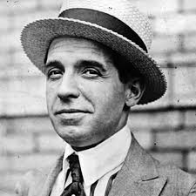
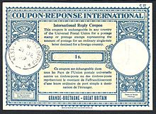
Carlo Ponzi

Slide 7
Ponzi scheme – securities?
Ponzi victims are often being sold “securities”
May be securities in company that is a sham
May be complex “investment” that is an “investment contract”
May be investment in an investment fund that is a sham
State law fraud claim
Federal securities fraud claim (unregistered securities, fraudulent statements)

Slide 8
Bernie Madoff

Slide 9
Traffic monsoon

Slide 10
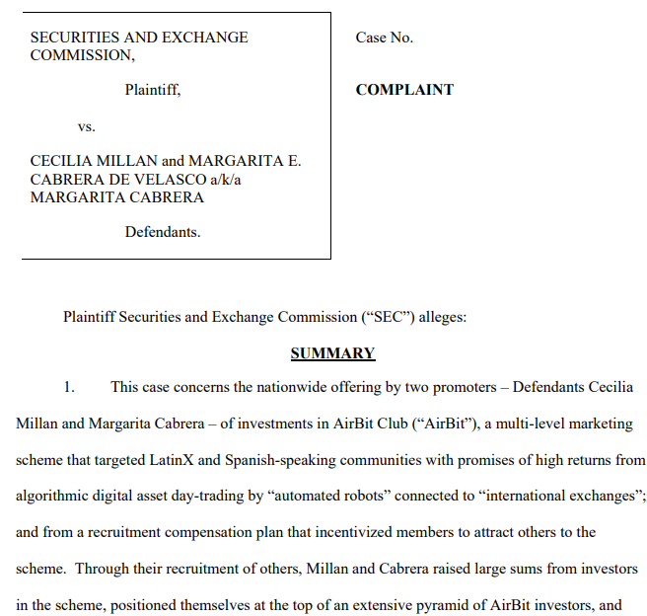

Slide 11
AFFINITY FRAUD

Slide 12
Daily lingo: DERIVATIVES, OPTIONS, SWAPS, ETC.

Slide 13
FORWARD CONTRACT FUTURES CONTRACT
Bidding to build house starting July 2021: how much is wood going to be July-October 2021?
Forward Contract: Lumberyard agrees to supply Builder with X amount of lumber for $Y during 2021.
(If price is greater than Y, Builder saves money. If price is lower than Y, Builder foregoes the bargain.)
Futures Contract: Buy a standardized contract for July Lumber at $Y on an exchange.
(If price is greater than Y, Builder can sell the contract for the difference. If price is less than Y, Builder will lose the bargain.)

Slide 14
FORWARD CONTRACT FUTURES CONTRACT
Lumber is not a security
Forwards/futures not a security
Commodity futures are regulated
Bidding to build house starting July 2021: how much is wood going to be July-October 2021?
Forward Contract: Lumberyard agrees to supply Builder with X amount of lumber for $Y during 2021.
(If price is greater than Y, Builder saves money. If price is lower than Y, Builder foregoes the bargain.)
Futures Contract: Buy a standardized contract for July Lumber at $Y on an exchange.
(If price is greater than Y, Builder can sell the contract for the difference. If price is less than Y, Builder will lose the bargain.)

Slide 15
Stock option
Call Option:
Option to buy Clorox stock at Date X at Price Y.
If price is more than Y at Date X, option holder will exercise, purchase at Y and sell at the higher market price
If price is less than Y, option holder will let the option expire and not exercise. Option holder is out the “option premium”
Put Option:
Option to sell Clorox stock at Date X at Price Y.
If price is more than Y at Date X, option holder will let the option expire and not exercise. Option holder is out the “option premium”
If price is less than Y, at Date X, option holder will exercise, sell at Y after purchase at the lower market price

Slide 16
“long” positions “short positions”
Call Option:
Option to buy Clorox stock at Date X at Price Y.
If price is more than Y at Date X, option holder will exercise, purchase at Y and sell at the higher market price
If price is less than Y, option holder will let the option expire and not exercise. Option holder is out the “option premium”
Put Option:
Option to sell Clorox stock at Date X at Price Y.
If price is more than Y at Date X, option holder will let the option expire and not exercise. Option holder is out the “option premium”
If price is less than Y, at Date X, option holder will exercise, sell at Y after purchase at the lower market price
LONG
YOU BENEFIT IF PRICE INCREASES
SHORT
YOU BENEFIT IF PRICE DECREASES

Slide 17
More!
Call Option
Seller of a put option
Put Option
Seller of a call option
Overlapping Call Option and Put Option (Straddle)
Contract to “swap” appreciation, interest, and/or dividends from two different securities or currencies

Slide 18
HEDGING V. SPECULATION
If the derivative reduces overall risk, it’s a hedge
If the derivative increases overall risk, it’s speculation

Slide 19
What is a security?
Section 2(a)(1) of the Securities Act of 1933:
The term ‘‘security’’ means any note, stock, treasury stock, security future, security-based swap, bond, debenture, evidence of indebtedness, certificate of interest or participation in any profit-sharing agreement, collateral-trust certificate, preorganization certificate or subscription, transferable share, investment contract, voting-trust certificate, certificate of deposit for a security, fractional undivided interest in oil, gas, or other mineral rights, any put, call, straddle, option, or privilege on any security, certificate of deposit, or group or index of securities (including any interest therein or based on the value thereof), or any put, call, straddle, option, or privilege entered into on a national securities exchange relating to foreign currency, or, in general, any interest or instrument commonly known as a ‘‘security’’, or any certificate of interest or participation in, temporary or interim certificate for, receipt for, guarantee of, or warrant or right to subscribe to or purchase, any of the foregoing.

Slide 20
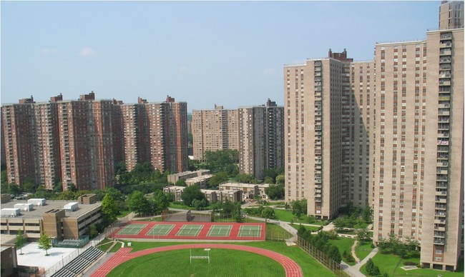
UNITED HOUSING FOUNDATION, INC. V. FORMAN

Slide 21
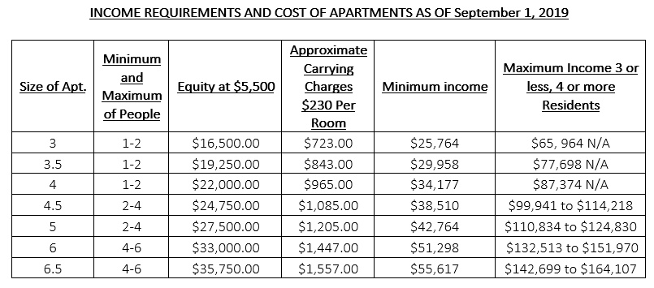

Slide 22
I thought plaintiffs purchased “shares of stock”

Slide 23
What is a security?
Section 2(a)(1) of the Securities Act of 1933:
The term ‘‘security’’ means any note, stock, treasury stock, security future, security-based swap, bond, debenture, evidence of indebtedness, certificate of interest or participation in any profit-sharing agreement, collateral-trust certificate, preorganization certificate or subscription, transferable share, investment contract, voting-trust certificate, certificate of deposit for a security, fractional undivided interest in oil, gas, or other mineral rights, any put, call, straddle, option, or privilege on any security, certificate of deposit, or group or index of securities (including any interest therein or based on the value thereof), or any put, call, straddle, option, or privilege entered into on a national securities exchange relating to foreign currency, or, in general, any interest or instrument commonly known as a ‘‘security’’, or any certificate of interest or participation in, temporary or interim certificate for, receipt for, guarantee of, or warrant or right to subscribe to or purchase, any of the foregoing.

Slide 24
Why did riverbay use the term “stock”?

Slide 25
What was the purpose of the payment?

Slide 26
Were these shares “investment contracts”?
Person invests money
In a common enterprise
With an expectation of profit
Solely from the efforts of others

Slide 28
WARFIELD V. ALANIZ
Charitable gift annuities

Slide 29
Were these annuities “investment contracts”?
Person invests money
In a common enterprise
With an expectation of profit
Solely from the efforts of others

Slide 30
SEC V. MERCHANT CAPITAL, LLC
What type of entity was the issuer here?

Slide 31
What is a general partnership?
Personal liability
Fiduciary duties
Right to co-manage
Ability to bind partnership
Vicarious liability in tort
Imputed Knowledge

Slide 32
What is a general partnership with an LLP election?
Personal liability
Fiduciary duties
Right to co-manage
Ability to bind partnership
Vicarious liability in tort
Imputed Knowledge

Slide 33
Because of the howey test. . . .
Person invests money
In a common enterprise
With an expectation of profit
Solely from the efforts of others

Slide 34
Which are securities?
General Partnerships Interest
Member-Managed LLC Interest
Limited Partnerships Interests
Manager-Managed LLC Interest

Slide 35
Limited liability partnerships?

Slide 36
Williamson test
(1) an agreement among the parties leaves so little power in the hands of the partner or venturer that the arrangement in fact distributes power as would a limited partnership; or
(2) the partner or venturer is so inexperienced and unknowledgeable in business affairs that he is incapable of intelligently exercising his partnership or venture powers; or
(3) the partner or venturer is so dependent on some unique entrepreneurial or managerial ability of the promoter or manager that he cannot replace the manager of the enterprise or otherwise exercise meaningful partnership or venture powers.

Slide 37
howey test
Person invests money
In a common enterprise
With an expectation of profit
Solely from the efforts of others
Williamson test for partnership/LLC interests

Slide 38
howey test
Person invests money
In a common enterprise
With an expectation of profit
Solely from the efforts of others
Williamson test for partnership/LLC interests

Slide 39
Is it in 2(a)(1)?

Slide 40
What is a security?
Section 2(a)(1) of the Securities Act of 1933:
The term ‘‘security’’ means any note, stock, treasury stock, security future, security-based swap, bond, debenture, evidence of indebtedness, certificate of interest or participation in any profit-sharing agreement, collateral-trust certificate, preorganization certificate or subscription, transferable share, investment contract, voting-trust certificate, certificate of deposit for a security, fractional undivided interest in oil, gas, or other mineral rights, any put, call, straddle, option, or privilege on any security, certificate of deposit, or group or index of securities (including any interest therein or based on the value thereof), or any put, call, straddle, option, or privilege entered into on a national securities exchange relating to foreign currency, or, in general, any interest or instrument commonly known as a ‘‘security’’, or any certificate of interest or participation in, temporary or interim certificate for, receipt for, guarantee of, or warrant or right to subscribe to or purchase, any of the foregoing.

Slide 41
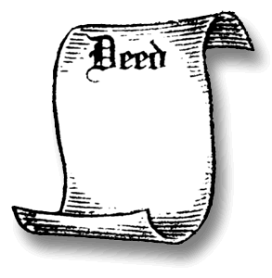
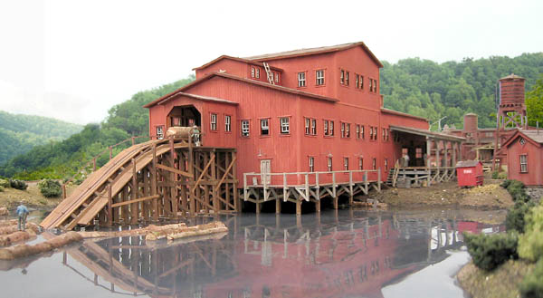
Difference?
100%
Sawmill, Inc.
Sawmill, Inc.

Slide 42
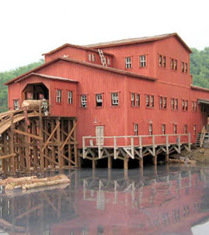
Difference?
100%
Sawmill, Inc.
10%
Sawmill, Inc.

Slide 43
Who is suing? Why?

Slide 44
B & D Co.
Landreth Timber Co.

Slide 45
85%
15%
X
B & D Co.
Landreth Timber Co.

Slide 47
Remember, Forman!
As we also recognized in Forman, the fact that instruments bear the label “stock” is not of itself sufficient to invoke the coverage of the Acts. Rather, we concluded that we must also determine whether those instruments possess “some of the significant characteristics typically associated with” stock, recognizing that when an instrument is both called “stock” and bears stock’s usual characteristics, “a purchaser justifiably [may] assume that the federal securities laws apply.”

Slide 48
What are the significant characteristics of “stock”?

Slide 49
What about Howey?
Person invests money
In a common enterprise
With an expectation of profit
Solely from the efforts of others

Slide 50
What about Howey?
Person invests money
In a common enterprise
With an expectation of profit
Solely from the efforts of others

Slide 51
2(a)(1) “stock” or Howey test for “investment contract”
Person invests money
In a common enterprise
With an expectation of profit
Solely from the efforts of others

Slide 52
Avenue Capital Management II, l.p. v. Schaden

Slide 53
What is a security?
Section 2(a)(1) of the Securities Act of 1933:
The term ‘‘security’’ means any note, stock, treasury stock, security future, security-based swap, bond, debenture, evidence of indebtedness, certificate of interest or participation in any profit-sharing agreement, collateral-trust certificate, preorganization certificate or subscription, transferable share, investment contract, voting-trust certificate, certificate of deposit for a security, fractional undivided interest in oil, gas, or other mineral rights, any put, call, straddle, option, or privilege on any security, certificate of deposit, or group or index of securities (including any interest therein or based on the value thereof), or any put, call, straddle, option, or privilege entered into on a national securities exchange relating to foreign currency, or, in general, any interest or instrument commonly known as a ‘‘security’’, or any certificate of interest or participation in, temporary or interim certificate for, receipt for, guarantee of, or warrant or right to subscribe to or purchase, any of the foregoing.

Slide 54
What’s going on?
DEBT
DEBT

Slide 55
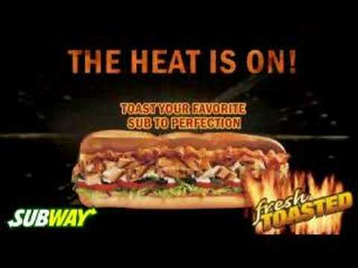

Slide 56
Restructuring!
EQUITY
EQUITY
LLC

Slide 57
Manager-managed llc investment contract?
Who manages Quiznos, LLC?

Slide 58
Manager-managed llc investment contract?
Who manages Quiznos, LLC?
Avenue/Fortress – 80% of the membership interests
Appoint 8/9 managers to Board of Managers
Board chooses CEO
Can dissolve LLC; can change to member-managed

Slide 59
howey test
Person invests money
In a common enterprise
With an expectation of profit
Solely from the efforts of others
Williamson test for partnership/LLC interests

Slide 60
What are Avenue/Fortress complaining about?
They run the company!
Fraudulent statements that induced them to purchase the LLC interests

Slide 61
Interesting questions
If Quiznos was a corporation and Avenue/Fortress received “stock”? (Landreth)

Slide 62
Interesting questions
Fortress only owned 10%; could only appoint one manager
Are Fortress’ LLC interests a security?
Any other arguments?

Slide 63
What is a security?
Section 2(a)(1) of the Securities Act of 1933:
The term ‘‘security’’ means any note, stock, treasury stock, security future, security-based swap, bond, debenture, evidence of indebtedness, certificate of interest or participation in any profit-sharing agreement, collateral-trust certificate, preorganization certificate or subscription, transferable share, investment contract, voting-trust certificate, certificate of deposit for a security, fractional undivided interest in oil, gas, or other mineral rights, any put, call, straddle, option, or privilege on any security, certificate of deposit, or group or index of securities (including any interest therein or based on the value thereof), or any put, call, straddle, option, or privilege entered into on a national securities exchange relating to foreign currency, or, in general, any interest or instrument commonly known as a ‘‘security’’, or any certificate of interest or participation in, temporary or interim certificate for, receipt for, guarantee of, or warrant or right to subscribe to or purchase, any of the foregoing.

