Slide 1
Securities regulation #9

Slide 2
Section 3(a)(11) Intrastate offerings
Exempt Securities:
(11) Any security which is a part of an issue offered and sold only to persons resident within a single State or Territory, where the issuer of such security is a person resident and doing business within or, if a corporation, incorporated by and doing business within, such State or Territory.

Slide 3
Securities act release no. 4434
3(a)(11) – applies to Local Financing
Same state: incorporation, doing business, offered to residents
“part of an issue” offered or sold
“come to rest”

Slide 4
“come to rest” “part of an issue”
3(a)(11)
Unrestricted resale
ISSUER

Slide 5
“come to rest” “part of an issue”
COLO. ISSUER
3(a)(11)
UTAH ISSUER
ARIZ. ISSUER

Slide 6
“come to rest” “part of an issue”
COLO. ISSUER
UTAH ISSUER
ARIZ. ISSUER

Slide 7
Busch v. carpenter
Come to Rest?
Doing Business?

Slide 8
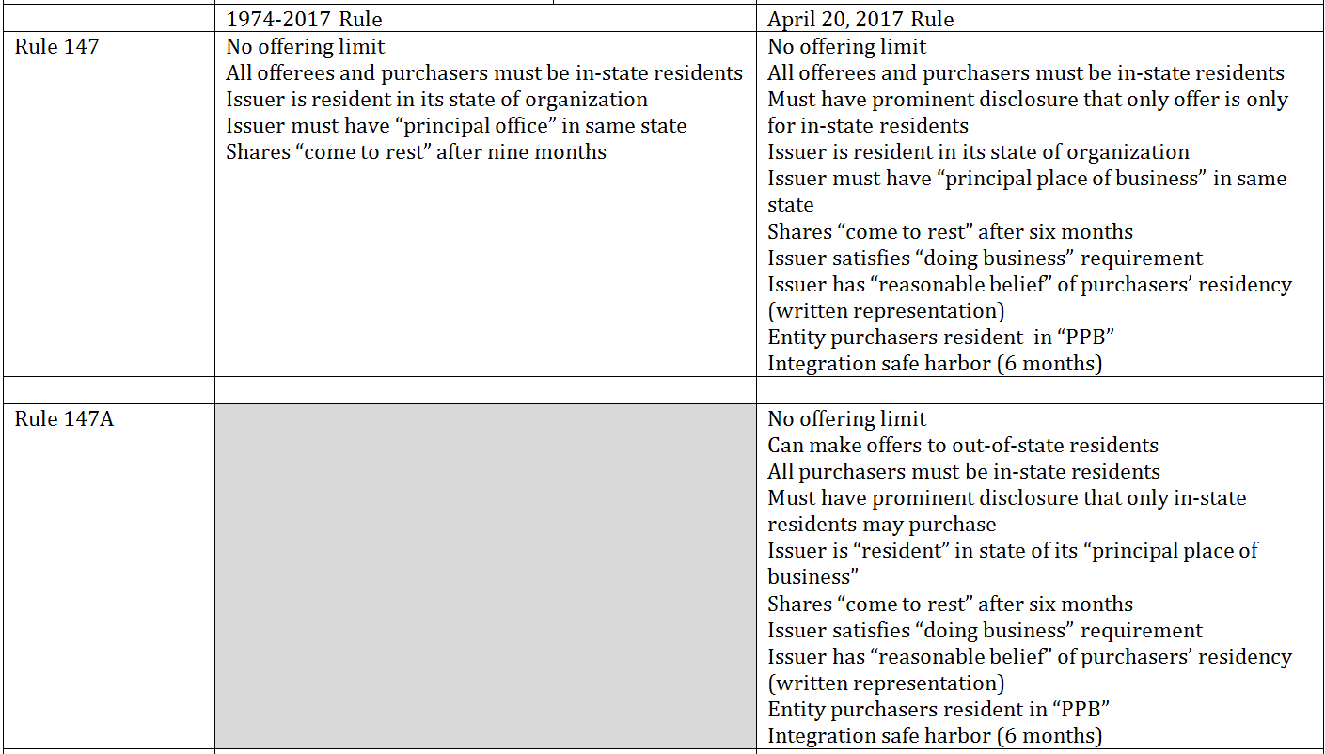
30 days
30 days

Slide 9
Sec v. Ralston purina (1953)
Public offering?

Slide 10
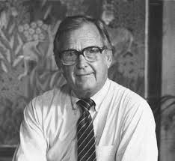
Doran v. petroleum mgmt. corp. (1977)
Public offering?

Slide 11
Doran v. petroleum mgmt. corp. (1977)
Public offering?
“Even the offeree-plaintiff's 20-20 vision with respect to the facts underlying the security would not save the exemption if any one of his fellow offerees was in a blind.”
“More specifically, we shall require on remand that the defendants demonstrate that all offerees, whatever their expertise, had available the information a registration statement would have afforded a prospective investor in a public offering. Such a showing is not independently sufficient to establish that the offering qualified for the private placement exemption, but it is necessary to gain the exemption and is to be weighed along with the sophistication and number of the offerees, the number of units offered, and the size and manner of the offering. ”

Slide 12
The Life Cycle of a Start-Up
Creation
Own funds
Family/
friends
Angel Investors
Venture debt
Later VC Rounds
Venture Capital
Initial Public Offering

Slide 13
Securities Regulation
Creation
Own funds
Family/ friends
Angel Investors
Venture debt
Later VC Rounds
Venture Capital
Initial Public Offering

Slide 14
Securities Regulation
Creation
Own funds
Family/ friends
Angel Investors
Venture debt
Later VC Rounds
Venture Capital
Initial Public Offering

Slide 15
REGULATION D
Creation
Own funds
Family/ friends
Angel Investors
Venture debt
Later VC Rounds
Venture Capital
Initial Public Offering
4(a)(2)

Slide 16
Regulation “d”
Rule 501-506
Section 3(b)(1): “small issues authority”
Rule 504
Section 4(a)(2): “transaction by an issuer not involving a public offering”
Rule 506

Slide 17
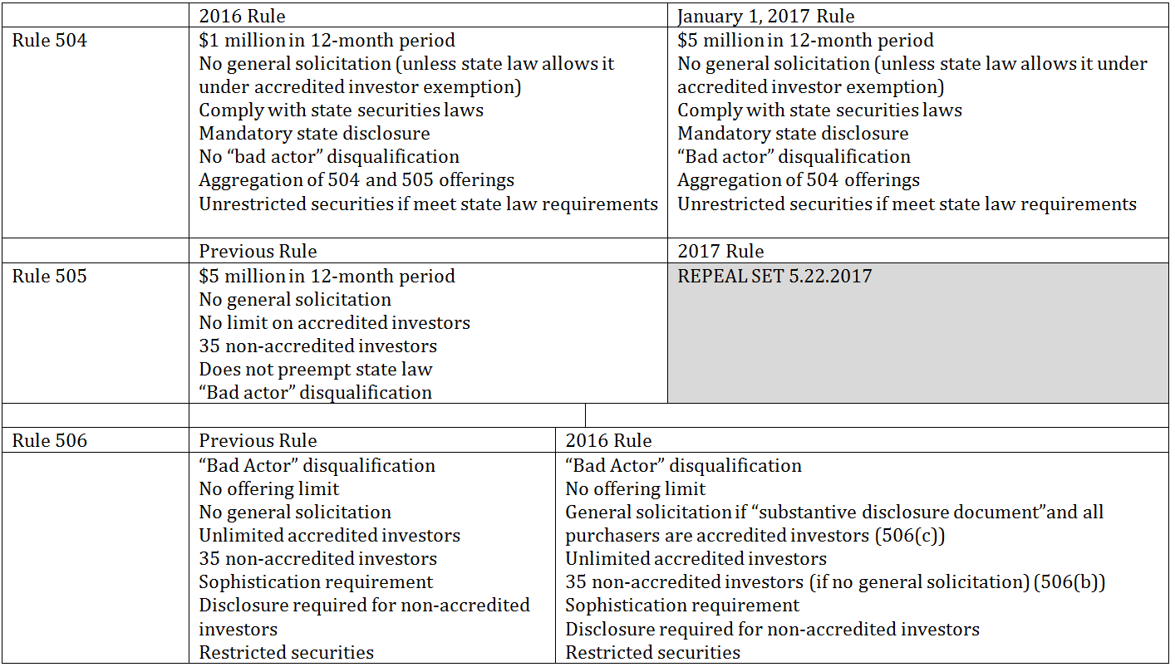

Slide 18
ACCREDITED INVESTOR

Slide 19
Rule 501(a): accredited investor
Entities with $5M assets (not formed for this purpose)
Individuals with $1M net worth (excluding residence)
Individuals with $200k income/year
Married couples with combined $300k income/year
Entity in which all equity owners are Accredited Investors
Proposed: “professional designations”
Proposed: “knowledgeable employees” of a private fund
Proposed: “spousal equivalent”

Slide 20
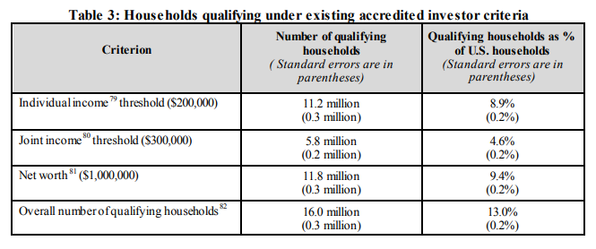
How many accredited investors?

Slide 21
4(a)(2)
Transactions by an issuer not involving any public offering

Slide 22
Sec v. Ralston purina (1953)
Public offering?

Slide 23
Doran v. petroleum mgmt. corp. (1977)
Public offering?

Slide 24
Doran v. petroleum mgmt. corp. (1977)
Public offering?
“Even the offeree-plaintiff's 20-20 vision with respect to the facts underlying the security would not save the exemption if any one of his fellow offerees was in a blind.”
“More specifically, we shall require on remand that the defendants demonstrate that all offerees, whatever their expertise, had available the information a registration statement would have afforded a prospective investor in a public offering. Such a showing is not independently sufficient to establish that the offering qualified for the private placement exemption, but it is necessary to gain the exemption and is to be weighed along with the sophistication and number of the offerees, the number of units offered, and the size and manner of the offering. ”

Slide 25
Securities Regulation
Creation
Own funds
Family/ friends
Angel Investors
Venture debt
Later VC Rounds
Venture Capital
Initial Public Offering

Slide 26
REGULATION D
Creation
Own funds
Family/ friends
Angel Investors
Venture debt
Later VC Rounds
Venture Capital
Initial Public Offering
4(a)(2)

Slide 27
Regulation “d”
Rule 501-506
Section 3(b)(1): “small issues authority”
Rule 504
Section 4(a)(2): “transaction by an issuer not involving a public offering”
Rule 506

Slide 28
$10

Slide 29
ACCREDITED INVESTOR

Slide 30
Rule 501(a): accredited investor
Entities with $5M assets (not formed for this purpose)
Individuals with $1M net worth (excluding residence)
Individuals with $200k income/year
Married couples with combined $300k income/year
Entity in which all equity owners are Accredited Investors
New: “professional designations” (Series 7, etc.)
Proposed: “knowledgeable employees” of a private fund
Proposed: “spousal equivalent”

Slide 31
How many accredited investors?

Slide 32
Rule 504
Offering Limit of $5 ($10) million within twelve-month period
No general solicitation (unless state law allows for accredited investors only)
Must comply with state “blue sky” laws
Must provide state required disclosure
If meet state requirements, securities will be “unrestricted”
Must file notice on Form “D”

Slide 33
Rule 506: Two paths
506(b) – no general solicitation; may have up to 35 unaccredited investors if they are “sophisticated”
506(c) – general solicitation as long as all purchasers are accredited investors
No maximum limit
Shares are “restricted”
Must file notice on Form “D” (requirement, not a condition)
No “bad actors”

Slide 34
General solicitation
NOT ALLOWED:
Ad, article, notice or other communication published in any newspaper, magazine, or similar media or broadcast over television or radio
Seminar or meeting whose attendees have been invited by any general solicitation or general advertising

Slide 35
FINRA rule 2111 (Suitability)
Broker-dealer has to “have a reasonable basis to believe that a recommended transaction or investment strategy involving a security or securities is suitable for the customer, based on the information obtained through the reasonable diligence of the [firm] or associated person to ascertain the customer’s investment profile.”
Age, other investments, financial situation and needs, tax status, investment objectives, investment experience, investment time horizon, liquidity needs and risk tolerance.

Slide 36
2019

Slide 37
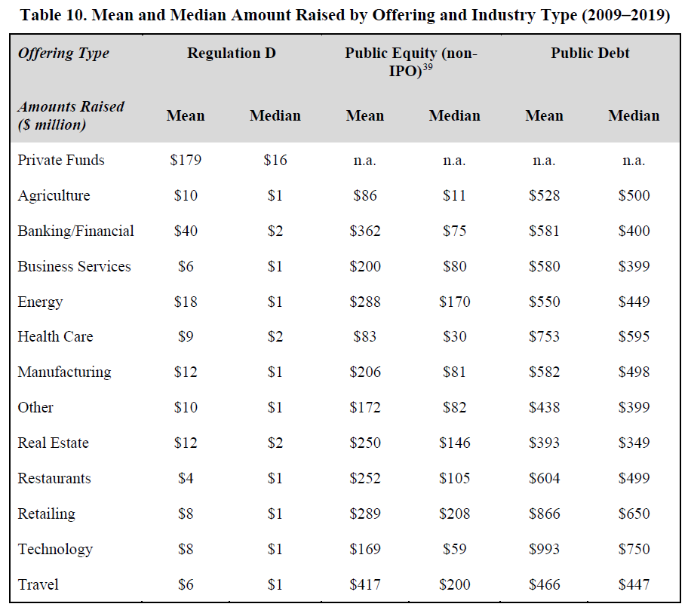

Slide 38
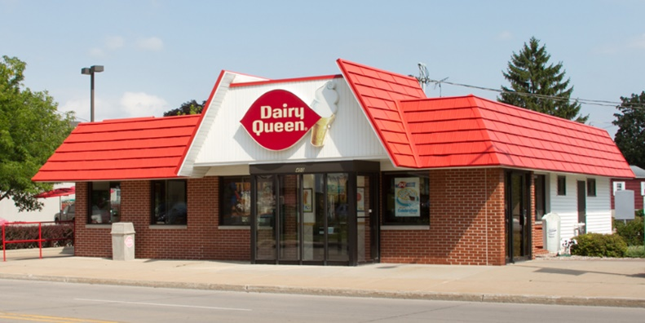
In re kenman corp.
39 limited partners
$875k
25 limited partners
$280k
Kenman
Kenman
Orem DQ Assoc.
Missiondale Palms Assoc.

Slide 39
In re kenman corp.
39 limited partners
$875k
25 limited partners
$280k
Kenman
Kenman
Orem DQ Assoc.
Form D
Missiondale Palms Assoc.

Slide 40
Footnote 6
In determining what constitutes a general solicitation, the Commission’s Division of Corporation Finance has underscored the existence and substance of pre-existing relationships between the issuer and those being solicited.

Slide 41
No-Action Letter
Not general solicitation to offer to 330 persons with whom the general partner has a pre-existing relationship and for whom the general partner has determined suitability/sophistication requirements.
General solicitation for officer/insurance broker to send to 600 persons with whom he had a preexisting relationship.

Slide 42
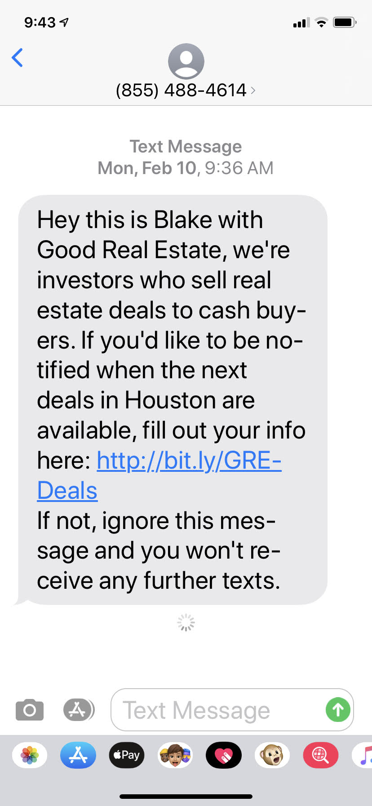

Slide 43
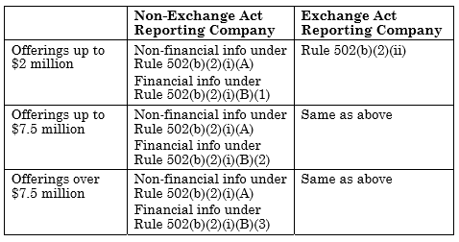
Disclosure

Slide 44
Two sets of problems
Needs large amount of capital, but doesn’t want the costs of an IPO
Wants to sell to strangers, wants unrestricted shares
Needs small amount of capital and does not have access to venture capital
Very early stage company

Slide 45
Solution?
April 5, 2012 – Jumpstart Our Business Start-ups Act
Amendments to Regulation A (Regulation A+)
Title III – Capital Raising Online While Deterring Fraud and Unethical Non-Disclosure Act

Slide 46
Section 3(b)(2): “Additional Issues”
3(b)(1): Rule 504 (under $5M) ($10M)
3(b)(2): Regulation A (under $50M) ($75M)

Slide 47
Regulation A+
Section 3(b)(2): “Additional Issues”
Two Tiers:
$20M (Tier 1) $50M (Tier 2) ($75M)
Tier 2 has ongoing reporting
Mini IPO registration
Costs are much lower than IPO
Regulation “A”: Rules 251 – 263
Ineligible: Reporting companies; blank check companies; issuers of oil & gas/mineral rights; bad actor

Slide 48
limitations
$20/$50M in twelve-month period
Secondary Sales:
Affiliates may only sell $6M in the Tier 1 offering or $15M in the Tier 2 offering
All sellers other than issuer – 30% of a Reg A offering
Investment Limitations: Tier 2 AND not listed on a national exchange after offering
Individual Unaccredited Investors are limited to no more than 10% of the greater of annual income or net worth
Institutional Unaccredited Investors are limited to 10% of the greater of annual revenue or net assets

Slide 49
Reporting requirements
Tier 1 must file Exit Report
Form 1-Z
Tier 2 has ongoing reporting (annual, semiannual, current); audited financial statements
Forms1-K; 1-SA; 1-U
Tier 2 Issuer may exit ongoing reporting if fewer than 300 shareholders and offering has ended
Must file Exit Report on Form 1-Z

Slide 50
State securities registration
Tier 2 offerings are not required to be registered in each state

Slide 52
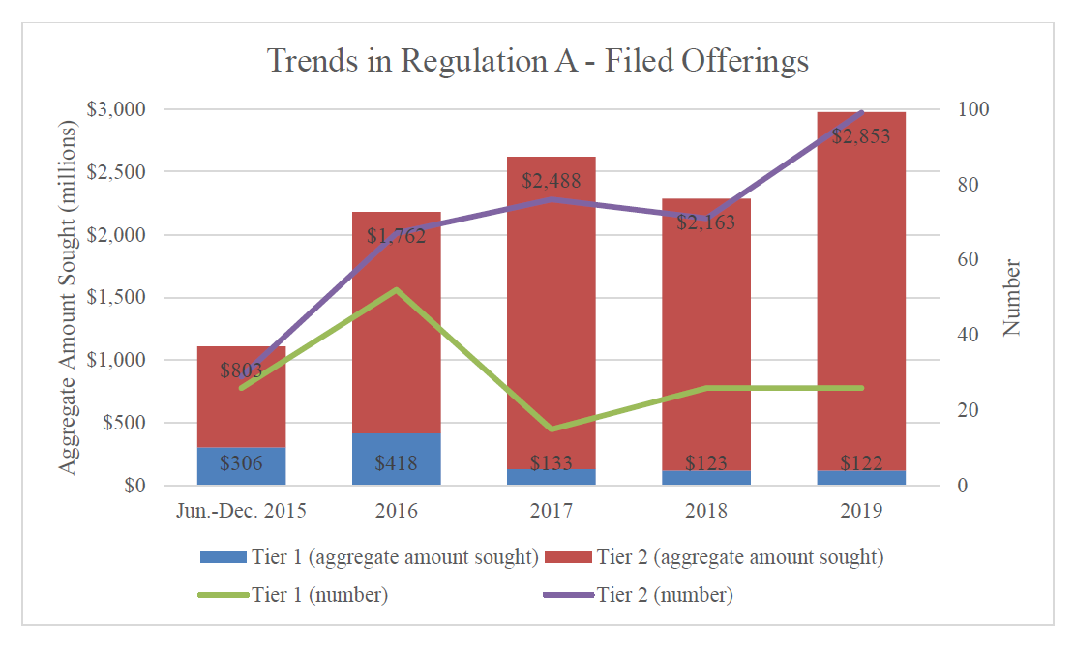

Slide 53
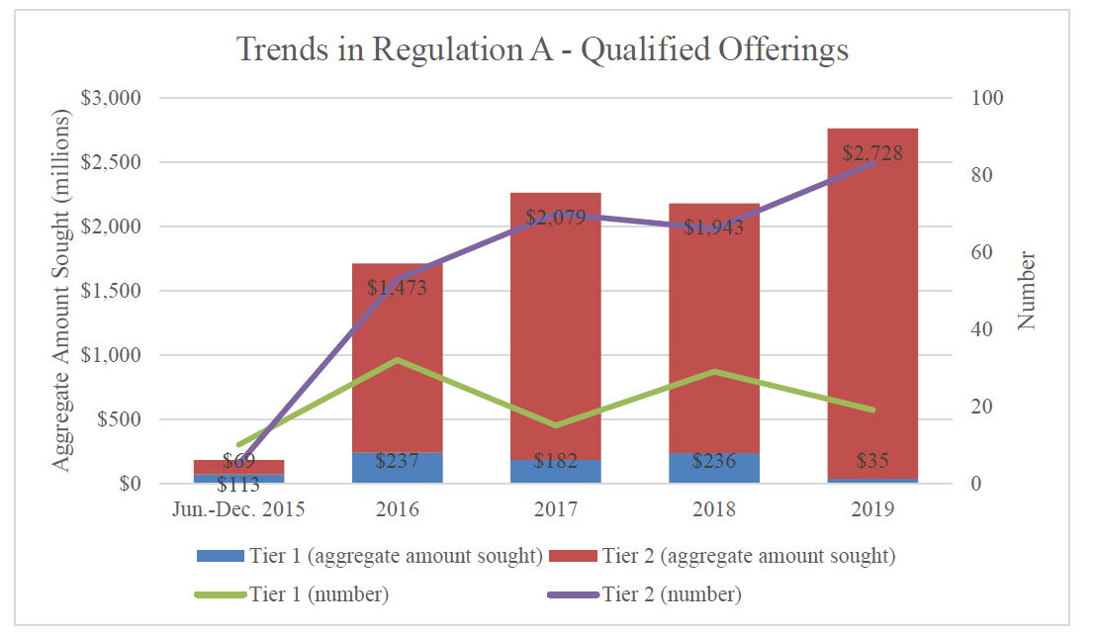

Slide 54
crowdfunding

Slide 55
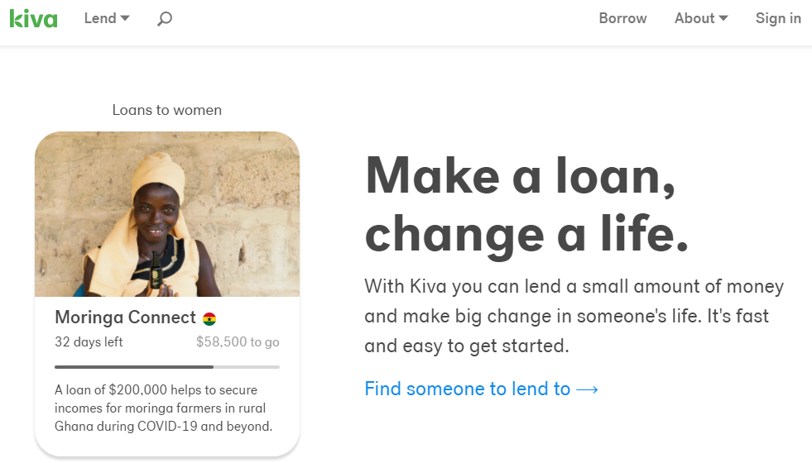
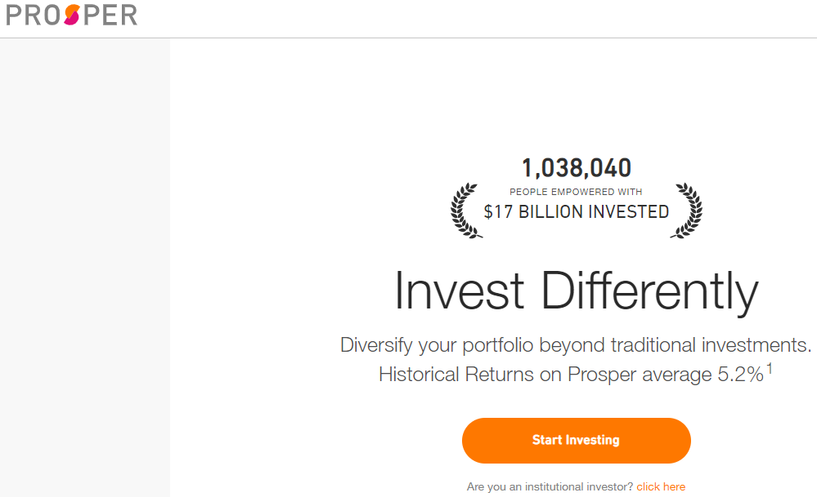
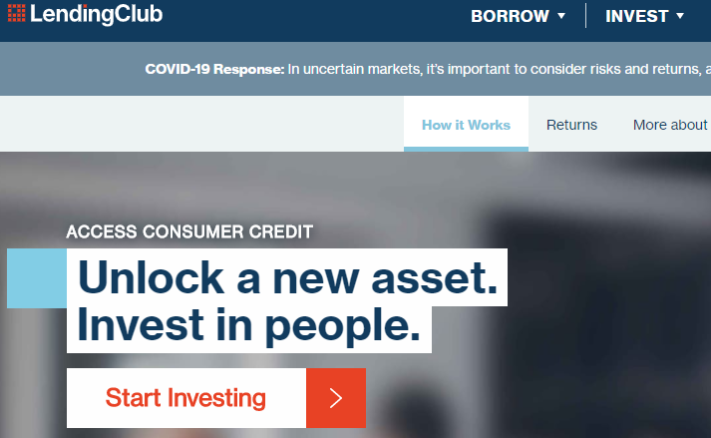

Slide 56
Two theories of crowdfunding
Disintermediation:
Entrepreneurs have access to capital without network of VC firms, underwriters, etc.
Investors have access to start-up opportunities without brokers, placement agents, underwriters

Slide 57
Circa 2012: Five Categories of Crowdfunding
Donor CF
DonorsChoose, Razoo, StartSomeGood
Reward CF
Pre-purchase CF
Kickstarter, Rockethub, Indiegogo
Non interest-bearing loan CF
Kiva
Return CF
ProFounder
Lending Club
Prosper

Slide 58
The Perils of Return pre-2012 Crowdfunding
Securities Act of 1933
3(a)(11) Intrastate?
504?
505?
506?
12(g)(1) – 500 shareholder rule

Slide 59
The Perils of Return pre-2012 Crowdfunding
Securities Act of 1933
3(a)(11) Intrastate? Offers to out-of-state residents
504?
505?
506?
12(g)(1) – 500 shareholder rule
General Solicitation
Unaccredited Investors

Slide 60
Section 4(a)(6): crowdfunding
Exempted Transaction (shares are restricted)
Issuer limited to $1,070,000/year
Investors limited to percentage of income/net worth
Transaction must be done through one online platform, either a registered broker-dealer or funding portal
No funds are received by issuer until “target” is reached
Mandatory disclosure on Form C
Mandatory annual report
All advertising must be done through the portal.
Regulation CF (Rule 100 – 305)

Slide 61
Investor limits

Slide 62
Form “C”
Rule 201 – Disclosure Requirements
Less than $107,000: Tax return information certified by CEO
$107,000 to $535,000: Financial statements reviewed by an independent public accountant
$535,000 to $1,070,000: Financial statements audited by an independent public accountant

Slide 63
PROPOSALS
$5 million
No investor limits for accredited investors

Slide 64
Portals: Form CFPortal
58 approved crowdfunding portals
Registered with FINRA

