Slide 1
Securities regulation day #2

Slide 2
Which of the following statements is most accurate regarding federal securities regulation?
A. Federal securities regulation began following the financial crisis of 2008.
B. Federal securities regulation began following the 1929 stock market crash.
C. Federal securities regulation ensures that only companies with sound business plans are offered for investment to the public.
D. Federal securities regulation ensures that only companies with the best business plans are offered for investment to the public.
E. Federal securities regulation only applies to debt securities.

Slide 3
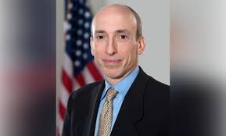
Gary Gensler

Slide 4
How does securities regulation move market prices toward fundamental value?

Slide 5
Disclosure of what
What information do investors need to know to make a decision about
Whether to purchase the security
What price to offer for the security
What information is material?

Slide 6
How do you price an equity interest in a going concern?

Slide 7
The Old Man and the Tree
For Sale:
Apple tree: Yields $100 apples a year. Ten years old.
Bought tree for $30 over 10 years ago
Lumber is worth $50
Make me an offer!

Slide 8
Lumberjack
$50 – the price that the chopped wood would fetch on the open market
Liquidation Value – usually lower than the value as a “going concern”

Slide 9
Apple Producer #1
$100 – I will make $100 next year off the crop of fruit
Only assumes that tree will produce one year
Also confuses revenue with profit
$100 – I will make $100 next year off the crop of fruit

Slide 10
Marketing Major
$1,500 – tree will produce for 15 more years
May confuse revenue with profit;
$1500 in 2032 is much less than $1500 in 2018
Will the tree last 15 years at the same level of production?

Slide 11
Accounting Student
$30 – what the man paid for the tree 30 years ago.
Book value is usually much lower than “going concern”

Slide 12
Old Man’s Rebuttal
Discounted Cash Flow
What is the present value of the income from this asset over its useful life?
Expected cash flows in the future
Discounted by the “discount rate”
Every project has a different discount rate and expected life
$270

Slide 13
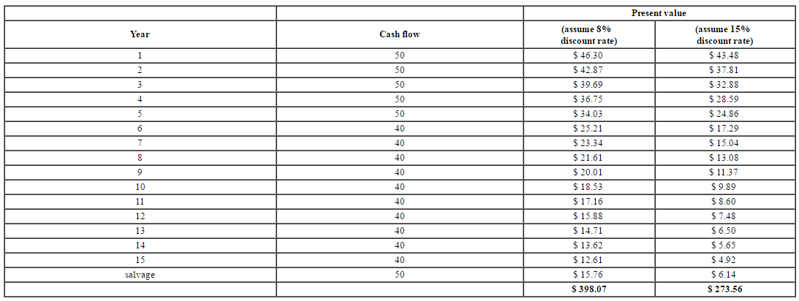

Slide 15
Why isn’t the valuation just profits x 15 years?
Time Value of Money
Must Know the Discount Rate

Slide 16
Why isn’t the valuation just profits x 15 years?
Time Value of Money
Must Know the Discount Rate
How Risky? What Kind of Risky?

Slide 17
Modern Portfolio Theory
A reasonable investor seeks Diversification
Diversification of investments can eliminate some risk, but not systematic risk (or market risk).
Unsystematic risk = firm-specific or industry-specific risk
Because you can diversify against this, it should not be a factor in determining the discount rate

Slide 18
Diversification

Slide 19
Diversification

Slide 20
Unsystematic risk v. systematic risk
If you can diversify away unsystematic risk (fuel prices may rise, it might be a warm winter), investors do not demand a discount because of that type of risk
Systematic risk can’t be diversified away, and some stocks are more sensitive to systematic risk. Stocks that are sensitive to systematic risk (high Beta) are discounted because of systematic risk (discount rate)

Slide 21
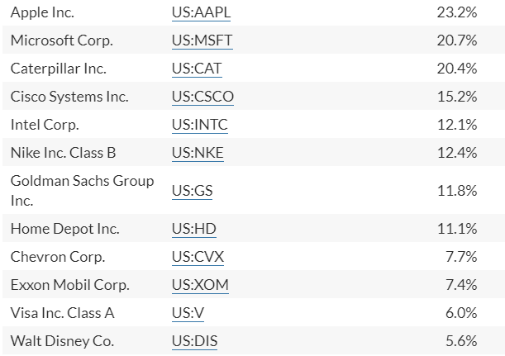
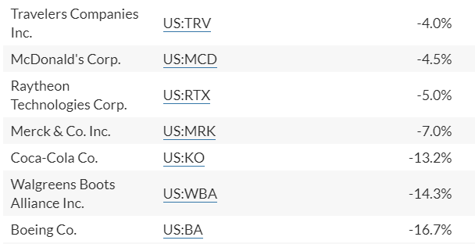
What companies were hurt the most in the covid downturn?

Slide 22
Systematic risk v. unsystematic risk
COVID brought both Systematic Risk and exposed companies’ Unsystematic Risk (Company-Specific Risks)
Systematic Risk – market downturn, unemployment, lockdown
Unsystematic Risk – consumer goods, restaurants, clothing, air travel, hotels

Slide 23
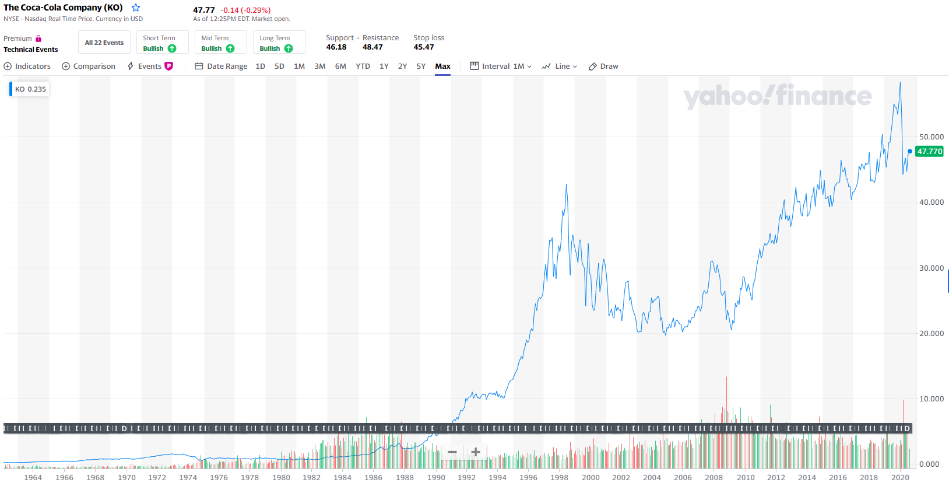
Coca-Cola, Inc.

Slide 24
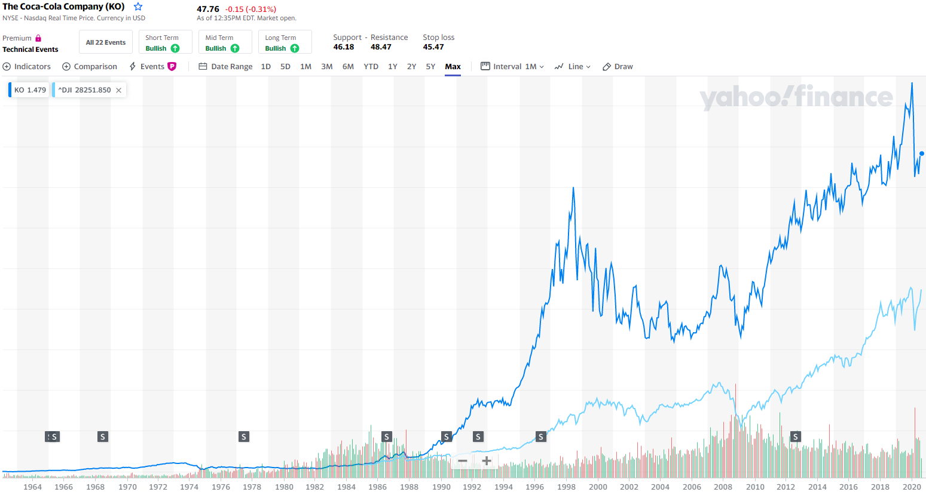
Coca-cola v. dow

Slide 25
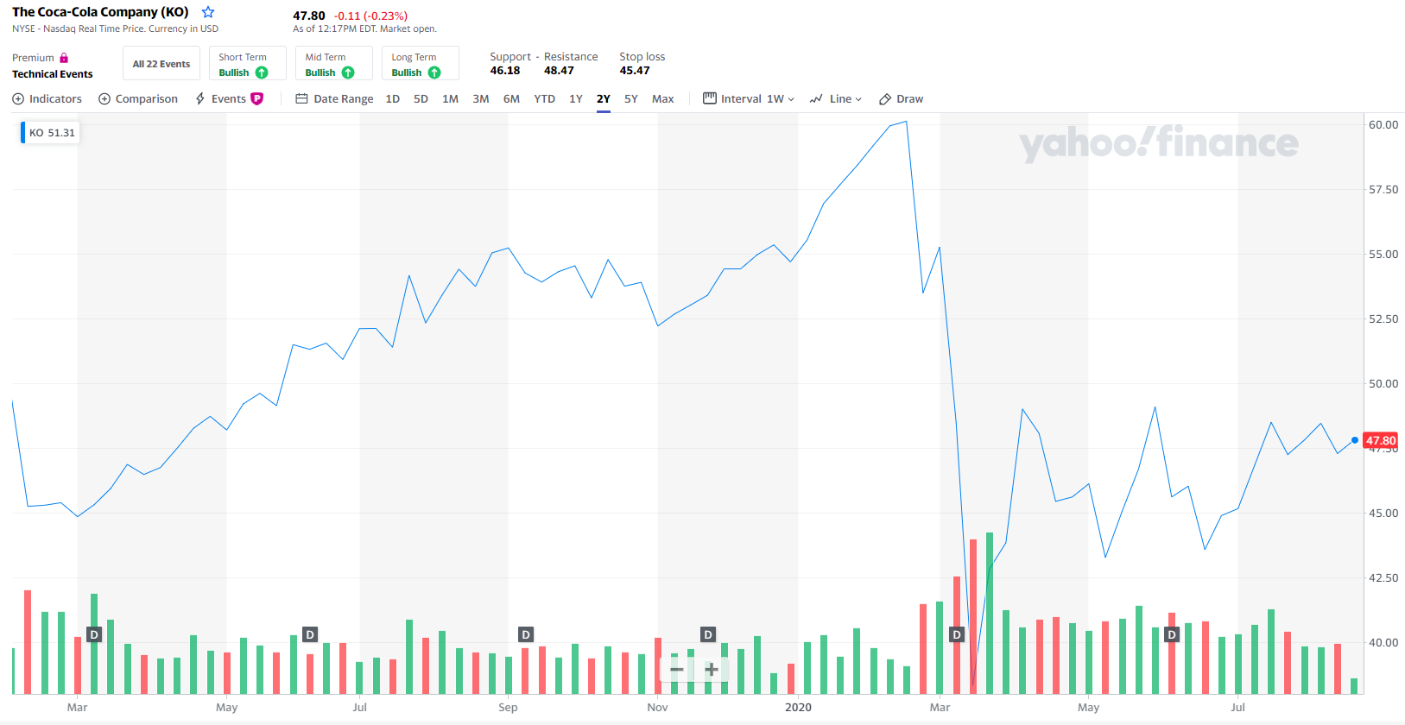
Coca-cola this year

Slide 26
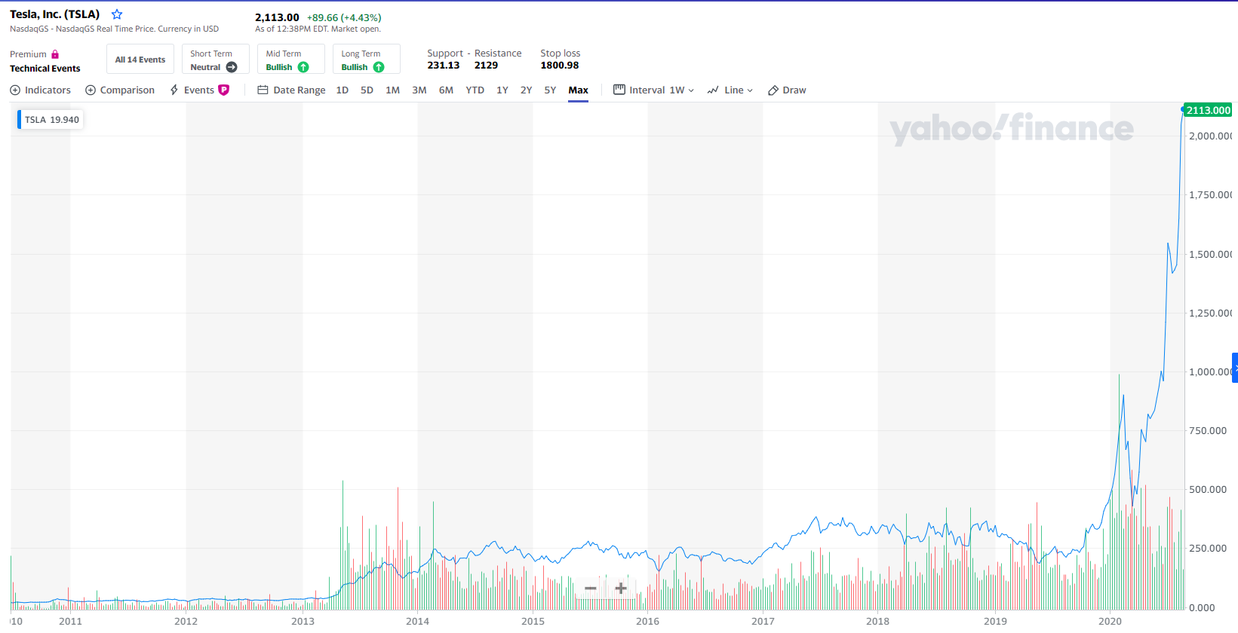
Tesla (tsla)

Slide 27
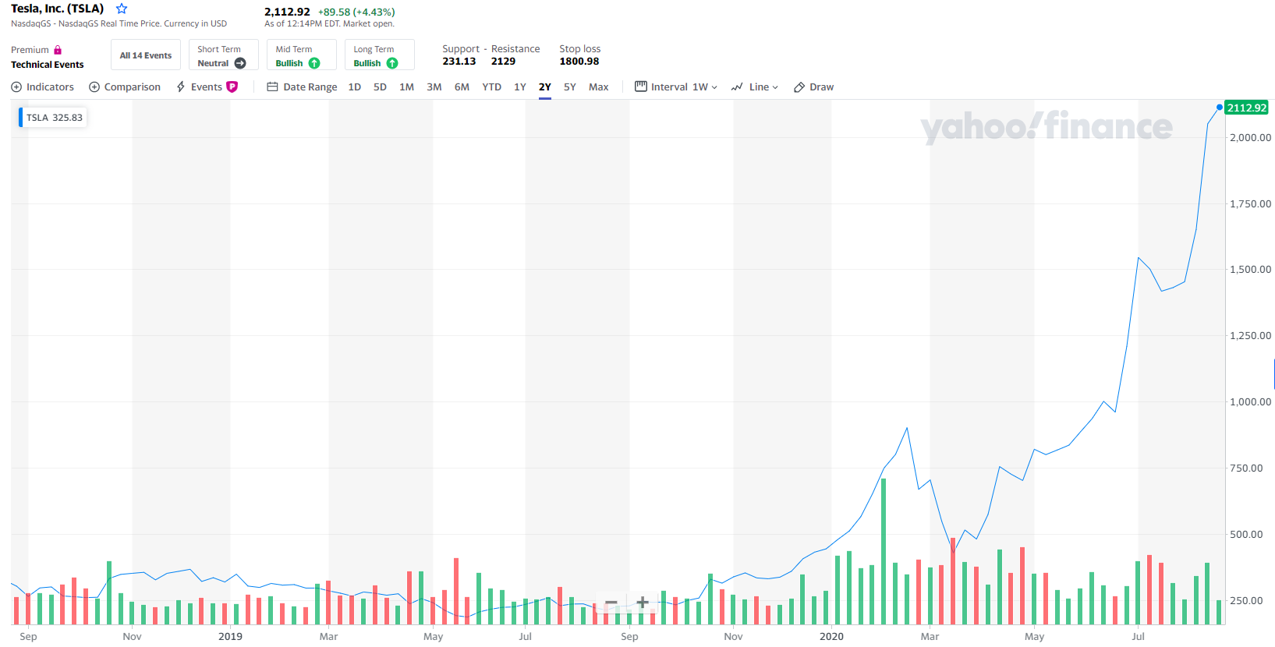
Tesla this year

Slide 28
Capital Asset Pricing Model
Cap-M – the amount of risk that an investor assumes should affect the price of a capital asset
Assets with the same risk have the same “rate of return”
All firms have an internal rate of return (if a firm spends $1000 on its operations, what that investment will be worth in three years)

Slide 29
Cap-M Formula
R(sec) = [R(U.S. Treasury)] + [Beta(sec) X (R(mkt) – R(U.S. Treasury))]
Beta – calculated by various market participants and listed
Risky Investment = 2.0 Beta
Risk = Market Risk = 1.0 Beta
If less risky than market, <1.0 Beta
If more risky than the market, >1.0 Beta

Slide 30
Tesla BETA = 1.3

Slide 31
Coca-cola beta = .55

Slide 32
Low beta stocks
Campbell Soup (.39)
Clorox Company (.26)

Slide 33
Discounted Cash Flows
Valuing a going concern – have to fix a discount rate to use, which is based on Beta
Have to know Beta to calculate the Discount Rate
Have to know the Discount Rate to calculate the DCF valuation
Have to know the DCF valuation to determine the share price

Slide 34
How does securities regulation support accurate pricing of shares?

Slide 35
Disclosure-Based Solution

Slide 36
What does disclosure do?
Alerts investors to both Systematic Risk and Unsystematic Risk
Provides historical and current financial information
Allows for accurate pricing --- IF DISCLOSURE IS TRUE

Slide 37
Efficient capital market hypothesis

Slide 38
Efficient Capital Market Hypothesis
Weak Form
Past price movements constitute information already embedded in the current stock prices – cannot predict future movements. So, stocks walk a “random walk.” Empirical studies prove this – changes in stock price are statistically independent from prior changes.

Slide 39
Efficient Capital Market Hypothesis
Semi-Strong
At any point in time, market prices are an unbiased forecast of future cash flows that fully reflects all publicly available information.
Strong
Price reflects ALL information, both public and private

Slide 40
Efficient Capital Market Hypothesis
Four Assumptions:
Capital markets are complete
Information is immediately and costlessly available
Investors have homogeneous expectations
Investors have same time horizons

Slide 41
Under ECMH, Can You Profit From Trading on New Information?

Slide 42
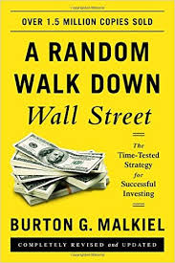
Under ECMH, Can You Profit From Trading on New Information?
Probably not.
All foreseeable events are already in the stock price
New information is immediately incorporated into the stock price

Slide 43
Does ECMH hold more accurately for large, publicly-held corporations or for small companies on regional exchanges?

Slide 44
2020 Baby Contest
Vote for the cutest baby!

Slide 45
Baby “A”

Slide 46
Baby “B”

Slide 47
Baby “C”

Slide 48
Baby “D”

Slide 49
Baby “E”

Slide 50
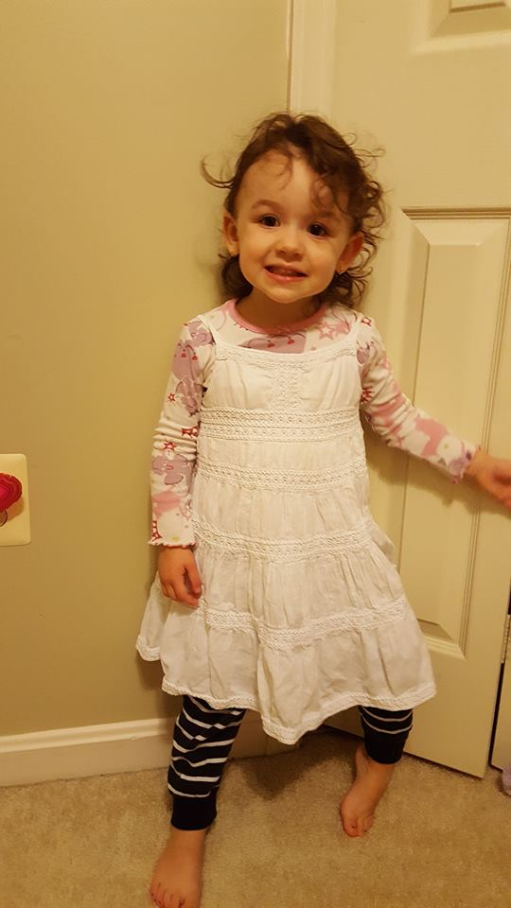
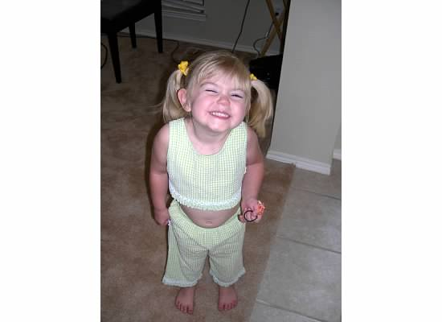
Vote for Your Favorite!
C
B
A
E
D

Slide 51
Vote for THE BABY YOU THINK WON!
C
B
A
E
D

Slide 52
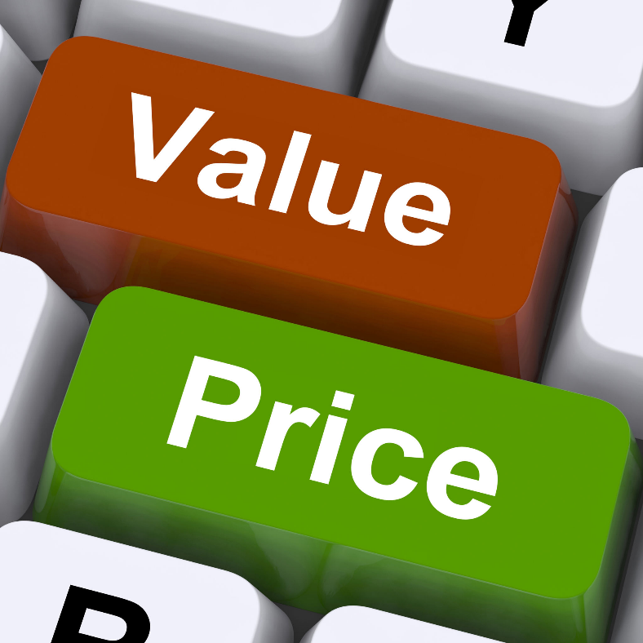
Securities Regulation Goal:
To have the market price move toward fundamental value
Fundamental Value
Market Price

Slide 53
Noise
Sentiment investors
Can move market price away from fundamental value
Can profit by
Value Investing
Chasing Herd (Positive Feedback Trading)

Slide 54
Behavioral Economics
Investors aren’t always rational
Heuristics
Representativeness
Availability
Adjustment & Anchoring
Endowment Effect
Loss Aversion
Self-confidence

Slide 55
Who are the gatekeepers?

Slide 56
The Underwriter

Slide 57
The Accounting Firm

Slide 58
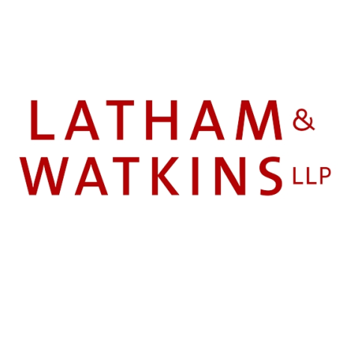
The Law Firm

Slide 59
Initial public offering market

Slide 60
Ratings Agencies (Bonds)

Slide 61
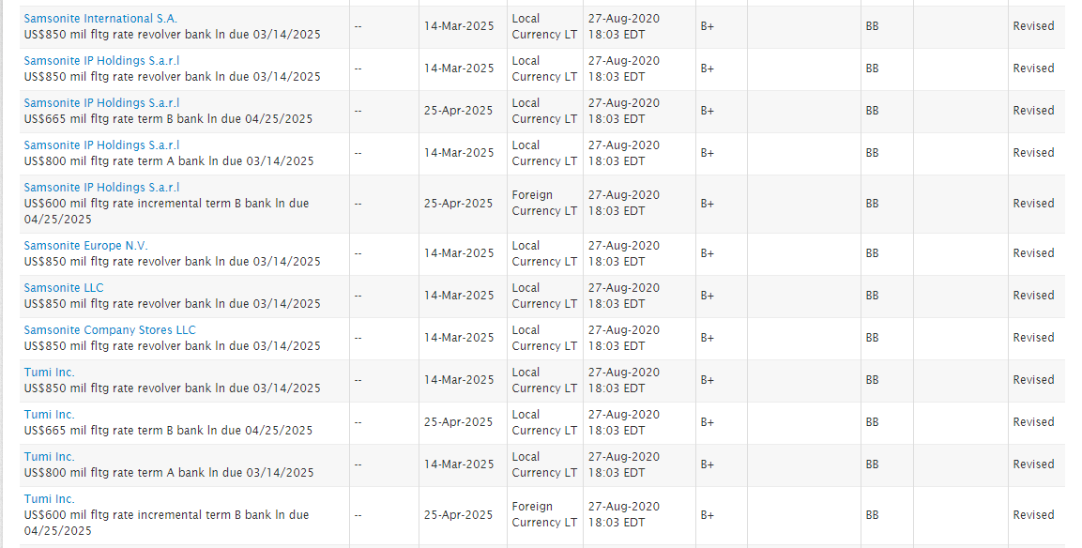

Slide 62
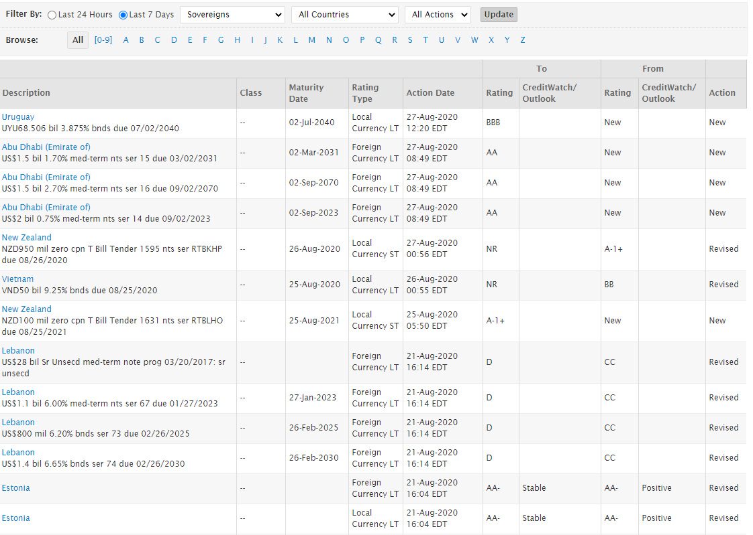

Slide 63
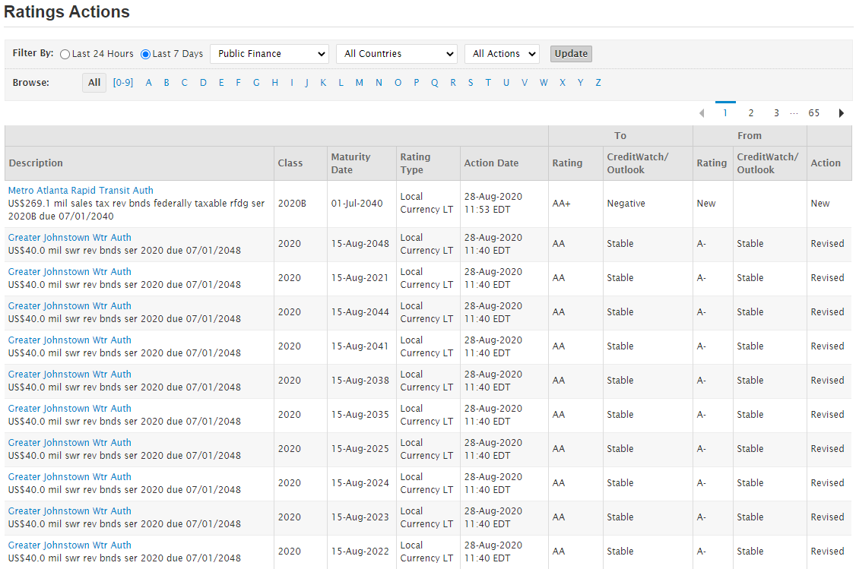

Slide 64
Securitization
What is an asset-backed security (ABS)?

Slide 65
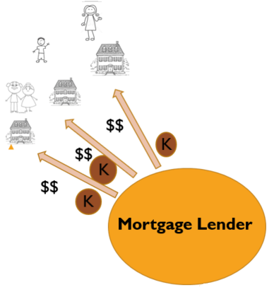
Start with a contract with payment streams for a period of years

Slide 66
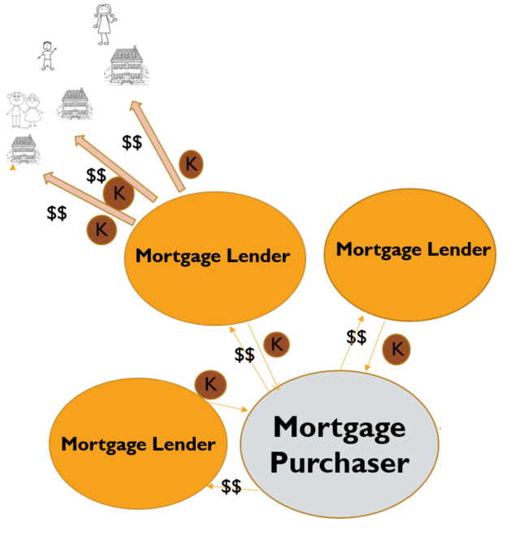
sell those contracts to a mortgage purchaser

Slide 67
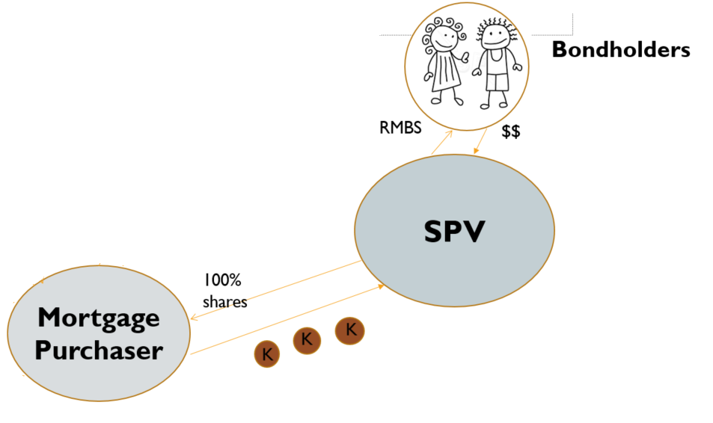
Mortgage purchaser contributes mortgages to special purpose vehicle it owns/controls
SPV issues bonds to Bondholders that pay interest and are secured by mortgages

Slide 68
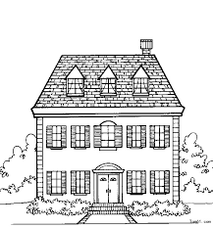
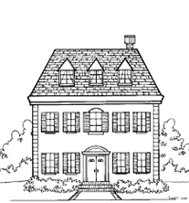
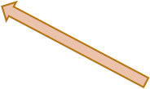
Residential mortgage-backed security (rmbs)
$$
Bondholders
$$
K
$$
RMBS
$$
Mortgage Lender
Mortgage Lender
SPV
$$
$$
100%
shares
Mortgage Purchaser
Mortgage Lender
$$

Slide 69
Bondholders
$$
RMBS
$$
$$
SPV
100%
shares
Mortgage Purchaser
$$
$$
$$
$$

Slide 70
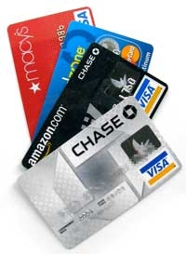
What is an asset-backed security (ABS)?
$$
Bondholders
$$
K
$$
ABS
$$
Credit Card Lender
Credit Card Lender
SPV
$$
$$
100%
shares
Credit Card Receivables Purchaser
Credit Card Lender
$$

Slide 71
Meltdown in rmbs market
Bondholders
$$
RMBS
$$
$$
SPV
100%
shares
Mortgage Purchaser
$$
$$
$$
$$

Slide 72
Collateralized debt obligation: Like an ABS, but secured by different “tranches” of assets in different spv entities
Bondholders
RMBS
“A” Tranche
SPV
“B” Tranche
100%
shares
“C” Tranche
Mortgage Purchaser
$$
$$
CDO
$$
$$

Slide 73
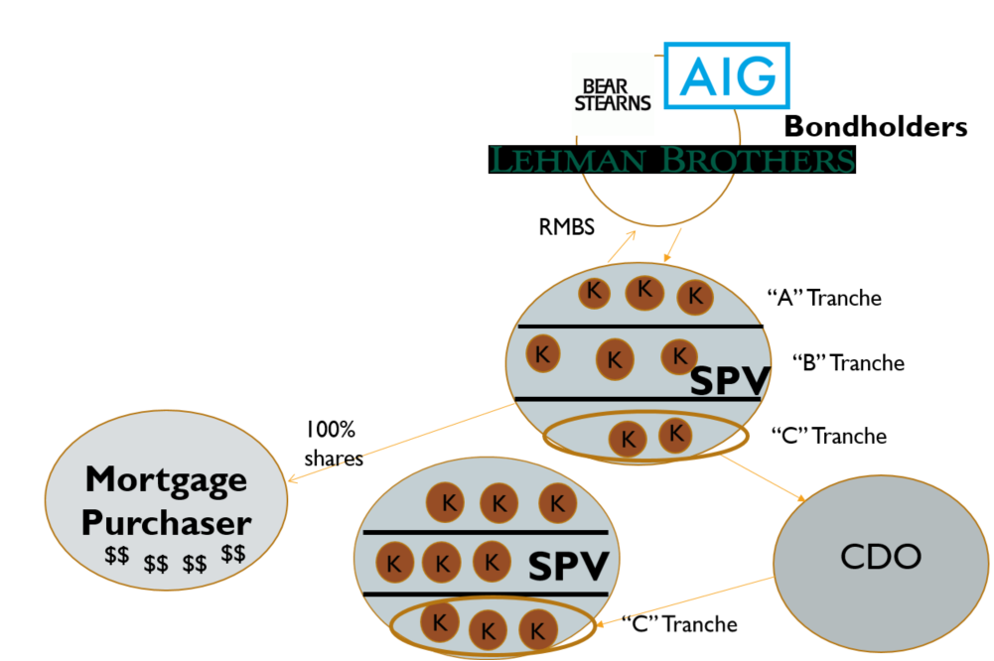
RMBS + CDOs

Slide 74
RMBS/cdo BUYER AND cds SELLER
Credit Default Swap

