Slide 1
Securities regulation #8

Slide 2
law professor usha RODRIGUES blogs about ipos. SHE HEARS THAT roblox MAY SOON FILE FOR AN IPO. Prof. Rodrigues blogs about how excited she is about that prospect because she loves roblox
A. If Roblox files for a Direct Listing, then the gun-jumping rules concerning offers in Section 5 don’t apply.
B. If Roblox files its registration statement more than 30 days after Prof. Rodrigues removes her blogpost, then she has not violated Section 5.
C. If Prof. Rodrigues does not include forward-looking information in her blogpost, then she has not violated Section 5.
D. Prof. Rodrigues has not violated Section 5.
E. If Prof. Rodrigues had waited until Roblox files its registration statement, then she would not have violated Section 5.

Slide 3
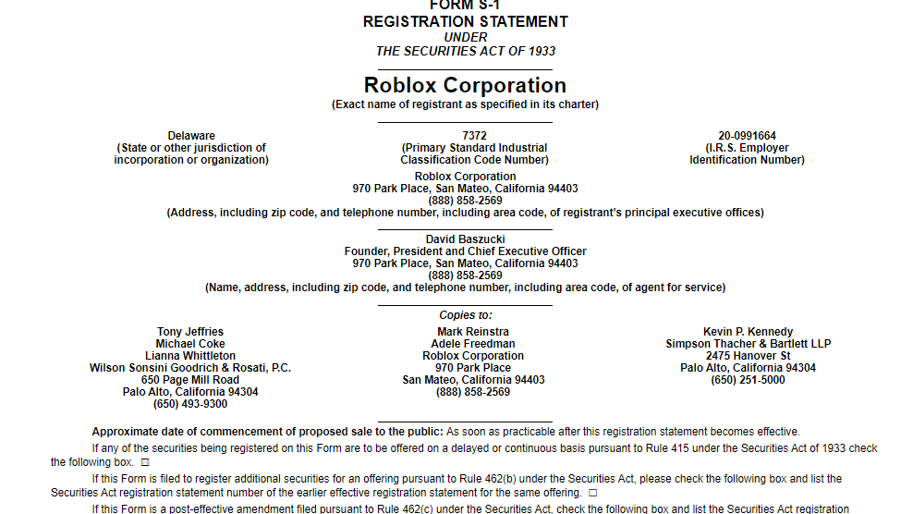

Slide 4
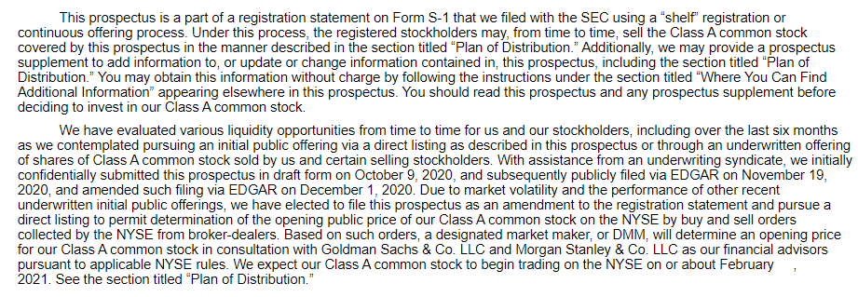

Slide 5
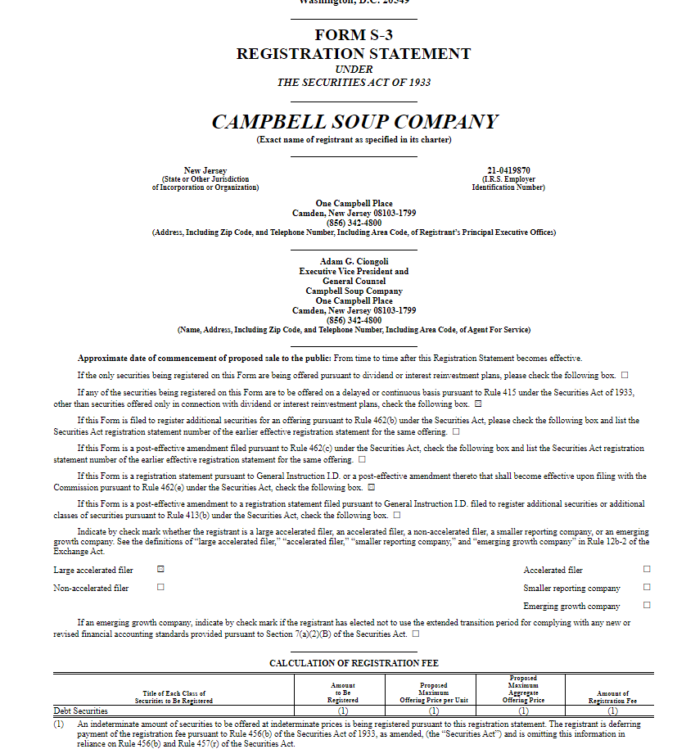

Slide 6
Lingo Wednesday: wksi, Form S-3 & bond offering

Slide 7
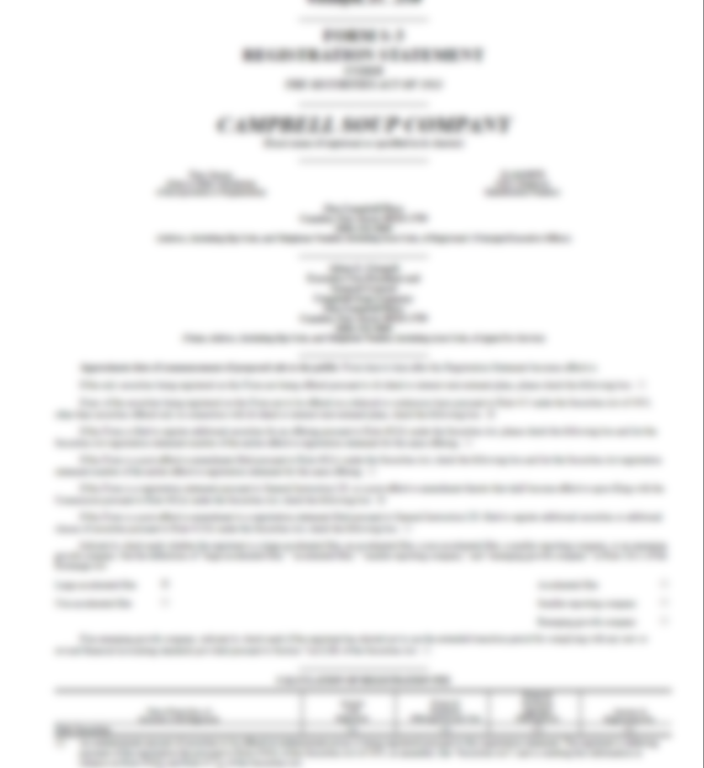



Slide 8
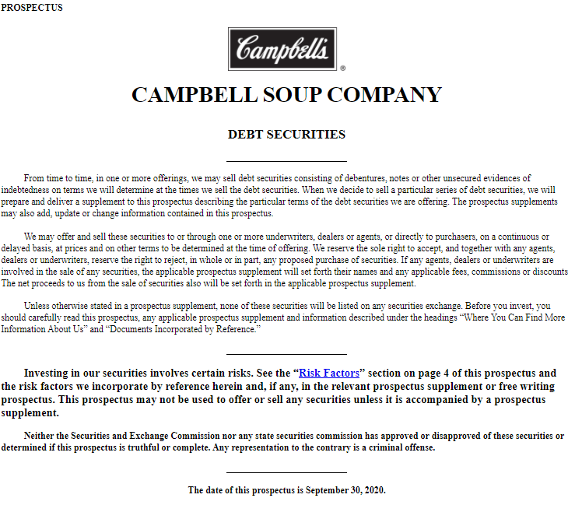

Slide 9
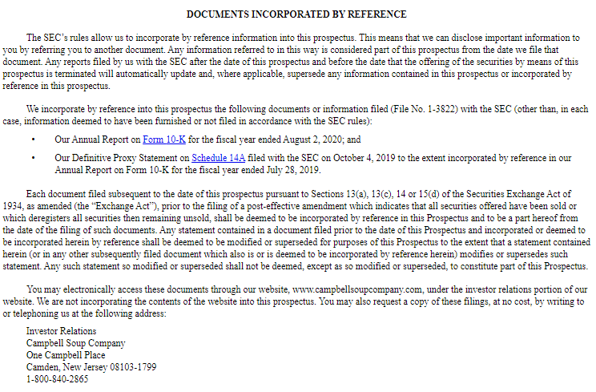

Slide 10
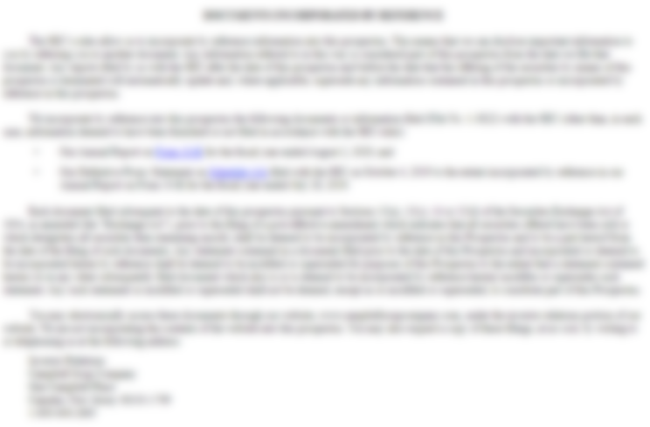
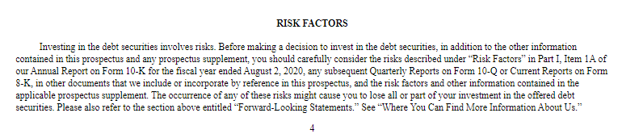

Slide 11
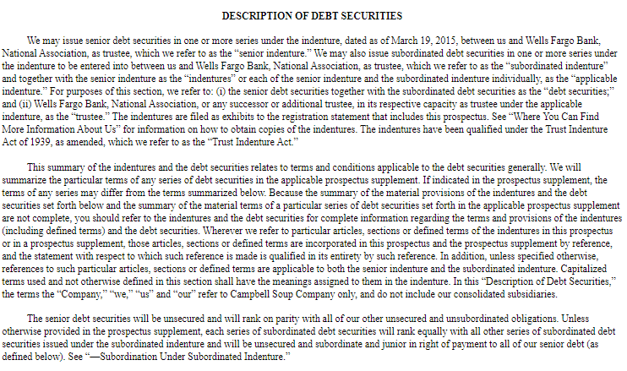

Slide 12
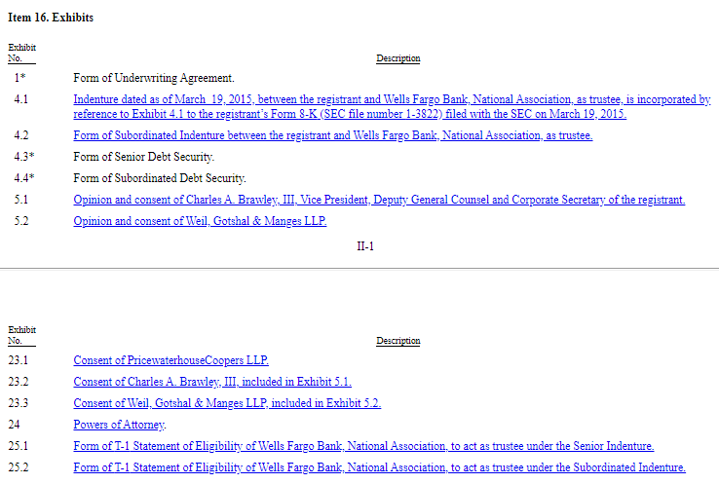

Slide 13
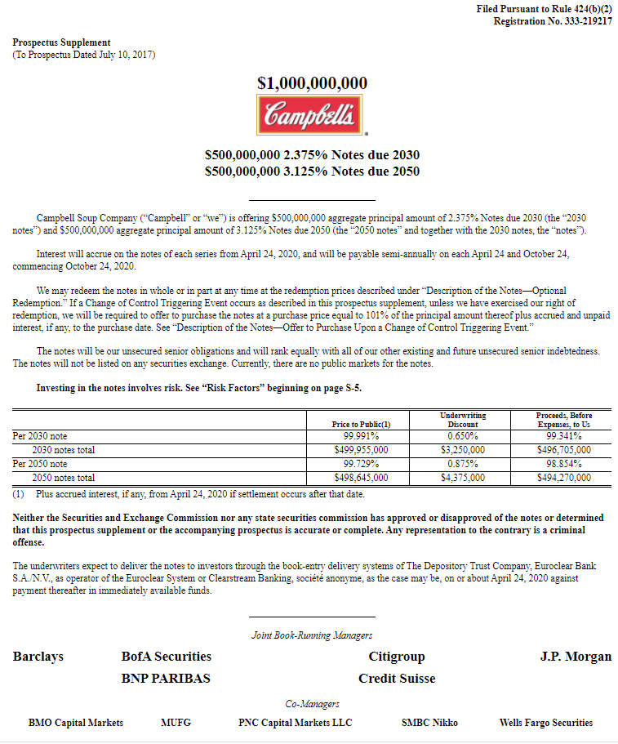

Slide 14
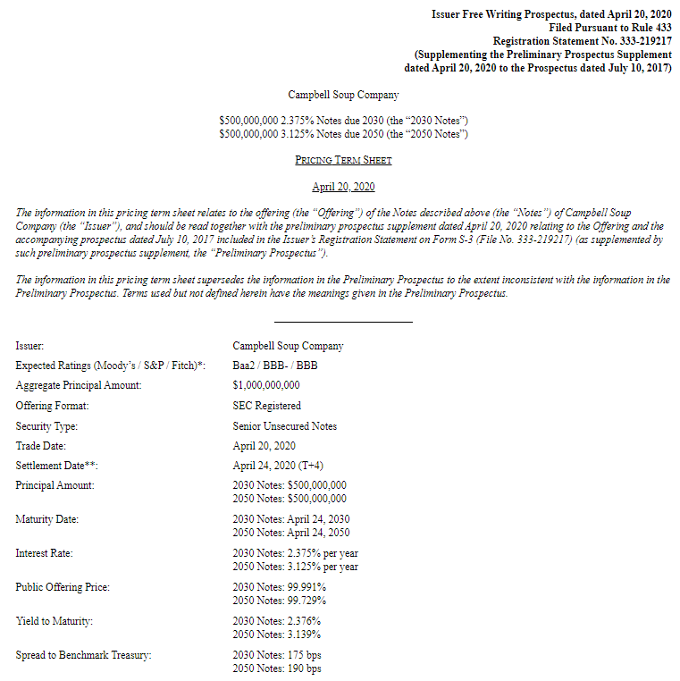

Slide 15
Timeline
Pre-Filing Period
Waiting Period
(In registration)
Registration is effective
Sales & Delivery
“Sales”
“Offers to Sell”
“Offers to Buy”
“Sales”
“Offers to Sell”
“Offers to Buy”
“Sales”
“Offers to Sell”
“Offers to Buy”
“Sales”
“Offers to Sell”
“Offers to Buy”

Slide 16
Gun-Jumping Rules
Section 5(b)
(b) It shall be unlawful for any person
  to ... transmit any prospectus relating to any security with respect to which a registration statement has been filed under this title, unless such prospectus meets the requirements of section 10; or
  to carry ... any such security for the purpose of sale or for delivery after sale, unless accompanied or preceded by a prospectus that meets the requirements of subsection (a) of section 10.
Notes:
Section 5(b)(2) requires that a final prospectus accompany or precede the delivery of the security (Moot point: no one actually delivers securities anymore.)
Section 5(b)(1) forbids the transmission of non-conforming prospectuses

Slide 17
Yay! Now we can make offers!
Wait –
(b) It shall be unlawful for any person
  to ... transmit any prospectus relating to any security with respect to which a registration statement has been filed under this title, unless such prospectus meets the requirements of section 10; or
  to carry ... any such security for the purpose of sale or for delivery after sale, unless accompanied or preceded by a prospectus that meets the requirements of subsection (a) of section 10.
And --
The term "prospectus" means any prospectus, notice, circular, advertisement, letter, or communication, written or by radio or television, which offers any security for sale or confirms the sale of any security; except that ...

Slide 18
So. . . .
Any offer that is a “written communication” violates 5(b) if it does not conform to the requirements of a Section 10 prospectus.
  Prospectus has the same information as the registration statement without the exhibits.
  10(a) Final Prospectus
  10(b) Preliminary Prospectus
All oral offers are allowed (except by “radio and television”)
All written “offers” must have some sort of exemption from the prospectus rules.

Slide 19
And. . .
“Written communication” under Rule 405:
“[A]ny communication that is written, printed, a radio or television broadcast, or a graphic communication”
● “Graphic communication … shall include all forms of electronic media, including, but not limited to, audiotapes, videotapes, facsimiles, CD-ROM, electronic mail, Internet Web sites….”
● “Graphic communication shall not include a communication that, at the time of the communication, originates live, in real-time to a live audience and does not originate in recorded form….

Slide 20
“tombstones”
Rule 135 (you learned already)
Rule 134
Section 2(a)(10)(b)

Slide 21
2(a)(10)(b)
[A] notice, circular, advertisement, letter, or communication in respect of a security shall not be deemed to be a prospectus if it states from whom a written prospectus meeting the requirements of section 10 may be obtained and, in addition, does no more than identify the security, state the price thereof, state by whom orders will be executed….

Slide 22

tombstone

Slide 23
Rule 134
The term "prospectus“ or “free writing prospectus” ... shall not include a communication limited to the statements required or permitted by this section ... :
(a) Such communication may include any one or more of the following items of information, ... :
  (1) the name of the issuer of the security;
  (2) The title of the security … and the amount … being offered;
  (3) A brief indication of the general type of business of the issuer ...
  (10) The names of the underwriters… ;
  (11) The anticipated schedule for the offering … and a description of marketing events … .

Slide 24
Rule 134
  Permissible Information (factual information on issuer, information on the security, price, use of proceeds, underwriters, procedures underwriters will use to conduct offering)
  Mandatory Information (legend, contact person to obtain prospectus)
  Exceptions from Rule 134(b) requirements
  Solicitations of interest
    May solicit an offer to buy the security or request the recipient to indicate whether he or she might be interested in the security if it has the LEGEND

Slide 25
“No offer to buy the securities can be accepted and no part of the purchase price can be received until the registration statement has become effective, and any such offer may be withdrawn or revoked, without obligation or commitment of any kind, at any time prior to notice of its acceptance given after the effective date.”

Slide 26
Free writing prospectuses
(rules 164, 433)
NEW FOR 2005!
any written communication that offers to sell or solicits an offer to buy a security that are or will be subject to a registration statement that do not meet the requirements of a § 10 statutory prospectus
indirect communications through media sources offering or soliciting
  Compensated
  Uncompensated
Conditions:
  LEGEND
  Filing Requirement (date of first use)

Slide 27
Free Writing Prospectuses
Rule 164/433 Requirement | Non-reporting & Unseasoned | Seasoned & WKSI
Eligibility | Only after filing of registration statement | Only after filing of registration statement (WKSI may use Rule 163 in Pre-Filing Period)
§ 10 Prospectus (Rule 433(b)) | Must have filed; must accompany or precede | Must have filed
Not summary or FWP
No need if prior §10 prospectus with no material change
Need §10(a) prospectus in post-effective period

Slide 28
Free Writing Prospectuses
Rule 164/433 Requirement | Non-reporting & Unseasoned | Seasoned & WKSI
Eligibility | Only after filing of registration statement | Only after filing of registration statement (WKSI may use Rule 163 in Pre-Filing Period)
§ 10 Prospectus (Rule 433(b)) | Must have filed; must accompany or precede | Must have filed
Information (Rule 164(c)/433(c)) | - No info conflicting with reg. stat. + periodic rep. - Legend | - No info conflicting with reg. stat. + periodic rep. - Legend
Filing (Form FWP) (Rule 164(b)/433(d)) | FWP must be filed with SEC no later than first use | FWP must be filed with SEC no later than first use
Record Retention (Rule 164(d)/433(g)) | -Three years (if not filed) | - Three years (if not filed)

Slide 29
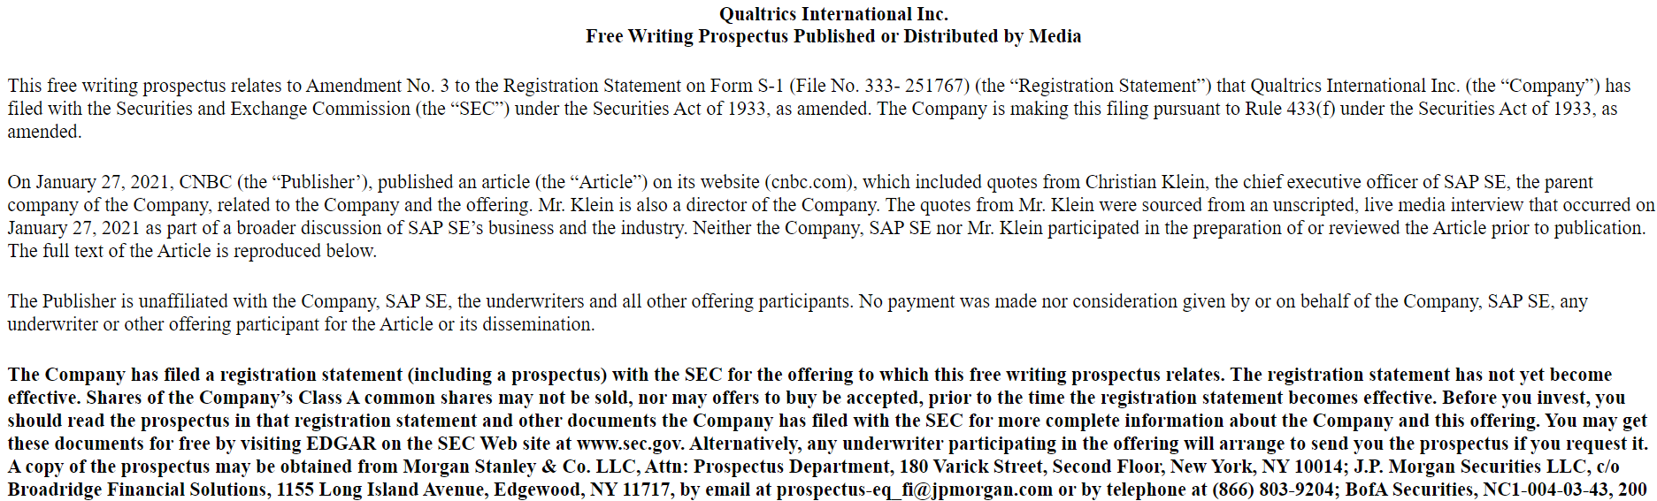
What if someone else publishes issuer-provided information?

Slide 30
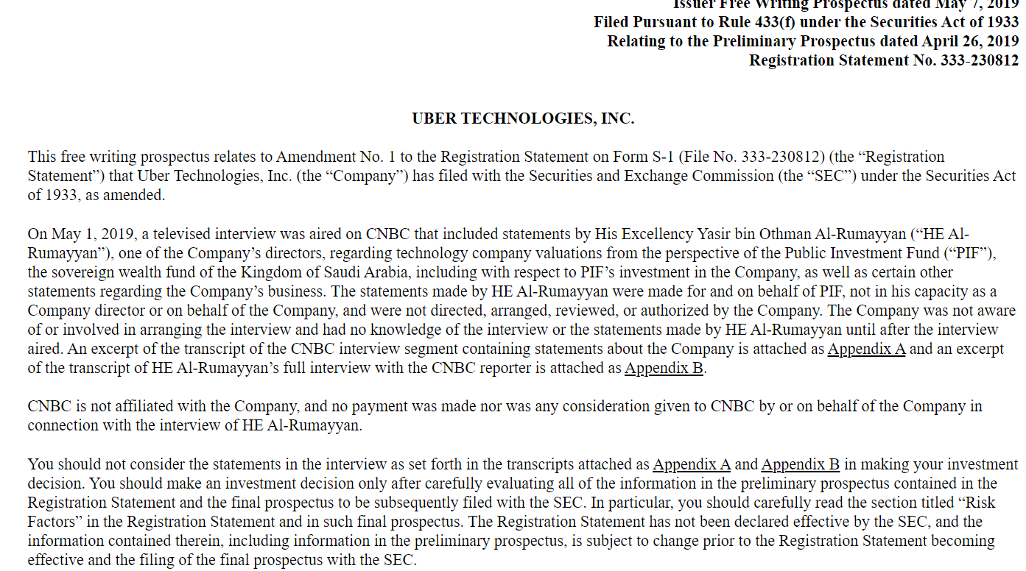
What if someone at the issuer speaks out of turn?

Slide 31
Road shows
● “Graphic communication shall not include a communication that, at the time of the communication, originates live, in real-time to a live audience and does not originate in recorded form….”

Slide 32
Road shows
Treated as “oral”
Communication
(Rule 405)
Real-Time
Roadshow?
Yes
No
“Bona fide” electronic
road show available?
See Rule 433(h)(5)
Equity Offering
By Non-Exch. Act
Rep. Co.
Yes
Yes
No
No
No filing required
Rule 433(d)(8)
Filing required
Rule 433(d)(8)

Slide 33
Analyst safe harbors
Rule 137
Rule 138
Rule 139

Slide 34
Analyst Research
TYPES OF
ANALYSTS
BUY-SIDE
ANALYSTS
SELL-SIDE
ANALYSTS
work directly
for large
institutional
investors
associated
with large
brokerage
firms, investment banks,
Advisory firms
Notes:
Many students will only have a general sense of securities analysts and the role they play in the capital markets. We therefore start this section with a discussion of the different types of securities analysts in the marketplace.
Securities analysts are divided into “buy-side” and “sell-side” analysts. Buy-side analysts work directly for large institutional investors (e.g., mutual funds, pension funds, etc.), providing advice on where the institutional investors should invest.
Sell-side analysts on the other hand typically are associated with a large Wall Street brokerage firm (e.g., Merrill Lynch, Goldman Sachs, etc.). Sell-side analysts typically do not charge for their research, instead distributing the research broadly into the capital markets for free. Nothing is really free of course. Sell-side analysts are typically cross-subsidized by the brokerage firm – either from trading commissions earned by brokers (although since trading commissions were deregulated in the mid-1970s, commissions have dropped under the competitive pressure) and from investment banking revenue. Some sell-side analysts are independent (and indeed, purists may argue that independent analysts are not sell-side analysts at all but rather an independent third category), selling their information directly to investors (e.g., Valueline).

Slide 35
Rule 137
Nonparticipants may publish or distribute, in the regular course of business, information, opinions and recommendations on any issuer
--no compensation
      --only safe harbor for research reports on Nonreporting Issuers

Slide 36
Rule 138
If a REPORTING ISSUER, than participants and nonparticipants in a preferred stock or debt offering can report on registrant’s common stock
And vice-versa

Slide 37
Rule 139
If a SEASONED issuer (S-3), participants and nonparticipants can publish opinions and recommendations focused solely on the issuer if previously done so
And can publish industry research if regular publication and issuer not spotlighted in industry

Slide 38
Section 2(a)(3)
LEGAL EFFECT: not an offer
… The publication or distribution by a broker or dealer of a research report about an emerging growth company that is the subject of a proposed public offering of the common equity securities ... shall be deemed for purposes of paragraph (10) of this subsection and section 5(c) not to constitute an offer for sale or offer to sell a security, even if the broker or dealer is participating or will participate in the registered offering of the securities of the issuer. …
Notes:
Question: What if Ewing Oil is an emerging growth company?
Answer: Then the exemption in § 2(a)(3) would also apply.

Slide 39
Ewing oil (hypo 6, scenario 1)
glossy pamphlet
“rocket fuel”
doctors
and lawyers
registration
statement filed
Notes:
Ewing Oil mails out a glossy pamphlet containing a photograph of J.R. and detailed information on the offering and how the offering will work like “rocket fuel” to propel Ewing Oil’s growth. The pamphlets are mailed to, among others, all the doctors and lawyers located in California and New York.
Answer – Not a valid free writing prospectus; violates § 5(b)(1). The glossy pamphlet is certainly a written offer under the SEC’s releases (as it mentions the offering in detail and does not fall under any of the safe harbors that apply in the Waiting Period – Rules 134, 135 as well as Rules 168 and 169). (FWP analysis on next slide)

Slide 40
Free Writing Prospectuses
Rule 164/433 Requirement | Non-reporting & Unseasoned | Seasoned & WKSI
Eligibility | Only after filing of registration statement | Only after filing of registration statement (WKSI may use Rule 163 in Pre-Filing Period)
§ 10 Prospectus (Rule 433(b)) | Must have filed; must accompany or precede | Must have filed
Information (Rule 164(c)/433(c)) | - No info conflicting with registration statement - Legend | - No info conflicting with registration statement - Legend
Filing (Rule 164(b)/433(d)) | Must be filed with SEC no later than first use | Must be filed with SEC no later than first use
Record Retention (Rule 164(d)/433(g)) | -Three years (if not filed) | - Three years (if not filed)

Slide 41
Ewing Oil FWP Example
Ewing Oil Inc. to sell $200 million of Common Stock to Public Offering
New York, NY—October 12, 2006—Ewing Oil, Inc. announced today it has entered into an agreement with Barnes-Wentworth Investments to raise approximately $200 million of common stock through an initial public offering.
“We are pleased to be able to share the exciting opportunities at Ewing Oil with outside investors,” said J.R., CEO of Ewing Oil. “We expect that the influx of funds from the new investors will provide the rocket fuel to our continued expansion”.
Ewing Oil has filed a registration statement (including prospectus) with the SEC for the offerings to which this communication relates. Before you invest, you should read the prospectus in the registration statement and other documents that Ewing Oil has filed with the SEC for more complete information about Ewing Oil and these offerings. You may get these documents for free by visiting EDGAR on the SEC website at www.sec.gov. Alternatively, Ewing Oil will arrange to send you the prospectus if you request it by call (800)-555-1000 or by writing to Ewing Oil’s Investor Relations Department, 40 Washington Sq. South, Dallas, TX 75201.
Click here for the most recent prospectus.

Slide 42
Ewing oil hypo 6, scenario 2
“capital from offering will fuel growth”
Business 2.0
Notes:
2. Scenario Two: J.R. decides to give an interview to Business 2.0 magazine. In the interview, J.R. discusses the offering and her hope that Ewing Oil’s business will rapidly expand due to the capital provided by the offering. The Business 2.0 article quotes the entire interview.
Answer – The Business 2.0 article is a free writing prospectus. Rule 433(f) makes clear that a media report that derives from information given by the issuer or a person working on behalf of the issuer is a free writing prospectus. But an exception exists for certain media communications from the following requirements of Rules 433 – Rule 433(b)(2)(i) (delivery of statutory prospectus), (c) (information requirements including legend), and (d) (filing with SEC). See Rule 433(f).
To obtain the exception, two conditions must be met.
First, the media source must not be compensated by the issuer or someone working on behalf of the issuer.
The “the issuer or any other person participating in the offer or sale of the securities files the written communication with the Commission with the legend required by paragraph (c)(2) of this section within four business days after the issuer or other offering participant becomes aware of the publication, radio, or television broadcast, or other dissemination of the written communication." Rule 433(f)(1). Rule 433(f)(2) allows the issuer to satisfy the filing requirement by filing a copy of the materials provided by the issuer to the media, including “transcripts of interviews or similar materials.”

Slide 43
Issuer-provided information = issuer
Issuer must have an exemption from Section 5(b)
Is it FWP?
Media article with issuer-provided information can be FWP if:
  Not compensated
  Issuer files within 4 days

Slide 44
Ewing oil hypo 6, scenario 3
Barnes-
Wentworth
not filed
w/ SEC
valuation
analysis
Bobby
CFO
Notes:
3. Scenario Three: Cliff of Barnes-Wentworth Investments sends out an information packet on the Ewing Oil offering, including the basic terms and its own analysis of the valuation of the company, together with the preliminary prospectus to potential dealers in the offering and a select group of institutional investors that have participated in prior IPOs with Barnes-Wentworth Investments. In constructing its valuation analysis, Barnes-Wentworth relied on detailed financial information obtained from Ewing Oil as well as discussions with Ewing Oil's chief financial officer, Bobby. Barnes-Wentworth Investments does not file the information packet with the SEC.

Slide 45
Underwriter analysis?
Can be free writing, but underwriter must file
If it has issuer-provided information, issuer must file
If it just has analysis from information in the registration statement, underwriter does not need to file (issuer does not need to file)
Must have legend
Must be preceded or accompanied by the current prospectus
Underwriter must retain records for three years

Slide 46
Ewing oil hypo 6, scenario 5
post
roadshow
on website
Notes:
5. Scenario Five: Recall that J.R. and Cliff embarked on a “road show” across the country to pitch the offering to institutional investors. Suppose that J.R. has one of the road show presentations recorded and posted as a media file on the investor relations section of Ewing Oil’s website.

Slide 47
Bona Fide Electronic Road Show
Rule 433(h)(5) – “A bona fide electronic road show means a road show that … contains a presentation by one or more officers of an issuer or other person in an issuer’s management … and, if more than one road show that is a written communication is being used, includes discussion of the same general areas of information regarding the issuer, such management, and the securities being offered as such other issuer road show or shows….”

Slide 48
Road shows
Treated as “oral”
Communication
(Rule 405)
Real-Time
Roadshow?
Yes
No
“Bona fide” electronic
road show available?
See Rule 433(h)(5)
Equity Offering
By Non-Exch. Act
Rep. Co.
Yes
Yes
No
No
No filing required
Rule 433(d)(8)
Filing required
Rule 433(d)(8)

Slide 49
Gun-Jumping Rules
PRE-FILING
PERIOD
POST-
EFFECTIVE
PERIOD
WAITING
PERIOD
Rule 135
Rule 134
Rule 163
Rule 163A
Rule 164
Rule 433
Rule 168
Rule 169
Rule 137
Rule 138
Rule 139
§ 2(a)(3)
§ 4(a)(1)

Slide 50
Ewing Oil (Hypothetical 7, Scenario 1)
Dallas
Morning News
Reporter
learned of Ewing Oil’s IPO from friend who saw Rule 135 notice
researched Ewing Oil’s business
writes story about offering as part of a general report on the high-flying IPO market
  published in Market section
  included projections on Ewing Oil’s future profitability
Notes:
Hypothetical Seven
Ewing Oil shares are not currently publicly traded, so there are no analysts following its securities. The news of its impending public offering, however, has caused some members of the investment community to take notice of Ewing Oil. Consider whether any of these discussions of Ewing Oil’s initial public offering run afoul of the gun-jumping rules.
Scenario One: Donna is a reporter for the Dallas Morning News. She heard of Ewing Oil's public offering from a friend who saw Ewing Oil's Rule 135 notice. After researching Ewing Oil's business, Donna writes a story on the offering as part of a general report on the high‑flying IPO market. The story is published on page C1 of the Morning News (the market page) and includes projections on Ewing Oil's future profitability.
Answer – No violation. Donna is not a broker or dealer and thus ineligible for Rule 137, 138, or 139. Donna’s communications arguably “condition” the market and thus constitute a written “offer” and therefore a prospectus in violation of § 5(b)(1). (Donna could, of course, argue that she is not trying to sell the securities in making her communication).

Slide 51
Ewing Oil (Hypothetical 7, Scenario 1)
Section 4(a)(1) of the 1933 Act
The provisions of section 5 shall not apply to –
  (1) transactions by any person other than an issuer, underwriter, or dealer
Notes:
Even if Donna is considered as making a written “offer,” this is not the end of the story, however. Section 4(a)(1) exempts transactions from § 5 if they do not involve an issuer, underwriter or dealer. Even if Donna’s story is viewed as an offering transaction, she and the Morning News could take advantage of § 4(a)(1)’s exemption. Outside of the issuer and those assisting the issuers (who are likely underwriters as defined under § 2(a)(11)), only those who may fall under the term “dealer” as defined in § 2(a)(10) must worry about § 5. All others are excluded by § 4(a)(1)’s exemption from § 5.
Question – What if Donna is the author of an investment newsletter and she sends out a newsletter covering the upcoming offering?
Answer – Presumably she is not a “dealer” under § 2(a)(10). If she is not otherwise assisting the issuer, she is also not an underwriter under § 2(a)(11). Thus, it would appear that this type of communication is still exempt under § 4(a)(1). Note that if Donna is not a broker-dealer, she has no financial incentive to get investors to buy the IPO. Thus, fears about the broker-dealers’ incentives to push even bad IPO stocks to unsuspecting investors are absent.

Slide 52
Rule 137: Non-participants
LEGAL EFFECT: not an underwriter
Allows broker-dealers to distribute information about reporting and non-reporting issuers
  Regular course of business
  Non-participating broker-dealers
Section 4(a)(3) exempts dealers not acting as underwriters from § 5
Notes:
Rule 137 removes the dealer from treatment as an underwriter. If Rule 137 applies, the dealer may therefore take advantage of § 4(a)(3) (assuming that the offer does not take place in the excluded time period). Rule 137 applies to non-reporting issuers as well as reporting issuers. Ewing Oil is not a blank check company, shell company, or penny stock issuer. Neither Marilee nor Stonehurst is participating in the offering or receiving compensation from the issuer or other participants in the offering. Thus, Marilee and Stonehurst can take advantage of Rule 137 to escape underwriter status and thus may make use of the exemption from § 5 contained in § 4(a)(3) at least outside of the excluded time periods within § 4(a)(3).
One issue is Rule 137(c)’s requirement that the broker-dealer publish the research report in the “regular course of business." Here, the report is Stonehurst’s first on Ewing Oil. Although Rule 137 does not define “regular course of business,” Rule 139 provides some guidance. Rule 139(a)(1)(ii) requires both “regular course of business” and that the broker-dealer has published other reports on the issuer at the “time of the of publication or distribution” of the research report in question. In the proposing release for the Public Offering Reforms, the SEC makes clear that this second requirement of Rule 139(a)(1)(ii) is meant to block broker-dealers seeking to initiate coverage on an issuer to use Rule 139. Because Rule 137 lacks this second requirement, the “regular course of business” requirement should not block broker-dealers seeking to initiate coverage on an issuer from using Rule 137. A contrary interpretation would effectively undermine the intention of the rule to allow coverage of non-reporting issuers.

Slide 53
Section 2(a)(3)
LEGAL EFFECT: not an offer
… The publication or distribution by a broker or dealer of a research report about an emerging growth company that is the subject of a proposed public offering of the common equity securities ... shall be deemed for purposes of paragraph (10) of this subsection and section 5(c) not to constitute an offer for sale or offer to sell a security, even if the broker or dealer is participating or will participate in the registered offering of the securities of the issuer. …
Notes:
Question: What if Ewing Oil is an emerging growth company?
Answer: Then the exemption in § 2(a)(3) would also apply.

Slide 54
Ewing Oil (Hypothetical 7, Scenario 3)
Research Analyst
(Barnes-Wentworth)
analyst gives a “buy” recommendation for the IPO
summary of report published in a monthly newsletter
report distributed before the effective date of the offering
this is Barnes-Wentworth’s first report on Ewing Oil
Notes:
3. Scenario Three: Lucy is an analyst at Barnes-Wentworth Investments, the managing underwriter for Ewing Oil's offering. In preparation for the IPO, Lucy writes a research report for Ewing Oil, giving the company a "buy" recommendation for the IPO. Barnes-Wentworth publishes a summary of the report (with the buy recommendation) in its monthly newsletter sent out prior to the effective date of the offering. Ewing Oil has previously not been covered in the regular newsletter.

Slide 55
Rule 139: participants and non-participants
LEGAL EFFECT: not an offer
Issuer-specific reports
  S-3 issuers
  Filed required periodic reports for past 12 mos.
  Must be issued in “regular course of [broker-dealer’s] business”
  Cannot be initiation (or renewal) of coverage
Industry reports
  Reporting issuers
  Similar information on industry or comprehensive list of recommendations
  No greater space or prominence for issuer
  Must be issued in “regular course of [broker-dealer’s] business”
  Must have similar info on issuer in similar reports at time of publication
Notes:
Answer – Not permitted under Rule 139. Rule 139 is reserved solely for Exchange Act reporting issuers, which Ewing Oil is not. Barnes-Wentworth Investments is clearly an underwriter and thus may not make use of the § 4(a)(1) or § 4(a)(3) exemptions from § 5. Even if Rule 139 did apply, Ewing Oil would have a problem if it characterized the report as an issuer-specific report. The fact that Ewing Oil has not previously been covered in the regular newsletter disqualifies the opinion from meeting the requirement that the broker-dealer publish research in the regular course of business and “such publication or distribution does not represent the initiation of publication of research reports about such issuer or its securities or re-initation of such publication following discontinuation of publication of such research reports.” Rule 139(a)(1)(iii) (for issuer-specific reports). [Note though that Barnes-Wentworth may meet the requirement in Rule 139(a)(2)(v) that the communication be in the “regular course of its business” and that the broker-dealer “is including similar information about the issuer or its securities in similar reports” (for industry reports).]

Slide 56
Section 2(a)(3)
LEGAL EFFECT: not an offer
… The publication or distribution by a broker or dealer of a research report about an emerging growth company that is the subject of a proposed public offering of the common equity securities ... shall be deemed for purposes of paragraph (10) of this subsection and section 5(c) not to constitute an offer for sale or offer to sell a security, even if the broker or dealer is participating or will participate in the registered offering of the securities of the issuer. …
Notes:
Question: What if Ewing Oil is an emerging growth company?
Answer: Then the exemption in § 2(a)(3) would also apply.

Slide 57
Gun-Jumping Rules
PRE-FILING
PERIOD
POST-
EFFECTIVE
PERIOD
WAITING
PERIOD
Rule 135
Rule 134
Rule 163
Rule 163A
Rule 164
Rule 433
Rule 168
Rule 169
Rule 137
Rule 138
Rule 139
§ 2(a)(3)
§ 4(a)(1)

Slide 58
That’s too hard?
How about an exemption?

Slide 59
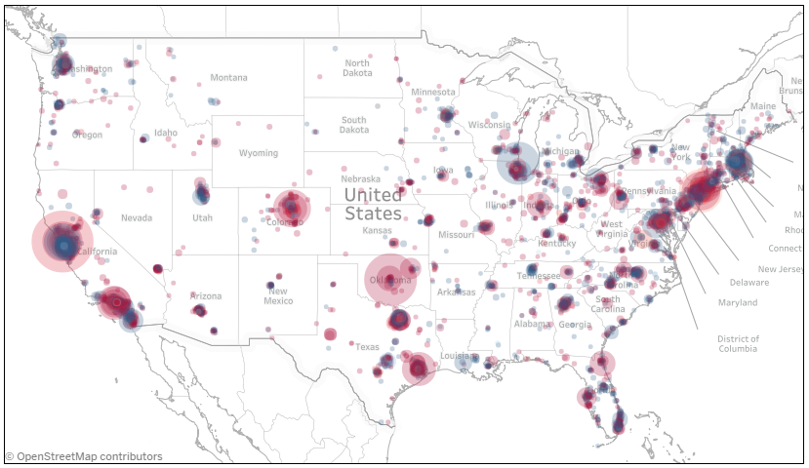
Meanwhile, far away from the SEC

Slide 60
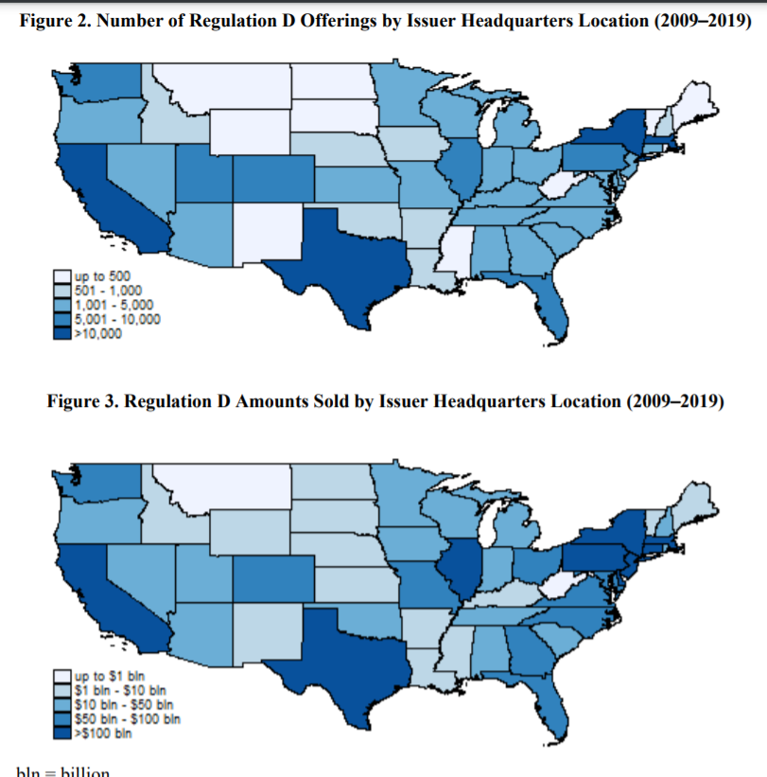
Regulation d

Slide 61
Exemptions
May be exempt because offering is Private (Nonpublic)
May be exempt because offering is Small
  Regulation “D”
    504 (small) & 506 (nonpublic)
May be exempt because offering is intrastate
  Rule 147 & 147A
May be exempt because of alternate process
  Regulation “A+”
  Crowdfunding

Slide 62
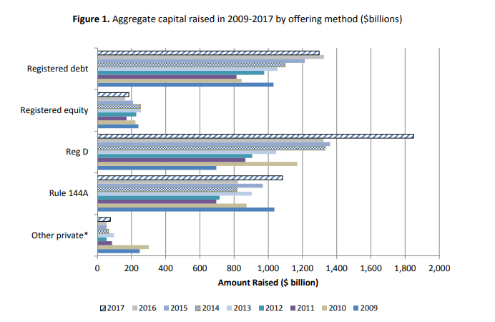
Aggregate amount raised 2009-2017

Slide 63
Aggregate amount raised 2009-2017

Slide 64
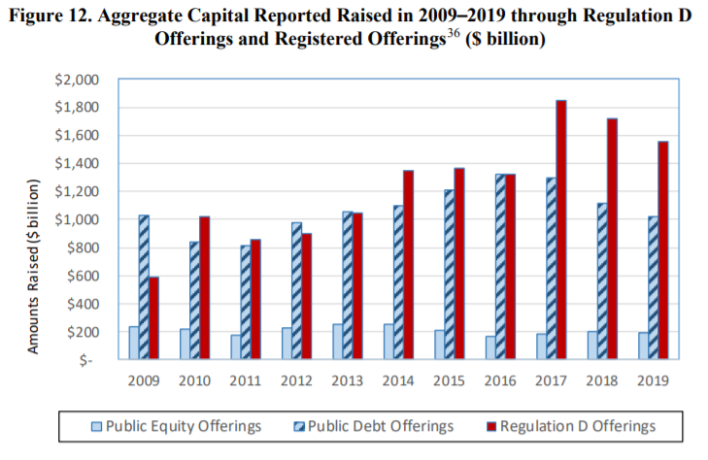

Slide 65
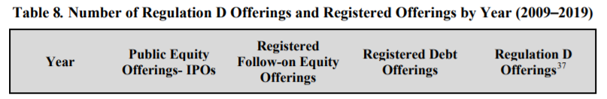
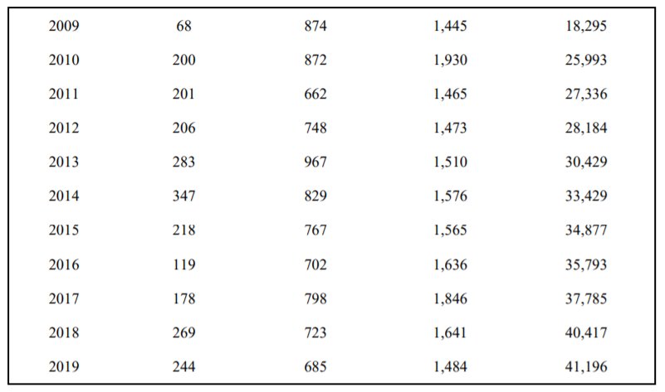

Slide 66
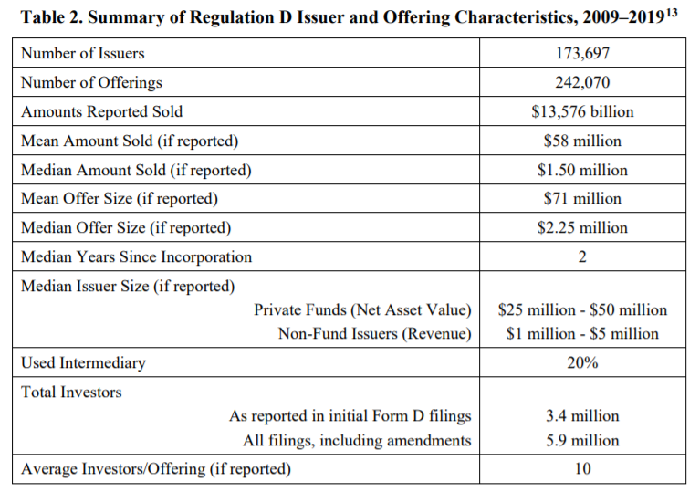

Slide 67
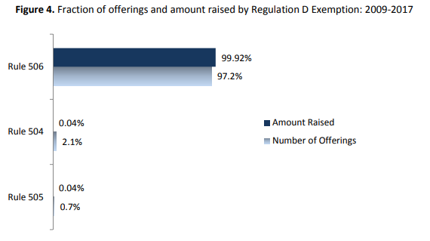
504 v. 505 v. 506

Slide 68
Effective March 15, 2021
New SEC final rules
Increase offering limits
Clarify communication rules and general solicitation
Harmonize disclosure and eligibility requirements
Rule Changes
  147, 147A
  Regulation A ($50 - $75 MM)
  Regulation D (501-508) (Raise 504 from $5 MM to $10 MM)
  Regulation CF ($1.07 MM -- $5 MM; no individual limit for accredited investors)

Slide 69
Section 3(a)(11)
Intrastate offerings
Exempt Securities:
(11) Any security which is a part of an issue offered and sold only to persons resident within a single State or Territory, where the issuer of such security is a person resident and doing business within or, if a corporation, incorporated by and doing business within, such State or Territory.

Slide 70
Securities act release no. 4434
3(a)(11) – applies to Local Financing
  Same state: incorporation, doing business, offered to residents
“part of an issue” offered or sold
“come to rest”

Slide 71


“come to rest”
“part of an issue”
3(a)(11)
Unrestricted resale
ISSUER

Slide 72

“come to rest”
“part of an issue”
COLO. ISSUER
3(a)(11)
UTAH ISSUER
ARIZ. ISSUER

Slide 73
“come to rest”
“part of an issue”
COLO. ISSUER
UTAH ISSUER
ARIZ. ISSUER

Slide 74
Busch v. carpenter
Come to Rest?
Doing Business?

Slide 75
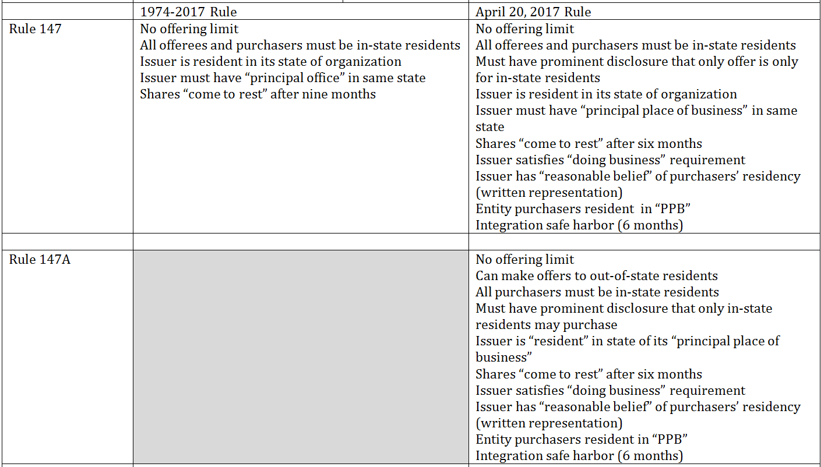
30 days
30 days

Slide 76

Sec v. Ralston purina (1953)
Public offering?

Slide 77

Doran v. petroleum mgmt. corp. (1977)
Public offering?

Slide 78
Doran v. petroleum mgmt. corp. (1977)
Public offering?
“Even the offeree-plaintiff's 20-20 vision with respect to the facts underlying the security would not save the exemption if any one of his fellow offerees was in a blind.”
“More specifically, we shall require on remand that the defendants demonstrate that all offerees, whatever their expertise, had available the information a registration statement would have afforded a prospective investor in a public offering. Such a showing is not independently sufficient to establish that the offering qualified for the private placement exemption, but it is necessary to gain the exemption and is to be weighed along with the sophistication and number of the offerees, the number of units offered, and the size and manner of the offering. ”

Slide 79
The Life Cycle of a Start-Up
Creation
Own funds
Family/
friends
Angel Investors
Venture debt
Later VC Rounds
Venture Capital
Initial Public Offering

Slide 80
Securities Regulation
Creation
Own funds
Family/ friends
Angel Investors
Venture debt
Later VC Rounds
Venture Capital
Initial Public Offering

Slide 81
Securities Regulation
Creation
Own funds
Family/ friends
Angel Investors
Venture debt
Later VC Rounds
Venture Capital
Initial Public Offering

Slide 82
REGULATION D
Creation
Own funds
Family/ friends
Angel Investors
Venture debt
Later VC Rounds
Venture Capital
Initial Public Offering
4(a)(2)

Slide 83
Regulation “d”
Rule 501-506
Section 3(b)(1): “small issues authority”
  Rule 504
Section 4(a)(2): “transaction by an issuer not involving a public offering”
  Rule 506

Slide 84
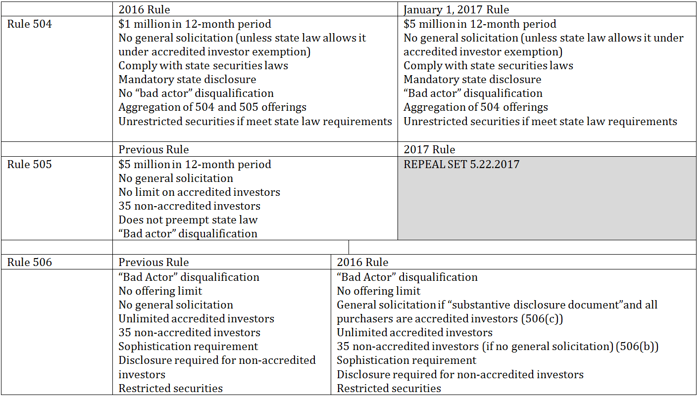

Slide 85
ACCREDITED INVESTOR

Slide 86

Rule 501(a): accredited investor
Entities with $5M assets (not formed for this purpose)
Individuals with $1M net worth (excluding residence)
Individuals with $200k income/year
Married couples with combined $300k income/year
Entity in which all equity owners are Accredited Investors
  Proposed: “professional designations”
  Proposed: “knowledgeable employees” of a private fund
  Proposed: “spousal equivalent”

Slide 87
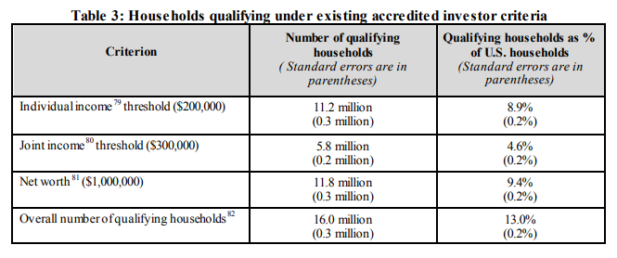
How many accredited investors?

