Slide 1
Securities regulation #11

Slide 2
Material misstatements and omissions
If no duty to disclose, then SILENCE IS GOLDEN
  Duty: 8-K; 10-K; 10-Q; S-1; S-3, etc.
However, if an issuer chooses to speak, then what is spoken must be truthful
Rule 10b-5 (Exchange Act Rule under Section 10(b)); Section 11 of Securities Act (registration statements); Section 12 of Securities Act (prospectus)
  Any untrue statement of a material fact
  Omissions – failure to state a material fact necessary in order the make the statements made, in the light of the circumstances under which they were made, not misleading.

Slide 3
You can lie if it’s not material

Slide 4
Section 10(b) rule 10b-5
STATUTE
rULE
It shall be unlawful for any person. . . .
To use or employ, in connection with the purchase or sale of any security registered on a national securities exchange or any security not so registered. . .any manipulative or deceptive device of contrivance in contravention of such rules and regulations as the commission may prescribe as necessary or appropriate in the public interest or for the protection of investors
It shall be unlawful for any person. . .
(a) To employ any device, scheme, or artifice to defraud
(b) To make any untrue statement of a material fact or to omit to state a material fact necessary in order to make the statements made, in the light of the circumstances under which they were made, not misleading, or
(c) To engage in any act, practice, or course of business which operates or would operate as a fraud or deceit upon any person.

Slide 5
Section 10(b) rule 10b-5
STATUTE
rULE
It shall be unlawful for any person. . . .
To use or employ, in connection with the purchase or sale of any security registered on a national securities exchange or any security not so registered. . .any manipulative or deceptive device of contrivance in contravention of such rules and regulations as the commission may prescribe as necessary or appropriate in the public interest or for the protection of investors
It shall be unlawful for any person. . .
(a) To employ any device, scheme, or artifice to defraud
(b) To make any untrue statement of a material fact or to omit to state a material fact necessary in order to make the statements made, in the light of the circumstances under which they were made, not misleading, or
(c) To engage in any act, practice, or course of business which operates or would operate as a fraud or deceit upon any person.

Slide 6

Basic v. Levinson

Slide 7
Basic v. Levinson (1988)
Combustion Engineering, Inc. expressed interest in acquiring Basic starting in 1976
1976 – conversations regarding a merger
10/21/77 – denial
9/25/78 – denial
11/6/78 – denial
12/18-19/78 – announcement of merger

Slide 8
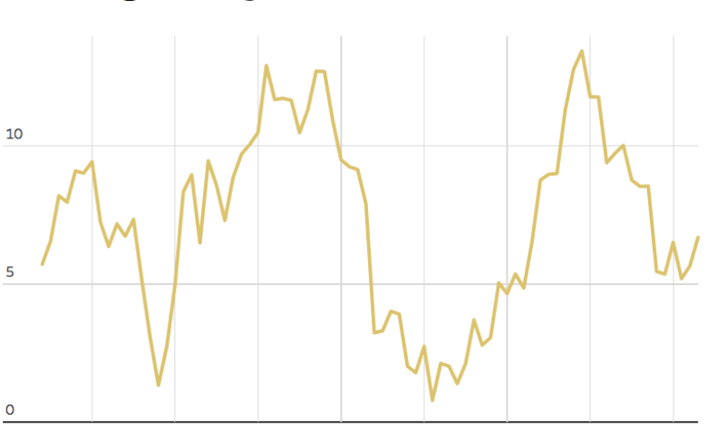

Who Loses from nondisclosure?
Nondisclosure of Negative Information
Disclosure of positive “LIE”
“LIE” that hid negative news

Slide 9
Who Loses from nondisclosure?
Nondisclosure of Negative Information
Disclosure of positive “LIE”
Buy
Sell
“LIE” that hid negative news

Slide 10
Who Loses?
Nondisclosure of Positive Information
“LIE” that hid positive news
Disclosure of “LIE” that hid positive news

Slide 11
Who Loses?
Nondisclosure of Positive Information
“LIE” that hid positive news
Buy
Sell
Disclosure of “LIE” that hid positive news

Slide 12
When do you have to speak?
When is a lie material?
Basic never had to speak
Basic chose to answer question – then had to be honest if MATERIAL
Total Mix Test: would a reasonable investor believe this to be important given the total mix of information in the marketplace?
What is particularly interesting about merger discussions?

Slide 13





“total mix” of information
Investor
Calls
Analyst Recommendations
Research reports
SEC
Documents
Financial News

Slide 14
Just for speculative events;
SEC v. Texas Gulf Sulphur Co.
Materiality will depend at any given time upon a balancing of both the indicated probability that the event will occur and the anticipated magnitude of the event in light of the totality of the company activity
Balancing
Probability
Magnitude
Totality

Slide 15
Materiality: total mix test
Total Mix Test
Current Events
Speculative
Events
Balancing Test

Slide 16
WHICH STATEMENT IS TRUE REGARDING Basic v. Levinson?
a. The Basic CEO did not have a duty to speak about the merger negotiations.
b. The Basic CEO had a duty to file a Form 8-K once the merger negotiations made it seem probable that the merger would occur.
c. The Basic CEO did not have a duty to speak about the merger negotiations, but could lie about them if asked because of confidentiality.
d. The Basic CEO did not have a duty to speak about the merger negotiations, but had a general duty to be truthful when speaking to the public.
e. None of the above.

Slide 17
WHICH STATEMENT IS TRUE REGARDING Basic v. Levinson?
a. The Basic CEO did not have a duty to speak about the merger negotiations.
b. The Basic CEO had a duty to file a Form 8-K once the merger negotiations made it seem probable that the merger would occur.
c. The Basic CEO did not have a duty to speak about the merger negotiations, but could lie about them if asked because of confidentiality.
d. The Basic CEO did not have a duty to speak about the merger negotiations, but had a general duty to be truthful when speaking to the public.
e. None of the above.

Slide 18
SEC Staff accounting bulletin No. 99
Can issuers and their accountants rely on a “rule of thumb” of 5% that any event or discrepancy that falls below that threshold is immaterial?
FASB “Material” = “The omission of misstatement of an item in a financial report is material if, in the light of surrounding circumstances, the magnitude of the item is such that it is probable that the judgment of a reasonable person relying upon the report would have been changed or influenced by the inclusion or correction of the item.”

Slide 19
whether the misstatement arises from an item capable of precise measurement or whether it arises from an estimate and, if so, the degree of imprecision inherent in the estimate¹⁴
whether the misstatement masks a change in earnings or other trends
whether the misstatement hides a failure to meet analysts' consensus expectations for the enterprise
whether the misstatement changes a loss into income or vice versa
whether the misstatement concerns a segment or other portion of the registrant's business that has been identified as playing a significant role in the registrant's operations or profitability
whether the misstatement affects the registrant's compliance with regulatory requirements
whether the misstatement affects the registrant's compliance with loan covenants or other contractual requirements
whether the misstatement has the effect of increasing management's compensation – for example, by satisfying requirements for the award of bonuses or other forms of incentive compensation
whether the misstatement involves concealment of an unlawful transaction.

Slide 20
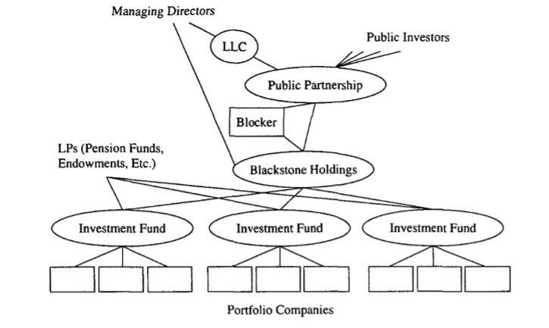
Litwin v. Blackstone Group, L.P.
Blackstone Group, L.P.

Slide 21
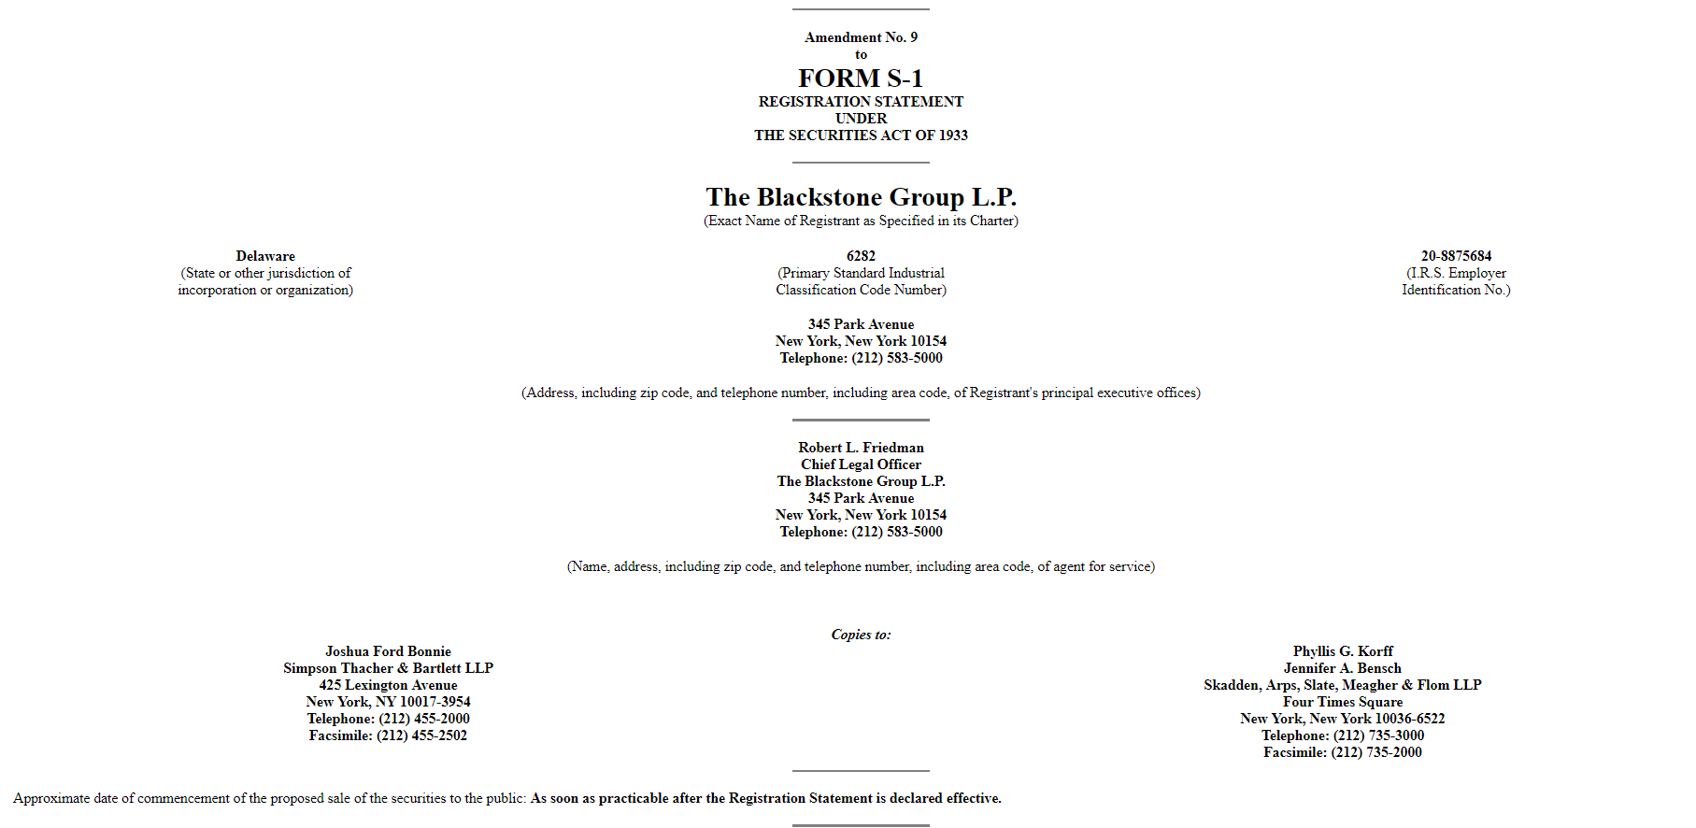

Slide 22
Litwin v. Blackstone Group, L.P.
Blackstone Group, L.P.
Marketable Alternative Asset Management
Real Estate
Corporate Private Equity

Slide 23
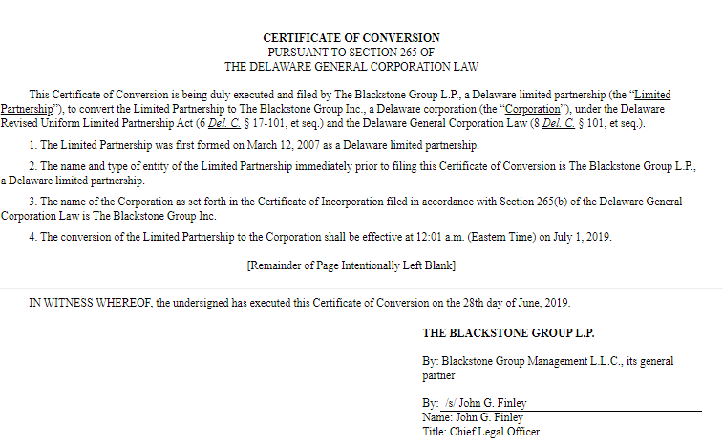

Slide 24
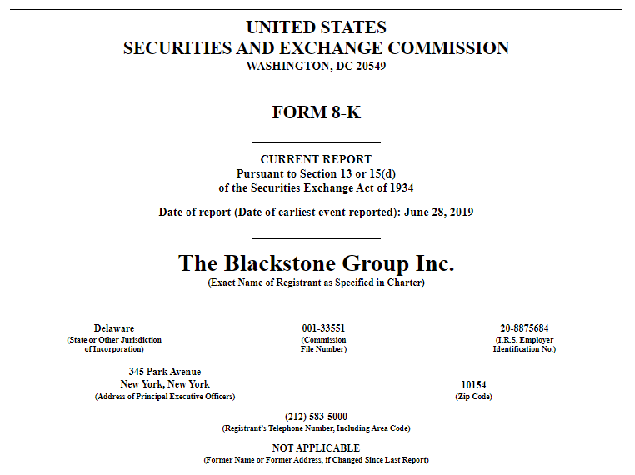
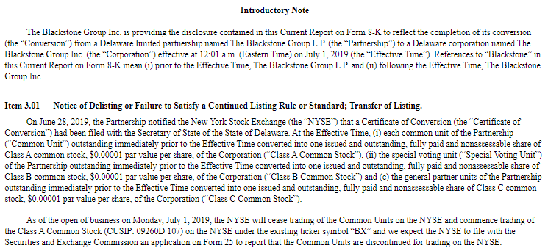

Slide 25

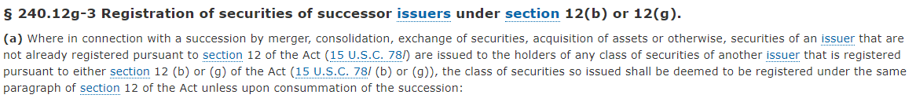
What about the new shares?

Slide 26
Litwin v. Blackstone Group, L.P.
Blackstone Group, L.P.
Marketable Alternative Asset Management
Real Estate
Corporate Private Equity
Freescale
Semiconductor
FGIC

Slide 27
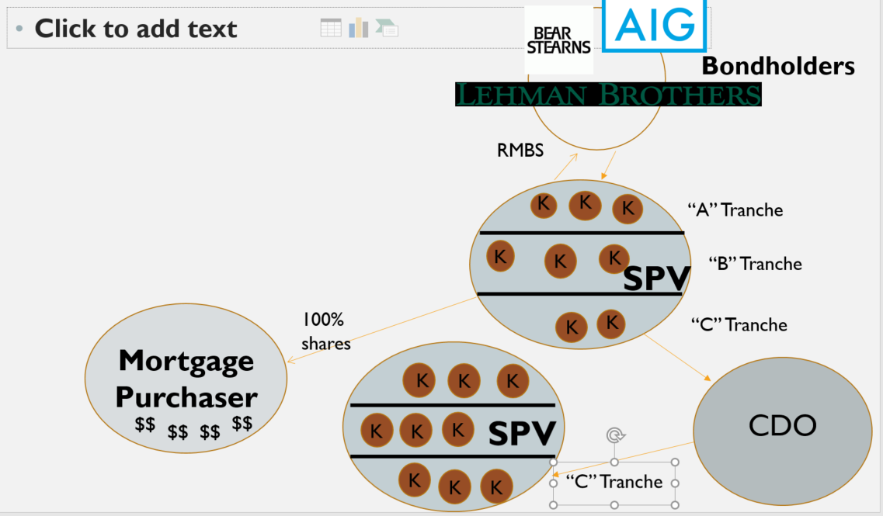
Financial guaranty – sold credit default swaps on cdo’S AND rmbs
Financial Guaranty
CDS
CDS ($13b)
Bondholders

Slide 28
Litwin v. Blackstone Group, L.P.
Blackstone Group, L.P.
Marketable Alternative Asset Management
Real Estate
Corporate Private Equity
$331MM
(0.4%)
Freescale
Semiconductor
FGIC
(3.5%)

Slide 29
Did Blackstone have a duty to disclose?
Form S-1 (Registration Statement)
Regulation S-K
  Item 303 – Management’s Discussion and Analysis of Financial Condition and Results of Operations
    (MD&A)
  303(a)(3)(ii) – “Describe any known trends or uncertainties that have had or that the registrant reasonably expects will have a material favorable or unfavorable impact on net sales or revenues or income from continuing operations.”

Slide 30
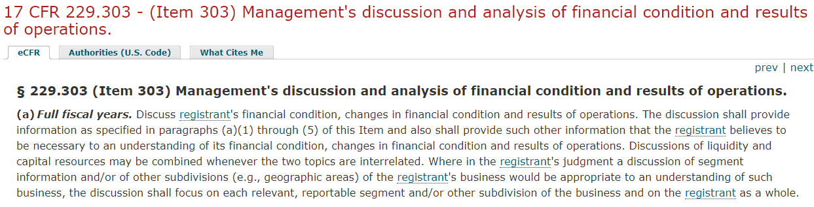
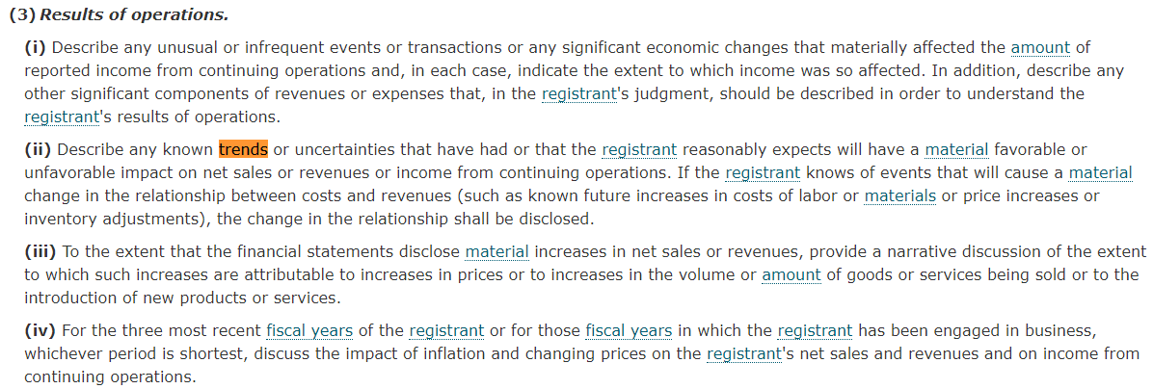

Slide 31
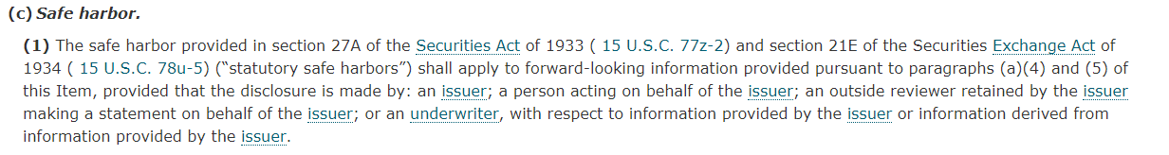
Instructions for 303(a)(3)
Safe harbor?

Slide 32
Quantitative v. qualitative

Slide 33
whether the misstatement arises from an item capable of precise measurement or whether it arises from an estimate and, if so, the degree of imprecision inherent in the estimate¹⁴
whether the misstatement masks a change in earnings or other trends
whether the misstatement hides a failure to meet analysts' consensus expectations for the enterprise
whether the misstatement changes a loss into income or vice versa
whether the misstatement concerns a segment or other portion of the registrant's business that has been identified as playing a significant role in the registrant's operations or profitability
whether the misstatement affects the registrant's compliance with regulatory requirements
whether the misstatement affects the registrant's compliance with loan covenants or other contractual requirements
whether the misstatement has the effect of increasing management's compensation – for example, by satisfying requirements for the award of bonuses or other forms of incentive compensation
whether the misstatement involves concealment of an unlawful transaction.
District Court

Slide 34
whether the misstatement arises from an item capable of precise measurement or whether it arises from an estimate and, if so, the degree of imprecision inherent in the estimate¹⁴
whether the misstatement masks a change in earnings or other trends
whether the misstatement hides a failure to meet analysts' consensus expectations for the enterprise
whether the misstatement changes a loss into income or vice versa
whether the misstatement concerns a segment or other portion of the registrant's business that has been identified as playing a significant role in the registrant's operations or profitability
whether the misstatement affects the registrant's compliance with regulatory requirements
whether the misstatement affects the registrant's compliance with loan covenants or other contractual requirements
whether the misstatement has the effect of increasing management's compensation – for example, by satisfying requirements for the award of bonuses or other forms of incentive compensation
whether the misstatement involves concealment of an unlawful transaction.
Second Circuit
District Court

Slide 35
whether the misstatement arises from an item capable of precise measurement or whether it arises from an estimate and, if so, the degree of imprecision inherent in the estimate¹⁴
whether the misstatement masks a change in earnings or other trends
whether the misstatement hides a failure to meet analysts' consensus expectations for the enterprise
whether the misstatement changes a loss into income or vice versa
whether the misstatement concerns a segment or other portion of the registrant's business that has been identified as playing a significant role in the registrant's operations or profitability
whether the misstatement affects the registrant's compliance with regulatory requirements
whether the misstatement affects the registrant's compliance with loan covenants or other contractual requirements
whether the misstatement has the effect of increasing management's compensation – for example, by satisfying requirements for the award of bonuses or other forms of incentive compensation
whether the misstatement involves concealment of an unlawful transaction.
Second Circuit
District Court

Slide 36
In re Merck & co., inc. securities litigation
Merck & Co.
100%
Medco

Slide 37

In re Merck & co., inc. securities litigation
Merck & Co.
Public Investors
Medco

Slide 38
Did Merck have a duty to speak?

Slide 39
Timeline
1999 Form 10-K: recognized revenue “for the amount billed to the plan sponsor.”
2001 Form 10-K: recognized revenue “based on the prescription drug price negotiated with the plan sponsor.”
April 17, 2002 Form S-1: disclosed that it had erroneously recognized revenue, but without quantifying the amount
June 21, 2002 WSJ article: estimated that $4.6 billion was erroneously recognized
July 5, 2002: Form S-1/A: disclosed $12.4 billion was erroneously recognized
July 9, 2002: Postponed IPO indefinitely

Slide 40
How did court decide if the misstatement was “material”?

Slide 41
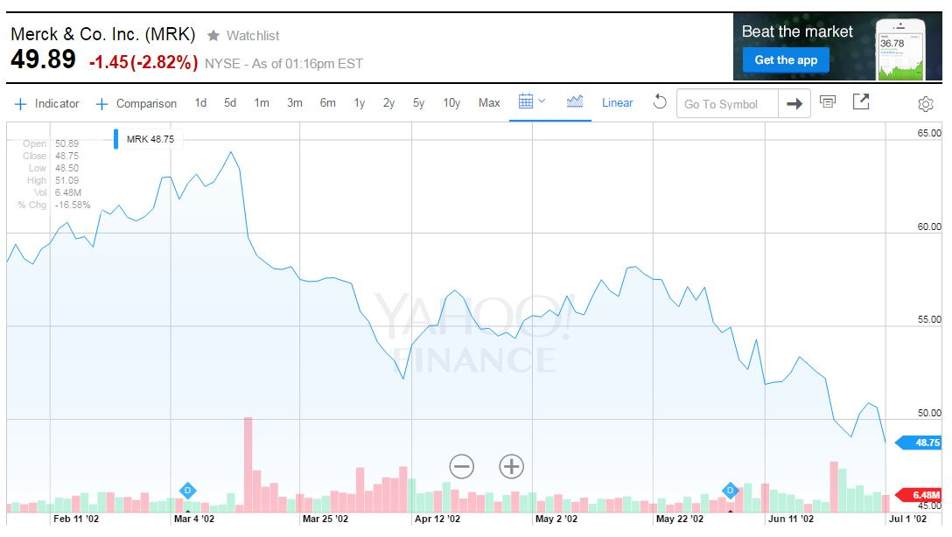
Form S-1
WSJ

Slide 42
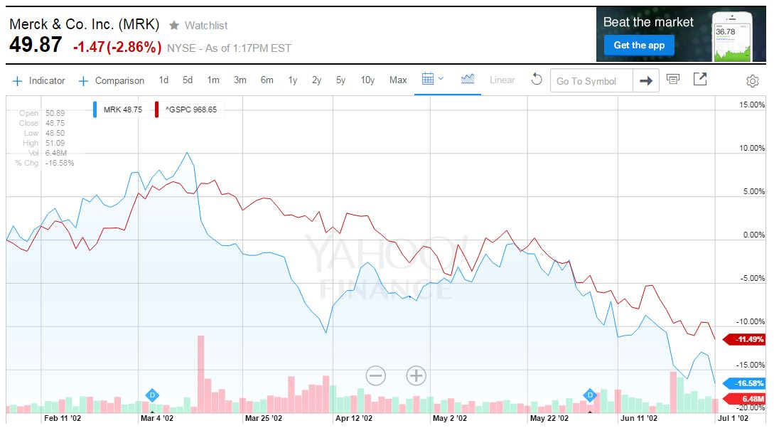
Form S-1
WSJ

Slide 43
What does price movement have to do with materiality?
If reasonable investors think information is material
Then the information will have a “price impact”

Slide 44


Positive information
More buyers than sellers
Price goes up

Slide 45
Negative information
More sellers than buyers
Price goes down

Slide 46

Event studies

Slide 47
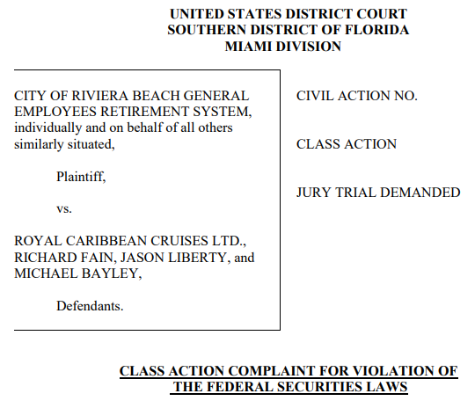
Royal Caribbean
40. The Class Period begins on February 4, 2020, when Royal Caribbean issued a press release with 2019 financial results, 2020 earnings guidance, and COVID-19 updates. The Company held an earnings call with investors on the same day. The press release read, “The company is very encouraged about the demand environment for 2020. Wave Season has started on a strong note with overall rates higher than same time last year and booked load factors ahead of same time last year on a like-for-like basis.” During the conference call with investors later that day, CEO Fain discussed the impact of COVID-19, stating: “[o]ne important bright spot is that looking beyond the current outbreak we aren't seeing a big impact on overall bookings elsewhere.”

Slide 48
45. In addition to the misstatements about customer bookings during the earnings call on February 4, 2020, Defendants misled investors regarding the Company’s safety protocols and exposure to the virus. For example, CEO Fain stated: “[i]n conjunction with CLIA, our industry trade group, we have initiated strong safeguards to help contain the spread of the disease and to protect our guests and crew.” He assured investors that “[a]ll these steps that we’re taking and others are taking are expected to ultimately contain the virus, but we don’t know how long that will take.” Downplaying the risk of the virus to the business, especially one as serious as COVID-19, Bayley stated that the Company is “taking a series of what we believe to be very prudent and sensible actions that will not entirely eliminate the risk but massively minimize this risk.”
46. On or around February 7, 2020, four passengers disembarking from one of the Company’s cruise ships in New Jersey displayed COVID-19 symptoms and were subsequently tested. In response, the Company stated: “we are closely monitoring developments regarding coronavirus and have rigorous medical protocols in place onboard our ships.” Further, the Company assured that “[i]n alignment with new stricter CDC protocols, we are tightening our measures to protect guests and crew. These steps are intentionally conservative.”

Slide 49
So far:
Materiality tests
Total Mix Test (Basic balancing test for speculative events)
Qualitative Factors
Market Test

Slide 50

Matrixx Initiatives, Inc. v. Siracusano

Slide 51
After receiving “adverse event reports”
“Poised for growth in the upcoming cough and cold season”
“very strong momentum”
Revenues would “be up in excess of 50%”
“reports of anosmia were “completely unfounded and misleading”
“the safety and efficacy of zinc gluconate for the treatment of symptoms related to the common cold have been well established”

Slide 52
What test does court use for “materiality?”
A. Total Mix Test
B. Market Test
C. 5% Rule of Thumb

Slide 53
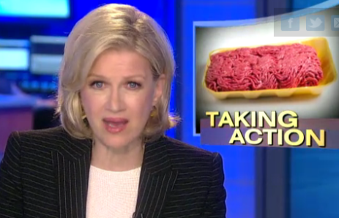
Longman v. Food Lion, inc.

Slide 54
How Can a shareholder recover the loss when the stock price drops?
Derivative lawsuit
Securities fraud lawsuit
Breach of Duty
  Duty of Care?
  Duty of Loyalty?
    Conflicted Transaction?
    Self-Dealing?
    Oversight?
Misstatement or Omission?

Slide 55
But remember. . .
The federal securities laws deal with false or misleading statements in connection with investments. The federal securities laws do not create liability for poor business judgment or failed operations.
See Santa Fe Indus., Inc. v. Green, 430 U.S. 462, 479, 97 S.Ct. 1292, 51 L.Ed.2d 480 (1977).

Slide 56
What are the misstatements?
1989 10-K: “continues to insure that Food Lion employees receive competitive wages and excellent benefits”
“we will continue to pay close attention to service levels and cleanliness in our stores and believe we will achieve high marks from customers in these areas.”
August 1990 Press Release: “competitive wages and excellent benefits”
September 1991 Press Release: “Food Lion has a very clear policy against working off the clock.”
“denies claims of employee mistreatment”
1991 10-K: “clean and conveniently located stores” “job security, good wages, good working conditions and some of the best benefits”
August 1990: Union called for a Food Lion boycott
September 1991: Union filed a complaint with DOL
November 1992: PrimeTime Live
August 1993: DOL Settlement regarding union complaints

Slide 57
Two arguments
PrimeTime Live Cleanliness issues
Labor issues

Slide 58
Labor issues
Truth on the Market Defense
    The truth is already in the market
    Given the total mix, our lies were discounted

Slide 59
Remember: The efficient capital market hypothesis
The price of a publicly-held stock should reflect all public information in the “total mix”
An investor buying such a stock at its market price is buying at a price that incorporates the “total mix”
If an issuer has omitted a material fact when they have a duty to disclose or misstated a fact, the stock price already reflects the true fact if it the true fact is already in the “total mix”
The “truth on the market” defense

Slide 60
Fraud on the market
Truth on the market
All misstatements by an issuer are automatically incorporated into the stock price of a publicly-held stock
An investor does not have to read the particular misstatement in order to prove reliance or causation between their purchase of the stock and the stock price drop
Because they purchased at the market price, which incorporated the misstatement, they relied on the market price and they are harmed by the misstatement
All public facts are incorporated into the stock of a publicly-held stock
If a fact is known to the marketplace, it is incorporated into the price
The issuer may have omitted a material fact, or misstated the fact, but if the true fact is in the marketplace, the stock price already incorporates it
An investor buying the stock at the market price is not harmed by not having the true fact restated by the issuer or by having the issuer deny the true fact.

Slide 61
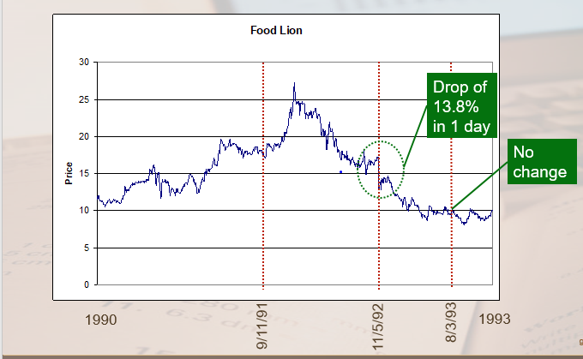
Market test?

Slide 62
What about the tv show?
Puffery
Reasonable investors do not add puffery into the “total mix”
The market discounts puffery

Slide 63
Securities fraud – “bad fact”
Not Actionable
No.
Was Fact Material?
Fraudulent Misstatement?
Yes.
Yes.
Yes.
Actionable
Was there a duty to speak about the fact?
No.
Was Omitted Fact Material?
No.
Not Actionable
Was Fact Material?
No.
Yes.
No.
No.
Was Issuer Silent about the Fact?
Actionable
Yes.
Not Actionable
Yes.
Not Actionable
Actionable

Slide 64
Julie invested money in a Young Living Essential Oils, LLC distributorship ($100/month). This investment gave her product she could resell for $132, but most months she could not sell most of the product. She could also make a 24% commission on product sold by those she recruited, but it was also hard to recruit others. Julie believes that the recruiting materials contain false statements. What is YLEO’s strongest defense against a securities law class action?
Julie’s distributor interest is not a security because it is an LLC interest.
Julie’s distributor interest is not a security because the profitability depends more on her efforts than on YLOE’s efforts.
Julie’s distributor interest is not a security because there is no vertical commonality between her and YLEO.
Julie’s distributor interest is not a security because what she bought was for her consumption not for profit.
Julie’s distributor interest is not a security because the PSLRA exempts intrastate securities from federal anti-fraud regulation.

Slide 65
the recruiting portion of YLEO’s website has statements such as “At the intersection of cutting-edge research and traditional wisdom, Young Living’s essential oils and oil-infused products empower you to claim your best life” and members have “the opportunity to bring life-changing solutions to homes around the world.” However, according to the FDA, YLEO do not have any medicinal purposes. What is YLEO’s strongest defense to Section 12(a)(2) claim?
Those statements are mere puffery, and the reasonable market disregards puffery given the total mix of information.
Those statements are not material because whether the products have successful wellness solutions is forward-looking.
Those statements are not material because they are merely the opinions of the company.
Those statements are not material unless O’Shaughnessy actually believed them.
Even if the statements are material, they are not actionable unless O’Shaughnessy proves a but, for relationship between the statements and her purchase.

