Slide 1
Securities regulation #7

Slide 2
Current event: Gamestop lingo: short-selling
Two ways to have a “short position”:
1. Purchase (for a premium) a put option
2. Sell (for a premium) a call option

Slide 3

So, I see gamestop is in trouble.
I think the stock will decrease in value.
12/1 – stock price $16.
I think it will fall to $10.
I can buy a put option to sell on 3/1 for $13.
I have to pay the premium for the option
If the price falls to $10, my option is worth $3
I can sell a call option for Purchaser to buy on 3/1 for $13.
I will receive the premium for the option

Slide 4

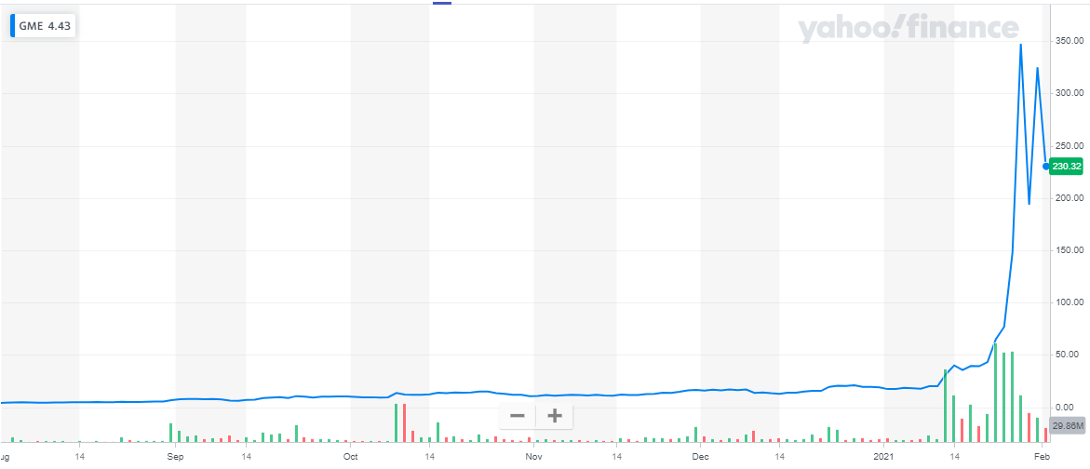
The stock begins to rise
If I bought a put option to sell on 3/1 for $13, my option is decreasing in value to become worthless.
If the stock price is over $13 on 3/1, I will not exercise.
Regardless of the 3/1 price, my loss is capped at the premium.
If I sold the call option, the Purchaser has the right to purchase the stock from me at $13 on 3/1, no matter what the market price is. As the price increases, the value of the option increases to the Purchaser, but decreases for me.
As the price approaches $350, the value to Purchaser is $333; the loss to me is $333 and rising. I will have to buy shares for $350 and sell for $13. The broker-dealer will require me to put up some security – either GameStop shares or cash.

Slide 5
Monday lingo:
What is a “Direct listing”?

Slide 6





Initial Public Offering
3rd Purchaser
2nd Purchaser
3rd Purchaser
VC
IPO Purchaser
2nd Purchaser
ISSUER
IPO Purchaser
2nd Purchaser
VC
3rd Purchaser
IPO Purchaser

Slide 7
Public Purchaser
2nd Purchaser
Public Purchaser
3rd Purchaser
Early Investors
Shareholders
2nd Purchaser
Public Purchaser
3rd Purchaser
Employees
2nd Purchaser
VC
Public Purchaser
ISSUER
VC
3rd Purchaser
Public Purchaser
Direct Listing
2nd Purchaser

Slide 8
Public Purchaser
2nd Purchaser
Public Purchaser
3rd Purchaser
Early Investors
Shareholders
2nd Purchaser
Public Purchaser
3rd Purchaser
Employees
2nd Purchaser
VC
Public Purchaser
ISSUER
VC
3rd Purchaser
Public Purchaser
Primary Direct Floor Listing
2nd Purchaser

Slide 9
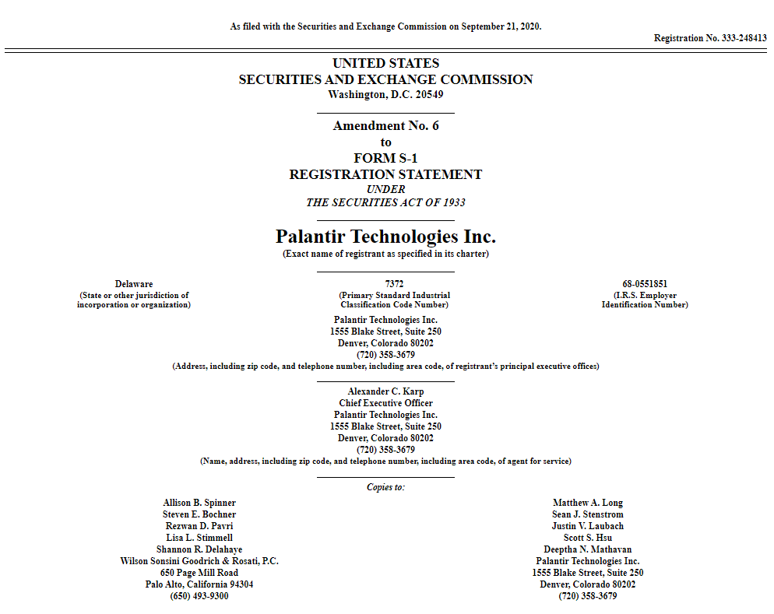

Slide 10
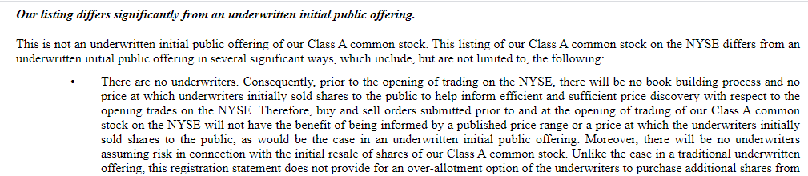
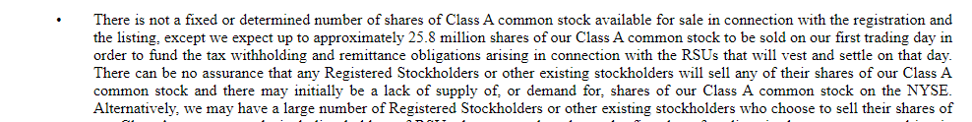

Slide 11
Back to initial public offerings

Slide 12
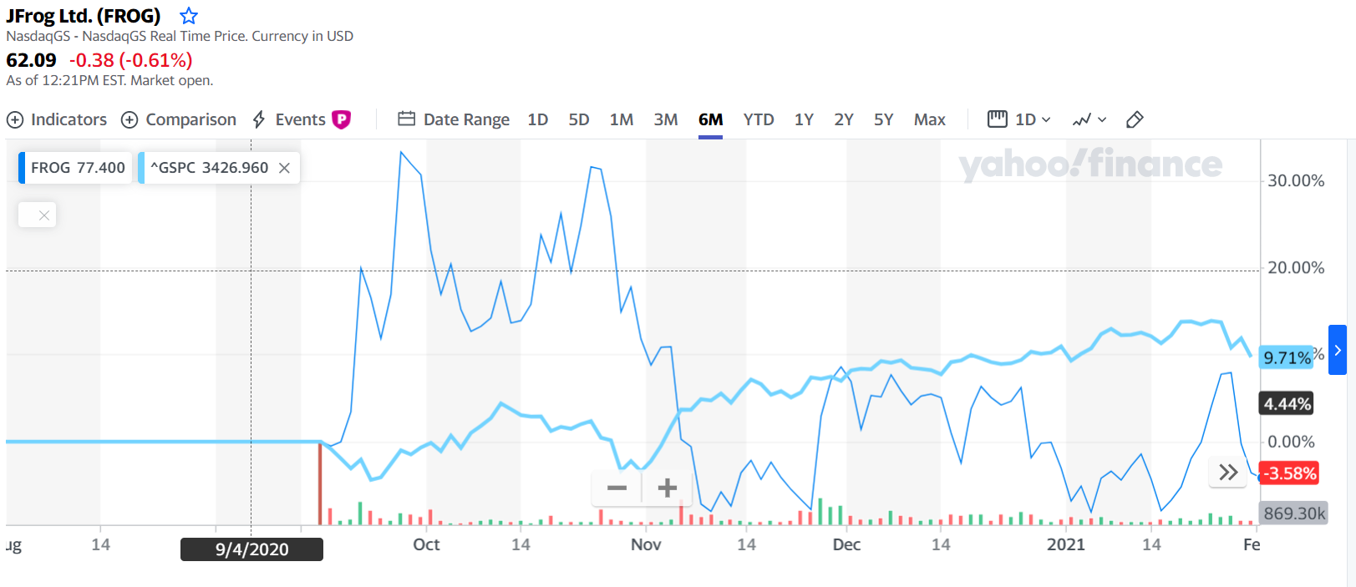
JFrog’s public offering
104.17%
$245
IPO Price: $120

Slide 13
Timeline
Pre-Filing Period
Waiting Period
(In registration)
Registration is effective
Sales & Delivery

Slide 14
Registration Statement
Section 6 & 7 of ‘33 Act
Form S-1
Form F-1
Draft (Confidential) Form S-1
  EGCs and non-EGCs

Slide 15
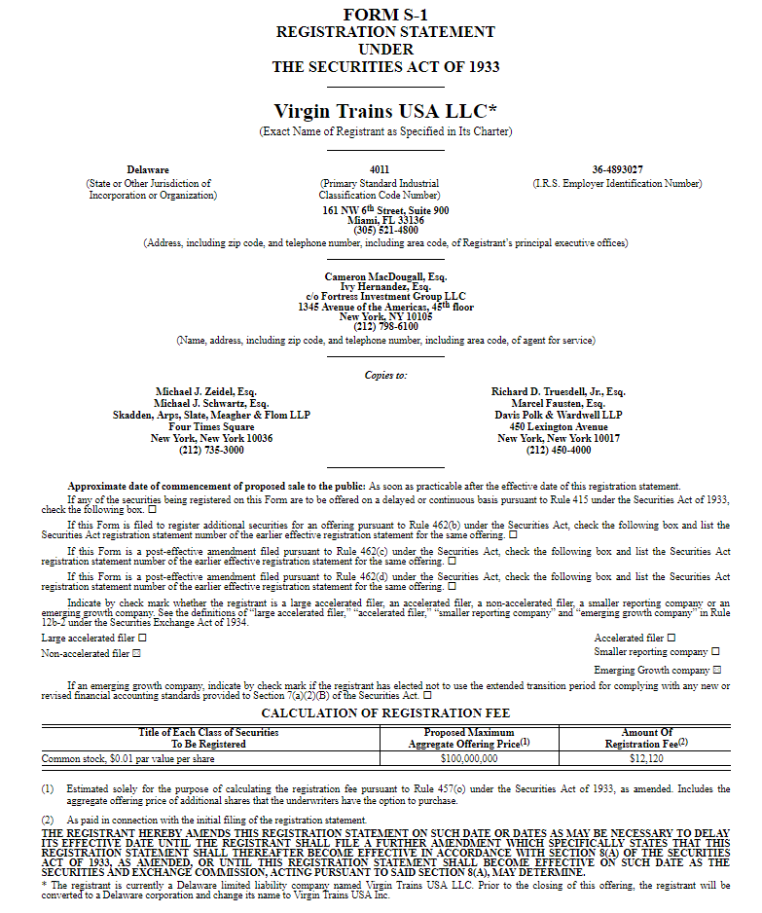

Slide 16
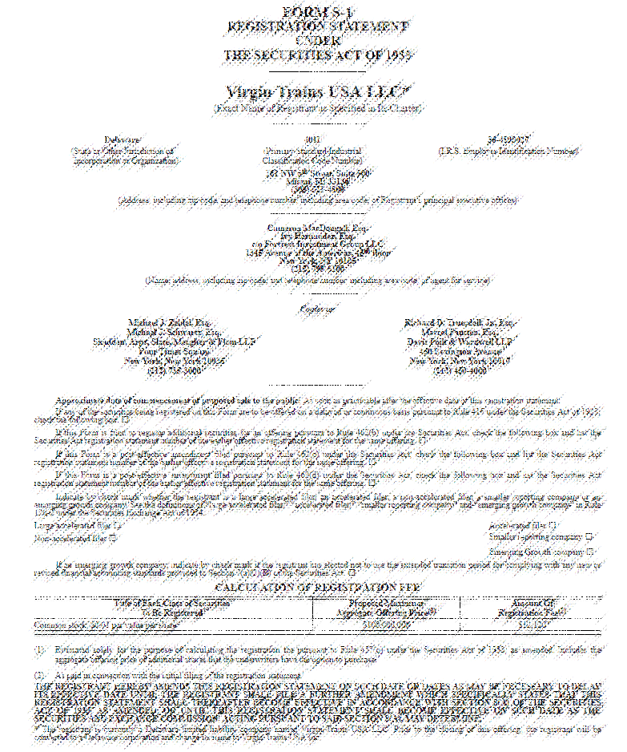

Slide 17
IPO Gun-jumping in three rules
1. Don’t make offers to sell a security until you file your registration statement (S-1 or F-1)
  What is an offer?
2. Don’t make an offer after you file your registration statement in writing unless it is in a prospectus
  What is a prospectus?
3. Don’t sell a security before your registration statement has been declared effective by the SEC

Slide 18
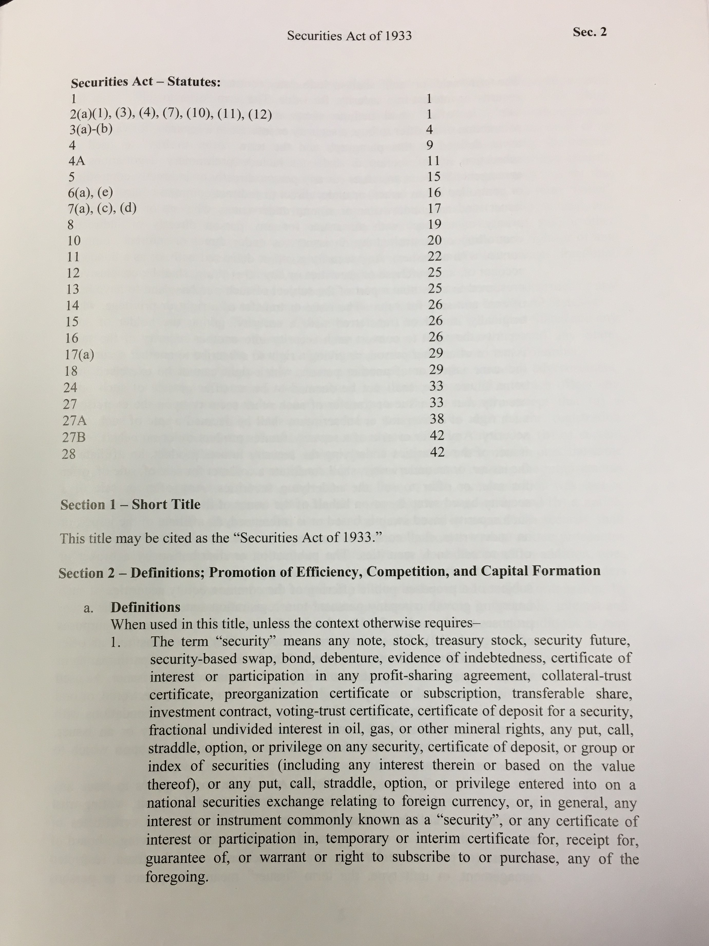
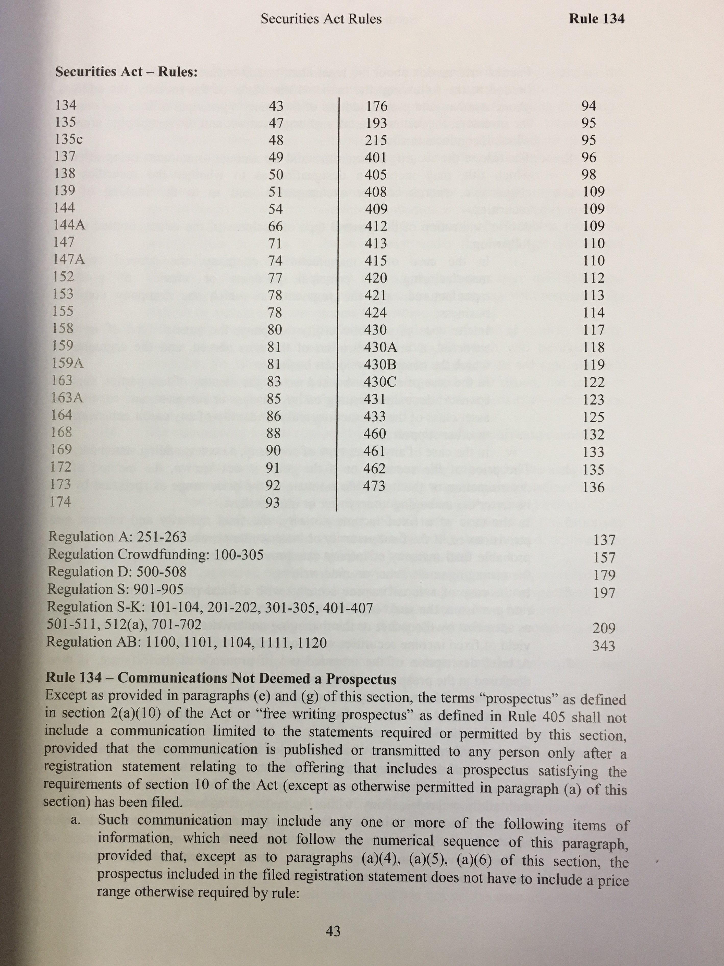
Where are we getting this?
Statute
Rules

Slide 19
Gun-Jumping Rules
Section 5(a)
Unless a registration statement is in effect as to a security, it shall be unlawful for any person, directly or indirectly
  (1) to ... sell [a] security through the use or medium of any prospectus or otherwise; or
(2) to carry ... in interstate commerce ...
any ... security for the purpose of sale
or for delivery after sale.
Notes:
Section 5(a) forbids sales before the registration statement has been declared effective

Slide 20
Gun-Jumping Rules
Section 5(c)
(c) It shall be unlawful for any person ... to offer to sell or offer to buy ... any security, unless a registration statement has been filed as to such security ...
Notes:
Offers are forbidden until the registration statement is on file with the SEC

Slide 21
Gun Jumping Rules
Sale and Offer – Section 2(a)(3) Definitions
The term "sale" or "sell" shall include every contract of sale or disposition of a security or interest in a security, for value. The term "offer to sell", "offer for sale", or "offer" shall include every attempt or offer to dispose of, or solicitation of an offer to buy, a security or interest in a security, for value. …
Notes:
Definition does not offer much guidance, although it is certainly intended to be broad in its reach.

Slide 22
Registration statement
Method of Registration – Section 6(a)
Information Required in a Registration Statement – Section 7(a)
I.P.O.
Form S-1 (must provide information according to Regulation S-K)
Form S-3 (must provide information according to Regulation S-K, but can incorporate by reference)
  Can register to make offers on a delayed or continuous basis under Rule 415 (shelf offerings).
Form F-1 (similar to S-1, but for foreign filers)
I.P.O.

Slide 23
Registration statement
Basic Information Package (Regulation S-K)
  Audited financial statements (balance sheets for the end of the most recent two fiscal years, income statement and statement of changes in financial position for each of the most recent fiscal years)
  Selected financial information for the last five years – trends in sales, income, loss, assets, obligations, dividends, etc.
  Management Discussion & Analysis
  Trading market for the issuer’s stock
  Distribution and use of proceeds
  Securities of the Registration
  Exhibits and Undertakings (not in prospectus)

Slide 24
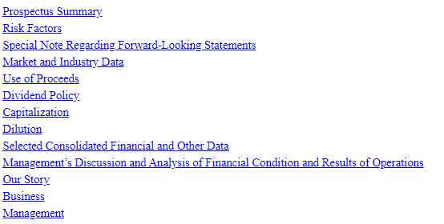

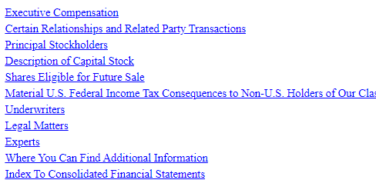

Slide 25
What kind of risks?
General Business Risks
Industry-Specific Risks
Economic Climate Risks
Firm-Specific Risks
General Investment Risks/Stock Ownership Risks

Slide 26
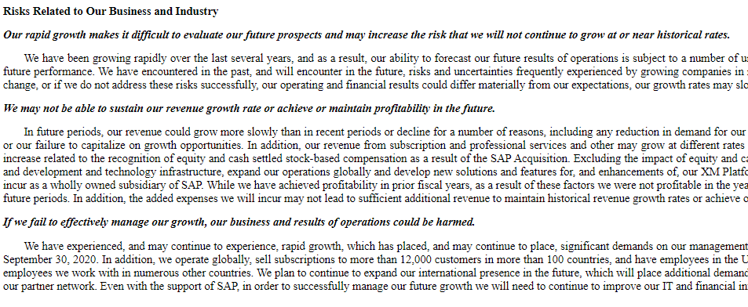
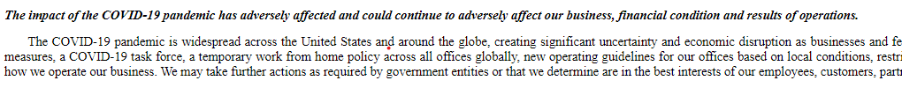

Slide 27
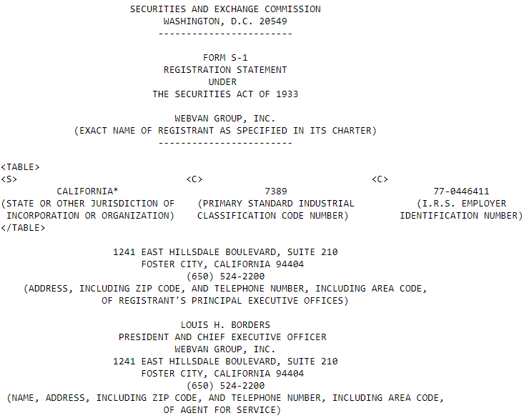
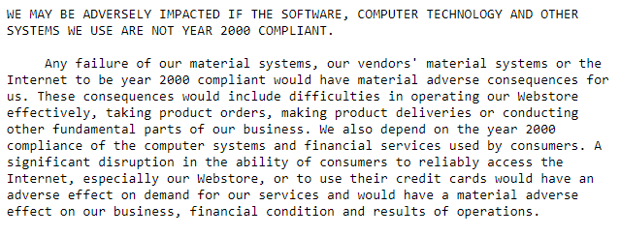

Slide 28
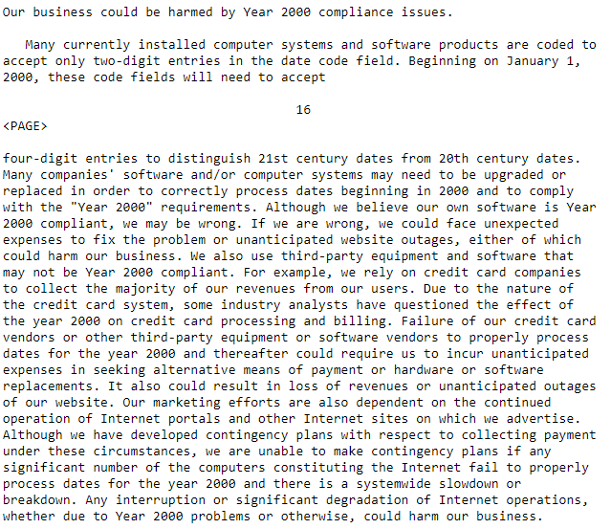
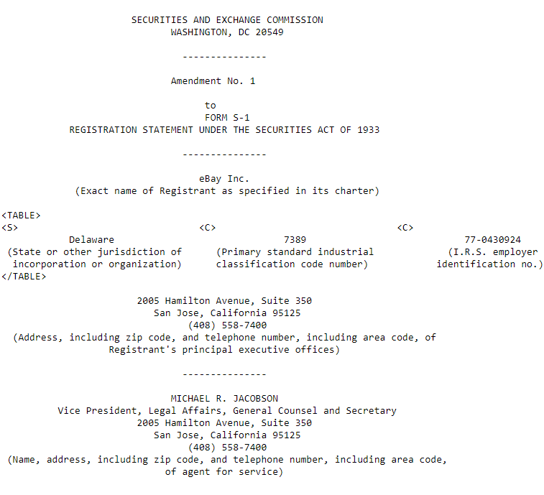

Slide 29
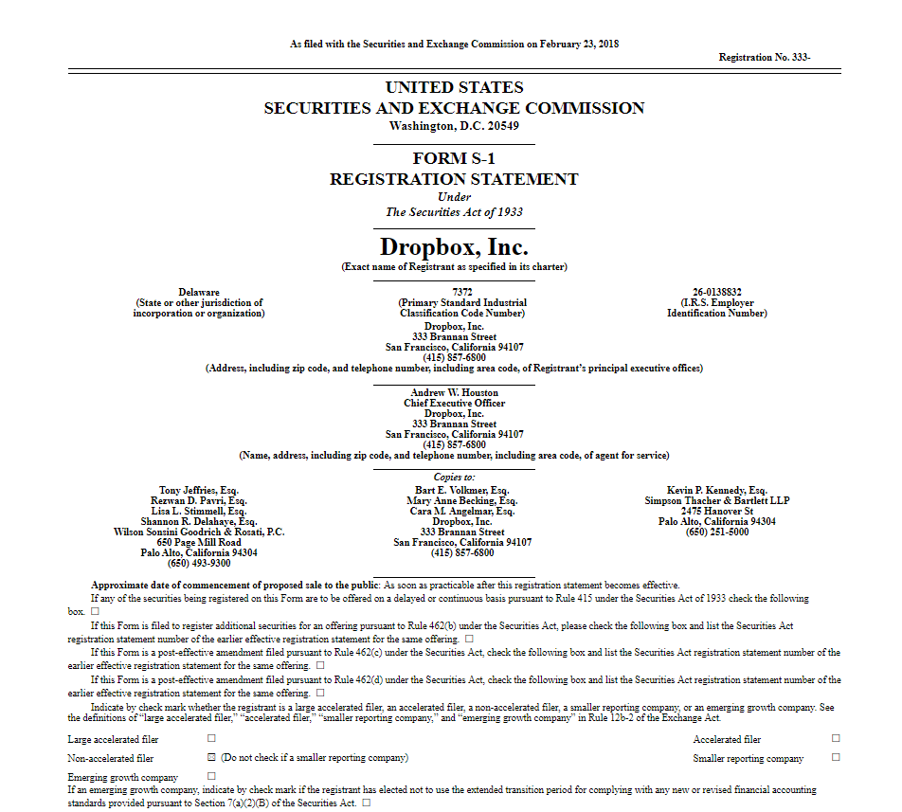

Slide 30
The multi-class structure of our common stock will have the effect of concentrating voting control with those stockholders who held our capital stock prior to the completion of this offering, and it may depress the trading price of our Class A common stock.
In addition, in July 2017, FTSE Russell and Standard & Poor’s announced that they would cease to allow most newly public companies utilizing dual or multi-class capital structures to be included in their indices. Affected indices include the Russell 2000 and the S&P 500, S&P MidCap 400, and S&P SmallCap 600, which together make up the S&P Composite 1500. Under the announced policies, our multi-class capital structure would make us ineligible for inclusion in any of these indices, and as a result, mutual funds, exchange-traded funds, and other investment vehicles that attempt to passively track these indices will not be investing in our stock. These policies are very new and it is as of yet unclear what effect, if any, they will have on the valuations of publicly traded companies excluded from the indices, but it is possible that they may depress these valuations compared to those of other similar companies that are included.
Dual-Class Common

Slide 31
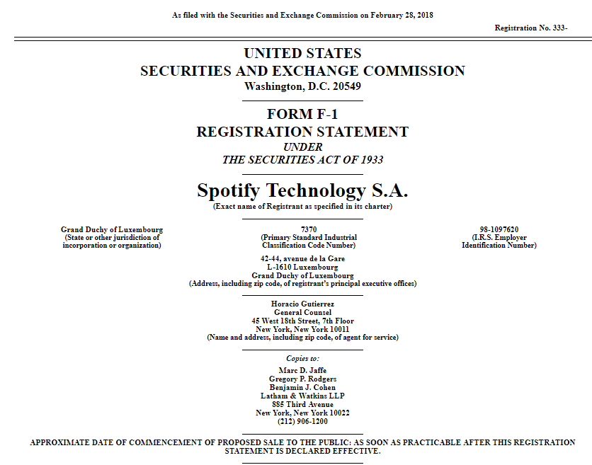

Slide 32
Risks Related to Owning Our Ordinary Shares
Our listing differs significantly from an underwritten initial public offering.
This is not an underwritten initial public offering. This listing differs from an underwritten initial public offering in several significant ways, which include, but are not limited to, the following:
There are no underwriters. Consequently, prior to the opening of trading on the NYSE, there will be no book building process and no price at which underwriters initially sold shares to the public to help inform efficient price discovery with respect to the opening trades on the NYSE. . . .Moreover, there will be no underwriters assuming risk in connection with the initial resale of our ordinary shares. . . [No stabilization techniques.]
There is not a fixed number of securities available for sale. Therefore, there can be no assurance that any Registered Shareholders or other existing shareholders will sell any or all of their ordinary shares. . .
None of our Registered Shareholders or other existing shareholders have entered into contractual lock-up agreements or other contractual restrictions on transfer, except for TME and Tencent.
We will not conduct a traditional “roadshow” with underwriters prior to the opening of trading on the NYSE. Instead, we intend to host an investor day. . . .
Such differences from an underwritten initial public offering could result in a volatile market price for our ordinary shares and uncertain trading volume and may adversely affect your ability to sell your ordinary shares.
Direct Listing

Slide 33
As a foreign private issuer, we are exempt from a number of U.S. securities laws and rules promulgated thereunder and are permitted to publicly disclose less information than U.S. companies must. This may limit the information available to holders of the ordinary shares.
As a foreign private issuer, we will file an annual report on Form 20-F within four months of the close of each fiscal year ended December 31 and furnish reports on Form 6-K relating to certain material events promptly after we publicly announce these events. However, because of the above exemptions for foreign private issuers, which we intend to rely on, our shareholders will not be afforded the same information generally available to investors holding shares in public companies that are not foreign private issuers.
We are organized under the laws of Luxembourg and a substantial amount of our assets are not located in the United States. It may be difficult for you to obtain or enforce judgments or bring original actions against us or the members of our board of directors in the United States.
As there is no treaty in force on the reciprocal recognition and enforcement of judgments in civil and commercial matters between the United States and Luxembourg, courts in Luxembourg will not automatically recognize and enforce a final judgment rendered by a U.S. court.
Foreign Issuer

Slide 34
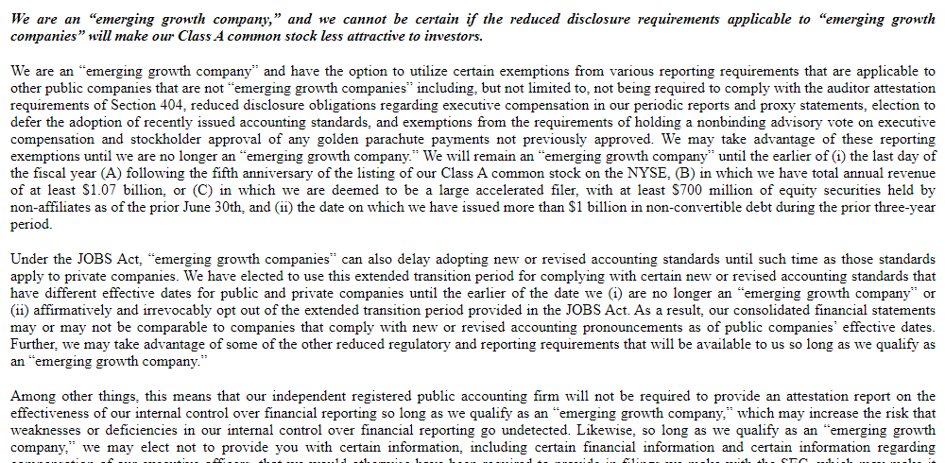
Palantir (Sept. 2020)
Emerging Growth Company Status

Slide 35
Emerging Growth
Companies
Notes:
We typically summarize the special provisions of the JOBS Act of 2012 that affect how emerging growth companies go through the public offering process. This includes reduced disclosure requirements (including only two years of audited financial statements), confidential draft registration statements, and a new “test the waters” regime.
In discussing these new provisions, we emphasize competing arguments on the wisdom of easing the burdens of the public offering process for emerging market companies. On the one hand, Congress was motivated by the notion that the public offering process is too costly, driving many smaller, startup companies away from the public capital markets. By reducing these costs, the hope is that startup companies will raise more capital through registered public offerings, leading to more job creation and faster economic growth. On the other hand, one can worry that some small startup companies may expose investors to a high degree of risk and possibly fraud.

Slide 36
Emerging Growth Companies
Definition [JOBS Act of 2012]
Section 2(a)(19) of the Securities Act
The term ‘emerging growth company’ means an issuer that had total annual gross revenues of less than $1,000,000,000 (as such amount is indexed for inflation every 5 years by the …) during its most recently completed fiscal year.
Notes:
Under $1 billion in revenues to qualify as an emerging growth company

Slide 37
Section 2(a)(19)
An issuer that is an emerging growth company as of the first day of that fiscal year shall continue to be deemed an emerging growth company until the earliest of—
the last day of the fiscal year of the issuer during which it had total annual gross revenues of $1,000,000,000 … or more [indexed for inflation]
the last day of the fiscal year of the issuer following the fifth anniversary of the date of the first sale of common equity securities of the issuer pursuant to an effective registration statement … .
Notes:
Status expires after five years from IPO or hitting $1 billion in revenues
Two other ways: ‘‘(C) the date on which such issuer has, during the previous 3-year period, issued more than $1,000,000,000 in non-convertible debt; or
‘‘(D) the date on which such issuer is deemed to be a ‘large accelerated filer’, as defined in [Exchange Act Rule 12b– 2]."

Slide 38
Special Provisions
Exemption from Dodd Frank Act Say on Pay and Golden Parachute provisions and Executive Compensation disclosure obligations
Reduced financial disclosures
  IPO registration statement need not present more than 2 years of audited financial statements (usually 3)
Exempt from §404 of Sarbanes Oxley
  Auditor Assessment of Internal Controls
Notes:
Less costly—at least initially—transition to public company status

Slide 39
IPO Provisions for EGCs
Exemption from definition of an “offer” in § 2(a)(3) for certain research reports (including investment bank analyst pre-IPO reports)
Confidential draft registration statement review by the SEC prior to public filing.
Testing the waters with QIBs and institutional accredited investors in the Pre-Filing Period under §5(d)

Slide 40
Note: Draft registration statement filing now available to all issuers
SEC, Draft Registration Statement Processing Procedures Expanded (June 29, 2017)
“Staff decision” – no rule change; no notice and comment

Slide 41
NOTE: testing the waters now available to all issuers
Rule adopted by the SEC on September 25, 2019:
§ 230.163B Exemption from section 5(b)(1) and section 5(c) of the Act for certain communications to qualified institutional buyers or institutional accredited investors
(a) Attempted compliance with this rule does not act as an exclusive election, and the issuer also may claim the availability of any other applicable exemption or exclusion. Reliance on this rule does not affect the availability of any other exemption or exclusion from the requirements of section 5 of the Act (15 U.S.C. 77e).
(b)(1) An issuer, or any person authorized to act on behalf of an issuer, may engage in oral or written communications with potential investors described in paragraph (c) of this section to determine whether such investors might have an interest in a contemplated registered securities offering, either prior to or following the date of filing of a registration statement with respect to such securities with the Commission. Communications under this rule will be exempt from section 5(b)(1) (15 U.S.C. 77e(b)(1)) and section 5(c) of the Act (15 U.S.C. 77e(c)).
(2) Any oral or written communication by an issuer, or any person authorized to act on behalf of an issuer, made in reliance on this rule will be deemed an “offer” as defined in section 2(a)(3) of the Act (15 U.S.C.77b(a)(3)).
(3) Any oral or written communication by an issuer, or any person authorized to act on behalf of an issuer, made in reliance on this rule is not required to be filed with the Commission, including pursuant to § 230.424(a) or § 230.497(a) of Regulation C under the Act or section 24(b) of the Investment Company Act of 1940 (15 U.S.C. 80a-24(b)) and the rules and regulations thereunder.
(c) Communications under this rule may be made with potential investors that are, or that an issuer or person authorized to act on its behalf reasonably believes are: (1) Qualified institutional buyers, as defined in § 230.144A; or (2) Institutions that are accredited investors, as defined in §§ 230.501(a)(1), (a)(2), (a)(3), (a)(7), or (a)(8).

Slide 42
Gun Jumping Rules
Issuer Categories
– Non-Reporting Issuer
  – No periodic reports
– Unseasoned Issuer
  – Reporting, but not eligible for S-3
– Seasoned Issuer
  – S-3 eligible for primary offerings
– Well-Known Seasoned Issuers (WKSI)
  – S-3 eligible for primary offerings, and
  – $700 million in equity or $1 billion in debt
    offerings over last three years
Emerging Growth Company

Slide 43
Timeline
Pre-Filing Period
Waiting Period
(In registration)
Registration is effective
Sales & Delivery
“Sales”
“Offers to Sell”
“Offers to Buy”
“Sales”
“Offers to Sell”
“Offers to Buy”
“Sales”
“Offers to Sell”
“Offers to Buy”
“Sales”
“Offers to Sell”
“Offers to Buy”

Slide 44
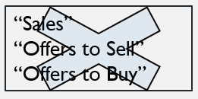
Pre-Filing Period
Pre-Filing Period
Waiting Period
(In registration)
Registration is effective
Sales & Delivery
What are the regulatory goals of the Pre-Filing Period?
What rules apply?
What safe harbors are available?

Slide 45
Pre-Filing Period
All potential investors should receive the same information about the offering; at the same time; in the same format as other offerings.
Regulatory concern:
Release of nonfactual information that could attract investor interest
“Conditioning the Market”

Slide 46
Does the communication “condition the market”?
SEC Release No. 3844
motivation of the communication
arranged after a financing decision is more likely an offer
type of information
soft, forward-looking information is more likely an offer
breadth of the distribution
broader means more likely an offer
form of the communication
written, easily reproduced and distributed communications are more likely an offer
mentioning facts about the offering
naming the underwriter is more likely an offer

Slide 47
Pre-Filing Period Safe Harbors
Rule 135
Rule 163A
Rule 163
Rule 168
Rule 169

Slide 48
ALWAYS REMEMBER section 4(a)(1)
Exempted Transactions:
The provisions of section 5 shall not apply to “transactions by any person other than an ISSUER, UNDERWRITER OR DEALER
Exempt: journalists, ordinary investors, etc.

Slide 49
Rule 163A: Exemption from Section 5(c)
In all registered offerings by ISSUERS, any communication made by or on behalf of an issuer more than 30 days before the date of the filing of the registration statement that does not reference a securities offering that is or will be the subject of a registration statement shall not constitute an offer to sell, offer for sale, or offer to buy . . . .

Slide 50
Rule 135: Notice of Proposed registered offerings
It is not an OFFER if the ISSUER (not UNDERWRITER) discloses an intention to make a public offering
Cannot identify underwriters or price
Must have LEGEND (“This notice does not constitute an offer to sell securities.”)
Limited Information:
  Issuer name; title, amount and basic terms of securities offered; anticipated timing; brief statement of the manner and purpose of the offering

Slide 51
Rule 163: Exemption from 5(c) for WKSI’s
“An offer by or on behalf of [a WKSI] is exempt from the prohibitions in section 5(c) of the Act. . . .provided that”
  1. The written communication that is an offer will be a “free writing prospectus” under Rule 405 and a prospectus under 2(a)(10)
  2. Legend
  3. Must file with the SEC “promptly” upon the filing of the registration statement

Slide 52
Rule 163 Legend
The issuer may file a registration statement (including a prospectus) with the SEC for the offering to which this communication relates. Before you invest, you should read the prospectus in that registration statement and other documents the issuer has filed with the SEC for more complete information about the issuer and this offering. You may get these documents for free by visiting EDGAR on the SEC Web site at www.sec.gov. Alternatively, the company will arrange to send you the prospectus after filing if you request it by calling toll-free 1-8XX-XXXX.

Slide 53
Rule 168: Exemption from 2(a)(10) prospectus and 5(c) Offer
The regular release or dissemination by an ISSUER of communications containing factual business information or forward-looking information shall be deemed not to constitute an offer to sell. . . .
Conditions:
  Must be a Reporting Issuer
  Must not mention the offering
  The issuer has previously released or disseminated information of the type described in the ordinary course of its business and the timing, manner, and form is consistent with past releases.
Examples:
  Factual information about the issuer, its business or financial developments
  Advertisements of products and services
  Dividend notices

Slide 54
Rule 169: Exemption from Sections 2(a)(1) Prospectus and 5(c) offer
Safe harbor for factual business information
Conditions:
  Must not mention the offering
  The issuer has previously released or disseminated information of the type described in the ordinary course of its business and the timing, manner, and form is consistent with past releases.
  Can be a nonreporting company
  Factual information about the issuer, its business or financial developments
  Advertisements of products and services

Slide 55
Prefiling Period Safe Harbors
Safe Harbor | Exemption | Type of Issuer | Type of Information Allowed
Rule 163A | § 5(c) | All | – May not reference offering
Rule 163 | § 5(c) | WKSI (163(a)(1)) | – Offers
Rule 168 | §§ 5(c) and 2(a)(10) | Exchange Act Reporting Issuer | Factual Info + Ads + Certain Forward-Looking Info (168(b)(1),(2)) – May not be part of offering activities (168(c))
Rule 169 | §§ 5(c) and 2(a)(10) | All | Factual Info + Ads (169(b)(1)) – May not be part of offering activities (169(c))

Slide 56
Prefiling Period Safe Harbors
Safe Harbor | Mandatory Info | Other restrictions
Rule 163A | None | >30-days prior to filing of registration statement (issuer take reasonable steps to control further distribution) (163A(a)) – Not for U/W or Dealer participating in offering(163A(c)) – Excluded issuers (163A(b)(3),(4))
Rule 163 | Legend if written (163(b)(1)) | – Must file written communication as free writing prospectus after filing of registration statement (163(b)(2)) – Not for U/W or Dealer participating in offering (163(c)) – Excluded issuers (163(b)(3))
Rule 168 | None | – Not for U/W or Dealer participating in offering (168(b)(3)) – Prev. Released/Ordinary course of business (168(d)(1)) – Consistent timing, manner, form (168(d)(2)) – Not Inv. Co. or Bus. Dev. Co. (168(d)(3))
Rule 169 | None | – Not for U/W or Dealer participating in offering (169(b)(2)) – Ordinary course of business (169(d)(1)) – Consistent timing, manner, form (169(d)(2)) – Non-Investor recipients/issuer’s agents historically provided such info (169(d)(3)) – Not Inv. Co. or Bus. Dev. Co. (169(d)(4))

Slide 57
Silver horse, inc., an online equestrian supply store, has never had a public offering. On December 1, 2019, the PR department had the webmaster create a poll on the front page of the website, asking “would you jump at the chance to invest in a silverhorse ipo?” The poll is live for 3 days, then it is removed. Silverhorse files its Form s-1 on a confidential basis on February 1, 2020.
A. This statement falls under the safe harbor of Rule 163A because it was removed from the website more than 30 days prior to filing the registration statement.
B. This statement falls under the safe harbor of Rule 163 because Silverhorse, Inc. is a WKSI.
C. This statement falls under the safe harbor of Rule 169 because it is aimed at customers visiting Silverhorse’s website for product information and ordering.
D. This statement falls under the safe harbor of Rule 135 because it does not identify the underwriters or the price.
E. None of the above.

Slide 58
Ewing Oil (Hypo 1, Scenario 1)
“I can get you in on the ground floor at $20 per share.”
“cartel”
buddies
J.R.
CEO
PRE-FILING
PERIOD
Notes:
1. Scenario One: Before finding an underwriter or filing a registration statement with the SEC, J.R. telephones a number of business associates from "the cartel" about investing in Ewing Oil's IPO. Among other things J.R. says, "I can get you in on the ground floor at $20 per share."
Answer – These are clearly offers under § 2(a)(3) of the Securities Act. Indeed, J.R. mentions the IPO and tells investors she can get them in “on the ground floor” – this is perhaps the clearest cut case of an “offer” that does not explicitly use the word “offer” under the Securities Act. Given that this is a § 2(a)(3) “offer,” why is it prohibited? Section 5 is the central provision of the gun-jumping rules. Because the telephone calls satisfy the interstate communication requirement, § 5(c) prohibits these “offers” prior to the filing of the registration statement. An additional issue here (and in the other questions in this hypothetical) is whether the gun-jumping rules apply at all? Is Ewing Oil “in registration”? What if J.R.’s purpose is obviously to drum up interest in the offering?
Note that the exclusion for communications taking place more than 30-days prior to the filing of the registration statement in Rule 163A does not apply to these phone calls because the calls reference the offering. Ewing Oil is ineligible for Rule 163 (it is not a WKSI). Lastly, Rule 169 does not apply because the telephone call is not purely “factual” and the communication targets potential investors.

Slide 59
Gun-Jumping Rules
Section 5(c)
(c) It shall be unlawful for any person ... to offer to sell or offer to buy ... any security, unless a registration statement has been filed as to such security ...
Notes:
Offers are forbidden until the registration statement is on file with the SEC

Slide 60
Any Pre-Filing Period Safe Harbors?
Rule 135
Rule 163A
Rule 163
Rule 168
Rule 169

Slide 61
Ewing Oil (Hypo 1, Scenario 2)
“optimistic about fracking”
“revolutionize the industry”
does not mention IPO
does not say “offer”
ad in
World Oil
“IN REGISTRATION”
Notes:
Scenario Two: Assume that Ewing Oil is "in registration." J.R. places an ad in World Oil magazine touting Ewing Oil's business (Ewing Oil had run a similar ad a year earlier in other oil industry periodicals). In the ad, J.R. does not specifically mention Ewing Oil's IPO plans. Instead, the ad discusses Ewing Oil's "optimistic" view of the demand for fracking technology. Moreover, the ad also mentions the turbo-fracking technology that Ewing Oil is developing will be "coming soon" and that it will "revolutionize the industry."
Answer – Here J.R. never uses the word “offer” nor does she mention the IPO. Nonetheless, she may be “conditioning the market.” The SEC releases make clear that purely factual disclosures particularly those which are part of a regular course of disclosures to the market are permissible. Are J.R.’s comments purely factual? On the one hand, the ad is directed primarily at customers, supporting the view that this is not an offer. On the other hand, the discussion of the “optimistic” prospects for the industry seem like conditioning the market. The fact that J.R. initiated the ad while Ewing Oil is in registration suggests that the purpose of the communication is to condition the market. Note, however, that the ad is similar to one run a year ago, so it is perhaps consistent with past business practices. The edges of “conditioning the market” are uncertain.
Question – Does Rule 169 shield the newspaper ad from the gun-jumping rules?
Answer – Maybe. If Rule 169 applies, it shields the newspaper ad from the prohibition on offers contained in § 5(c) as well as treatment as a prospectus under § 2(a)(10), removing the prohibition (important in the Waiting and Post-Effective periods) of § 5(b)(1), (2).

Slide 62
Rule 169: Exemption from Sections 2(a)(1) Prospectus and 5(c) offer
Safe harbor for factual business information
Conditions:
  Must not mention the offering
  The issuer has previously released or disseminated information of the type described in the ordinary course of its business and the timing, manner, and form is consistent with past releases.
  Can be a nonreporting company
  Factual information about the issuer, its business or financial developments
  Advertisements of products and services

Slide 63
Ewing Oil (Hypo 1, Scenario 3)
Financial Statements &
“Ewing Oil’s strong financial future ensures that
we’ll be around
a long time to
help customers
like you!”
ad in
World Oil
“IN REGISTRATION”
Notes:
3. Scenario Three: J.R.'s World Oil ad also includes financial projections showing strong future growth in revenues and earnings for Ewing Oil. The projections end with the following statement: "Ewing Oil's strong financial future ensures that we'll be around a long time to help customers like you!“
Answer – The SEC releases take a decidedly more negative view toward so-called soft information disclosure. The presence of soft information projections of revenues and profits despite the presence of the ad in a college newspaper and the “customer”-directed disclaimer is likely to make this seem like “conditioning the market.” Instructors may also wish to ask students how often they see financial projections in ads directed at customers. If such projections were allowed simply because they are in a newspaper ad and directed at “customers,” any company could skirt the gun-jumping rules with such a technique. If we are going to have gun-jumping rules the boundaries will need to be policed.
What makes soft information so troublesome? After all, investors purchase stock primarily to obtain an investment return in the future. Information about future profitability and revenues would seem highly relevant to investors. On the other hand, such information alone without accompanying risk factors or other disclosures contained in the registration statement may lead at least some investors astray. Soft projections are, by definition, hard to verify, so investors are arguably more vulnerable to being led astray. Investors may be more easily driven into a “frenzy” when faced with future projections. Or maybe not.

Slide 64
Ewing Oil (Hypo 2, Scenario 1)
Barnes-
Wentworth
J.R.
CEO
Cliff
investment
banker
letter of intent
managing
underwriter
Notes:
Hypothetical Two
1. One of J.R.'s first decisions after deciding to take Ewing Oil public is to contact her friend Cliff, an investment banker at Barnes-Wentworth Investments. J.R. asks Cliff if Barnes-Wentworth Investments will act as the managing underwriter for the offering. J.R. discusses pricing, the number of shares, and the timing of the IPO with Cliff over the telephone. After some discussions, Cliff agrees on behalf of Barnes-Wentworth Investments to take on the position of managing underwriter. J.R. and Cliff record their tentative agreement in a letter of intent. The letter of intent omits the offering price.

Slide 65
Section 5(c)
It shall be unlawful for any person ... to offer to sell or offer to buy ... any security, unless a registration statement has been filed as to such security ...
Notes:
Answer – Not a problem. First, we should consider why the discussion between J.R. and Cliff may run afoul of the gun-jumping rules. The telephone call meets the interstate commerce prerequisite, so we need to first ask whether the discussion counts as “conditioning the market.” Presumably, a discussion that mentions the IPO and discusses possible pricing would count as an “offer.” Once classified an “offer,” § 5(c) prohibits the discussion in the Pre-Filing Period.

Slide 66
Section 2(a)(3)
The term "sale" or "sell" shall include every contract of sale or disposition of a security or interest in a security, for value. The term "offer to sell", "offer for sale", or "offer" shall include every attempt or offer to dispose of, or solicitation of an offer to buy, a security or interest in a security, for value. The terms defined in this paragraph and the term "offer to buy" as used in subsection (c) of section 5 shall not include preliminary negotiations or agreements between an issuer ... and any underwriter or among underwriters who are or are to be in privity of contract with an issuer ...

Slide 67
Ewing Oil (Hypo 2, Scenario 2)
Barnes-
Wentworth
underwriting syndicate
(15 banks)
J.R.
CEO
Notes:
Hypothetical
2. After agreeing to act as managing underwriter for the Ewing Oil offering, Barnes-Wentworth Investments starts putting together a syndicate of underwriters to handle the firm commitment offering. Through a series of telephone calls, faxes, and emails, Cliff negotiates with representatives from twenty different investment banks (fifteen of whom eventually agree in principle to participate in the offering).

Slide 68
Section 2(a)(3)
The term "sale" or "sell" shall include every contract of sale or disposition of a security or interest in a security, for value. The term "offer to sell", "offer for sale", or "offer" shall include every attempt or offer to dispose of, or solicitation of an offer to buy, a security or interest in a security, for value. The terms defined in this paragraph and the term "offer to buy" as used in subsection (c) of section 5 shall not include preliminary negotiations or agreements between an issuer ... and any underwriter or among underwriters who are or are to be in privity of contract with an issuer ...

Slide 69
Ewing Oil (Hypo 2, Scenario 3)
Barnes-
Wentworth
underwriting syndicate
(15 banks)
dealers
(5 banks)
J.R.
CEO
Notes:
3. The five investment banks that choose not to participate as underwriters make a counter-proposal. They ask Cliff if they can participate as dealers in the offering. As dealers, they will purchase shares from one of the underwriters participating in the offering rather than directly from the issuer. Consequently, they will handle far fewer shares than each of the individual underwriters (thereby reducing their risk). The investment banks acting as dealers will earn no more than the standard dealer’s commission from their sales. Cliff, on behalf of Barnes-Wentworth Investments, readily agrees to this arrangement from the prospective dealers’ counter-proposal.

Slide 70
Ewing Oil (Hypo 2, Scenario 3)
Barnes-
Wentworth
underwriting syndicate
(15 banks)
dealers
(5 banks)
J.R.
CEO
Notes:
3. The five investment banks that choose not to participate as underwriters make a counter-proposal. They ask Cliff if they can participate as dealers in the offering. As dealers, they will purchase shares from one of the underwriters participating in the offering rather than directly from the issuer. Consequently, they will handle far fewer shares than each of the individual underwriters (thereby reducing their risk). The investment banks acting as dealers will earn no more than the standard dealer’s commission from their sales. Cliff, on behalf of Barnes-Wentworth Investments, readily agrees to this arrangement from the prospective dealers’ counter-proposal.

Slide 71
Ewing Oil (Hypothetical 2, #4)
Barnes-
Wentworth
Pam’s
suggestions
J.R.
CEO
Notes:
4. Barnes-Wentworth Investments sends Pam, a recent business school graduate working for Cliff, to get Ewing Oil ready for the public offering. Pam goes over Ewing Oil's books, corporate records, board minutes and other records. She also has extensive discussions with Ewing Oil's auditors, Farlow & Culver. After some thought, Pam recommends that Ewing Oil reincorporate in Delaware, adopt anti‑takeover protections (including a classified board of directors), and convert all existing preferred shares into common stock. Are Pam's discussions with Farlow & Culver okay?

Slide 72
Ewing Oil (Hypo 3)
“We expect to raise $200 m. Proceeds will be used for
research and development. Managing underwriter is a well-known investment bank.”
press release
about IPO
J.R.
CEO
Notes:
Hypothetical 3
Excited by the prospect of Ewing Oil's upcoming public offering, J.R. puts out a press release on Ewing Oil's plans for the IPO. The press release mentions that Ewing Oil expects to raise $200 million for the offering and that the proceeds will be used to fund research and development on the turbo-fracking technology. The press release does not mention Barnes-Wentworth Investments by name, instead only stating "a well‑known, national investment bank has agreed in principle to act as our managing underwriter." Any problems?

Slide 73
Rule 135: Notice of Proposed registered offerings
It is not an OFFER if the ISSUER (not UNDERWRITER) discloses an intention to make a public offering
Cannot identify underwriters or price
Must have LEGEND (“This notice does not constitute an offer to sell securities.”)
Limited Information:
  Issuer name; title, amount and basic terms of securities offered; anticipated timing; brief statement of the manner and purpose of the offering
FAIL

Slide 74
However. . . .
Just because you do not meet a Safe Harbor Rule, does not mean you can’t argue that the speaker was not “conditioning the market”

