Slide 1
Securities regulation day #6

Slide 2
Lingo: spac or blank check company
SPAC – special purpose acquisition company

Slide 3
Step One:
Form a corporation.
Register shares with SEC to offer to the public.
Offering documents detail expertise of management in finding acquisition targets. Capital raised will be used to acquire an attractive target once identified.
SPAC

Slide 4
Step Two:
Identify an attractive target and proceed to acquire or merge with it.
Resulting entity will be publicly-held.
SPAC
Target, Inc.

Slide 5
SPAC

Slide 6
The Initial Public Offering

Slide 7
Initial public offering market

Slide 8
The Life Cycle of a Start-Up
Creation
Own funds
Family/ friends
Angel Investors
Venture debt
Later VC Rounds
Venture Capital
Initial Public Offering

Slide 9
The Life Cycle of a Start-Up
Creation
Own funds
Family/friends
Angel Investors
Venture debt
Later VC Rounds
Venture Capital
Acquisition

Slide 10
Exit Payoff

Slide 11
Snap, Inc.
Evan Spiegel (CEO) -- $384MM
Bobby Murphy (CTO) -- $384
Mitchell Lasky (GP, Benchmark) -- $256MM
Michael Lynton (COB) -- $1.3MM
Benchmark Capital Partners -- $256MM
Lightspeed Venture Partners -- $111.2MM
General Catalyst Group -- $13.8MM

Slide 12
Securities Regulation
Creation
Own funds
Family
friends
Angel Investors
Venture debt
Later VC Rounds
Venture Capital
Initial Public Offering

Slide 13
Securities Regulation
Creation
Own funds
Family/friends
Angel Investors
Venture debt
Later VC Rounds
Venture Capital
Initial Public Offering

Slide 14
The Players

Slide 15
The Issuer

Slide 16
The Issuer
Why?

Slide 17
The Underwriter

Slide 18
The Underwriter
What?

Slide 19
Bookbuilding

Slide 20
Some Numbers
1980-2020: average IPO first-day return is 18.4%
1999-2000: average “pop” is 65% (or 77%, according to other studies)
1999-2000 Technology firms: 100% or more
2002: 9.1%
2008: 5.7%
2010: 8.9%
2015: 21.1%
2018: 18.6%
2020: 41.6%

Slide 21
SOLD: $200,000
Tuesday, 9:00 a.m.

Slide 22
SOLD: $236,000
Tuesday, 3:00 p.m.

Slide 23
SOLD: $400,000
Tuesday, 3:00 p.m.
(1999)

Slide 24
Arguments for Bookbuilding/Underpricing
Compensation for providing price information
Protects litigation risk
Protects underwriting against “firm commitment” obligations
Compensation to regular customers/underwriting prospects

Slide 25
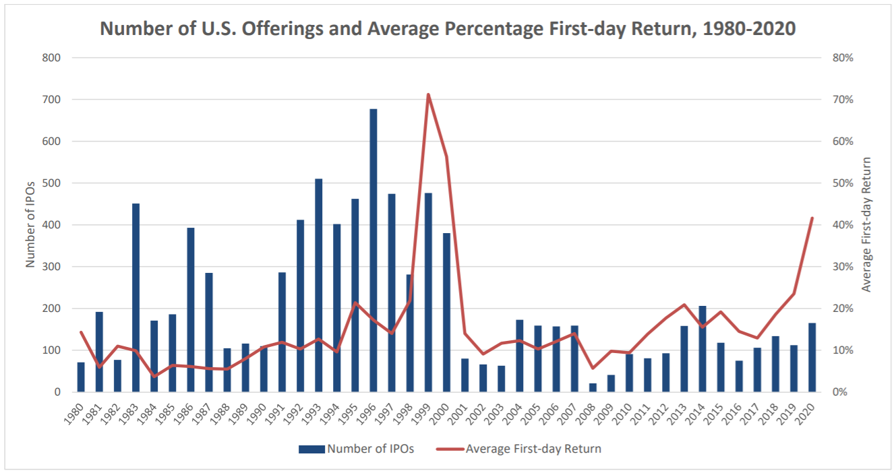

Slide 26
Arguments for Bookbuilding/Underpricing
Compensation for providing price information
Protects litigation risk
Protects underwriting against “firm commitment” obligations
Compensation to regular customers/underwriting prospects

Slide 27
Underwriter & issuer Liability
Section 11 Liability for material misstatements or omissions in the registration statement
Section 12 Liability for material misstatements or omissions in the prospectus

Slide 28
The Accounting Firm

Slide 29
Accounting Firm
Section 11 Liability for material misstatements or omissions in the registration statement
Liability for Portion Prepared by Accountant Only
Due Diligence Defense

Slide 30
The Law Firm

Slide 31
Law Firm
Confidentiality
“Risk Factors”
Legal Opinion
Section 11 Liability/Due Diligence Defense if named as preparing expert statement, report, or valuation
Liability if “primary actor”

Slide 32
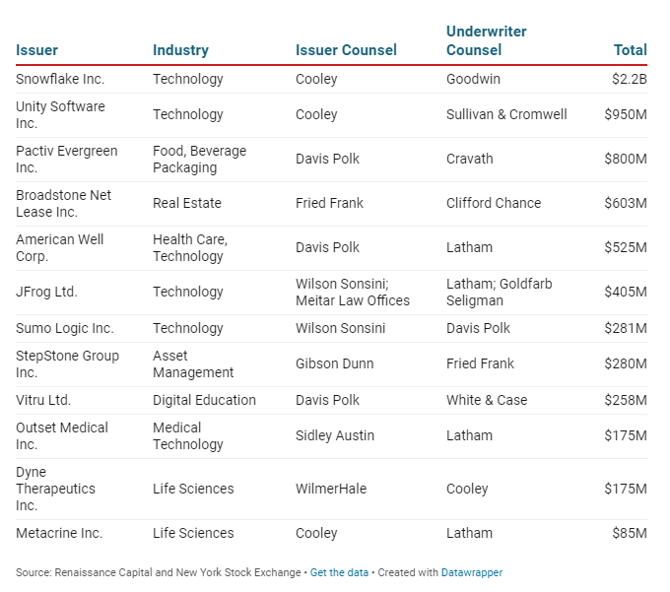

Slide 33
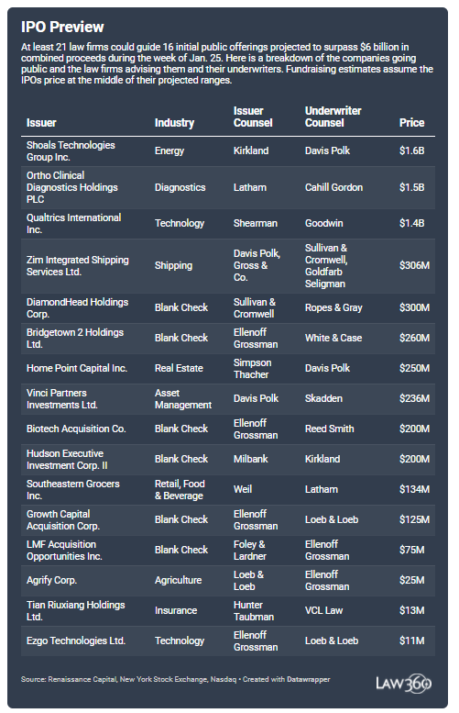

Slide 34
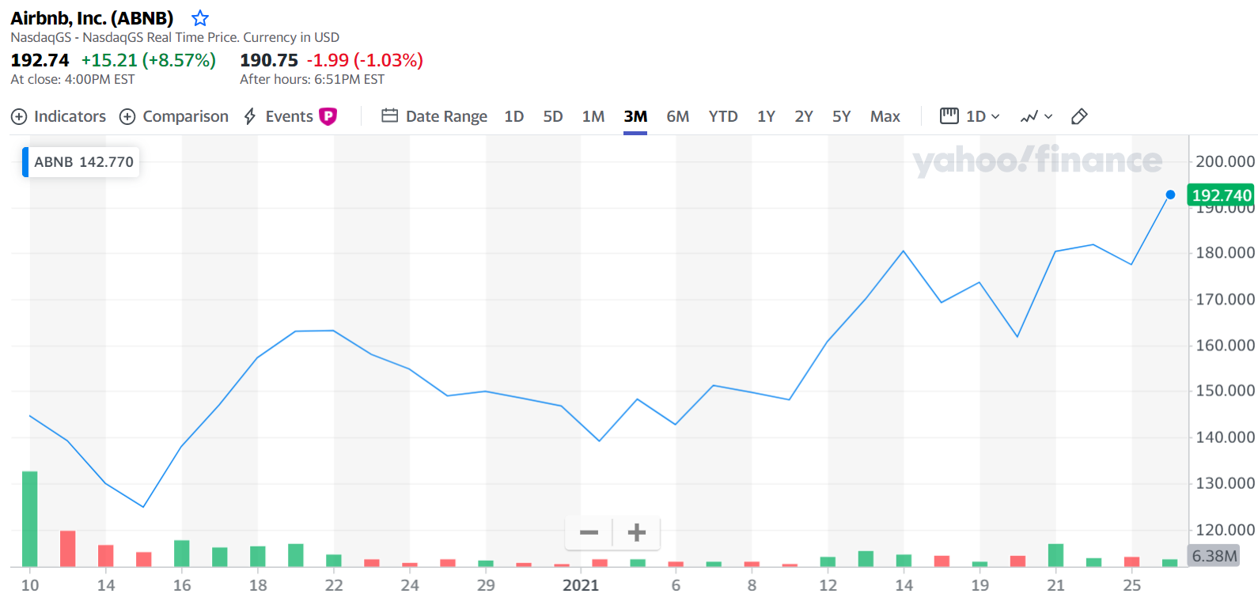

Slide 35
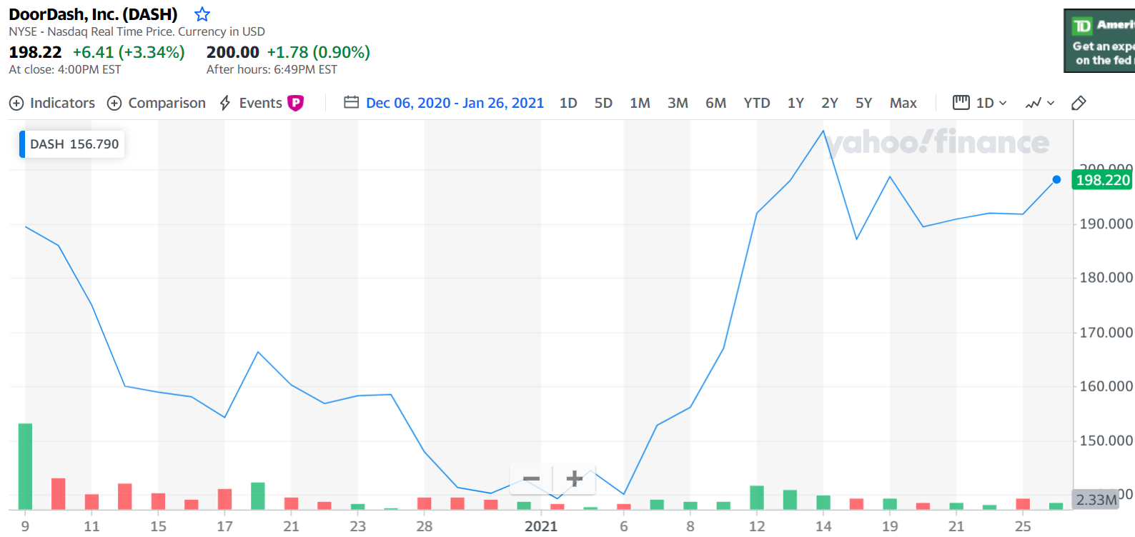

Slide 36
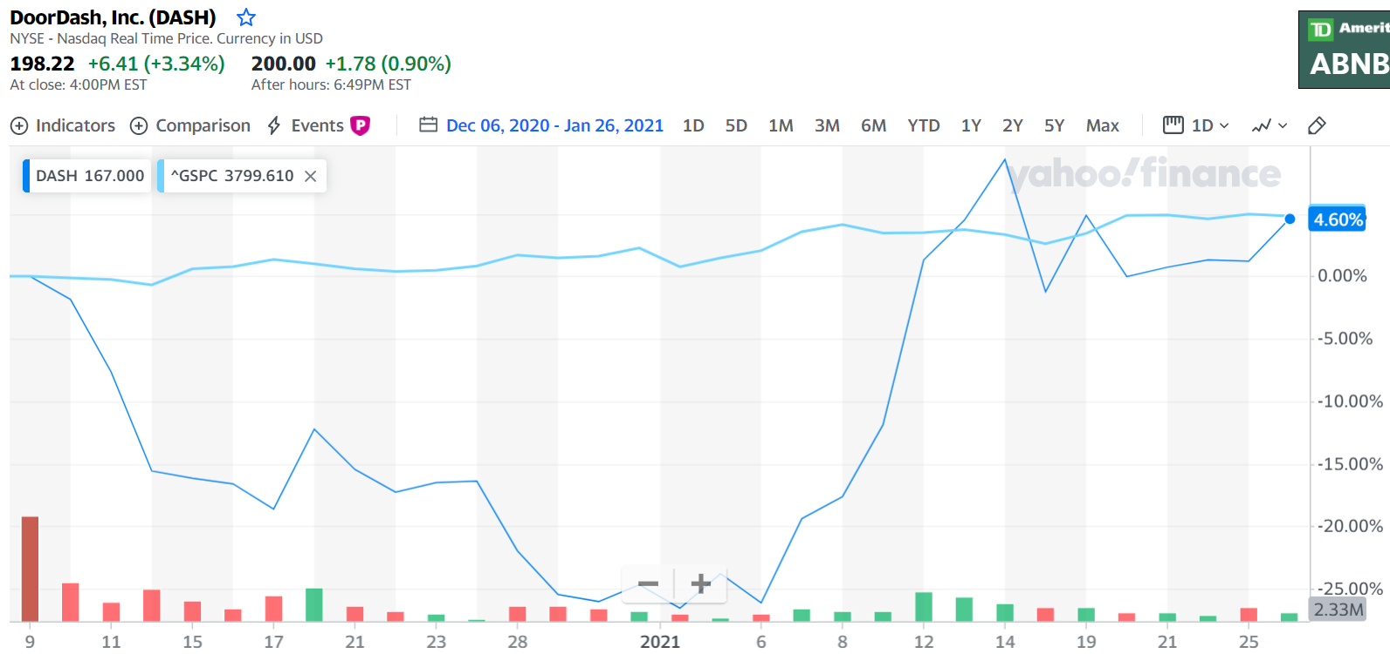

Slide 37
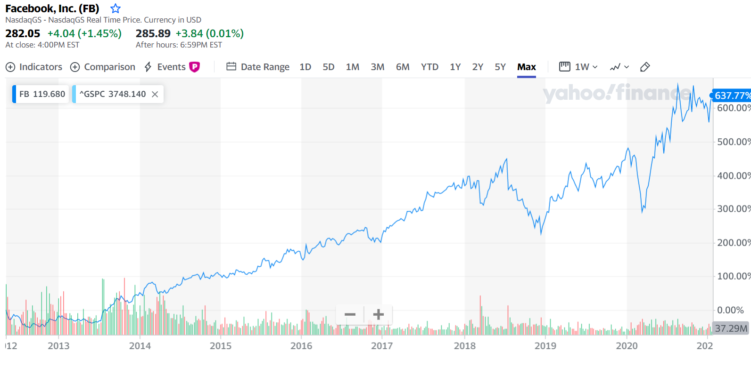

Slide 38
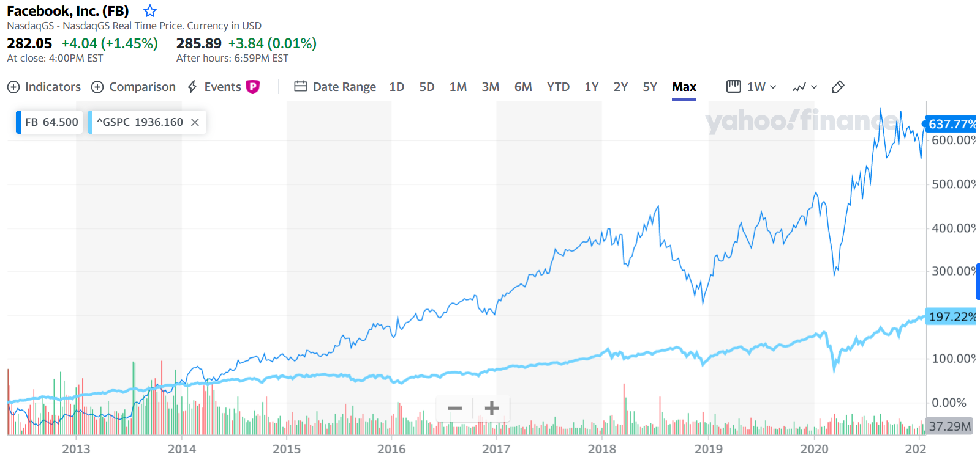

Slide 39
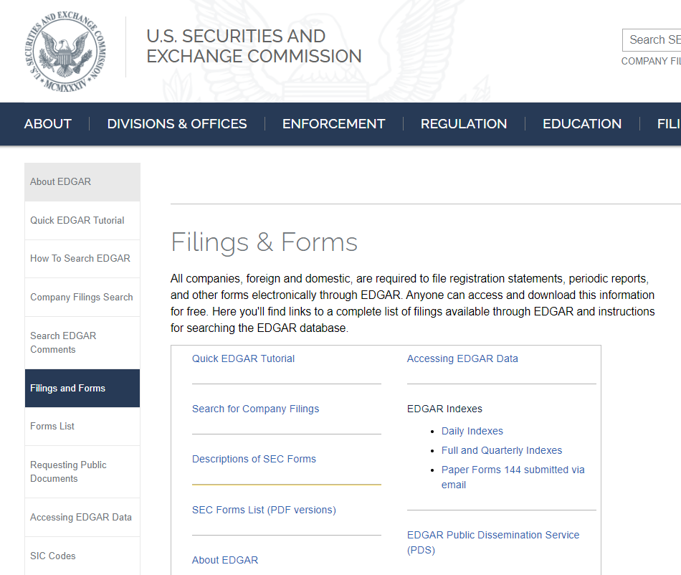
sec.gov/edgar

Slide 40
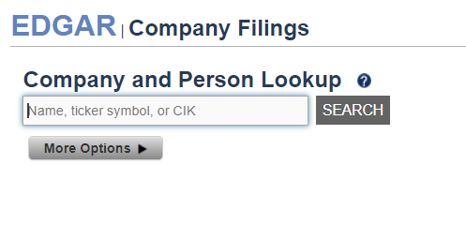

Slide 41
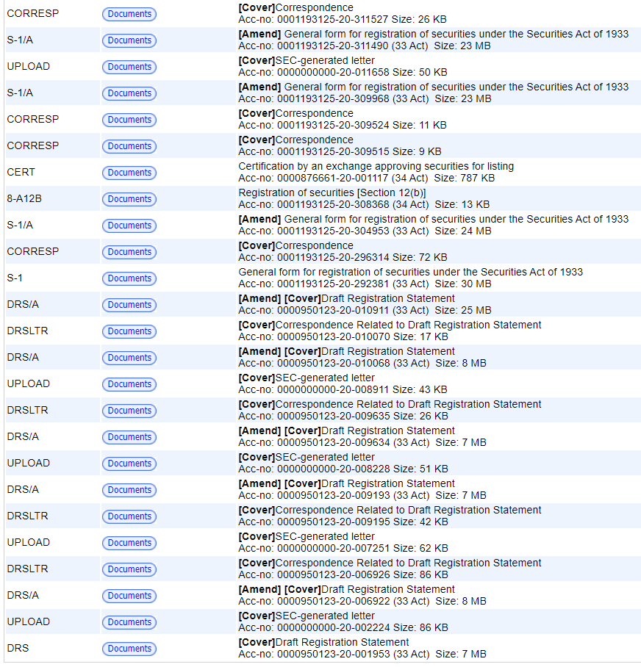

Slide 42
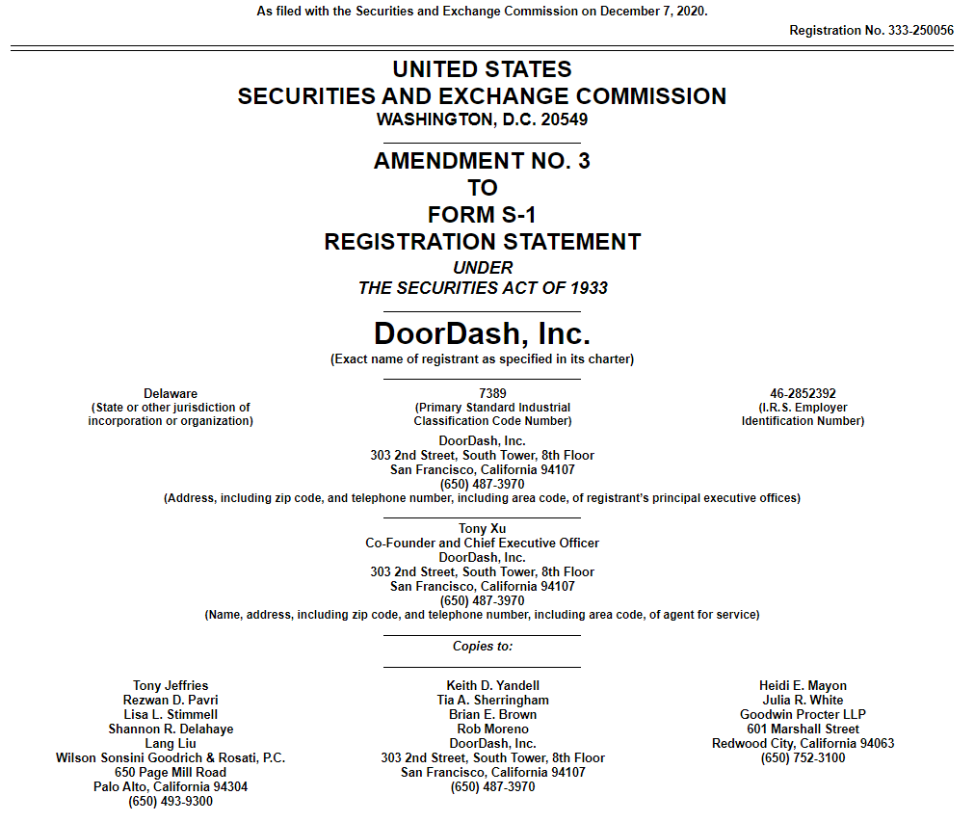

Slide 45
Securities Regulation
Securities Act of 1933 – registers securities and offerings
Securities Act of 1934 – regulates issuers (mostly of registered securities or listed securities)
Section 12(g) of ‘33 Act – 2000 shareholder rule

Slide 46
Timeline
Pre-Filing Period
Waiting Period
(In registration)
Registration is effective
Sales & Delivery

Slide 47
Registration Statement
Section 6 & 7 of ‘33 Act
Form S-1
Form F-1
Draft (Confidential) Registration Statement (DRS)
EGCs and non-EGCs
How do you know what to put in Form S-1
Regulation S-K

Slide 48
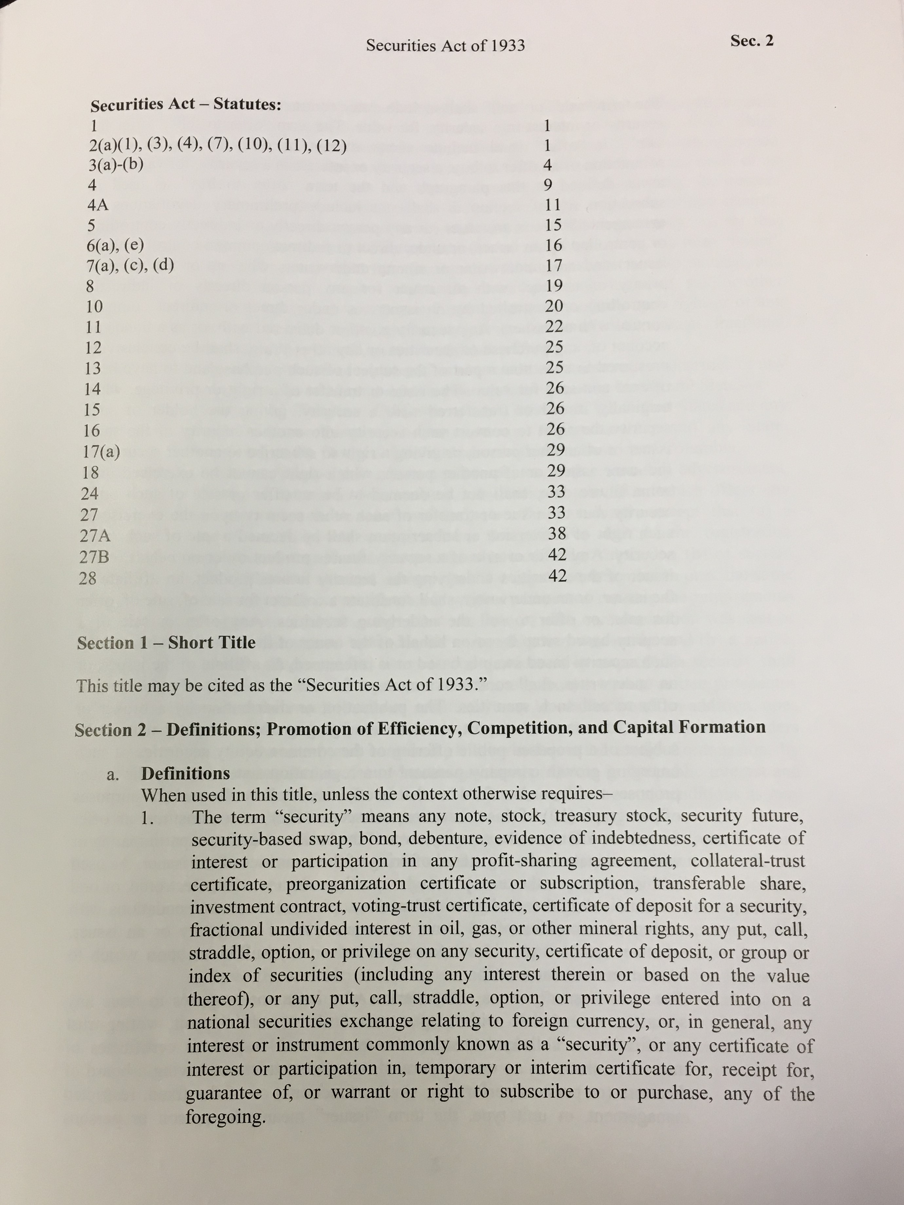
Where are we getting this?
Statute
Rules

Slide 49
Gun-Jumping Rules
Section 5(a)
Unless a registration statement is in effect as to a security, it shall be unlawful for any person, directly or indirectly
(1) to ... sell [a] security through the use or medium of any prospectus or otherwise; or
(2) to carry ... in interstate commerce ... any ... security for the purpose of sale or for delivery after sale.
Notes:
Section 5(a) forbids sales before the registration statement has been declared effective

Slide 50
Gun-Jumping Rules
Section 5(c)
(c) It shall be unlawful for any person ... to offer to sell or offer to buy ... any security, unless a registration statement has been filed as to such security ...
Notes:
Offers are forbidden until the registration statement is on file with the SEC

Slide 51
Gun Jumping Rules
Sale and Offer – Section 2(a)(3) Definitions
The term "sale" or "sell" shall include every contract of sale or disposition of a security or interest in a security, for value. The term "offer to sell", "offer for sale", or "offer" shall include every attempt or offer to dispose of, or solicitation of an offer to buy, a security or interest in a security, for value. …
Notes:
Definition does not offer much guidance, although it is certainly intended to be broad in its reach.

Slide 52
Registration statement
Basic Information Package (Regulation S-K)
Audited financial statements (balance sheets for the end of the most recent two fiscal years, income statement and statement of changes in financial position for each of the most recent fiscal years)
Selected financial information for the last five years – trends in sales, income, loss, assets, obligations, dividends, etc.
Management Discussion & Analysis
Trading market for the issuer’s stock
Distribution and use of proceeds
Securities of the Registration
Exhibits and Undertakings (not in prospectus)

Slide 53
Gun-Jumping Rules
Section 5(b)
(b) It shall be unlawful for any person
to ... transmit any prospectus relating to any security with respect to which a registration statement has been filed under this title, unless such prospectus meets the requirements of section 10; or
to carry ... any such security for the purpose of sale or for delivery after sale, unless accompanied or preceded by a prospectus that meets the requirements of subsection (a) of section 10.
Notes:
Section 5(b)(2) requires that a final prospectus accompany or precede the delivery of the security (Moot point: no one actually delivers securities anymore.)
Section 5(b)(1) forbids the transmission of non-conforming prospectuses

Slide 54
OK, so we won’t transmit any “PROSPECTUSES”. . . .

Slide 55
Gun-jumping rules
Prospectus: -- Section 2(a)(10) Definitions
The term "prospectus" means any prospectus, notice, circular, advertisement, letter, or communication, written or by radio or television, which offers any security for sale or confirms the sale of any security; except that ...
(b) a ... communication . shall not be deemed to be a prospectus if it states from whom a written prospectus meeting the requirements of section 10 of this title may be obtained and, in addition, does no more than identify the security, state the price thereof, state by whom orders will be executed, and contain such other information as the Commission, by rules or regulations deemed necessary or appropriate

Slide 56
ALWAYS REMEMBER section 4(a)(1)
Exempted Transactions:
The provisions of section 5 shall not apply to “transactions by any person other than an ISSUER, UNDERWRITER OR DEALER
Exempt: journalists, ordinary investors, etc.

Slide 57
Timeline
Pre-Filing Period
Waiting Period
(In registration)
Registration is effective
Sales & Delivery
“Sales”
“Offers to Sell”
“Offers to Buy”
“Sales”
“Offers to Sell”
“Offers to Buy”
“Sales”
“Offers to Sell”
“Offers to Buy”
“Sales”
“Offers to Sell”
“Offers to Buy”

Slide 58
Gun Jumping Rules
NEW! FOR 2012!
Issuer Categories
– Non-Reporting Issuer
– No periodic reports
– Unseasoned Issuer
– Reporting, but not eligible for S-3
– Seasoned Issuer
– S-3 eligible for primary offerings
– Well-Known Seasoned Issuers (WKSI)
– S-3 eligible for primary offerings, and
– $700 million in equity or $1 billion in debt
offerings over last three years
Emerging Growth Company

Slide 59
Well-known seasoned issuers (WKSI)
S-3 eligible for primary offerings
PLUS
$700 million in equity in the hands of non-affiliates.
OR $1 billion in non-convertible securities (non-common equity) registered offerings for cash over last three years. Must offer only non-convertible securities (other than common equity) unless meets the $75 million float requirement of Form S-3.
Can’t be: investment companies, shell companies, blank check companies, recent emergence from bankruptcy, “bad actors”

