Slide 1
Securities regulation #10

Slide 2
Exemptions
May be exempt because offering is Private (Nonpublic)
4(a)(2)
May be exempt because offering is Small
Regulation “D”
504 (small) & 506 (nonpublic)
May be exempt because offering is intrastate
Rule 147 & 147A
May be exempt because of alternate process
Regulation “A+”
Crowdfunding

Slide 3
Steve Rogers and Bucky Barnes design a line of jewelry made of a rare metal, vibranium. They purchase vibranium from the King of a small African country for this purpose. The jewelry is very popular on Etsy, creating revenues of over $25 million in 2018. The company, Brooklyn Bling, headquartered in New York, would like to expand into other lines, such as fine watches and tiaras, but that means outside capital. Steve and Bucky come to you to give them legal advice on how to raise additional capital. You find out during discussions that on November 11, 2019, the company sold $7 million of common stock to 26 investors, mostly friends from the army. Steve and Bucky offered the shares on a Facebook page for veterans. Which of the following statements is the most accurate?
The 2019 offering could qualify as an exempt offering under Rule 504 if the conditions of 502 were met.
The 2019 offering could qualify as an exempt offering under Rule 147 as long as all purchasers were from New York.
The 2019 offering could qualify as an exempt offering under Rule 147 as long as all purchasers were from New York and Brooklyn Bling is incorporated in New York.
The 2019 offering could qualify under 144A as long as all purchasers were accredited investors.
None of the above.
A
B
C
D
E

Slide 4
Steve and Bucky want to go ahead and raise $25 million in 2020. They ask you to give them advice on an initial public offering for Brooklyn Bling (“BB”). Which of the following statements is the most accurate?
An IPO may be the most cost-effective way for BB to raise $25 million.
In considering an IPO, BB should know that the legal, accounting, and investment banking fees for a crowdfunding campaign would be the same, and they could raise just as much capital.
In considering an IPO, BB should know that because they are an emerging growth company, some of the accounting and disclosure burdens would be reduced, for up to five years.
An IPO subjects an issuer to liability for false misstatements and omissions in the prospectus under Rule 11.
An IPO is often inevitable if an issuer has more than 500 shareholders and must therefore comply with the disclosure requirements of a public company anyway.
A
B
C
D
E

Slide 5
After the purchase. . . .
Can you sell your shares?

Slide 6
Remember. . . .
Section 12(a)(1) – no offers or sales of a security in violation of Section 5 (a registration statement should be effective before sale).
Unless the security is exempt, the resale of a security purchased in an exempt transaction is “restricted.”
Rule 506 securities and Regulation CF securities are “restricted”
Rule 504 and Regulation A securities are “unrestricted”
Rule 147 and 147A securities are unrestricted after six months; prior to the end of the six-month period, securities may be sold to resident purchasers only

Slide 7
Just to be sure. . .
Registered securities are “unrestricted”

Slide 8
Section 5 goes on forever. . .

Slide 9
Why?
RULE 506
If
unrestricted
ISSUER

Slide 10
Was it all for nothing?

Slide 11
The path to resale
The restricted securities holder needs an exemption

Slide 12
“open market trading exemption”
Section 4(a)(1) – the seller is not an issuer, underwriter or dealer
Issuer?
Underwriter?

Slide 13
Who is an underwriter?
Section 2(a)(11) – a person who
Purchases from an issuer with a view to the distribution of any security
Participates or has a direct or indirect participation in any such undertaking
Participates or has a participation in the direct or indirect underwriting of any such undertaking

Slide 14
Who is an underwriter?
Section 2(a)(11) – a person who
Purchases from an issuer with a view to the distribution of any security
Participates or has a direct or indirect participation in any such undertaking
Participates or has a participation in the direct or indirect underwriting of any such undertaking
Can’t know until resale

Slide 15
Purchaser with a view to the distribution of any security (obvious example)
exempt
ISSUER
Probably an underwriter!

Slide 16
Who is an underwriter?
Section 2(a)(11) – a person who
Purchases from an issuer with a view to the distribution of any security
Participates or has a direct or indirect participation in any such undertaking
Participates or has a participation in the direct or indirect underwriting of any such undertaking

Slide 17
Purchaser with a view to the distribution of any security (not as obvious)
exempt
“Quick” resale
ISSUER
Maybe an underwriter!

Slide 18
Before there was a safe harbor
What was the motivation of the purchaser?
How long did the purchaser hold the security?
2-3 years minimum (“bendpoint”)
Did any circumstances change that necessitated the purchaser to sell?

Slide 19
Purchaser with a view to the distribution of any security (not as obvious)
4(a)(2)
RULE 506
Lovey
4(a)(1)?
ISSUER
Yes – if Lovey did not purchase with a view to distribution

Slide 20
Back to the resale problem
RULE 506
resale?
resale
ISSUER
Maybe an issuer!
If seller = issuer,
Maybe an underwriter!

Slide 21
Who is an issuer?
2(a)(11) – underwriter is someone who purchases from an issuer with a view to distribution
“As used in this paragraph the term “issuer” shall include, in addition to an issuer, any person directly or indirectly controlling or controlled by the issuer, or any person under direct or indirect common control with the issuer.”

Slide 22
Who is an issuer?
2(a)(11) – underwriter is someone who purchases from an issuer with a view to distribution
“As used in this paragraph the term “issuer” shall include, in addition to an issuer, any person directly or indirectly controlling or controlled by the issuer, or any person under direct or indirect common control with the issuer.”
“Control Person”

Slide 23
Explain that again!
RULE 506
Resale
After 3 years
Quick Resale
ISSUER

Slide 24
Explain that again!
RULE 506
Resale
After 3 years
Quick Resale
ISSUER
Not an underwriter
Underwriter?

Slide 25
Explain that again!
RULE 506
Resale
After 3 years
Quick Resale
ISSUER
Not an underwriter
Underwriter?
No – did not purchase from “an issuer”

Slide 26
But: Watch closely!
RULE 506
Resale
After 3 years
Quick Resale
ISSUER
Underwriter?
Control Person

Slide 27
But: Watch closely!
RULE 506
Resale
After 3 years
Quick Resale
ISSUER
Underwriter?
Control Person
Purchased from “an issuer” with a view to a distribution

Slide 28
Who is a control person?
10% owner
Director
Officer
“Affiliate”

Slide 29
Why?
Issuer
Control Person
Underwriter
Underwriter

Slide 30
Aren’t there any safe harbors? Any other resale exceptions?
Yes, of course

Slide 31
Rule 144
Focuses on the reseller, not the repurchaser

Slide 32
Rule 144 Focus on the reseller
RULE 506
resale
ISSUER
Rule 144
Won’t be an underwriter if complies with Rule 144

Slide 33
Rule 144
Is the reseller an Affiliate (same as control person)?
Are the shares restricted or unrestricted?
Is the issuer a Reporting Company?

Slide 34
Holding period
Rule 144(d):
Measure the holding period from “the later of the date of the acquisition of the securities from the issuer or from an affiliate of the issuer, and any resale of such securities”
Holding periods by non-affiliates can “tack” (inheritance, gift)

Slide 35
 |  | Non-reporting Issuer | Reporting Issuer
Sales by Nonaffiliate of restricted stock | Holding Period | 1 year | 6 months
 | Volume (“trickle”) | n/a
 | Sales Method | n/a
 | Information | n/a | Publicly available 1 year period
 | Filing Requirement | n/a
 |  | Non-reporting Issuer | Reporting Issuer
Sales by Affiliates (and by their brokers) of restricted stock | Holding Period | 1 year | 6 months
 | Volume (“trickle”) | Less than the greater of (a) 1% of outstanding securities or (b) average weekly trading volume in any 3-month period; less than 10% of tranche if debt securities
 | Sales Method | Unsolicited broker’s transactions for equities
 | Information | Publicly available info given to B/D | Publicly available info
 | Filing Requirement | Form 144 if over 5000 shares/$50k
 |  | Non-reporting Issuer | Reporting Issuer
Sales by Affiliates (and by their brokers) of unrestricted stock | Holding Period | 1 year | 6 months
 | Volume (“trickle”) | Less than the greater of (a) 1% of outstanding securities or (b) average weekly trading volume in any 3-month period; less than 10% of tranche if debt securities
 | Sales Method | Unsolicited broker’s transactions for equities
 | Information | Publicly available info.
 | Filing Requirement | Form 144 if over 5000 shares/$50k

Slide 36
Rule 144A

Slide 37
Rule 144A
Only for nonissuers (purchasers only)
Generally used for issuers in conjunction with a Regulation D offering
Resale exemption, not offering exemption

Slide 38
Requirements
144A securities may not be of the same class as registered securities
Offerees and purchasers must be Qualified Institutional Buyer
The holder and the purchaser must have the right to obtain from the issuer basic financial information
Issuer must be reporting company or a company that has undertaken to provide current information
Shares are still restricted following Rule 144A

Slide 39
Qualified institutional buyer?
$100M under management
Insurance Company
Investment Company registered under the 1940 Act
Business Development company
Small Business Investment Company
Governmental Employee Benefit Plan
Employee Benefit Plan under ERISA
Pension Trusts
501(c)(3) organizations; business trust
Dealer ($10M under mgmt.)
Bank ($100M)

Slide 40
August 2020 Amendments
The amendments expand the definition of “qualified institutional buyer” in Rule 144A to include limited liability companies and RBICs if they meet the $100 million in securities owned and invested threshold in the definition. The amendments also add to the list any institutional investors included in the accredited investor definition that are not otherwise enumerated in the definition of “qualified institutional buyer,” provided they satisfy the $100 million threshold.

Slide 41
Remember this?
RULE 506
unrestricted
ISSUER
Probably an underwriter!

Slide 42
Rule 144A
RULE 506
Rule 144A
ISSUER
Professional
Underwriter

Slide 43
Rule 144A
RULE 506
Rule 144A
ISSUER
Professional
Underwriter

Slide 44
NEW! Section 4(a)(7) of the securities act
Resale exemption
All purchasers must be accredited investors
No general solicitation or advertising
Limited information requirement
Seller may not be the issuer or a subsidiary
Issuer must be engaged in business (not a shell company, SPAC)
The class of security must be authorized and outstanding for 90 days
Securities are still restricted

Slide 45
Rule 144A v. 4(a)(7)
Rule 144A
Rule 4(a)(7)
Purchasers must be QIBs (no individuals)
Securities may be newly issued
Securities may not be fungible with registered securities
Purchasers must be accredited investors
Securities must be authorized and outstanding for 90 days
Some required information

Slide 46
Transition: Liability First: materiality

Slide 47
Materiality is everywhere!
Mandatory Information Disclosure:
Issuers have a duty to disclose items required by SEC (Regulation S-K) in registration statement and periodic reporting:
Registration Statement (Form S-1; S-3)
Annual Report (Form 10-K)
Quarterly Report (Form 10-Q)
Continuous Report (Form 8-K)

Slide 48
Materiality
Ex ante determination of material information
Some have materiality thresholds built in: “to the extent material”
Form 8-K
Entry into a Material Definitive Agreement
Termination of a Material Definitive Agreement
Bankruptcy
Mine Safety
Significant Acquisition or Disposition of Assets
Material Impairment to Assets
Notice of Delisting or Transfer of Listing
Unregistered Sales of Securities
Material Modification to Debt Agreements
Change in Control
Departure/Appointment of Directors or Principal Officers
Amendments to Articles of Incorporation/Bylaws
Amendments to Code of Ethics or Waiver
Submission of Matters to Shareholders/Shareholder Director Nominations

Slide 49
Material misstatements and omissions
If no duty to disclose, then SILENCE IS GOLDEN
Duty: 8-K; 10-K; 10-Q; S-1; S-3, etc.
However, if an issuer chooses to speak, then what is spoken must be truthful
Rule 10b-5 (Exchange Act Rule under Section 10(b)); Section 11 of Securities Act (registration statements); Section 12 of Securities Act (prospectus)
Any untrue statement of a material fact
Omissions – failure to state a material fact necessary in order the make the statements made, in the light of the circumstances under which they were made, not misleading.

Slide 50
Objective materiality
When do we think that an error is “material”?
“Under three, high twos. I had two hour and fifty-something.”
4:01:25

Slide 51
hmmmm

Slide 52
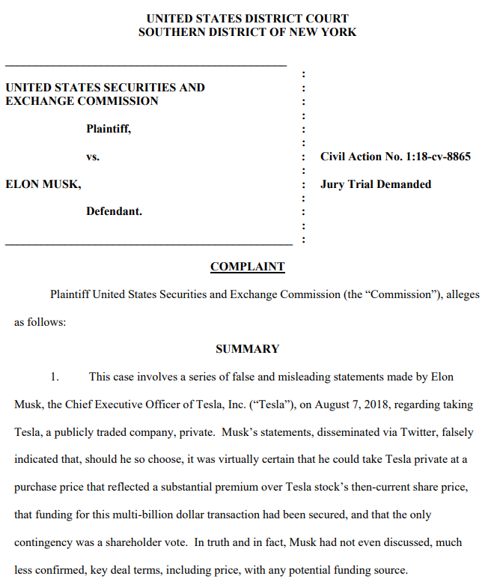
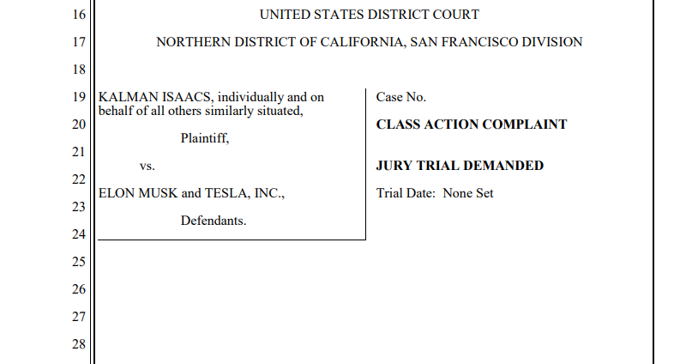

Slide 53
You can lie if it’s not material

Slide 54
U.S. v. Litvak (2d Cir. 2018)
What is material?

Slide 55
A sells to B
$40
A sells to B
$40.50
A
B
C

Slide 56
A sells to B
$35
B sells to C?
A
B
C

Slide 57
$79.75?
Norris from Invesco
$79.50?
Litvak from Jeffries

Slide 58
Litvak bought for 79-24. I’ll pay 79-30
I paid 79-16. I’m 14 ticks ahead!
$79.94?
Six ticks?
($.18/$100)
“I bid your level”
“6/32s is great”
($.42/$100)
“tick” = 1/32 of a dollar
3 cents ($.03)

Slide 59
Section 10(b) rule 10b-5
STATUTE
rULE
It shall be unlawful for any person. . . .
To use or employ, in connection with the purchase or sale of any security registered on a national securities exchange or any security not so registered. . .any manipulative or deceptive device of contrivance in contravention of such rules and regulations as the commission may prescribe as necessary or appropriate in the public interest or for the protection of investors
It shall be unlawful for any person. . .
(a) To employ any device, scheme, or artifice to defraud
(b) To make any untrue statement of a material fact or to omit to state a material fact necessary in order to make the statements made, in the light of the circumstances under which they were made, not misleading, or
(c) To engage in any act, practice, or course of business which operates or would operate as a fraud or deceit upon any person.

Slide 60
Section 10(b) rule 10b-5
STATUTE
rULE
It shall be unlawful for any person. . . .
To use or employ, in connection with the purchase or sale of any security registered on a national securities exchange or any security not so registered. . .any manipulative or deceptive device of contrivance in contravention of such rules and regulations as the commission may prescribe as necessary or appropriate in the public interest or for the protection of investors
It shall be unlawful for any person. . .
(a) To employ any device, scheme, or artifice to defraud
(b) To make any untrue statement of a material fact or to omit to state a material fact necessary in order to make the statements made, in the light of the circumstances under which they were made, not misleading, or
(c) To engage in any act, practice, or course of business which operates or would operate as a fraud or deceit upon any person.

Slide 61
How does it end?
Price paid was not immaterial as a matter of law (on appeal)
Overruled Denial of Motion in Limine – remand
Why was introduction of erroneous belief of agency relationship prejudicial?

